Slide 1
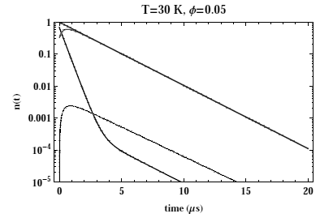
μd -
μd
μd -
n (t)
μ³He
Time (μs)

