Slide 1
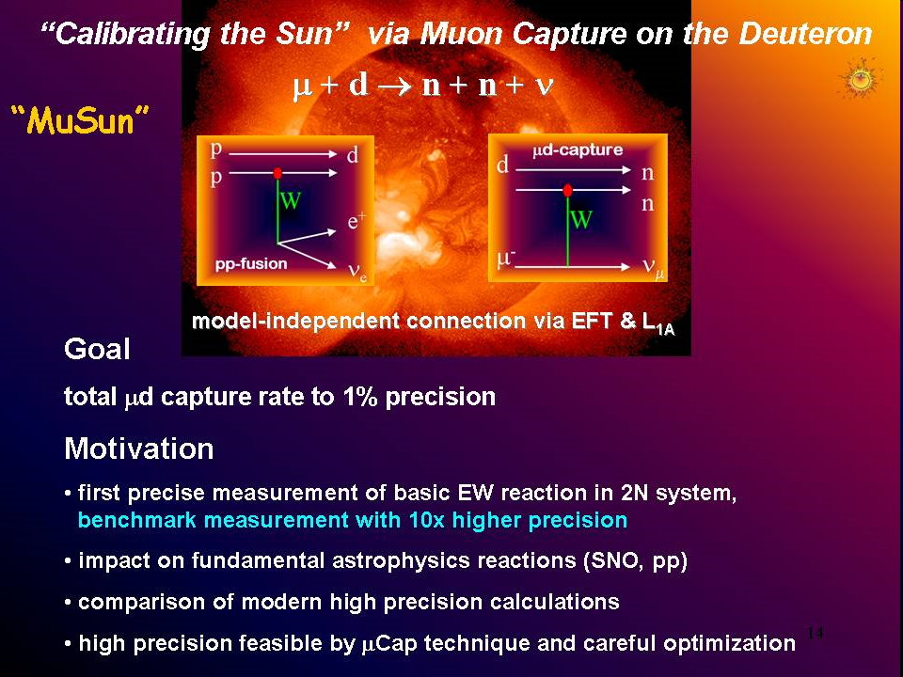

4th Joint meeting of the APS and PSJ, Oct 2014
Measurement of the dμd quartet-to-doublet fusion ratio (λ_{q} : λ_{d}) and the μd hyperfine rate λ_{qd} using the fusion neutrons from μ⁻ stops in D₂ gas.
- Nandita Raha, University of Kentucky for the MuSun Collaboration
V.A. Andreev, E.J. Barnes, R.M. Carey, W. Gohn, V.A. Ganzha, A. Gardestig, T. Gorringe, F.E. Gray, D.W. Hertzog, M. Hildebrandt, L. Ibanez, P. Kammel, B. Kiburg, S.A. Kizilgul. S. Knaack, P.A. Kravtsov, A.G. Krivschich, K. Kubodera, B. Lauss, M. Levchenko, X. Luo, K.R. Lynch, E.M. Maev, O.E. Maev, F. Mulhauser, M.H. Murray, F. Myhrer, A. Nadtochy, K. Neely, C. Petitjean, G.E. Petrov, J. Phillips, R. Prieels, D. Prindle, N. Raha, R. Ryan,G.N. Schapkin, N. Schroeder, G.G. Semenchuk, M.A. Soroka, V. Tishchenko, A.A. Vasilyev, A.A. Vorobyov, N. Voropaev, M.E. Vznuzdaev, F. Wauters, P. Winter.
Nandita Raha

Slide 2
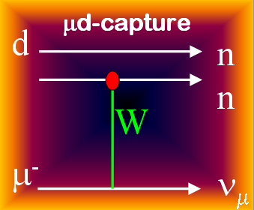
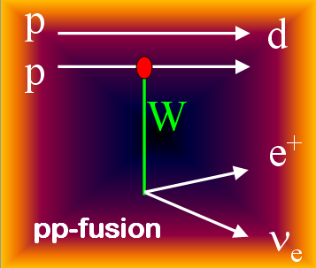
Experimental Goal and Motivation
  Measure muon capture rate in D₂ to a precision better than 1.5%
μ⁻ + d → n + n + ν_{μ}
Quartet
↑↑
μd
Rate Λ_{d} from μd (↑↓) atom
Doublet
↑↓
My Goal: To find relative populations of hyperfine states
finally used for measuring Λ_{d .}
-
Help understand weak nuclear reactions:
Solar pp fusion: p + p → d + e⁺ + ν_{e}
Neutrino interaction: ν + d → p + p + e⁻
Double beta decay ...
These reactions involve a poorly known two-nucleon weak axial current. The muon capture rate Λ_{d} determines a single LEC that parametrizes this two-nucleon weak axial current.
Nandita Raha
Notes:
Energy of pp fusion: 5.4 MeV (peak
Muon capture n – 1.3 Mev (max. #)) upto 53 MeV

Slide 3
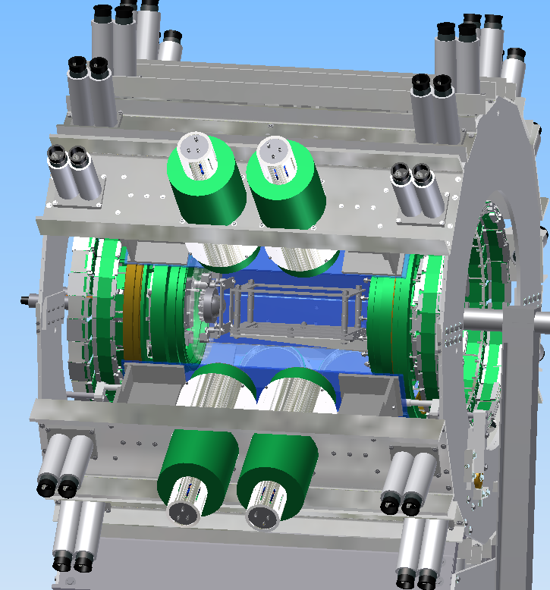
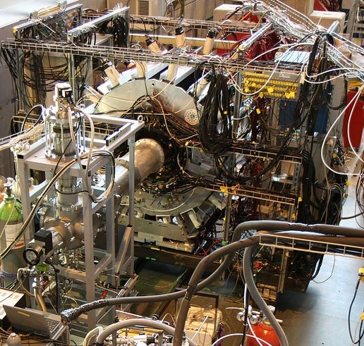
Experiment Overview
Experimental Setup:
Muons (Z - axis) enter Al vessel (~ 3 mm)– TPC (10 x 10 x 8.2 cm). X - horizontal and Y - vertical. Target deuterium.
Electron Scintillator
e⁻
Electron
and Neutron
Detectors
μ Scintillator
μ Wire Chamber
Electron Wire Chamber
μ beam
cryo-TPC
cryo-TPC
Neutron Detectors
Nandita Raha

Slide 4
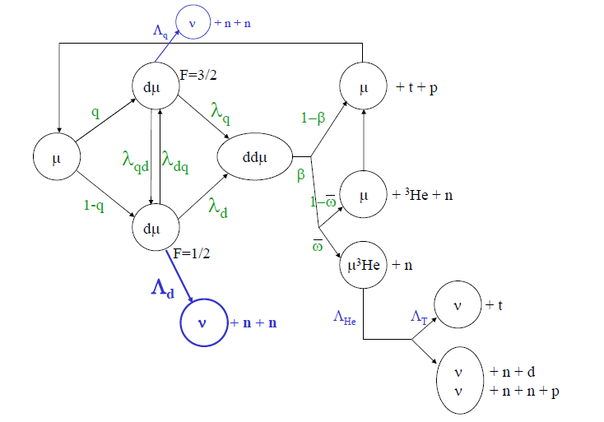
Muon Chemistry
0.002%
Initial pop.
Measure λ_{qd} and λ_{q} : λ_{d}
2/3
λ_{q}
3.05%
λ_{qd}
λ_{dq}
β
1/3
λ_{d}
Initial pop.
Fusion neutrons (2.45 MeV)
accompanied by e⁻
μ stopped in TPC
0.073%
Muon decay – 99.92%
Nandita Raha

Slide 5
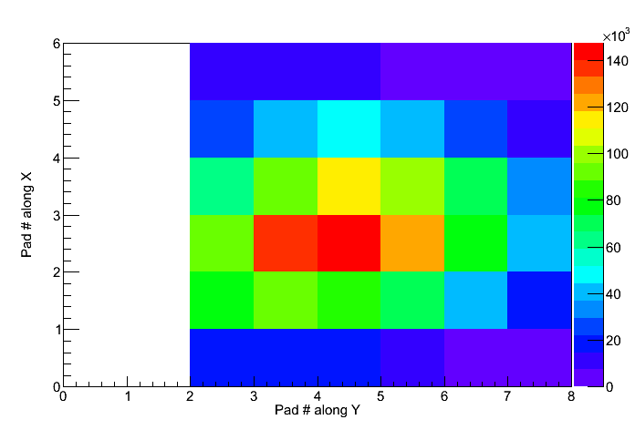
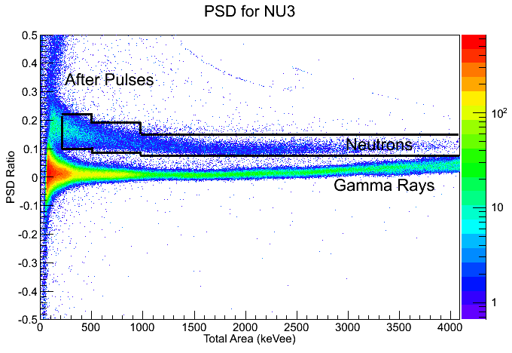
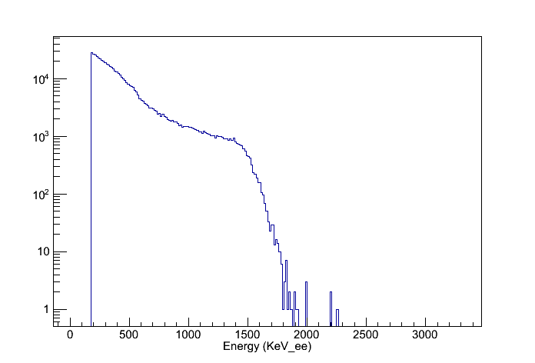
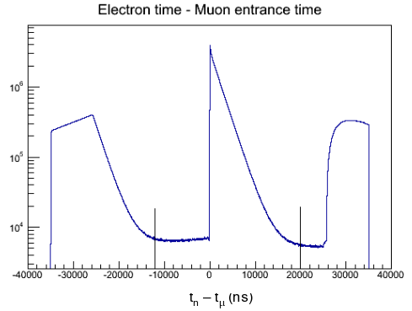
Fusion Neutron definition:
Muon stop
Neutron cut (PSD)
Accompanied by electrons
Energy < 2.5 MeV
Nandita Raha
t_{e}- t_{μ} (ns)

Slide 6
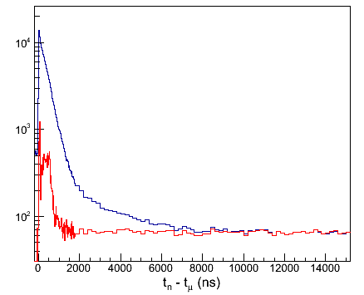
Fusion Neutron Time Distribution
Time distribution: Time of neutron relative to the muon entrance time.
All fusion neutron cuts applied gives time distribution in blue
Contains accidental background from accelerator and beamline neutrons.
Subtracted background histogram and fitted it.
Fusion Neutrons
Background
Nandita Raha

Slide 7
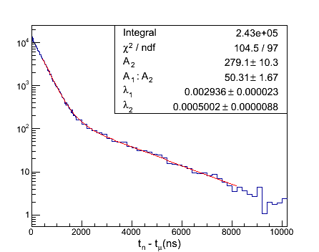
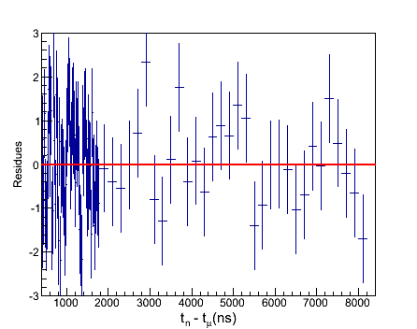
Lifetime Fit of Fusion time distribution
Lifetime fit: A two lifetime (λ₁ and λ₂) fit function from the general solution of muon
chemistry gives the fusion time distribution as,
n(t) = A₁ e^{−λ}1^{t} + A₂ e^{−λ}2^{t}
Fitted the background subtracted histogram with above fit function on a flat background = 0. Fit parameters A₁:A₂, prompt lifetime rate λ₁ and and slow rate λ₂ , A₂ – Initial population.
y(t) - y_{i}
Residue =
σ
Reduced χ² of 1.08
Nandita Raha

Slide 8
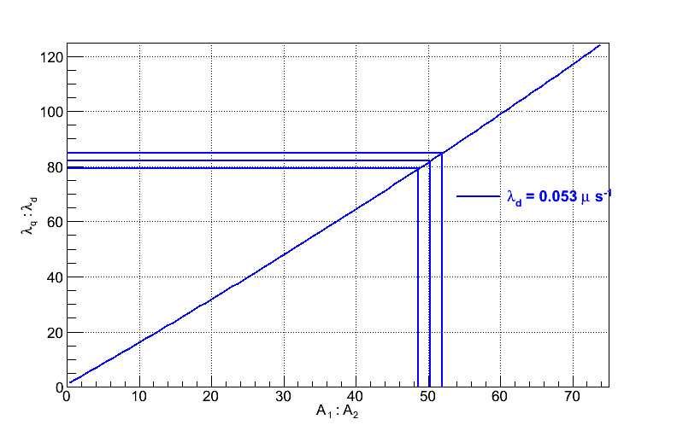
Results from Analytical Solutions
Differential equations of the population of states derived from the muon chemistry were solved
to find kinematic parameters λ_{qd} and λ_{q} : λ_{d} from the fit results.
λ₁ ~ φ (λ_{qd} - λ_{μ})
λ₂ ~ φ λ_{μ}
λ_{qd} ~ (λ₂ − λ₁) / φ
Thus the difference in λ₂ − λ₁ gave
λ_{qd} = 39.67 (0.4)
Amplitude ratio
A₁: A₂ = f ( λ_{q}: λ_{d} )
A plot of amplitude ratio versus λ_{q}: λ_{d}
gave λ_{q}: λ_{d} = 82.05 (2.89)

Slide 9
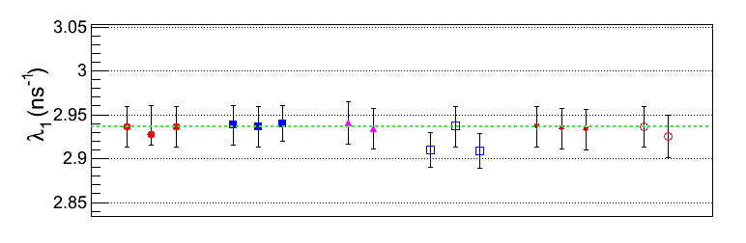
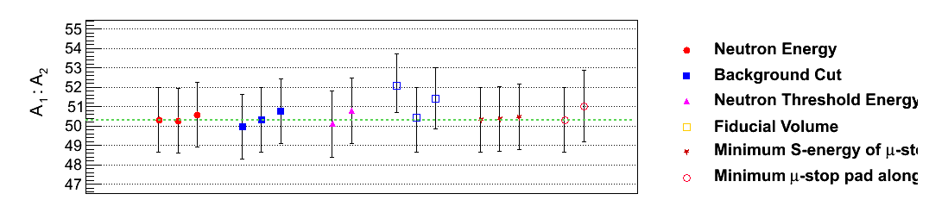
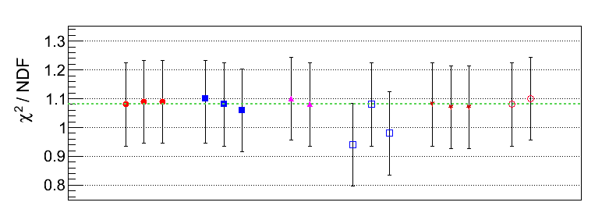
Systematic Errors
Shows stable fit results. The horizontal green line shows original values (before changing the cuts)
Neutron Energy
(E<2.45 MeV)
Background Cut
Neutron Threshold
Energy
Fiducial Volume
Minimum Energy of
μ -stop
Minimum μ -stop
pad along Z
Nandita Raha

Slide 10
Preliminary Results
The transition rate of muonic deuterium from quartet to double state at a temperature 34 K and density 6.12% LH₂
Preliminary
λ_{qd} = 39.67 + 0.402_{stat} + 0.032_{sys} μs^{-1_x0013_}
The dμd formation rate from quartet
state to double state
λ_{q} / λ_{d} = 82.05 + 2.89_{stat} + 2.78_{sys}
Experiment | Year | λ_{qd} (μs⁻¹) | λ_{q} : λ_{d} | Density | Temp (K)
SIN [1] | 1983 | 37.0^{+1.3} | 79.5(8.0) | 4.8 % | 34.7
PSI [2] | 1987 | 36.89 (0.8) | 80.17(7.8) | 4.83 % | 40
Dubna [3] | 1991 | 37.84 (21) | 65.51(0.59) | 4.9 % | 53
PSI (PNPI) [4] | 2011 | 37.1 (3) | 80.98(1.59) | 5.14 % | 32.2
This work | 2014 | 39.67 (0.4) | 82.05(4.01) | 6.12 % | 34
−1.7
1. First observation of muonic hyperfine effects in pure deuterium - P. Kammel et al. Phys.Rev. A28 2611-2622 (1983)
2. Muon Catalysed dd fusion b/w 25 to 150 K: Experiment - J. Zmeskal et. al. Phy. Rev. Vol. 42, # 3. 1987
3. D. V. Balin et al., Muon Catalyzed Fusion 5/6, 163(1990/1991).
4. High precision study of Muon Catalyzed Fusion in D2 and HD gas - D. V. Balin et al.
Nandita Raha

Slide 11
Conclusion
We obtain quite stable results which would help us find the relative populations of μd in quartet and doublet states under our experimental conditions. The relative population of the doublet state from this analysis will be further used by MuSun to ultimately find Λ_{d}
Thank You !
Nandita Raha

Slide 12
Back up Slides

Slide 13
Data Acquisition (DAQ)
μ
μ³He
n
e
³He
γ
t
p
Detector Collection (Triggered)
Front-End Electronics
MuSC
MuPC
eSCs
eGond
eWFD
tpcWFD
nFADC
tpcCHUPS
MIDAS Software (.mid & .odb)
ONLINE Analysis
OFFLINE Analysis
Cheetah computer
Analysis Modules
Midas Online Monitoring
Diagnostic Histograms
Online Display
Raw Analysis
No event reconstruction
No output tree
MU Analysis
MTA Analysis
CVS available
Analysis Modules
MU Event Display
Careful Analysis
Histogramming
Muon based trees
CVS available
Event Reconstruction
MTA Event Display
Muon Track trees
Full Event

Slide 14
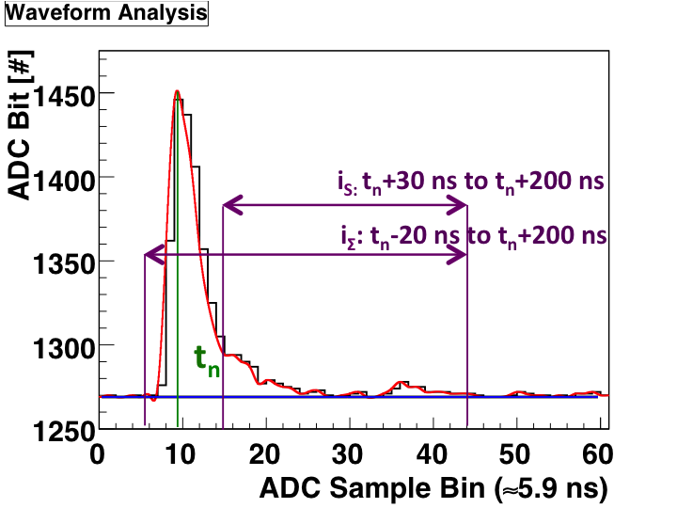
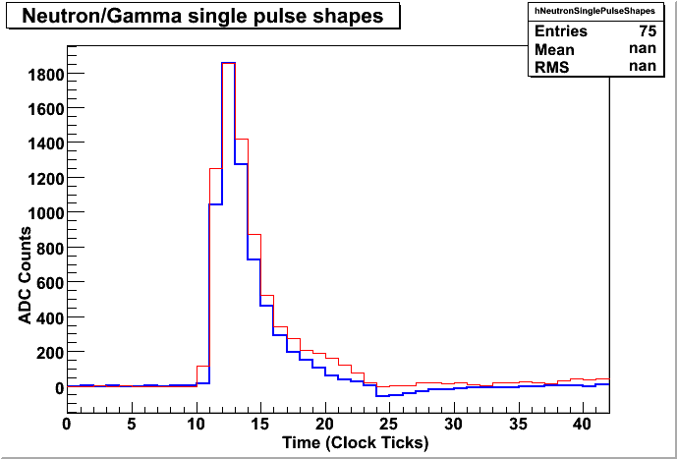
Neutron Analysis – Pulse Shape Discrimination
Neutrons have a larger tail amplitude than gamma rays. Used windows as shown to define tail and total areas.
PSD done by comparing the total and tail areas
Neutron pulse
Gamma-ray pulse
07/11/14

Slide 15
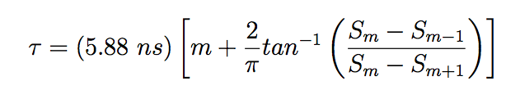
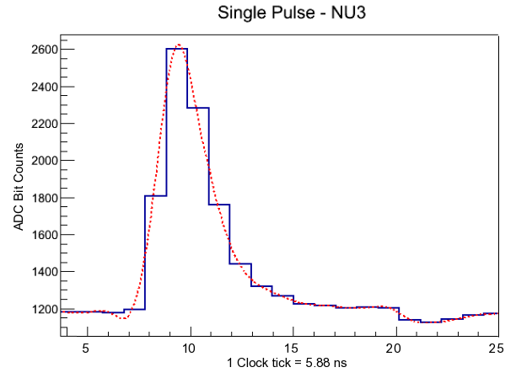
Time resolution – from pseudo time to true time
Templates were formed of average pulses after resolving them in time within a clock tick. Pseudo times explained in detail – defined as,
S_{m}
07/11/14

Slide 16
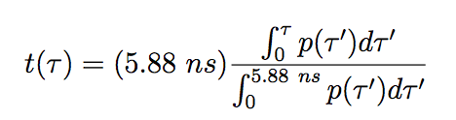
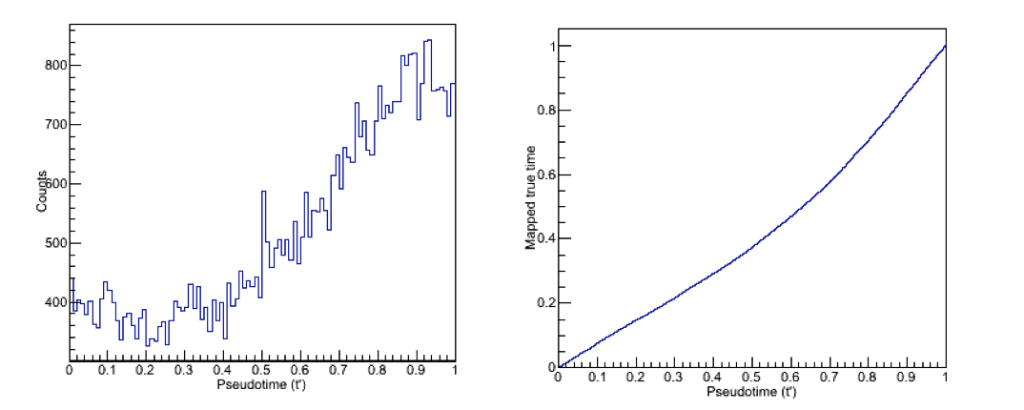
Time resolution – from pseudo time to true time
Running integral of pseudo time helps to map true times within a bin or clock tick.
Achieved a resolution of 1/100 th of a clock tick.
07/11/14

Slide 17
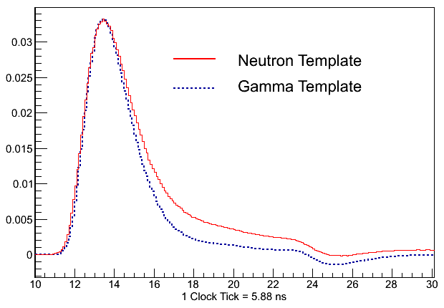
Pulse templates - Pulse Shape Discrimination
Average neutron/gamma pulse template for each detector range of 500 to 1500 keVee (easily distinguishable) after resolving the clock tick more finely.
Clock sampling speed was 170 MHz ~ 5.88 ns and we know data acquisition is independent of clock speed. Improved resolution of clock to get fraction of a clock tick
Overlayed Neutron and gamma: Neutron Red and Gamma Blue
07/11/14

Slide 18
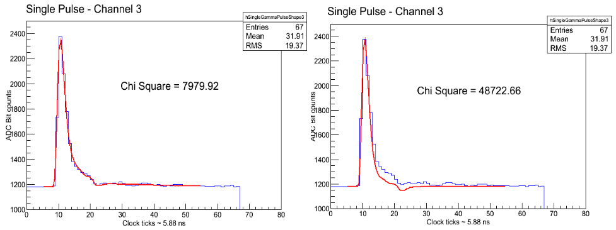
Fitting Pulses with templates -PSD
No analytical fit function – but a root histogram (template) used to fit, by reading bin content
All weights were set to 1 and error bars ignored to get large χ² – Brent's minimization was used for fitting
A neutron pulse first fitted with a neutron template and then a gamma template
07/11/14

Slide 19
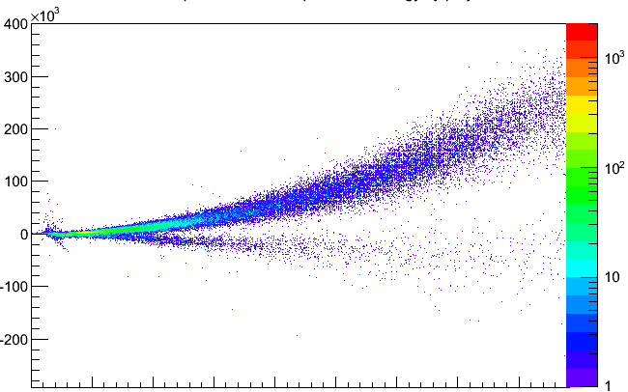
Fitting Pulses with templates -PSD
Least square fit of each pulse with neutron template (gave χ²_{n} ) followed by gamma
template (gave χ²_{γ}). Difference helps determine neutrons / gamma rays
Distribution of Neutron χ² − Gamma χ² relative to Energy
χ²_{n} − χ²_{γ}
Neutrons
0 200 400 600 800 1000 1200 1400 1600
07/11/14
Total Area (keVee)

Slide 20
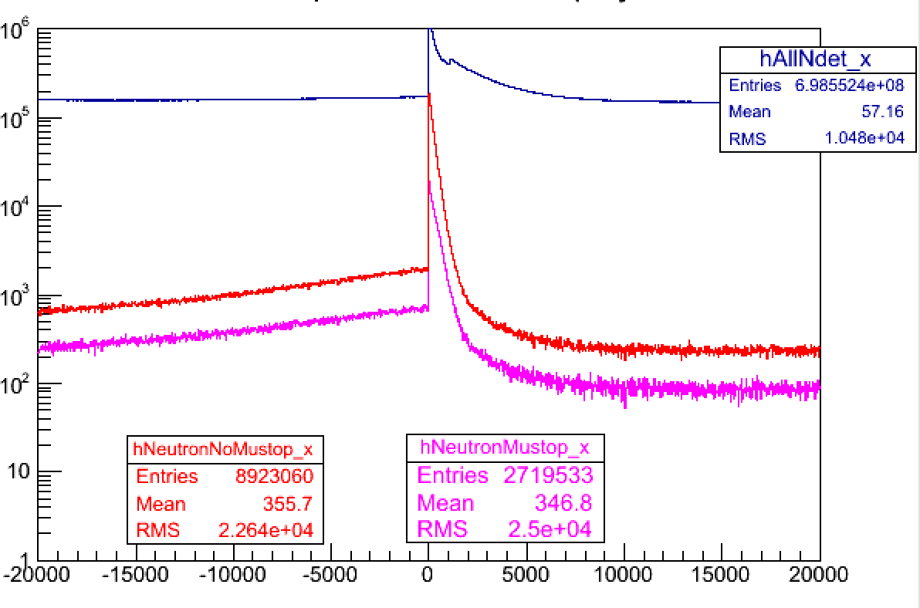
Neutron Time Spectrum
Pile up protection of muons (one muon enters the TPC in a specific time window + 40 μs) - Blue spectrum – all pulses seen by the counters (neutrons, gamma rays etc.) - Kinck due to after pulses.
Neutron time spectrum after applying PSD (gamma rays excluded) – Red Spectrum
Applied a muon stop condition in the TPC. Includes capture and fusion neutrons – Magenta Spectrum. This analysis is for ds_211 (around 1000 midas runs)
t_{n} – t_{μ} (ns)

Slide 21
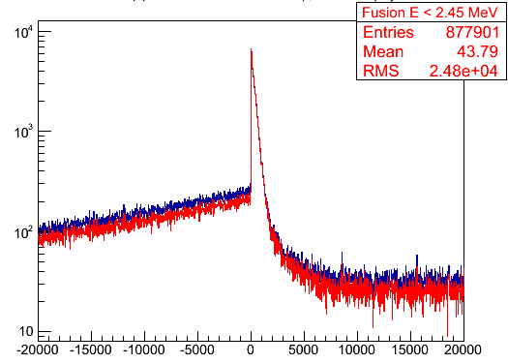
Fusion Neutron Time Spectrum
Fusions accompanied by electrons. An electron coincidence with e from fiducial volume of the TPC applied – Blue Spectrum
Fusion Neutron are monoenergetic – applied energy cut < 2.45 MeV – Red spectrum
t_{n} – t_{μ} (ns)

Slide 22
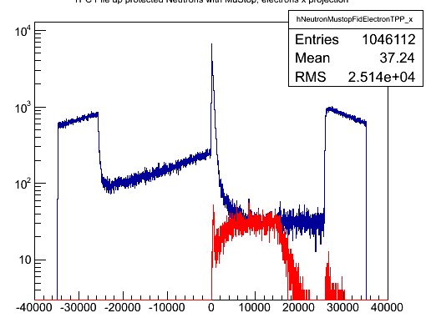
Background Spectrum
Background – from pre electron condition – electrons before the neutrons are generated in a window of -100 to -15000 ns time of electron time wrt to neutron time Red spectrum.
t_{n} – t_{μ} (ns)

Slide 23
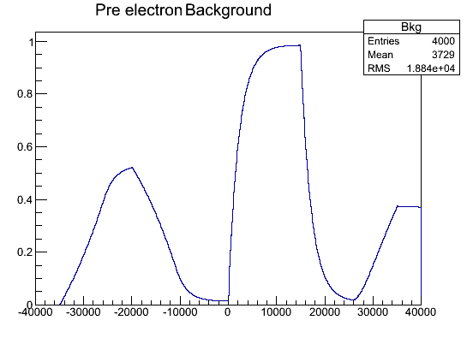
Background Spectrum
Electron association window is shown in the left panel. Probability for electrons to leak in the background window is found by shifting the pre electron window over every bin of the neutron spectrum divided by the area shown in the left (which is the sample space). Output of this in the right figure is the efficiency function.

Slide 24
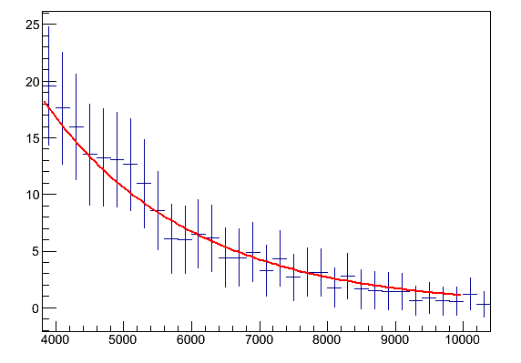
Error Propagation – Lifetime fit
N = Ne + Ne
Blue spectrum = pre electron and no pre electron – used two uncorrelated components
Red – only pre electron
Right spectrum efficiency ε
ε
Ne
Final fusion spectrum
Nf = Ne + Ne – Ne/ε
Errors were evaluated based on the above equation after rebinning each spectra 10 from ~ 2000 ns.
Results for a small range shown in the right plot. Previous slide has full spectrum errors (in log scale)

Slide 25
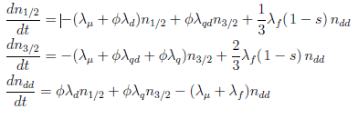
Muon Chemistry
0.002%
Initial pop.
Measure λ_{qd} and λ_{q} : λ_{d}
2/3
λ_{q}
3.05%
λ_{qd}
λ_{dq}
β
1/3
λ_{d}
Initial pop.
μ stopped in TPC
0.073%
Muon decay – 99.92%
Nandita Raha

Slide 26
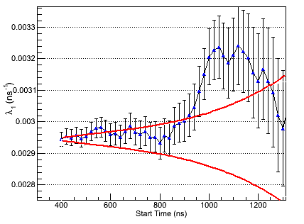
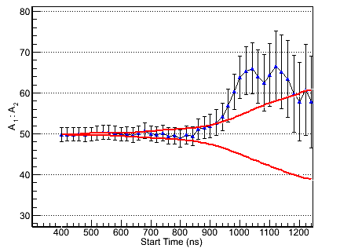
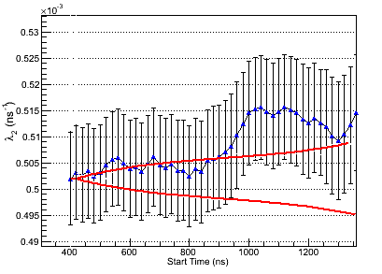
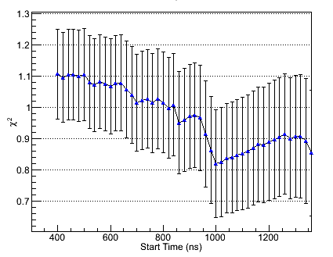
Start Time Scan for Fit Range

Slide 27
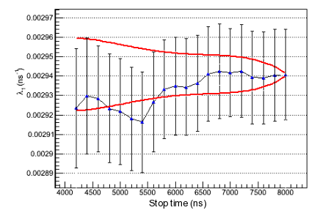
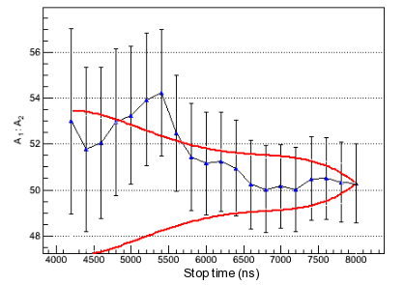
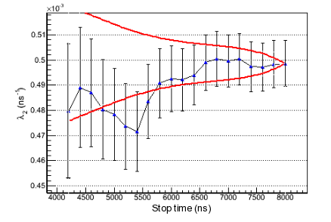
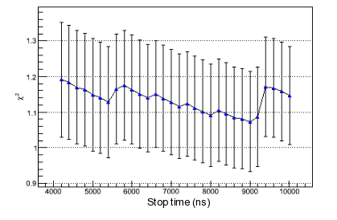
Stop Time Scan for Fit Range

Slide 28
Systematic Errors - Sources
In a previous analysis I completed a set of systematic error analysis – to near completion for this method. The fit results were extremely stable, and sources of these errors were found to be due to:
An imperfect pile up protection – accidental external muons in coincidence with the muon in consideration
Fiducial volume and other backgrounds in the muon stop definition
Misidentified muon stops like a fusion causing confusion
Misidentified electrons due to imperfect pile up protection and accidental electrons
Electrons not emanating from the fiducial volume of the TPC to eSC, but rather in opposite direction
Background spectrum being sensitive to electron Bremsstrahlung, afterpulses in neutron detectors, misidentified gamma rays etc.
Meticulous cuts were made to minimize these effects and all cuts corresponding to these effects were varied to investigate the effects

