Slide 1
Motivation /Interest – MuSun Experiment
Muon Chemistry
Two experiments for measuring muon lifetime
  Lifetime technique
  Neutron technique

Slide 2
Interest / Motivation –
MuSun Experiment

Slide 3

Far more precise than any current experimental information on weak interaction processes in the two-nucleon system.
Impact understanding of fundamental reactions of astrophysical interest, like
- Solar pp fusion
p + p --> d + e⁺ + ν_{e}
- Sudbury Neutrino Observatory observed
ν + d reactions
Since these reactions are similar to the muon decay reaction:
Recent effective field theory calculations have demonstrated, that all these reactions are related by one axial two-body current term, parameterized by a single low-energy constant.

Slide 4
Muon capture on the deuteron is a clean and accurate way to determine this constant. It uses the lifetime technique.
Once it is known, the astrophysical, as well as other important two-nucleon reactions, will be determined in a model independent way with the same precision as the measured muon capture reaction.

Slide 5
Muon Chemistry
(Liquid Deuterium)

Slide 6
(μd)1s – Mixture of Doublet(1/2) + Quartet spin (3/2) states
Irreversible quartet to doublet transition at a rate λ_{d}^{QD} >> muon decay rate (λ_{c})
μd atoms form dμd molecules at rates λ_{dd}^{Q} or λ_{dd}^{D}
dμd undergo fusion with branching ratios
60% and 40%:
dμd
n + He + μ⁻
dμd
t + p + μ⁻

Slide 7
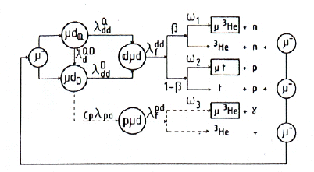
β = 60%
94% re-enter
cycle
Sticking probabilities (fraction of fusion events were dμd
remains in a bound state) ω₁, ω₂ very small
C_{p} – small conc. of hydrogen that forms pμd ions that undergo fusion by:
pμd
μ³He + γ (or μ + ³He)

Slide 8
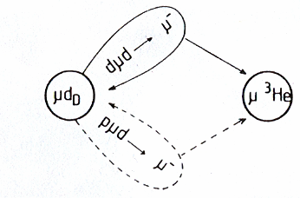


97% of its life.
Capture rate λ_{c}^{D}
3% of its life.
Capture rate λ_{c}^{3He}
Contribution: ε_{dμd}
ε_{f}
ε_{s}
Contribution: ε_{pμd}
In other systems μ lifetime negligibly small
Considering all this, the average muon capture rate is:
where,
and λ_{c}^{D} ~ 400 s⁻¹

Slide 9
Bardin et al. –
Lifetime Technique

Slide 10
Method
It was performed using a muon beam of Saclay linear accelerator (ALS), by the lifetime technique.
Muon capture rate is measured in liquid hydrogen by:
So detection of neutron and backgrounds neutrons from dd fusion is ignored.
Lifetimes of both µ⁻ and µ⁺ were measured with an accuracy of a few times 10⁻⁵.

Slide 11
Method
τ_{μ}- is measured by detecting muon decay electrons
Muons are stopped in target during the 3 µs beam burst.
The target geometry is such that muons stopped in L deuterium or in heavy wall materials (small part < 1%) were captured.

Slide 12
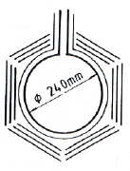
Experimental Setup
125 MeV/c muon beam, in 3 μs bursts at 3000 Hz frequency.
Target: Liquid deuterium in
spherical vessel
(φ = 24 cm) with Cu walls.

Slide 13
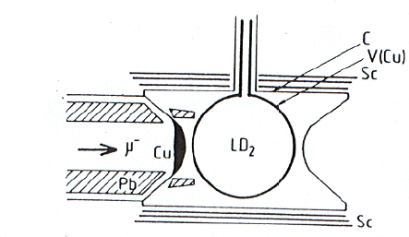
Experimental Setup
Muons pass through Pb collimators and Cu degrader, stop in deuterium target
Detector Set up: τ_{μ}- is measured by detecting muon decay electrons during a 65 μs gate with 6 telescopes surrounding the target. Each made of three 1.5 cm thick plastic scintillators.

Slide 14
Results and Analysis
Time distribution of delayed electrons is given by:
--- (1)
A (~ 4 x 10⁻⁴) is a pile up correction depending on electronic resolution
r (~ 0.1) is the rate of event per gate & telescope
B is a constant due to cosmic rays.
Rate effect is obtained for τ_{μ}+ at rates (r = 0.1 & 0.4).

Slide 15
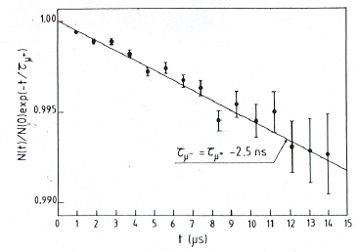
Results and Analysis
-

Slide 16
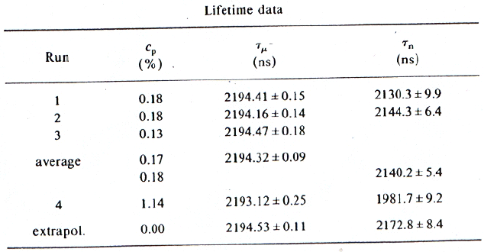
Results and Analysis
Results for negative muons stopped in deuterium is in the table below:
Average τ_{μ}- values extrapolated to zero density (C_{p}) of H

Slide 17

Results and Analysis
Precession effect in earth’s magnetic field, due to residual polarisation of negative muons stopped in L deuterium can affect τ_{μ}- value.
A value of 1% generates an absolute effect on τ_{μ}- < 0.01 ns.
This gives:

Slide 18

Results and Analysis
The time distribution of fusion neutrons from dμd system is analysed with Proton Contamination
Average life time extrapolated to pure deuterium target is
The correction term is:

Slide 19


Results and Analysis
The other correction due to fast formation of μ³He is given by,
A final correction due to relativistic effect of μ-atomic bond gives the final result as:

Slide 20
Cargnelli –
Neutron Technique

Slide 21

Method
Muon induced processes in pure gaseous deuterium, by the reaction:
The rate of nuclear capture process is very sensitive to hyperfine state (hfs) of the μd atom & depends on the resonant molecular formation rate as:

Slide 22
Method
Due to which population of states can be monitored experimentally detecting dd fusion neutrons
Capture neutrons were directly detected due to constant # of neutrons from:

Slide 23
Experimental Setup
Deuterium target should be highly purified from Z>1 atoms. Techniques used are listed:
Residual gas pressure well below 10⁻⁷ mbar maintained by repeated cycles of pumping and baking at 200º C
Deuterium gas purified by Pd filter.
Low gas temp (45K) – conc of z>1 atoms below 0.01 ppm

Slide 24
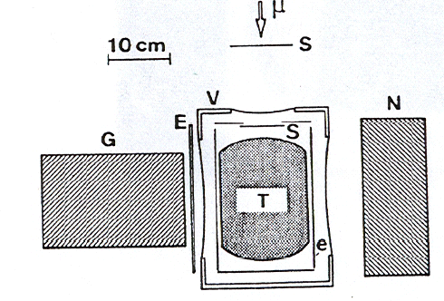
Experimental Setup
V – insulation vacuum chamber
E and e – electron counters
N – neutron detector
G – γ ray detector
Performed at the μE4 beam line of PSI
Incoming beams detected by telescope S, which consisted of 3 plastic scintillators.
Target T was surrounded by plastic scintillators to detect muon decay electrons.
Liquid scintillator (28 x 14 x 10 cm³) with pulse shape discrimination used to detect fusion & capture neutrons.
NaI (TI) detector used for background studies

Slide 25
Results and Analysis
For μd capture analysis only muon stops with no decay electron between 0 to 9 ns were accepted.
Analysis was performed was performed using a threshold above 2.5 MeV_{n} of dd fusion neutrons (0.9 – 3.3 MeV_{e})

Slide 26

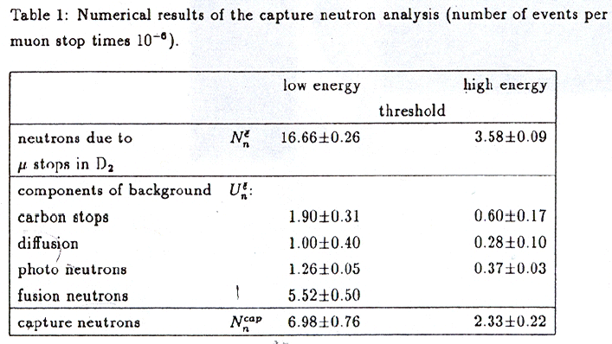
Results and Analysis
After subtraction of various background components the correlated neutrons were corrected using
--- ---(1)

Slide 27
Results and Analysis
Eqn (1) gives results for low
energy and high energy threshold as
and
The combined result is: s⁻¹

Slide 28
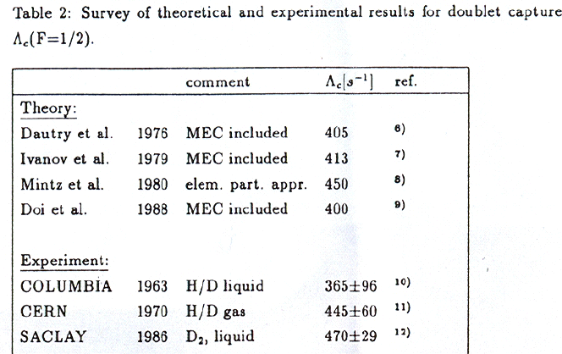
Results and Analysis
Results of the rest of the world:

