Slide 1
Neutron Data Analysis
      Calibration of detectors
      Neutron/gamma discrimination
      Software
      Future Plans

Slide 2

Energy Calibration of neutron counters
Sources used - 60Co and 137Cs
Emission spectra of 60Co – two photo peaks at
1.17 and 1.33 MeV giving an average of 1.25 MeV
Compton Scattering gives a Compton edge (max.
KE of electron) at 1.03 MeV using the formula
Photo peak of 0.667 MeV gives Compton Edge of 0.48 MeV for 137Cs
Notes:
Kicker – Fill time (fills with muons from proton acce.)5 micros
- Measurement time (muon decays take place) 25 mic
Event 80 ms long. Mid file – many events (run).
Event – data from all FE.
1 FE (1 VME crate)– 14 or 15 WFD (8 channels in each WFD)
Single channel of a WFD – bank
Bank – several pulses or Islands (digitized pulse). Size of island is 'n' 12-bit words . One timestamp has 4 12-bit words.
Veto Neutron detector: Stops actually charged particles & detects other pulses (the veto counter is just a plastic scintillator in front of the detector)

Slide 3
Energy Calibration of neutron counters
Compton scattering cross section obeys Klein Nishina formula falling sharply at the Compton edge. Owing to detector resolution there is a Gaussian smearing at the edge.
So a convolution of Klein-Nishina differential scattering cross-section and Gaussian is used to fit data

Slide 4
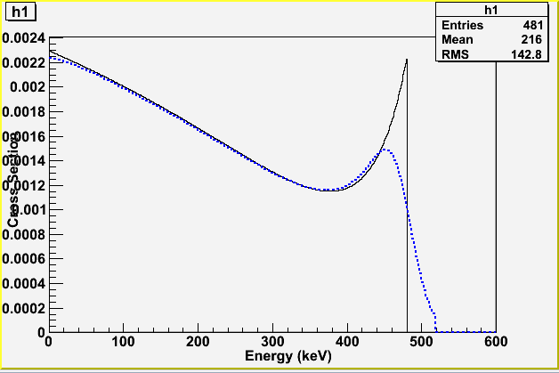
Energy Calibration of neutron counters
Klein Nishina
Convolution with Gaussian

Slide 5
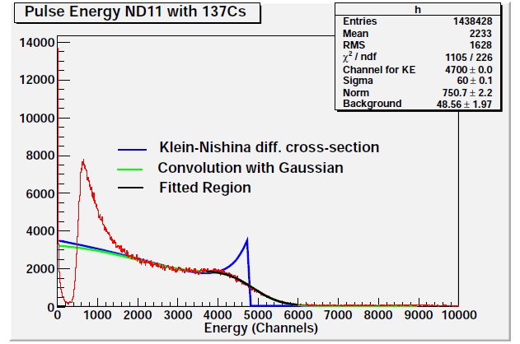
Energy Calibration of neutron counters
Example - detector ND11 with 137Cs

Slide 6
Energy Calibration of neutron counters
Data taken -
In the beginning – Ref elog:103
After shielding from muSR magnet with mu metal – Ref elog:104
At the end of run - Ref elog:86

Slide 7
Energy Calibration of neutron counters
Detector background -
Caused bad fit. E.g. NU6 / ND6 end of run data. Exponential term added for this. Got worse. Ref - elog:100. Final Calibration without background.
Reasons for background:
A source in the vicinity interfering with the detector
Detector specific issue
Not a perfect model - due to multiple scattering the distribution is distorted from Klein-Nishina scattering crosssection for a single electron undergoing Compton scattering
Interested only in the tail region and these backgrounds do not distort our region of interest

Slide 8
Energy Calibration of neutron counters
Table summarizes the calibration data during different stages
Counters | HV (V) | Gain (ch/keV_ee) After shielding | Gain (ch/keV_ee) End of run | Gain (ch/keV_ee) Initial
NU3 | 1140 | 6.12 | 7.32 | ~7.2
ND3 | 1480 | 6.21 | 6.41 | ~5.9
NU6 | 1470 | 6.21 | 6.7 | ~6.6
ND6 | 1600 | 6.18 | 6.38 | ~7.31
NU11 | 1660 | 6.61 | 7.75 | ~9.1
ND11 | 1800 | 7.47 | 8.58 | ~9.12
NU14 | 1400 | 4.32 | 4.22 | ~4.69
ND14 | 1350 | 4.23 | 5.25 | ~7.59

Slide 9
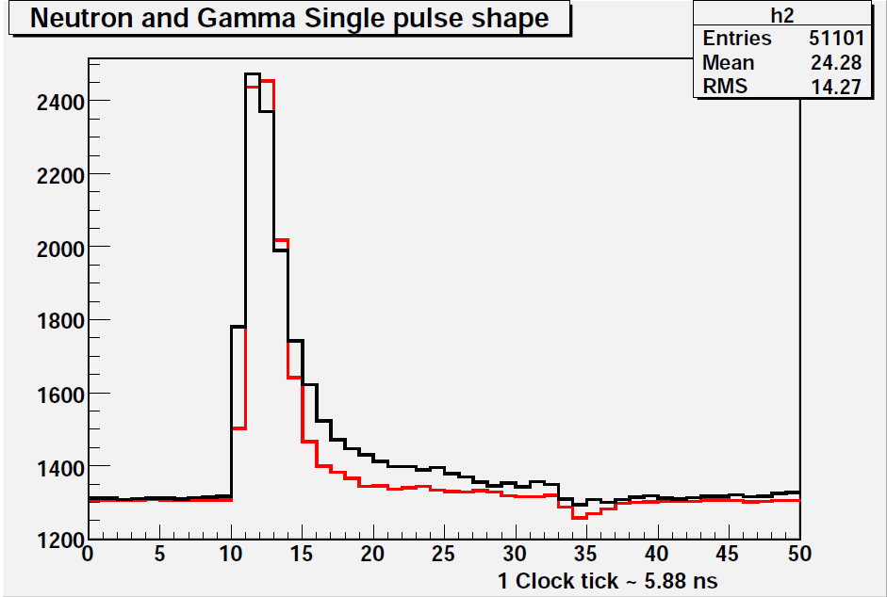
Neutron / Gamma discrimination
Neutron pulses have a longer tails compared to gamma rays.
Used for discrimination
Neutrons
Gamma Rays

Slide 10
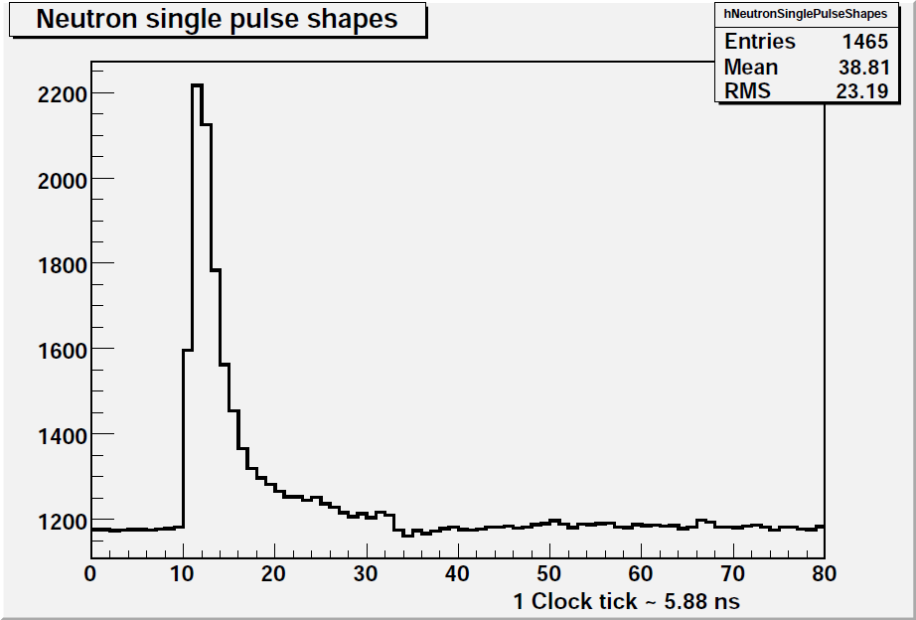
Neutron / Gamma discrimination
Previously, all tail and total integral were defined wrt to the bin corresponding to the peak value of a neutron/gamma pulse (to), which was changed to the bin corresponding to 50% of the peak value(to').
to
to'

Slide 11
Neutron / Gamma discrimination
Total integral - integral from 3 bins to the left of peak bin to 20 bins to the right of peak bin
Slow integral 20- integral from 3 bins to the right of peak bin to 20 bins to the right of peak bin
to
Total Integral
Slow Integral 20

Slide 12
Neutron / Gamma discrimination
Similarly other definitions are as follows -
Slow integral 25 - integral from 4 bins to the right of peak bin
to 20 bins to the right of peak bin
Slow integral 30 - integral from 5 bins to the right of peak bin
to 20 bins to the right of peak bin
Slow integral 35 - integral from 6 bins to the right of peak bin
to 20 bins to the right of peak bin
Slow integral 40 - integral from 7 bins to the right of peak bin
to 20 bins to the right of peak bin

Slide 13
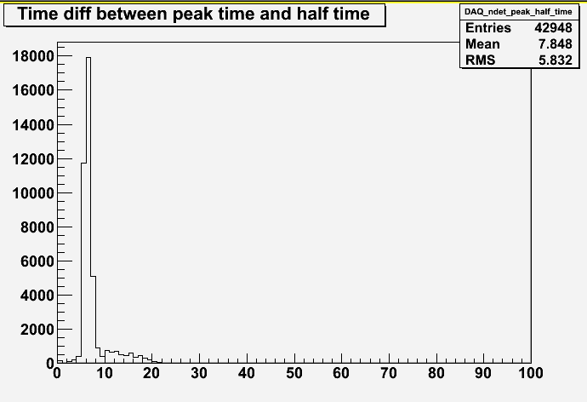
Neutron / Gamma discrimination
Time spectrum of peak bin time (to) wrt to half of peak bin (to')
Peak at ~7.8 ns => shift windows of
all definitions to left by ~1.3 samples (bins)

Slide 14
Neutron / Gamma discrimination
New definition - Total integral - integral from ~2 bins to the left of peak bin to ~21 bins to the right of peak bin
New Slow integral 20- integral from > 4 bins to the right of peak bin to > 21 bins to the right of peak bin
Total Integral
Slow Integral 20
to'

Slide 15
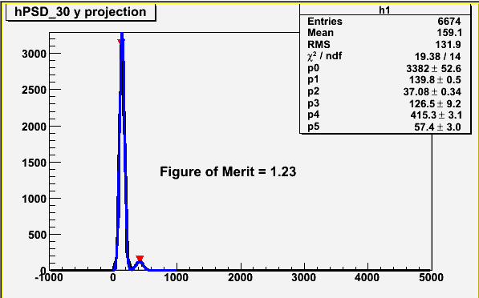
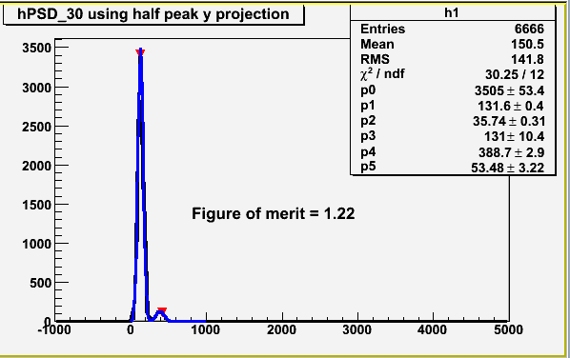
Neutron / Gamma discrimination
Testing performance of both definitions -
Figure of merit in both cases (peak and half bin algorithms) for window slowIntegral30. Took slices of energy of above plots, found peaks and fitted with a double gaussian – shown below
FOM = (p4-p1)/2.35(p2+p5)
p4 - p1

Slide 16
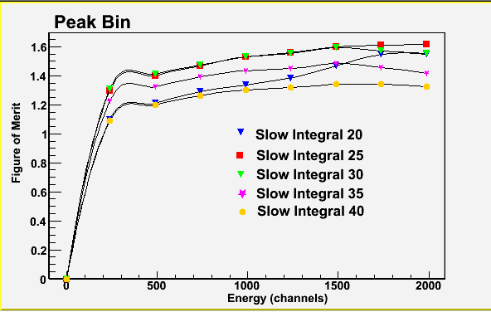
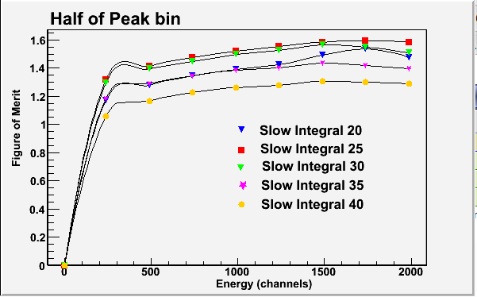
Neutron / Gamma discrimination
Took a run with neutron source and tested FOM for ND14

Slide 17
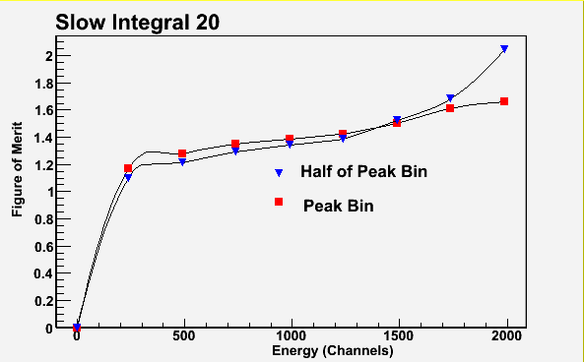
Neutron / Gamma discrimination
Comparing figure of merits of each definition individually.
Same run & same detector (ND14)

Slide 18
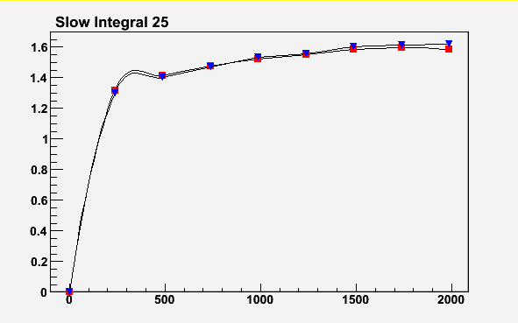
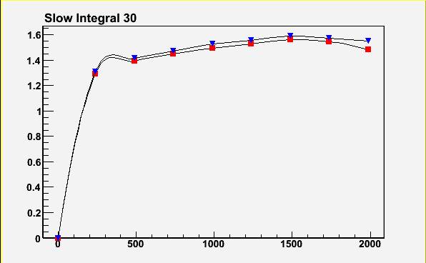
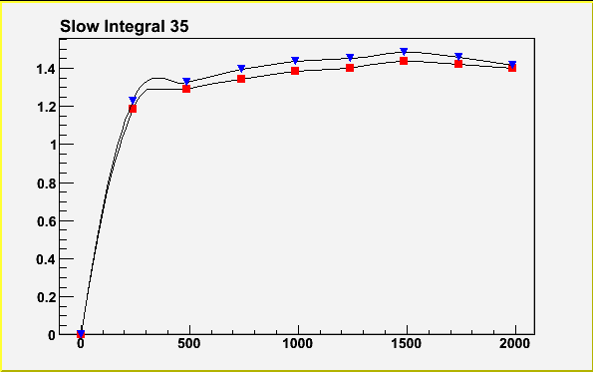
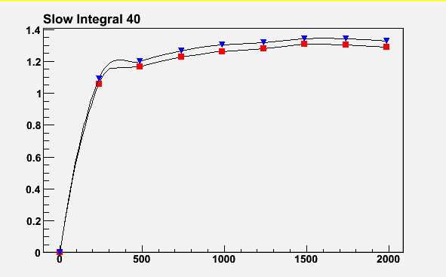
Other definitions and comparisons continued …..
Half of Peak bin
Half of Peak bin
Peak bin
Peak bin
Half of Peak bin
Half of Peak bin
Peak bin
Peak bin

Slide 19
Software Structure
Mu level
NDET bank is created with neutron data and properties.
Module MneutronFadc defines functions like total integral,
slow integral etc.
Module MNeutronFADCMQL was used for all calibration data and
source data with no beam as it is not associated with muons Module
TNeutronCoincidenceAnalysis is used to fill various
histograms and define neutrons, gammas, fusions, captures etc. used for
analyzing beam data as neutrons are associated with muons events.
Mta level - in progress
Data from mu level populated in tree – processed at MTA level
- MusunNeutonAnalysis module
Class structure reusable for all

Slide 20
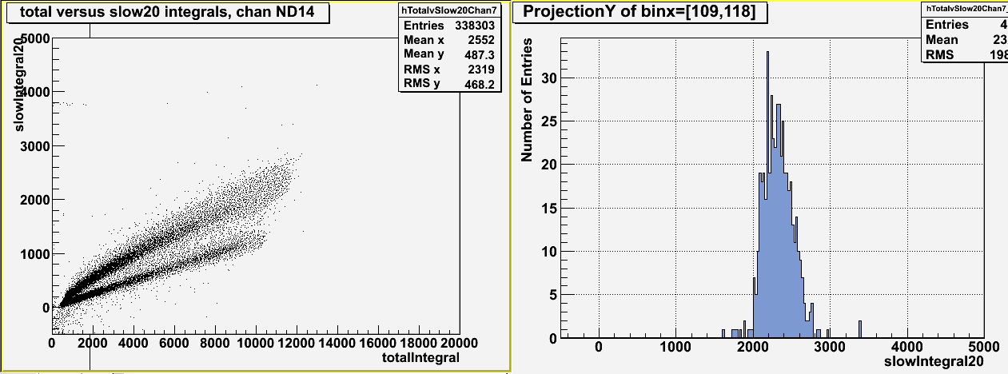
Software Structure
Problems / Future Plans
Check if data is consistent from both modules – TNeutronCoincidenceAnalysis and MneutronFADCMQL. With Neutron source used mql code which does not
fill slow to total histogram beyond 10000-12000 channels – do not understand??

Slide 21
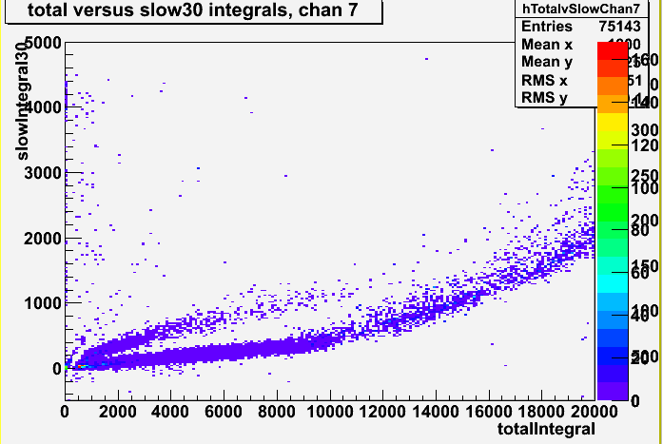
Software Structure
Problems / Future Plans
Analyzed a beam data run with mql module and saw pulses beyond 12000 too as
shown below – which is good :) and means data is consistent from both modules

Slide 22
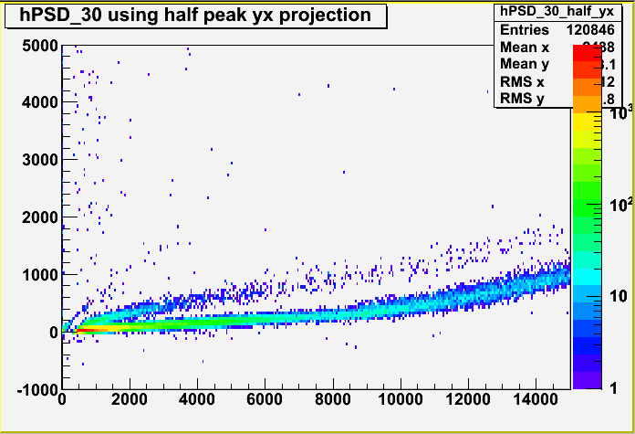
Neutron / Gamma discrimination
Neutron / Gamma discrimination
Problems / Future Plans
12 – bit FADC's limits reading high energy pulses (beyond 4096 ADC counts)
Template to fit the overloaded pulses
Overloaded pulses

Slide 23
Software Structure
Problems / Future Plans /Ideas
Replace MQL module for consistency with a calibration module that stores raw pulses without associated muons – which can be turned on/off from the odb
Structuring neutron data into reusable vector classes – for e.g
fNeutron, fGamma, fFusion etc. so that that can be available
globally – in progress
Take care of overloded pulses for n/g discrimination - plan to plot the energy vs. width of pulse for low energy and
extrapolate it for high energy
Veto electrons for captures – clean the spectrum

