Slide 1
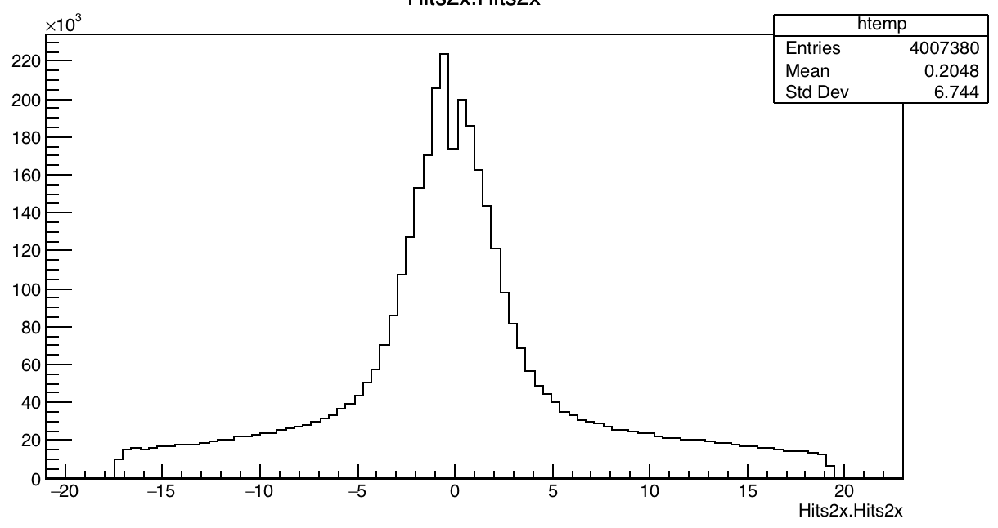
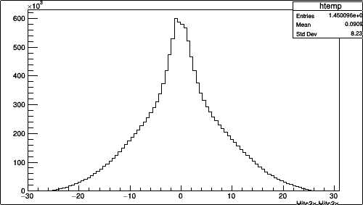
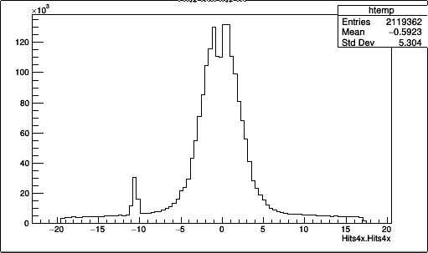
Example of 2x, 3x hits
Each event can have from one to several hits in plots Hits2x etc.
2x
4x
3x

Slide 2
Example of 4x hits
Each event can have from one to several hits
(stored in a vector) in plots Hits2x etc.

Slide 3
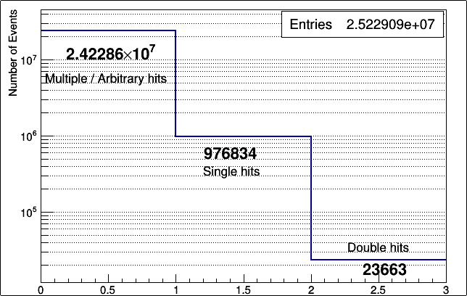
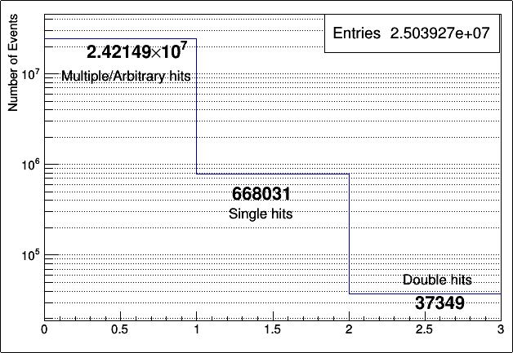
Multiplicities of simultaneous hits on planes 2 & 3
The left plot shows we have 976834 single hits and 23663 double hits in an event simultaneously for planes 2X and 3X respectively. The rest are either zero hits or with multiplicities > 2. Same for Y plane on the right.

Slide 4
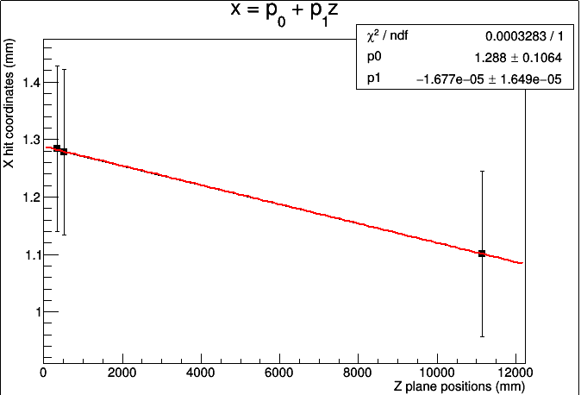
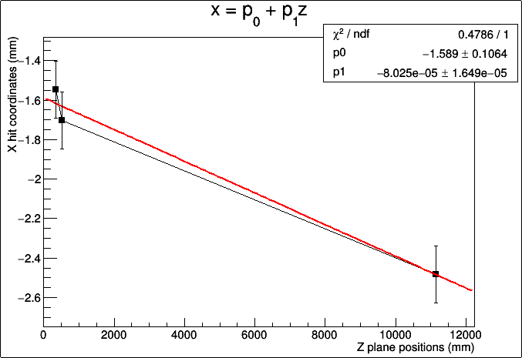
Example tracks with one hit on planes 2 & 3 simultaneously
Shown only tracks on xz plane. Used a constant error of mm for all points. This increases the chi2 ~50 times compared to case not using any errors. Used a straight line fit as shown.

Slide 5
Ideas to be done
Set error as the pitch (about 500 um)/sqrt(sigma) where sigma=12 um.
Check chi2 and slopes for single hits i.e. the 976834 tracks of x-z plane
Chose the 23663 double hit events. Pair 1st hit (primary hits) and 2nd hit pairs(secondary) and plot these. 2D scatter of chi2 and slopes.
Check if the single and double hits correspond to the same events for the Y-planes too...

