Slide 1
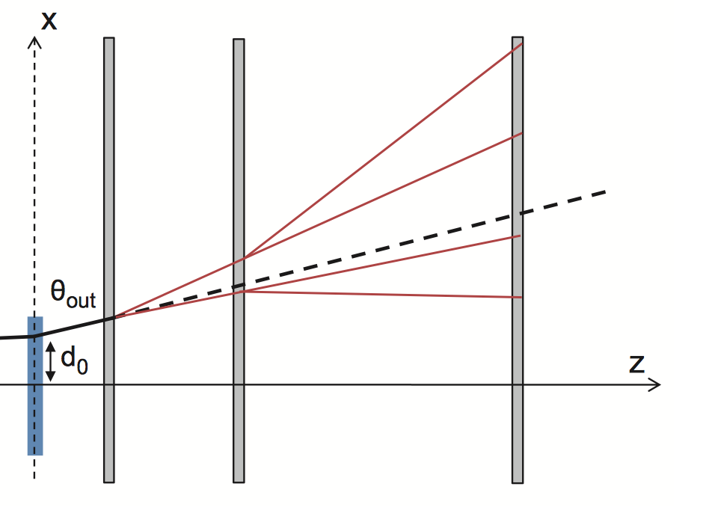
Track/ Event Reconstruction
2x
3x
4x
354 161 10639
Units in mm

Slide 2
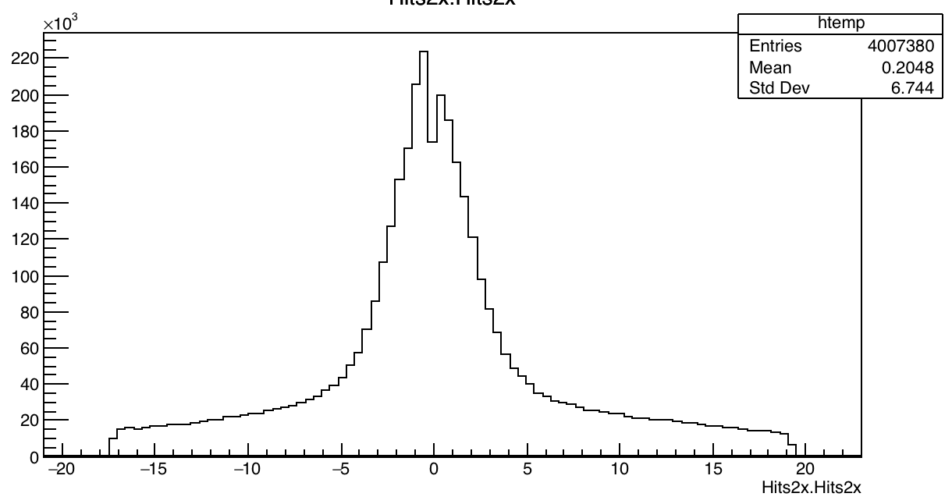
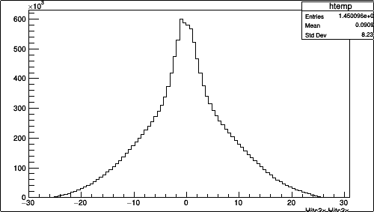
Example of 2x, 3x hits
Each event can have from one to several hits
(stored in a vector) in plots Hits2x etc.
2x
3x

Slide 3
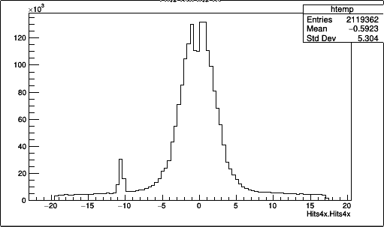
Example of 4x hits
Each event can have from one to several hits
(stored in a vector) in plots Hits2x etc.
4x

Slide 4
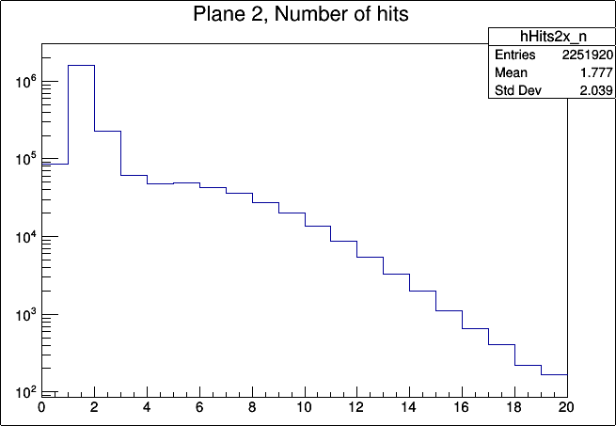
Example of 2x hits
The distribution of number of hits in an event for 2X plane

Slide 5
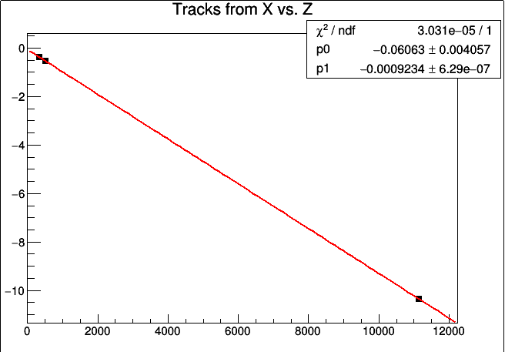
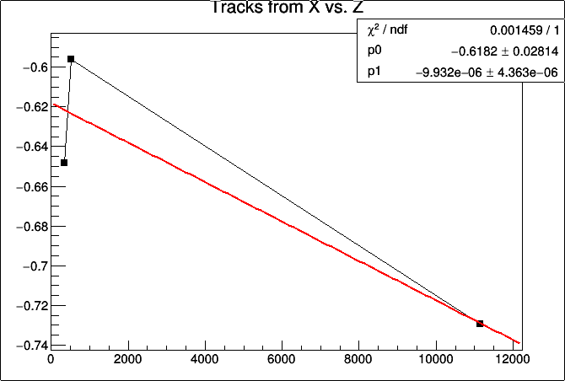
Track from 2x , 3x and 4x hits
Took first hit of an event and plotted 2x, 3x and 4x coord Vs z planes
And fitted with a straight line. Shown a couple of events (one bad & one good). Errors on these not known.
X – hits
X – hits
Z planes
Z planes

Slide 6
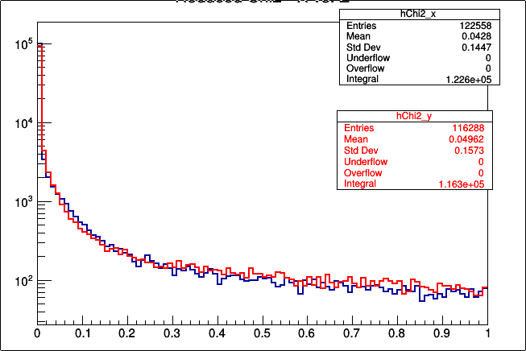
Chi2 distribution for X and Y hits

Slide 7
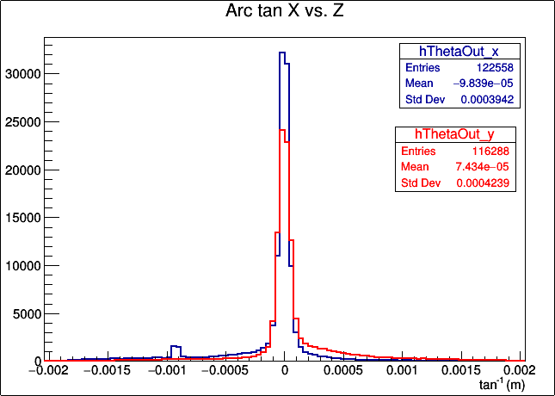
Slope (angle) distribution for X and Y hits
Notes:
<number>

