Slide 1
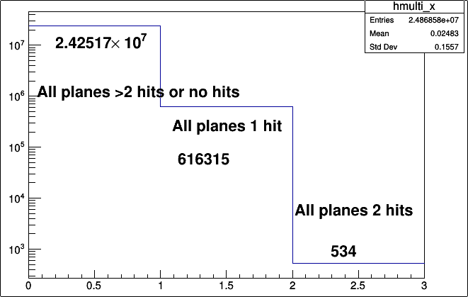
Multiplicities of all X planes

Slide 2
Ideas to be done
Set error as the pitch (about 100 um)/sqrt(sigma) where sigma=12 um.
Check chi2 and slopes for single hits i.e. the 61635 tracks of x-z plane
Chose the 534 double hit events. Pair 1st hit (primary hits) and 2nd hit pairs(secondary) and plot these. 2D scatter of chi2 and slopes.
Check if the single and double hits correspond to the same events for the Y-planes too...

