Slide 1

Soft errors and reliability
Ph.D R&D Project
Nanditha Rao under the guidance of
Prof. Madhav. P. Desai
Dept of Electrical Engineering
IIT Bombay
April 2012

Slide 2
Agenda
Objective
Soft errors and their impact
Redundancy techniques
Outline of the simulation setup
PIC architecture in brief
Implementation details
Simulation results
Conclusion

Slide 3
Objective
To study the impact of soft errors on processor execution and build reliability in the processor to reduce the impact

Slide 4
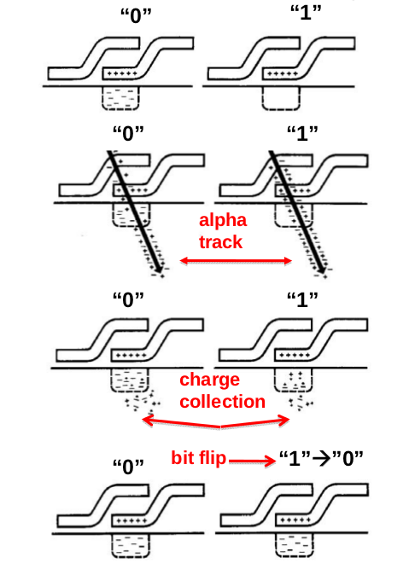
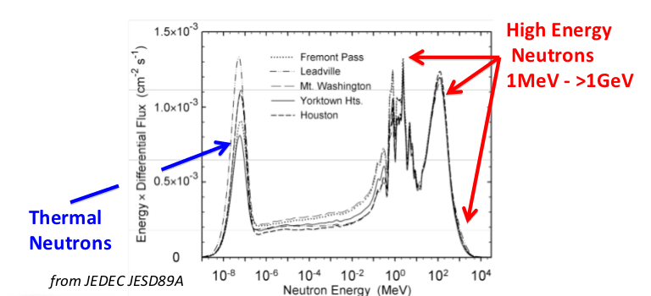
Soft error: physics
Alpha particles
High energy neutrons
A new physical mechanism for soft errors in dynamic memories,Timothy C. May, Murray H. Woods,Reliability Physics Symposium, 1978.

Slide 5
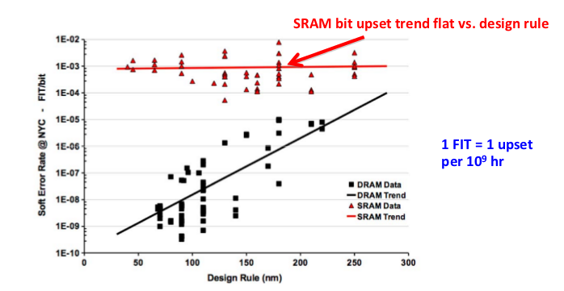
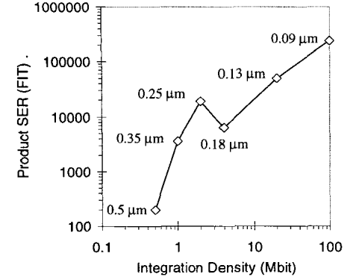
Soft error trends
SER per bit
System SER trend in SRAM
DRAM cell upset trending down
Robert. Baumann, “The Impact of Technology Scaling on Soft Error Rate Performance and Limits to the Efficacy of Error Correction,” Proc. IEEE Int’l Electronic Device Meeting, pp. 329-332, Dec. 2002.
10000 FIT/bit => 0.1 error/year per CPU
Charles Slayman, “Soft Error Trends and Mitigation Techniques in Memory Devices”, Ops A La Carte, Jan 2011
SRAM (128Mb): 20000 FIT/CPU -> 2 errors/year per CPU
DRAM:(2Tb): 2000 FIT -> 0.2 errors/year
Notes:
ER/chip of SRAM shows lit-
tle increase as feature size decreases. Furthermore, pipeline
depth has no noticeable effect, since the percentage of chip
area allocated to SRAM changes very little. SER/chip in
latches increases only slightly for all pipeline depths, a
combined effect of the relatively constant SER/latch and
the increasing number of latches at smaller feature sizes.
SER/chip of latches increases for deeper pipelines, due
solely to the greater number of latches required for deeper pipeline microarchitectures.
SER/chip in combinational logic increases dramatically
from 600nm to 50nm, from 10 to approximately 1.0, or
eight orders of magnitude. This is simply the composition
of a 10 increase in SER per individual logic chain and more
than 100 increase in logic chains per chip. At 50nm and a
6 FO4 pipeline, the SER per chip of logic exceeds that of
latches, and is within two orders of magnitude of the SER
per chip of unprotected memory elements.
2nd figure:
On the X-axis we plotted the number of errors at the nominal
process voltage 1.2V. The Y-axis shows the equivalent meas-
urements, i.e. for the same diode type and size, at voltages
other than 1.2V. A single voltage scaling coefficient applied
to both the NMOS and PMOS diodes and all sizes. The fined
solid lines show that scaling of voltage from 1.2V to OAV,
1:2V to l.OV, and 1.2V to 1.3V resulted in scaling of SER by
+loo%, +33%, and -9%, respectively. On the average, the
SER increased by 18% for every 10% reduction in voltage.

Slide 6
Mitigation techniques
Process/material improvements
Micro solutions
  Parity and Error correcting codes
Macro solutions
  Cycle-by-cycle lockstepping
  CPU or thread mirroring
    Identify the offending processor
    Double/Triple modular redundancy
  Exception Handling
  Checkpointing (recover from control flow errors)
  Multicore
Notes:
Two broad solutions for fault detection include cycle-by-cycle lockstepping of identical processor pipelines [15] and redundant multithreading (RMT) [9][1]. In cycle-by-cycle lockstepping, the same program is run on identical pipelines whose outputs are checked for mismatches every cycle. In RMT, outputs of selected committed instructions are checked for mismatch at commit point of instructions [12]. But, unlike lockstepping, RMT does not require the two threads to be cycle-synchronized
Arithmetic exceptions like overflow and divide-by-0
often can be ignored. For memory access exceptions, a default
value can be returned in case of a load and the operation can
be skipped in case of a store. Invalid instruction exceptions
require more processing in order for the program to complete
execution normally.
When an error is detected on a core, execution on both
the cores is stopped and architectural state from the error-
free core is copied onto the erroneous core. While resuming
the processor, the execution sequence is altered on only the
erroneous core (since PC is copied from error-free core). The
error-free core resumes from where it was stopped

Slide 7
Implementation details

Slide 8
Simulation setup: Outline
Model a pic microcontroller PIC16F84A in C language
Flip a bit in program memory and general purpose registers with a certain probability
  Detect crashes/errors
Implement an error correction algorithm (SECDED)
  Note the improvement in error/crash rate

Slide 9
The complete flow
Generate the assembly for PIC 16F84A from a C program using MPLAB IDE*
Read instruction mnemonic from the assembly
Instruction Fetch
Instruction Decode
Bit flip
  Generate a random number using rand()
  Flip a bit with a certain probability (0.6 to 1e-4)
Check for program crash/error
Instruction Execute
Repeat the same program till a max number of crashes occur

Slide 10
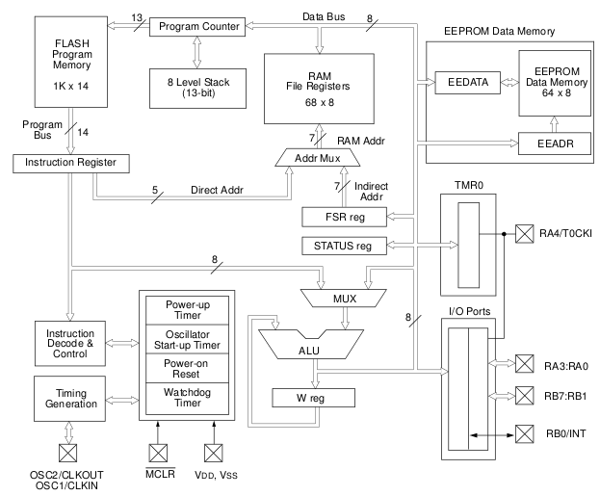
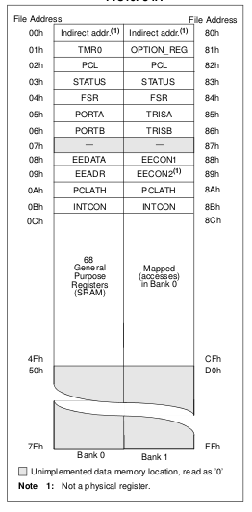
PIC16F84A- Block diagram
Register file map
PIC16F84A Datasheet

Slide 11
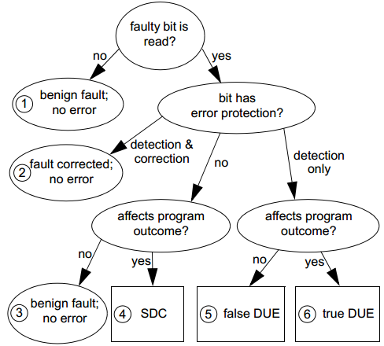
Soft error- bit flips
SDC: Silent Data Corruption
DUE: Detected Unrecoverable Error
Process kill or System kill
The Soft Error Problem: An Architectural Perspective, (HPCA-11) 2005

Slide 12
Crash conditions
Program counter changes
Current instruction gets modified into a Control flow instruction (CALL/GOTO/RETURN)
Unable to decode the instruction – Illegal opcode
Access a prohibited memory location
After a crash:
  Note the instruction cycle at which the crash occured
  Reset the system after each crash
  Reload instructions to program memory and restart execution
Calculate Mean time to failure (in terms of instruction cycles)

Slide 13
Error conditions
Data being accessed by current instruction gets modified
  Due to flipping of the content of memory location
  Due to flipping of the data bit in the instruction itself
Instruction in the program memory gets modified
  Bit in the opcode has flipped (say, ADD becomes MOVE)
  Destination bit has flipped (say, stores result in accumulator instead of memory)
  Bit oriented instructions: Bit value flips (e.g., BCF: Bit clear function- ends up clearing bit 4 instead of bit 5)
  Immediate value in the instruction changes (e.g., ADD 12, becomes ADD 13)
Keep track of the number of errors

Slide 14
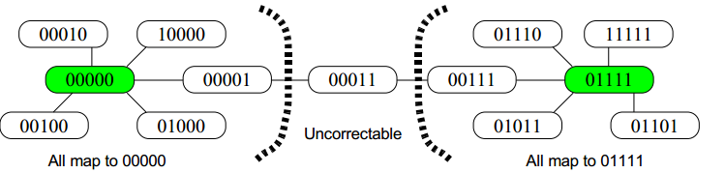
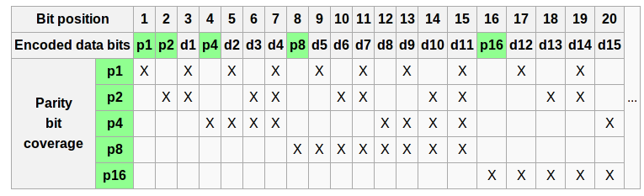
Hamming code
Single error correction, Double error detection: Code with Minimum Hamming Distance of 4
Constructing an Error Correcting Code,Andrew E. Phelps, University of Wisconsin, Madison
Encoding and Parity coverage
http://en.wikipedia.org/wiki/Hamming_code

Slide 15
SECDED- Hamming code
Encode while writing instruction into program memory
  Convert 8 bit register data into 13 bits
  Convert 14 bit instruction into 20 bits
Bit flip (flips the encoded content)
Detect and correct error during Instruction Fetch (reading from program memory)
  Decode the correct instruction
  Continue normal execution
Report crash only if Double error is detected
  Repeat for a maximum number of crashes
Calculate MTTF

Slide 16
Simulation results
1. Without Error correction

Slide 17
Examples: Histograms of crash events
Calculating Mean time to failure (instruction cycles)

Slide 18
Mean time to failure (instruction cycles) without error correction
Max number of successful instruction cycles executed and still no crash
Only 1 crash in a day

Slide 19
Analysing the crashes

Slide 20
Simulation results
1. With Error correction

Slide 21
Mean time to failure (instruction cycles)
With error correction
Crashes are only due to double bit errors
No crash in 2 days

Slide 22
Simulation time vs crashes
Lower probabilities, more time for lesser number of crashes
Higher probabilities, less time for more number of crashes
No crash in 36 hours

Slide 23
Errors corrected using SECDED

Slide 24
Future direction

Slide 25
Backup

Slide 26
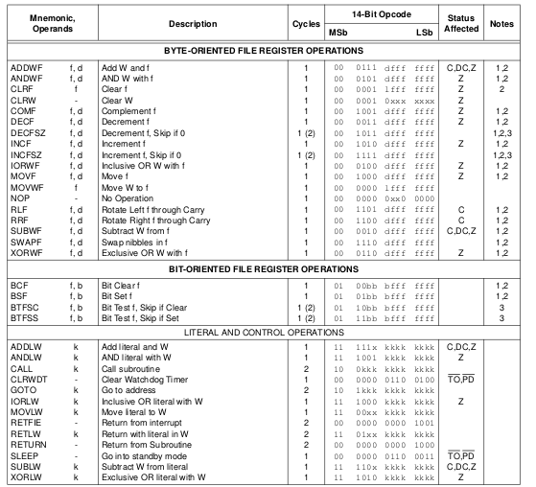
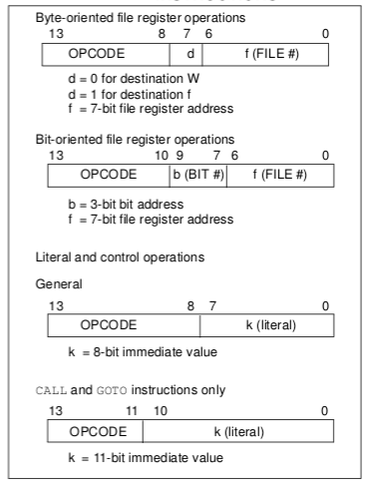
PIC16F84A- Instruction set summary
General format of instructions
PIC16F84A Datasheet

