Slide 1
Soft errors and reliability
Nanditha Rao
Mar 13 2012

Slide 2
Soft errors/ single event upsets (SEU)
Transient errors caused by high energy particle strikes (neutrons from cosmic rays and alpha particles from packaging material)
Flips the bit stored in a storage cell
Not a permanent fault
Error rate increases in proportion to the number of devices

Slide 3
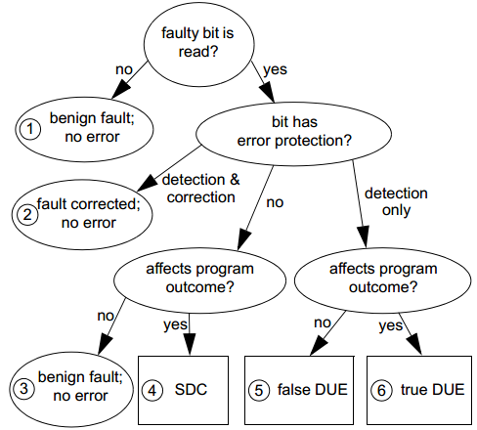
Model
SDC: Silent Data Corruption
DUE: Detected Unrecoverable Error
AVF: Architecture Vulnerability Factor: probability that a state change in the
device leads to an architecturally visible SDC or DUE error.
SDC+ DUE FIT = SER (Soft error rate)
MTTF is inversely related to FIT
Component FIT = Raw error rate * AVF
Process kill
System kill
The Soft Error Problem: An Architectural Perspective, (HPCA-11) 2005

Slide 4
Terminologies
AVF: Architecture vulnerability factor
  AVF of the program counter is practically 100% since it results in the execution of a qrong instruction
Architecturally correct execution (ACE):
  Individual instructions may generate incorrect results,
  A bit is called an ACE bit when it contains information that if changed will affect the final outcome of the program

Slide 5
Models
Statistical Fault Injection
  Introduce bit flips
  Compare the architectural state of the models
ACE Analysis in a Performance Model
  Identify which objects flowing through the machine are un-ACE
Probabilistic model
Notes:
A bit is called an ACE bit when it contains information that if changed will affect the final outcome of the program, and called an un-ACE (un-necessary for ACE) bit otherwise.

Slide 6
Failure set
Observable errors:
Written to an output device,
Values that affect program control flow (e.g., the value of
a branch target)
Value of an instruction opcode (an error could make the opcode illegal, causing a program crash)
Address of a memory location (an error could cause access to prohibited locations, causing a crash),
Destination register field of an instruction (an error could result in the corruption of an unknown and undesirable register).
Notes:
Not all erroneous values cause program failure. For example, an error that occurs in a dead
value does not cause failure since the value is not used again. Similarly, an error in a speculative
instruction that is later squashed does not cause program failure. We say an erroneous value results
in program failure if the error is observable by an external observer.

Slide 7
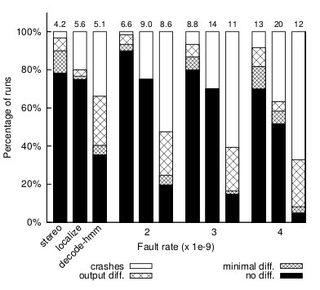
MTTF
The values that can cause failure: {v f 1 , vf 2 , ...},
The corresponding times for these failures: {tf 1 , tf 2 , ...},
For each value, vf i , the set of independent basic errors E f i ={ef i−1 , ef i−2 , ...} that can produce an error in vf i ,
Probability for each independent basic error.
Soft Error Resilience of Probabilistic Inference Applications
Notes:
Not all erroneous values cause program failure. For example, an error that occurs in a dead
value does not cause failure since the value is not used again. Similarly, an error in a speculative
instruction that is later squashed does not cause program failure. We say an erroneous value results
in program failure if the error is observable by an external observer.

Slide 8
Mitigation
Micro solutions
  ECC
  Parity
Macro solutions
  Cycle-by-cycle lockstepping
  CPU or thread mirroring
    Idenify the offending processor
    Double/Triple modular redundancy
  Exception Handling
  Checkpointing (recover from control flow errors)
  Multicore
Notes:
Two broad solutions for fault detection include cycle-by-cycle lockstepping of identical processor pipelines [15] and redundant multithreading (RMT) [9][1]. In cycle-by-cycle lockstepping, the same program is run on identical pipelines whose outputs are checked for mismatches every cycle. In RMT, outputs of selected committed instructions are checked for mismatch at commit point of instructions [12]. But, unlike lockstepping, RMT does not require the two threads to be cycle-synchronized
Arithmetic exceptions like overflow and divide-by-0
often can be ignored. For memory access exceptions, a default
value can be returned in case of a load and the operation can
be skipped in case of a store. Invalid instruction exceptions
require more processing in order for the program to complete
execution normally.
When an error is detected on a core, execution on both
the cores is stopped and architectural state from the error-
free core is copied onto the erroneous core. While resuming
the processor, the execution sequence is altered on only the
erroneous core (since PC is copied from error-free core). The
error-free core resumes from where it was stopped

Slide 9
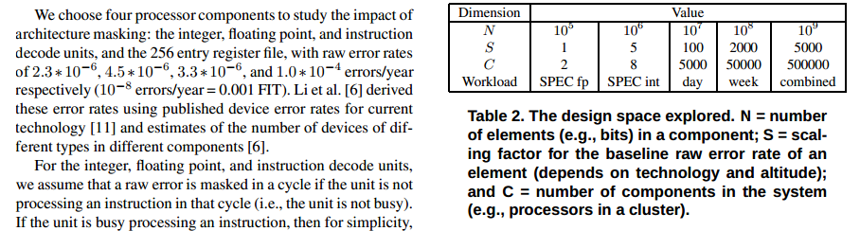
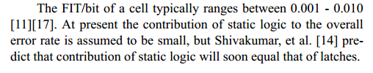
SER
To put it in perspective, 1 year MTBF is equal to approximately 114,077 FIT (approximately 1e9/(24*365))
The Soft Error Problem: An Architectural Perspective
Architecture-Level Soft Error Analysis:
Examining the Limits of Common Assumptions
Notes:
Two broad solutions for fault detection include cycle-by-cycle lockstepping of identical processor pipelines [15] and redundant multithreading (RMT) [9][1]. In cycle-by-cycle lockstepping, the same program is run on identical pipelines whose outputs are checked for mismatches every cycle. In RMT, outputs of selected committed instructions are checked for mismatch at commit point of instructions [12]. But, unlike lockstepping, RMT does not require the two threads to be cycle-synchronized
Arithmetic exceptions like overflow and divide-by-0
often can be ignored. For memory access exceptions, a default
value can be returned in case of a load and the operation can
be skipped in case of a store. Invalid instruction exceptions
require more processing in order for the program to complete
execution normally.
When an error is detected on a core, execution on both
the cores is stopped and architectural state from the error-
free core is copied onto the erroneous core. While resuming
the processor, the execution sequence is altered on only the
erroneous core (since PC is copied from error-free core). The
error-free core resumes from where it was stopped

Slide 10
SER
The rate at which SEUs occur is given as SER, and you measure it in FITs (failures in time), which is the number of failures in 1 billion device-operation hours. A measurement of 1000 FITs corresponds to a MTTF (mean time to failure) of approximately 114 years.
The potential impact on typical memory applications illustrates the importance of considering soft errors. A cell phone with one 4-Mbit, low-power memory with an SER of 1000 FITs per megabit will likely have a soft error every 28 years. A high-end router with 10 Gbits of SRAM and an SER of 600 FITs per megabit can experience an error every 170 hours. For a router farm that uses 100 Gbits of memory, a potential networking error interrupting its proper operation could occur every 17 hours. Finally, consider a person on an airplane over the Atlantic at 35,000 ft working on a laptop with 256 Mbytes (2 Gbits) of memory. At this altitude, the SER of 600 FITs per megabit becomes 100,000 FITs per megabit, resulting in a potential error every five hours. The FIT rate of soft errors is more than 10 times the typical FIT rate for a hard reliability failure.
http://www.edn.com/article/473992-Soft_errors_impact_on_system_reliability.php
Notes:
Two broad solutions for fault detection include cycle-by-cycle lockstepping of identical processor pipelines [15] and redundant multithreading (RMT) [9][1]. In cycle-by-cycle lockstepping, the same program is run on identical pipelines whose outputs are checked for mismatches every cycle. In RMT, outputs of selected committed instructions are checked for mismatch at commit point of instructions [12]. But, unlike lockstepping, RMT does not require the two threads to be cycle-synchronized
Arithmetic exceptions like overflow and divide-by-0
often can be ignored. For memory access exceptions, a default
value can be returned in case of a load and the operation can
be skipped in case of a store. Invalid instruction exceptions
require more processing in order for the program to complete
execution normally.
When an error is detected on a core, execution on both
the cores is stopped and architectural state from the error-
free core is copied onto the erroneous core. While resuming
the processor, the execution sequence is altered on only the
erroneous core (since PC is copied from error-free core). The
error-free core resumes from where it was stopped

