Slide 1
Fault models
Memory faults:
Static faults:
Pin-fault- Stuck at fault (1/0),
transition fault,
address decoder fault,
read faults (stuck-open faults)
Dynamic faults- Single cell or two-cell dynamic faults
e.g., Read followed by write RAW
Pattern sensitive faults (memory contents affected by aggressor patterns- 5 or 9 aggressor)

Slide 2
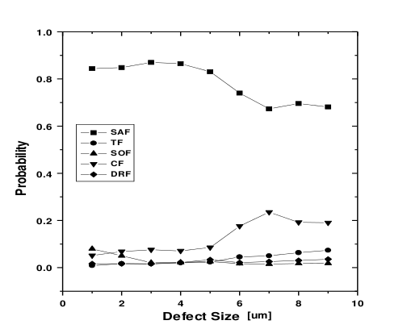
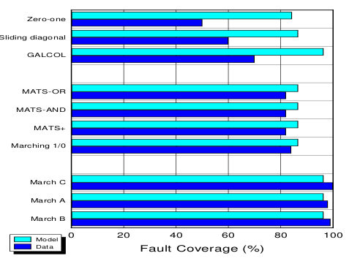
Fault probability and test algorithm
Fault probability distribution
SAF: Stuck at fault- most occuring
TF: Transition fault
SOF: Stuck open fault
CF: Coupling fault
DRF: Data retention fault
Fault coverage comparison for different algorithms.
March test algorithms provide complete coverage
Assessing SRAM Test Coverage for Sub–Micron CMOS Technologies,Vonkyoung Kim and Tom Chen, Colorado State University, VLSI Test Symposium, 1997., 15th IEEE

Slide 3
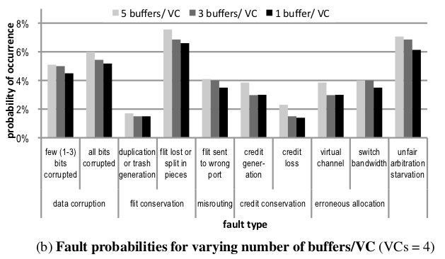
Probabilities of faults in Network on chips
Definitions used:
Upon timing violation, a flit, that is, flow control digit (small packets of data) are written to a different random buffer (flit loss) potentially overwriting a useful flit latched there (data corruption).
Also, since the buffer that the flit was intended for already sent a credit to the upstream router and not received the flit that used this credit, it assumes that the upstream router has not utilized this credit yet (credit loss).
At system-level, the destination node will never receive the corresponding flit while, from now on, this buffer’s capacity is reduced by one flit buffer.
Methodology used:
Step 1. Static Timing Analysis to determine the critical paths
• Step 2. Extraction of critical paths with stressing inputs
• Step 3. Monte Carlo circuit-level simulations of critical paths to capture process-induced timing violations
• Step 4. Map circuit-level faults to system-level fault types
Enabling System-Level Modeling of Variation-Induced Faults in Networks-on-Chips
Konstantinos Aisopos†§ , Chia-Hsin Owen Chen§ , Li-Shiuan Peh§†
Princeton University § Massachusetts Institute of Technology, DAC 2011

Slide 4
Probabilities of faults in Network on chips
Definitions used:
Upon timing violation, a flit, that is, flow control digit (small packets of data) are written to a different random buffer (flit loss) potentially overwriting a useful flit latched there (data corruption).
Also, since the buffer that the flit was intended for already sent a credit to the upstream router and not received the flit that used this credit, it assumes that the upstream router has not utilized this credit yet (credit loss).
At system-level, the destination node will never receive the corresponding flit while, from now on, this buffer’s capacity is reduced by one flit buffer.
Methodology used:
Step 1. Static Timing Analysis to determine the critical paths
• Step 2. Extraction of critical paths with stressing inputs
• Step 3. Monte Carlo circuit-level simulations of critical paths to capture process-induced timing violations
• Step 4. Map circuit-level faults to system-level fault types
Enabling System-Level Modeling of Variation-Induced Faults in Networks-on-Chips
Konstantinos Aisopos†§ , Chia-Hsin Owen Chen§ , Li-Shiuan Peh§†
Princeton University § Massachusetts Institute of Technology, DAC 2011

Slide 5
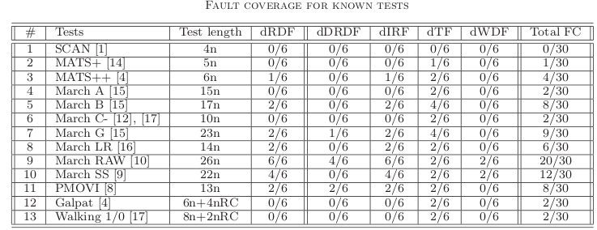
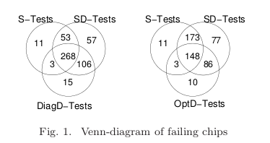
Importance of dynamic faults
Static Tests (S-Tests)- static faults
Diagnosis Dynamic tests- (DIag-D tests)- Single cell dynamic faults
Opt-D- optimised for certain single cell dynamic faults
SD-tests: Static and dynamic tests
Comparison of Static and Dynamic Faults in 65nm Memory Technology, Delft University of Technology and Intel Corporation, CiteSeerX - Scientific Literature Digital Library

Slide 6
Types of Fault injection
Memory corruption: Fault injected in the task memory image and could remain throughout the program execution
Spatial: Fault injection is triggered after N occurences of randomly chosen/user selected address
Temporal: A built-in hardware time counts down to 0 and an error is injected everytime the timer resets to 0

Slide 7
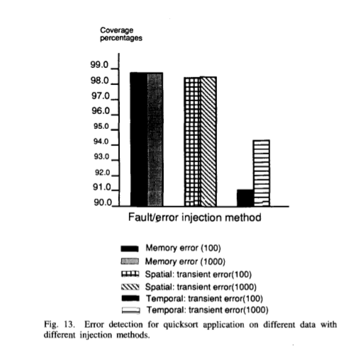
Fault injection method
Temporal method resulted in the lowest error detection coverage
Temporal injection method would challenge the error detection
mechanisms to a higher degree
Reference: FERRARI: A Flexible Software-Based Fault and Error Injection System, IEEE TRANSACTIONS ON COMPUTERS, VOL. 44,NO. 2, FEBRUARY 1995

Slide 8
Redundancy schemes
Error correction (Hamming code that can correct 1 to 3 bits whose value has been flipped)
Triple modular redundancy with majority voting logic
Checkpointing architectural states at regular intervals

Slide 9
Summary
Dynamic faults are important and should be modeled over static faults
TMR – temporal is a bigger challenge than spatial

