Slide 1

Architecture-level Soft error analysis and reliability
Ph.D R&D Project
Nanditha Rao under the guidance of
Prof. Madhav. P. Desai
Dept of Electrical Engineering
IIT Bombay
May 2nd 2012

Slide 2
Agenda
Objective
Soft errors and their impact
Mitigation techniques
Outline of the simulation setup
PIC architecture in brief
Implementation details
Simulation results
Conclusion

Slide 3
Objective
To study the impact of soft errors on processor at an architecture-level and build reliability to reduce the impact

Slide 4
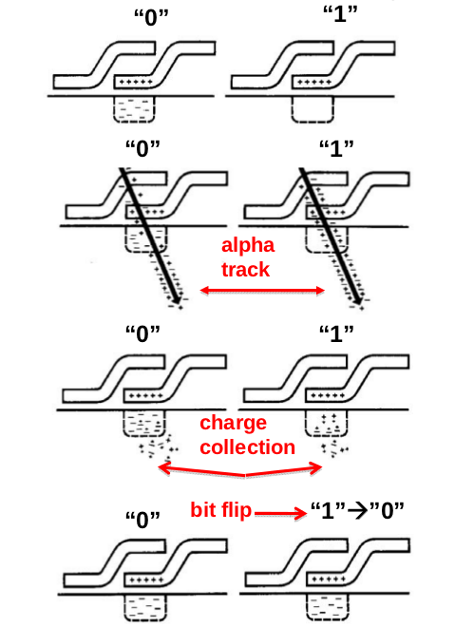
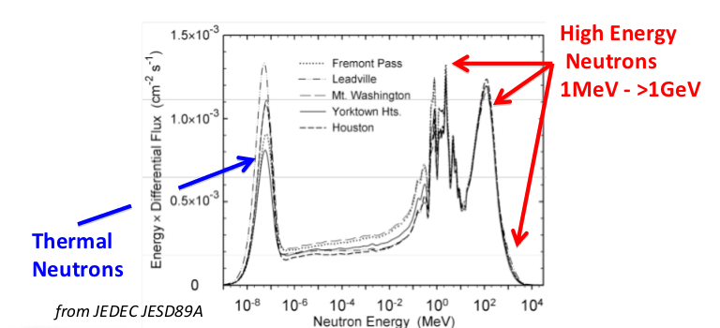
Soft error: causes and mechanism
Alpha particles
High energy neutrons
Charles Slayman, “Soft Error Trends and Mitigation Techniques in Memory Devices”, Jan 2011
Efficiency * electrons > Qcrit
A new physical mechanism for soft errors in dynamic memories,Timothy C. May, Murray H. Woods,Reliability Physics Symposium, 1978.
Notes:
Soft error- reversible, transient, bit-flip error, not due to any physical defect
Cosmic rays are energetic charged subatomic particles, originating in outer space. They may produce secondary particles that penetrate the Earth's atmosphere and surface.
May and Woods demonstrated that alpha particles from the spontaneous fission of 23 U and 230Th were responsible for the upset. These radioactive impurities are found in part per million concentrations in the ceramic packaging materials typically used for ICs
A 4MeV alpha entering Si because of has Initially a speed of .05c and loses energy at a rate of dE/dx 15OKeV/P.1 The number of electron-hole pairs produced per unit length is determined by the average required to produce an electron-hole pair in energy silicon.
This number has been measured for generation by
Highly energetic particles to be 3.6eV/electron-hole pair
Electron-Hole Pair Collection. Up to 2.5 x 10⁶
can be generated in a period of several picoseconds by the
passage of the energy, naturally-occurring alpha particle.
It is clear that the actual soft error rate of a particular test structure or actual device depends on a number of factors: flux and ionizing radiation, target area, critical energy of collection charge, efficiency, cell geometry, etc. These in turn are a function of device design and technology parameters and the package type and composition.
There are 625,000 charge carriers in 0.1 pC. Thus
if a 10 MeV particle delivers all its energy into
ionization of semiconducting silicon at 3.6 eV per
electron-hole pair, it creates 2.8 x 10⁶
electron-hole pairs or 0.44 pC of charge carriers.

Slide 5
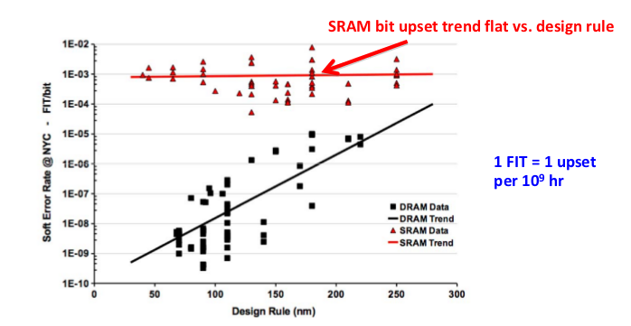
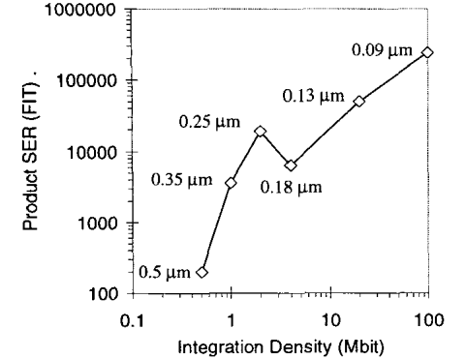
Soft error trends with technology
DRAM cell upset trending down
Robert. Baumann, “The Impact of Technology Scaling on Soft Error Rate Performance and Limits to the Efficacy of Error Correction,” Proc. IEEE Int’l Electronic Device Meeting, pp. 329-332, Dec. 2002.
System SER trend in SRAM
Charles Slayman, “Soft Error Trends and Mitigation Techniques in Memory Devices”, Ops A La Carte, Jan 2011
10000 FIT/bit => 0.1 error/year per CPU
SRAM (128Mb): 20000 FIT/CPU -> 2 errors/year per CPU
DRAM:(2Tb): 2000 FIT -> 0.2 errors/year
Notes:
ER/chip of SRAM shows little increase as feature size decreases.
SER/chip of latches increases for deeper pipelines, due
solely to the greater number of latches required for deeper pipeline microarchitectures.
SER/chip in combinational logic increases dramatically
from 600nm to 50nm, from 10 to approximately 1.0, or
eight orders of magnitude. This is simply the composition
of a 10 increase in SER per individual logic chain and more
than 100 increase in logic chains per chip. At 50nm and a
6 FO4 pipeline, the SER per chip of logic exceeds that of
latches, and is within two orders of magnitude of the SER
per chip of unprotected memory elements.
2nd figure:
On the X-axis we plotted the number of errors at the nominal
process voltage 1.2V. The Y-axis shows the equivalent meas-
urements, i.e. for the same diode type and size, at voltages
other than 1.2V. A single voltage scaling coefficient applied
to both the NMOS and PMOS diodes and all sizes. The fined
solid lines show that scaling of voltage from 1.2V to OAV,
1:2V to l.OV, and 1.2V to 1.3V resulted in scaling of SER by
+loo%, +33%, and -9%, respectively. On the average, the
SER increased by 18% for every 10% reduction in voltage.

Slide 6
Mitigation techniques
Process/material improvements
Design/Layout Techniques
Architectural
  Cycle-by-cycle lockstepping
  Double/Triple modular redundancy
  Exception Handling
  Checkpointing (recover from control flow errors)
  Multicore
Notes:
Silicon Process- SOI, implants
Material Selection – eliminate B10, low alpha materials,die coat to shield from alpha
Memory cell interleaving and Keep-out areas on IC
Keep-out areas on IC
• Separate sensitive memory from lead bumps in flip chip packaging
Lock-stepping: Uses redundant copies of the hardware and runs the program on the duplicate copies of hardware.. and compares the signals of both of them every cycle to detect a mismatch
Two broad solutions for fault detection include cycle-by-cycle lockstepping of identical processor pipelines [15] and redundant multithreading (RMT) [9][1]. In cycle-by-cycle lockstepping, the same program is run on identical pipelines whose outputs are checked for mismatches every cycle. In RMT, outputs of selected committed instructions are checked for mismatch at commit point of instructions [12]. But, unlike lockstepping, RMT does not require the two threads to be cycle-synchronized
Arithmetic exceptions like overflow and divide-by-0
often can be ignored. For memory access exceptions, a default
value can be returned in case of a load and the operation can
be skipped in case of a store. Invalid instruction exceptions
require more processing in order for the program to complete
execution normally.
When an error is detected on a core, execution on both
the cores is stopped and architectural state from the error-
free core is copied onto the erroneous core. While resuming
the processor, the execution sequence is altered on only the
erroneous core (since PC is copied from error-free core). The
error-free core resumes from where it was stopped

Slide 7
Implementation details
Architecture-level

Slide 8
Simulation setup: Outline
Model a pic microcontroller PIC16F84A in C language
Fault model: Flip a bit in program memory/data space with a certain probability (0.1 to 10⁻⁴)
  Detect crashes/errors and calculate MTTF
Implement an error correction algorithm (SECDED)
  Note the improvement in error/crash rate
Notes:
Harvard architecture: Separate instruction and data memory
Von neumann: Shared instr and data memory
Various suggestions have been made regarding a precise definition of RISC, but the general concept is that of a system that uses a small, highly-optimized set of instructions, rather than a more specialized set of instructions often found in other types of architectures. RISC systems use the load/store architecture.[1] The opposing architecture is known as complex instruction set computing, i.e. CISC.
The term "reduced" in that phrase was intended to describe the fact that the amount of work any single instruction accomplishes is reduced—at most a single data memory cycle—compared to the "complex instructions" of CISC CPUs that may require dozens of data memory cycles in order to execute a single instruction
A complex instruction set computer (CISC) is a computer where single instructions can execute several low-level operations (such as a load from memory, an arithmetic operation, and a memory store) and/or are capable of multi-step operations or addressing modes within single instructions.
A microcontroller is a specialized form of microprocessor that is designed to be self-sufficient and cost-effective, where a microprocessor is typically designed to be general purpose (the kind used in a PC). Microcontrollers are frequently found in automobiles, office machines, toys, and appliances.The microcontroller is the integration of a number of useful functions into a single IC package. It has: The CPU core (microprocessor)
Memory (both ROM and RAM)
Some parallel digital I/O

Slide 9
The complete flow
Convert C to PIC 16F84A assembly
Read instructions from file
Write to program memory
Repeat till a MAX number of crashes occur
Reset system
Instruction fetch
Instruction decode
Bit flip with a certain probability
Crash
Check for program crash/error
Error
Instruction execute

Slide 10
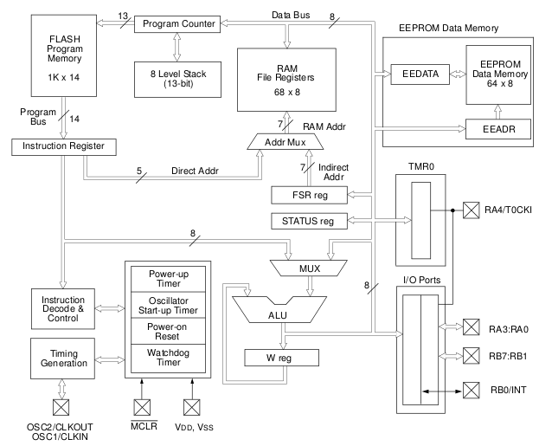
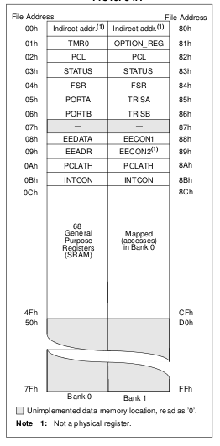
PIC16F84A- Block diagram
Register file map
PIC16F84A Datasheet

Slide 11
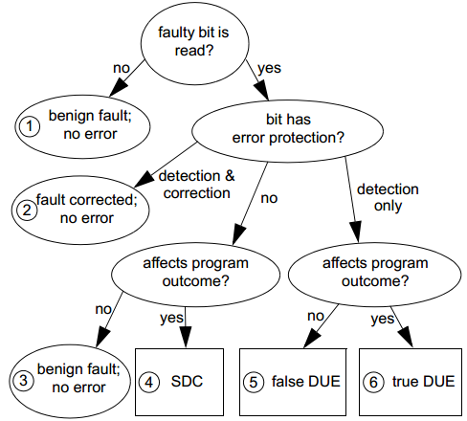
Fault model- single bit flip
SDC: Silent Data Corruption
DUE: Detected Unrecoverable Error
Process kill or System kill
The Soft Error Problem: An Architectural Perspective, (HPCA-11) 2005

Slide 12
Crash conditions
Program counter changes
Current instruction gets modified into a Control flow instruction (CALL/GOTO/RETURN)
Unable to decode the instruction – Illegal opcode
Access a prohibited memory location
After a crash:
  Note successful instruction cycles
  Reset the system
  Reload instructions and restart execution
Calculate Mean time to failure (instruction cycles)

Slide 13
Error conditions
Incorrect data
Instruction gets modified
  Opcode modified (say, ADD becomes MOVE)
  Destination bit flips (say, stores result in accumulator instead of memory)
  Bit value flips (e.g., BCF: Bit clear function- ends up clearing bit 4 instead of bit 5)
  Immediate value in the instruction changes (e.g., ADD 12, becomes ADD 13)
Keep track of the number of errors
Notes:
Incorrect data:
Due to flipping of the content of memory location
Due to flipping of the data bit in the instruction itself
Bit value flips in Bit oriented instructions:

Slide 14
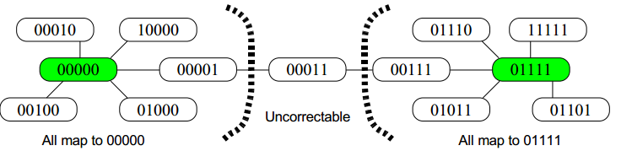
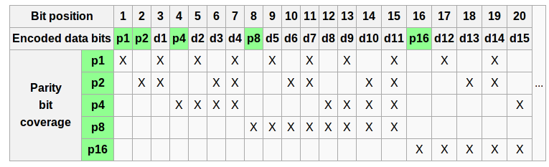
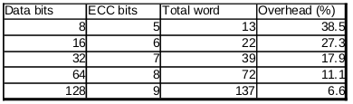
Hamming code
Single error correction, Double error detection: Code with Minimum Hamming Distance of 4
Andrew E. Phelps, Constructing an Error Correcting Code, University of Wisconsin, Madison
Encoding and Parity coverage
Overhead of parity bits
http://en.wikipedia.org/wiki/Hamming_code

Slide 15
The complete flow
Convert C to PIC 16F84A assembly
Read instructions from file
Encode and Write to program memory
Decode/detect/correct- Instruction fetch
Encode back
Repeat till a MAX number of crashes occur
CRASH DUE TO DOUBLE ERROR
Reset system
Instruction decode
Bit flip with a certain probability
Crash
Check for program crash/error
Error
Instruction execute

Slide 16
Simulation results
1. Without Error correction

Slide 17
Measuring the randomness of rand()
Uniform distrubution!
Notes:
Related work:
- study is based on data collected over more than 2 years and covers DIMMs of multiple vendors, generations, technologies, and capacities. All DIMMs were equipped with error correcting logic (ECC) to correct at least single bit errors.
- work in [13] compares the area and performance
penalties for Hamming code and TMR schemes for reconfigurable logic. In a case study, a group of 5 registers with 8-bit and 16-bit data widths has been considered as a register file. The synthesis results for Xilinx and Altera FPGAs does not show significant differences between the Hamming code and TMR implementations.
- Furthermore, the work in [15] indicates that there is very little gain (2%) in fault tolerance for on-chip caches if we increase the protection from SEC-DED to Double Error Correct-Triple Error Detect (DEC-TED) while the overhead for that extra 2% gain is large.
-

Slide 18
Examples: Histograms of crash events
Calculating Mean instruction cycles to failure
Notes:
Related work:
- study is based on data collected over more than 2 years and covers DIMMs of multiple vendors, generations, technologies, and capacities. All DIMMs were equipped with error correcting logic (ECC) to correct at least single bit errors.
- work in [13] compares the area and performance
penalties for Hamming code and TMR schemes for reconfigurable logic. In a case study, a group of 5 registers with 8-bit and 16-bit data widths has been considered as a register file. The synthesis results for Xilinx and Altera FPGAs does not show significant differences between the Hamming code and TMR implementations.
- Furthermore, the work in [15] indicates that there is very little gain (2%) in fault tolerance for on-chip caches if we increase the protection from SEC-DED to Double Error Correct-Triple Error Detect (DEC-TED) while the overhead for that extra 2% gain is large.
-

Slide 19
Mean time to failure (instruction cycles) without error correction
Max number of successful instruction cycles executed and still no crash
Only 1 crash in a day
MTTF increases with reducing error rate

Slide 20
Analysing the crashes
PC is mapped to 4 locations in register space and hence is the most vulnerable

Slide 21
Simulation results
1. With Error correction

Slide 22
Mean time to failure (instruction cycles)
With error correction
Crashes are only due to double bit errors
Quicker failure compared to the case with no ECC
No crash in 2 days

Slide 23
Simulation time vs crashes
Lower probabilities, more time for lesser number of crashes
Higher probabilities, less time for more number of crashes
No crash in 36 hours

Slide 24
Errors corrected using SECDED
Several errors were benign

Slide 25
Related work
Simulation vs particle induced fault injection on an IBM Power 6 RTL model
  Faults: Toggle mode and sticky mode
P. N. Sanda, Soft-error resilience of the IBM POWER6 processor, IBM Journal of Research and Development, May 2008
Detailed Verilog model of a deeply pipelined, out-of-order microprocessor
  Random single bit flip and experiment on different workloads
Nicholas J. Wang, Characterizing the Effects of Transient Faults on a High-Performance Processor Pipeline, UIUC, IEEE Dependable Systems and Networks, 2004
TMR vs Hamming study on an IBM Cu-08 (90nm) ASIC technology
Riaz Naseer, Analysis of Soft Error Mitigation Techniques for Register Files in IBM Cu-08 90nm Technology, IEEE Circuits and Systems, 2006
Instruction level fault injection and run three algorithms, using Cycle- cycle lock-stepping
Vicky Wong , “Soft Error Resilience of Probabilistic Inference applications ”, SELSE II, 2006
Analysis of four fault injection techniques
J. Arlat et al., Comparison of Physical and Software-Implemented Fault Injection Techniques, IEEE Trans. Computers, vol. 52, no. 8, Aug. 2003.
Statistical Sampling to Characterize Faulty Behavior
Barton, J.H.; Czeck, E.W.; Segall, Z.Z.; Siewiorek, D.P.; , "Fault injection experiments using FIAT," Computers, IEEE Transactions on , vol.39, no.4, pp.575-582, Apr 1990
Notes:
1. Fault Injection Verification of IBM POWER6 Soft Error Resilience: The fault may exist for the duration of a cycle (toggle mode) or for a larger number of cycles (sticky mode). The effect of the fault is evaluated by checking the system/processor status registers which flag errors such as checkstops, recoveries and machine errors.
2. Very similar to our approach. Set of trials are run, cycle- cycle lock-stepping. Random injection thru the pipeline
- Run for different benchmarks and workloads
- latch only injection and latch+RAM injection
- Several trials and find a fit in a good confidence interval
-Categorise the errors
3. We have synthesized 32-bit and 64-bit wide, 32-entry, dual read port, single write port RISC style register files in IBM Cu-08 90nm technology. We have implemented SEC Hamming code for various block lengths and TMR soft error mitigation techniques for these register files. A bit-error probability analysis has been performed to make the overall reliability comparison fair between TMR and Hamming codes.
Applying Hamming code on larger data widths such as 64-bit and 32- bit words as a single block have much larger latency which cannot be tolerated in register files used in extremely pipelined high-speed microprocessors. A compromise between area and latency can be achieved if SEC code is applied to 4-bit blocks of the data word. An SEC Hamming code applied on a block size of 4-bits saves around 45% area against TMR, incurring around 34% degradation in speed compared to TMR. Therefore a choice of block size for Hamming code may still provide area- and latency-efficient
error protection for register files.
Heavy-Ion Radiation, Pin-Level Injection, Electromagnetic Interferences and Software implemented fault injection. The results also showed that software injection using a simple bit-flip fault model is able to generate a similar error set as the physical techniques.
Reachability: Heavy-ion is better
Repeatability: Software model is better
In particular, injection in the code segment of the executed task was able to create a similar ratio of errors activating the hardware mechanisms.
Statistical Sampling to Characterize Faulty Behavior – very similar work, matrix multiplication. Error detction covergae, workload impact., error latency, instruction based analysis

Slide 26
Conclusions and Future Direction
ECC may not improve reliability at high error-rates
Extend the study using a more complex processor/fault model
Incorporate technology scaling trends
Derive a theory to correlate the observed MTTF trend
Predict the results for real error-rate scenarios in reasonable simulation time
Arrive at a generic solution
Notes:
Talk about related work.. and limitations of current work

Slide 27
Backup

Slide 28
History of soft error impact
1975 - Hughes aircraft company : Electronic anomalies in satellites
1978 - Intel: Studies on RAM (alpha particles in device package)
1979- IBM:
  Contribution of cosmic rays to terrestrial soft errors
  Study: DRAM errors: Upset rate: 10⁸/cm².
1981 - IBM - 16kb DRAM errors due to radioactive Krypton⁸⁵
1984 - IBM- studies impact of altitude on cache errors
1995 - Interaction of Boron 10 (in BPSG) with thermal neutrons
2000 - Soft Errors in SRAM cache used in Sun Microsystems servers
2003 - Cisco-12000 router cards show parity errors
Slayman, C. , “Soft errors — Past history and recent discoveries”, Integrated Reliability Workshop Final Report (IRW), Oct 2010
Notes:
Hughes Aircraft Company- cosmic ray supplies an instantaneous charge, part of which is collected across the various capacitances of the transistor. The particular mechanism assumed for turning the transistor on was the charging of the base-emitter capacitance to the turn-on voltage.
Intel RAM: A new physical soft error mechanism in dynamic RAMs and CCDs is the upset of stored data by the passage of heavily-ionizing radiation through the memory array area. Alpha particles are emitted in the radio-active decay of uranium and thorium present in parts-per-million levels in packaging materials. When an alpha particle penetrates the die surface, it can create enough electron-hole pairs near a storage node to cause a random, single-bit error.
1979- T H E R E ARE TWO GENERAL classes of i n t e r a c t i o n s b y which cosmic rays can disrupt electronic circuits. Energetic charged pa r t i c l e s c an pene t r a t e the s emi conduc tor and l e ave an ioni z a t ion wake of electron-hole pairs. Alternatively, the particle may directly i n t e r a c t with a single silicon nucleus and cause a wide variety of heavy recoiling charged particles which also create a dense burst of electron-hole pairs.
In all experiments, the dynamic RAM was exposed to the particle radiation while it was in its normal operating mode.16k DRAMs have been irradiated with neutrons having mean energies of 6.5, 9 and 14 MeV and with 32 MeV protons and have been found to undergo SEUs. For both particles, one upset is expected for approximately 10⁸ particles/cm2. The alpha particle discharges either the storage capacitor, the floating bit line, or the reference capacitor used by the sense amplifier. For each test, the lower 8K was filled with a single character, either '0' or '1' and then the memory space was checked to ensure that the writing had been correctly done and the chip was not spontaneously upsetting. The computer was put into a closed loop, awaiting a command from the remotely located teletype. Then the chip was irradiated to a given fluence of either protons or neutrons. After the irradiation was completed, the memory was reinterrogated. Each cell was then compared with the character with which it had been filled. The total number of upsets was printed and by option also the contents of the upset byte. Intel C2117-2, Motorola MCM4116L20, Texas Instrument TMS4116-200L, Hitachi HM4716A-3, and NEC pPD416D. Sensitivity drops with decreasing energy but for most chips the decrease is not great.
IBM - Cache-memory module installed at locations above 2600 feet had twice as many memory parity-check errors
1995- In 1995, Baumann and co-workers studied the effects of thermal neutron capture by 10B in boro-phospho-silicate glass (BPSG) [8]. The thermal neutron capture results in the fission of the 10B nucleus into a 1.47 MeV alpha particle, a 7Li nucleus with and energy of 0.84 or 1.014 MeV and a 478 keV gamma photon. Their measurements showed a typical 600nm thick later of BPSG would generate ~0.02 events cm-2 hr-1.

Slide 29
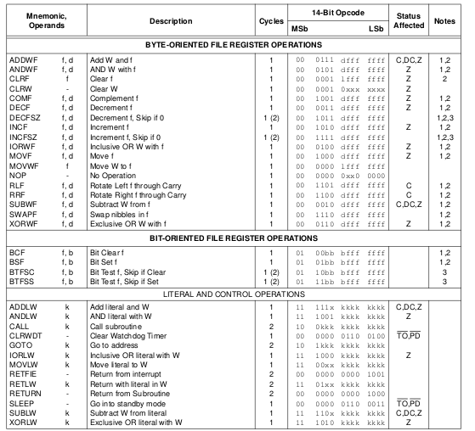
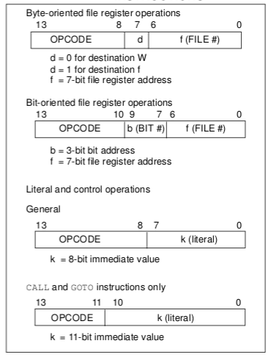
PIC16F84A- Instruction set summary
General format of instructions
PIC16F84A Datasheet

