Slide 1
Micro Organism Identifier
CS5100
Nandi Xu 2023/4/24

Slide 2
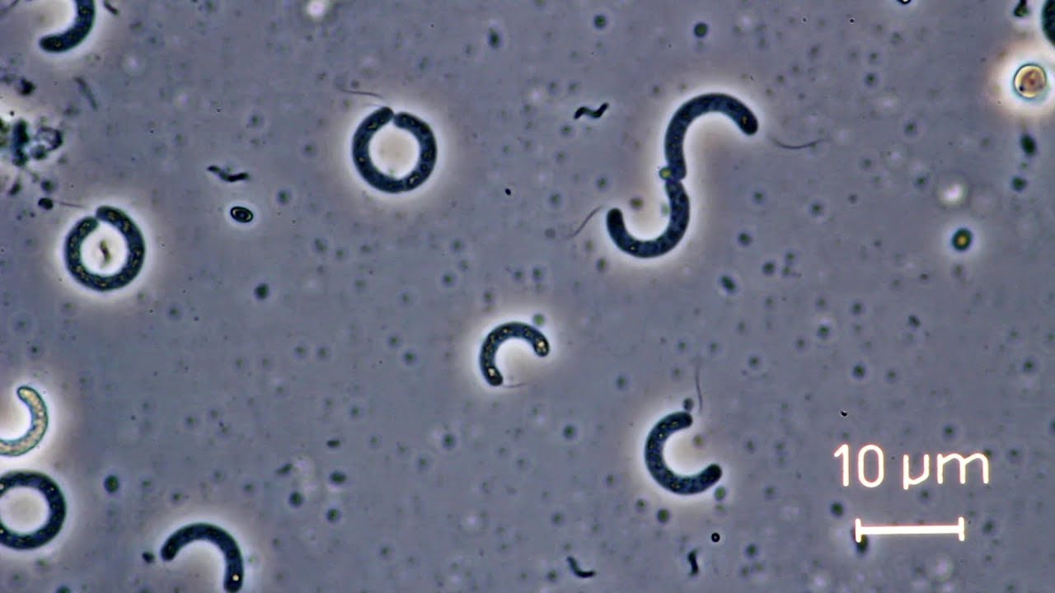
Problem:
Micro Organism Identification in Biomedical Engineering Industry

Slide 3


Data: Triangle and Circle
Source: Kaglle
0
1

Slide 4
Machine Learning Model and Data Pipeline
StandardScaler - SVC.
Accuracy: 0.99518
Cross-Validation Mean: 0.9947
StandardScaler - Perceptron.
Accuracy: 0.99494
Cross-Validation Mean: 0.9957

Slide 5
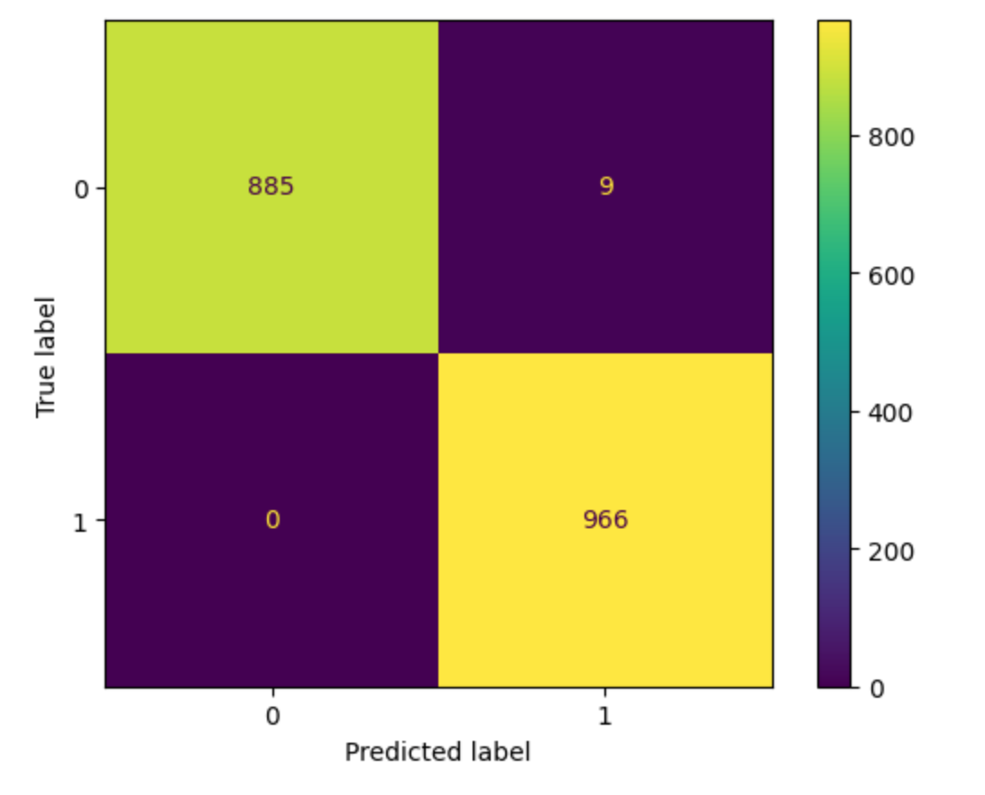
Result Visualization
Confusion Matrix

Slide 6

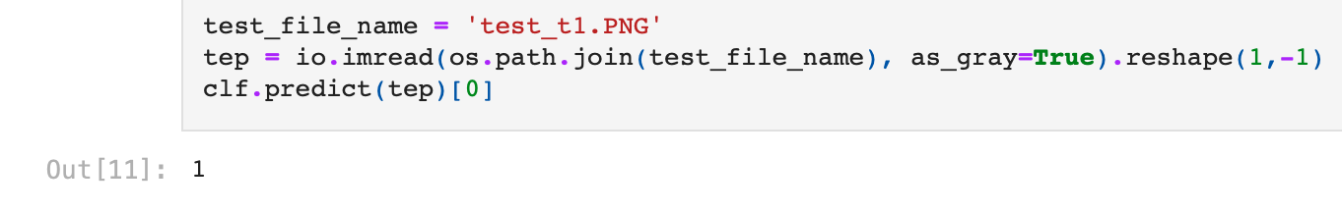
Manual Test with Unseen Data

Slide 7
Thank you!

