Slide 1
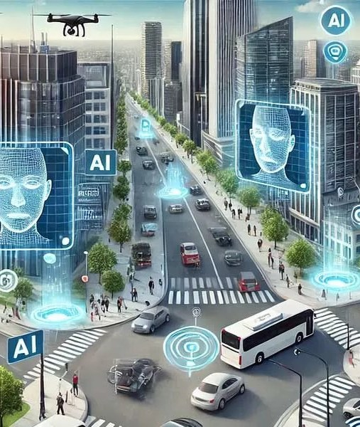
Revolutionizing Road Infrastructure with AI
Transforming Safety, Efficiency, and Sustainability
Image: constructionworld.in

Slide 2
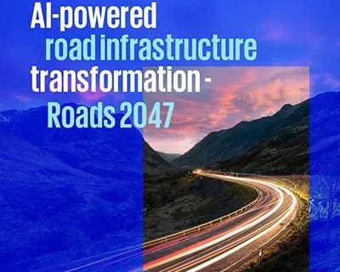
Introduction to AI in Road Infrastructure
Overview of the Current State and Future Potential
Artificial intelligence (AI) is transforming road infrastructure management with innovative tools improving safety, efficiency, and sustainability.
• Solid-state cells: higher energy density with lower fire risk
• Predictive maintenance: reducing downtime and costs
• Smart traffic management: optimizing flow and reducing congestion
Image: kpmg.com
2 / 11
Revolutionizing Road Infrastructure with AI

Slide 3
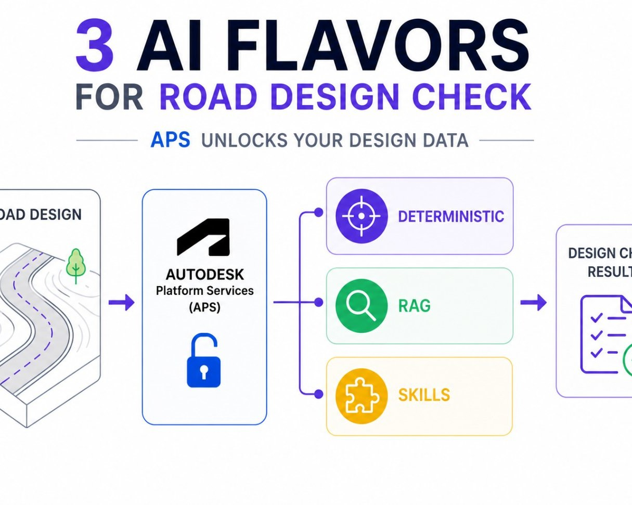
Design and Planning Optimization
How AI is Revolutionizing Road Design
AI-powered tools are driving material efficiency, robotic execution, risk-aware scheduling, and self-sustaining in road infrastructure development.
• Generative design: creating multiple design options quickly
• Building Information Modeling (BIM): improving construction planning
• Computer vision: analyzing data from images and videos
Image: aps.autodesk.com
3 / 11
Revolutionizing Road Infrastructure with AI

Slide 4
Construction Process Improvement
How AI is Enhancing Road Construction Efficiency
AI-powered solutions are enabling more efficient, cost-effective, and sustainable construction processes.
Robotic execution
improving accuracy and reducing labor costs
Risk-aware scheduling
optimizing project timelines and budgets
Material efficiency
minimizing waste and optimizing resource usage
4 / 11
Revolutionizing Road Infrastructure with AI

Slide 5
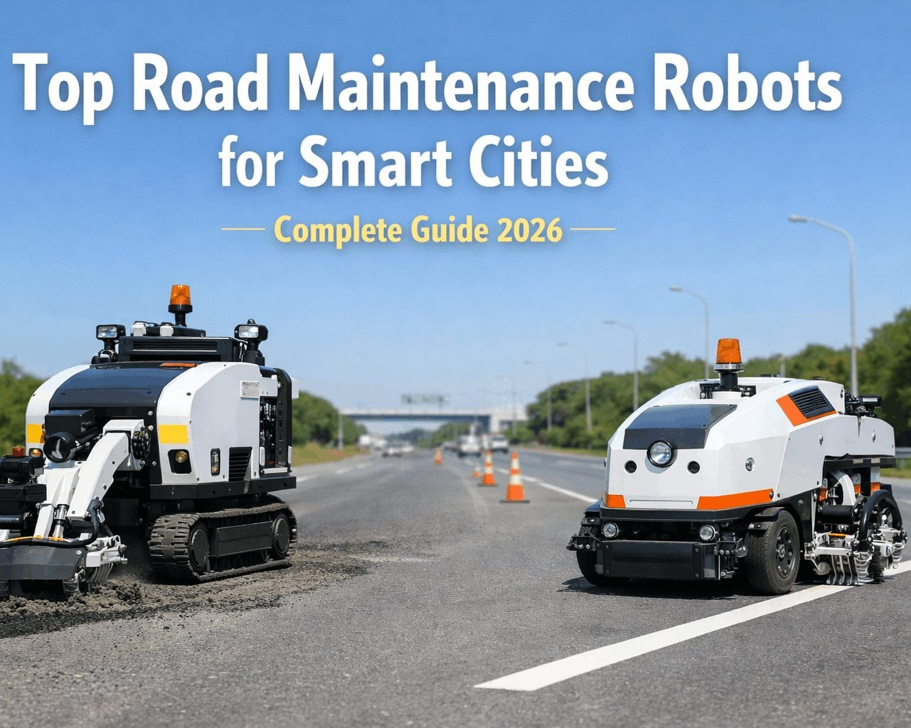
Maintenance and Asset Management
How AI is Improving Road Maintenance Efficiency
AI-powered tools are optimizing maintenance schedules, reducing downtime, and improving overall asset performance.
• Predictive maintenance: identifying potential issues before they occur
• Condition-based maintenance: scheduling maintenance based on actual conditions
• Data-driven decision-making: using analytics to inform maintenance strategies
Image: oxmaint.com
5 / 11
Revolutionizing Road Infrastructure with AI

Slide 6
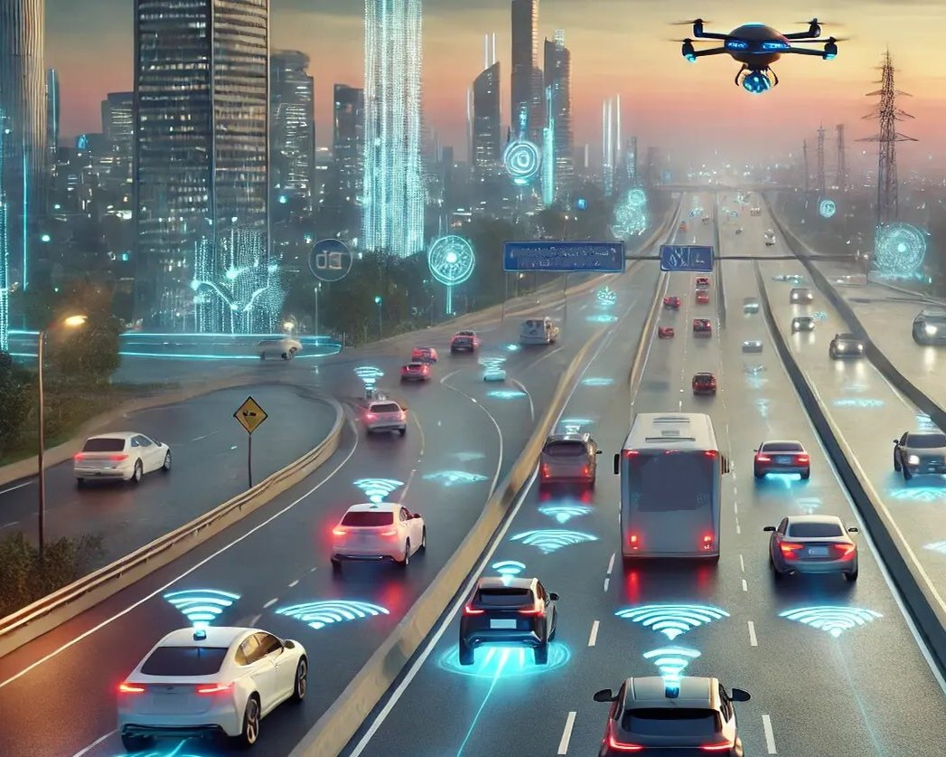
Safety and Security Enhancement
How AI is Improving Road Safety
AI-powered tools are improving safety, reducing accidents, and enhancing overall security.
• Intelligent traffic management: optimizing flow and reducing congestion
• Predictive analytics: identifying potential safety risks before they occur
• Real-time monitoring: providing situational awareness and incident response
Image: carsifu.my
6 / 11
Revolutionizing Road Infrastructure with AI

Slide 7
Economic Benefits of AI in Road Infrastructure
Reducing Costs and Increasing Efficiency
The full realization of an AI-enabled infrastructure vision has the potential to reduce logistics costs from 14% of GDP to below 8% by 2047.
Metric | Current Value | Projected Value
Logistics Costs as % of GDP | .14 | .08
• Reduced maintenance costs: extending asset lifespan and minimizing repairs
• Improved traffic flow: reducing congestion and increasing productivity
• Increased safety: reducing accidents and improving overall security
7 / 11
Revolutionizing Road Infrastructure with AI

Slide 8
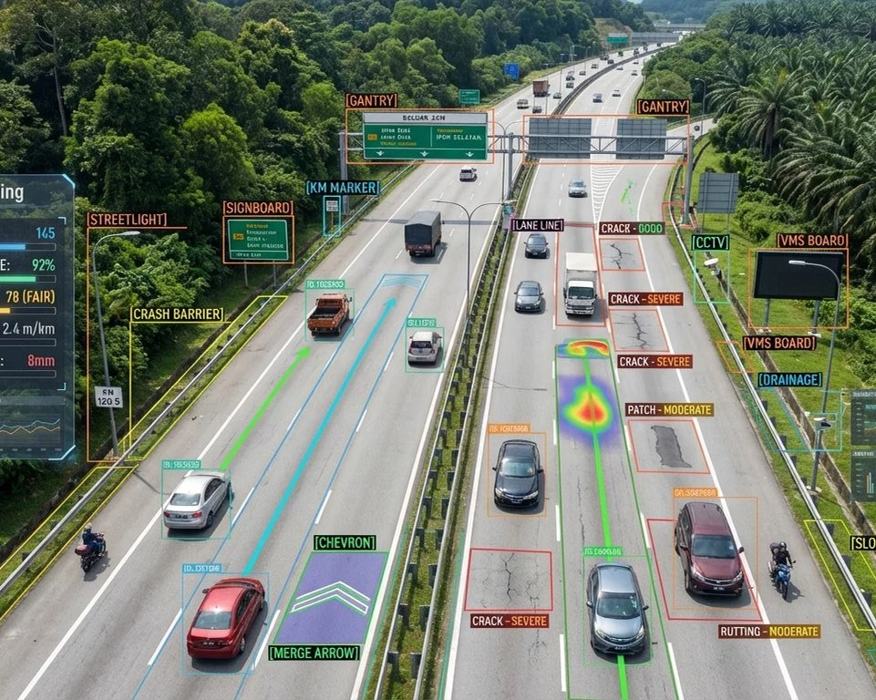
Future Directions and Challenges
Overcoming Barriers and Scaling Up AI Adoption
To fully realize the potential of AI in road infrastructure, challenges such as data quality, interoperability, and cybersecurity must be addressed.
• Data standardization: ensuring consistency and comparability across systems
• Interoperability: enabling seamless integration between different systems and technologies
• Cybersecurity: protecting against threats and ensuring the integrity of AI systems
Image: ahn-vertex.roadasset.co
8 / 11
Revolutionizing Road Infrastructure with AI

Slide 9
Conclusion
Key Takeaways and Future Directions
AI is transforming road infrastructure management with innovative tools improving safety, efficiency, and sustainability.
AI-powered solutions are enabling more efficient, cost-effective, and sustainable construction processes.
The full realization of an AI-enabled infrastructure vision has the potential to reduce logistics costs from 14% of GDP to below 8% by 2047.
9 / 11
Revolutionizing Road Infrastructure with AI

Slide 10
Sources & Image Credits
Research and images used in this presentation
Source | Link
5 Ways AI is Changing the Future of Road Infrastructure Management | roadvision.ai/blog/5-ways-ai-is-changing-the-future-of-road-infrastru…
AI in Road and Bridge Construction: Key Uses - cmicglobal.com | cmicglobal.com/resources/article/How-Construction-Firms-are-Using-AI-…
Top 10 AI Technologies Shaping the Future of Road Engineering | roadvision.ai/blog/top-10-ai-technologies-shaping-the-future-of-road-…
PDF Al-powered road infrastructure transformation - Roads 2047 | assets.kpmg.com/content/dam/kpmgsites/in/pdf/2025/09/ai-powered-road-…
AI in Infrastructure: Transforming Road and Bridge Construction | aiworldjournal.substack.com/p/ai-in-infrastructure-transforming
AI-powered road infrastructure transformation - Roads 2047 | kpmg.com/in/en/insights/2025/09/ai-powered-road-infrastructure-transf…
PDF Artificial Intelligence Applications For Efficient Road Asset ... | irf.global/ebooks/IRF-White-Paper-23_12.pdf
10 / 11
Revolutionizing Road Infrastructure with AI

Slide 11
Sources & Image Credits (continued)
Source | Link
AI Work for Infrastructure | Roads & Bridges | roadsbridges.com/editorialcommentary/article/55411104/ai-work-for-inf…
Image (slide: Revolutionizing Road Infrastructure with AI) — constructionworld.in | constructionworld.in/transport-infrastructure/highways-and-roads-infr…
Image (slide: Introduction to AI in Road Infrastructure) — kpmg.com | kpmg.com/in/en/insights/2025/09/ai-powered-road-infrastructure-transf…
Image (slide: Design and Planning Optimization) — aps.autodesk.com | aps.autodesk.com/blog/experimenting-ai-assisted-road-design-check-opt…
Image (slide: Maintenance and Asset Management) — oxmaint.com | oxmaint.com/industries/government/road-maintenance-robots-smart-citie…
Image (slide: Safety and Security Enhancement) — carsifu.my | carsifu.my/index.php/news/ai-powered-system-aims-to-revolutionise-roa…
Image (slide: Future Directions and Challenges) — ahn-vertex.roadasset.co | ahn-vertex.roadasset.co
11 / 11
Revolutionizing Road Infrastructure with AI

