Slide 1
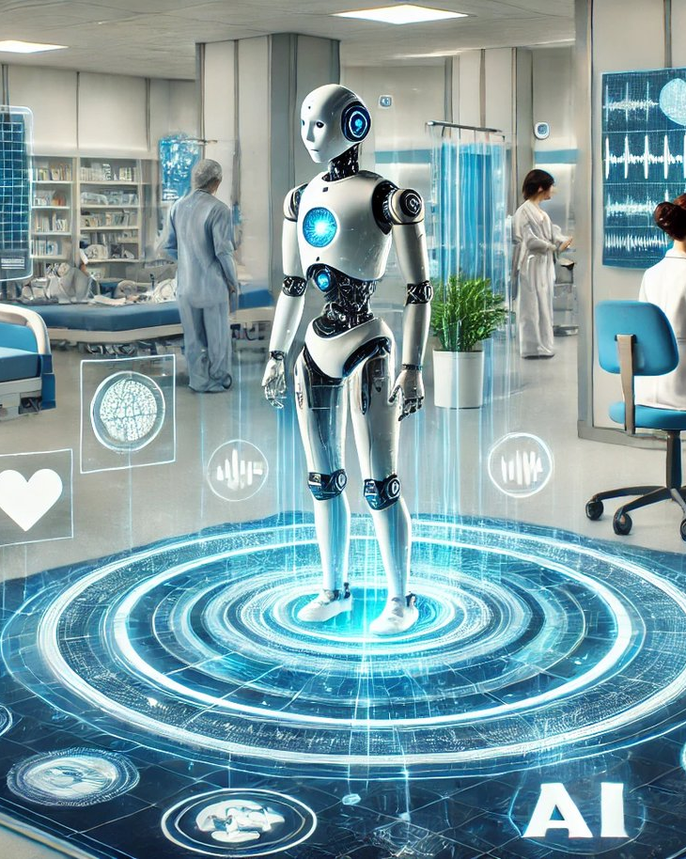
Revolutionizing Healthcare with Artificial Intelligence
Unlocking Efficiency, Accuracy, and Patient Outcomes
Image: ohematerials.org
Notes:
Image source: https://ohematerials.org/wp-content/uploads/2024/06/artificial-intelligence-in-healthcare.webp
Sources:
https://ohematerials.org/artificial-intelligence-in-healthcare-delivery/

Slide 2
Introduction to AI in Healthcare
Overview of Applications and Challenges
Disease diagnosis: AI-powered algorithms analyze medical data for early detection and treatment planning.
Clinical decision support systems: AI-assisted tools provide healthcare professionals with real-time recommendations.
Patient monitoring: AI-driven sensors and wearables track vital signs, detecting potential health issues.
Artificial intelligence (AI) is transforming the healthcare industry by improving diagnosis accuracy, streamlining clinical workflows, and enhancing patient care.
Revolutionizing Healthcare with Artificial Intelligence
2

Slide 3
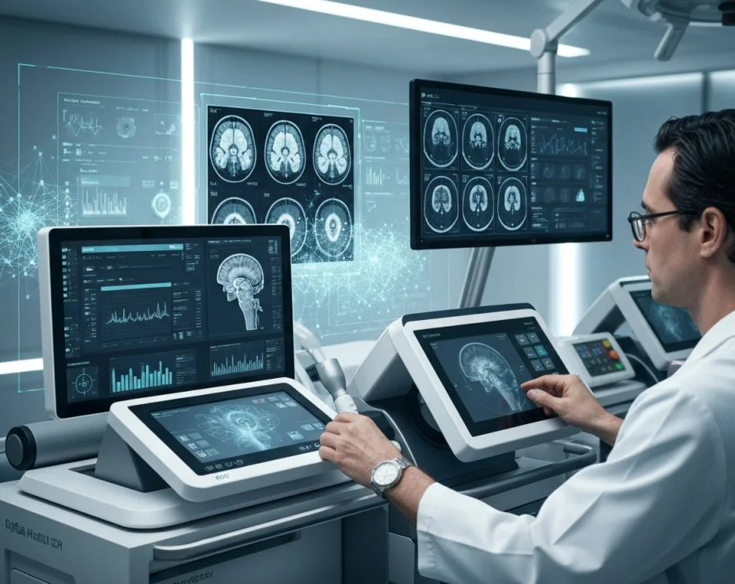
Applications of AI in Healthcare
Diagnostic Support, Predictive Modeling, and Treatment Optimization
AI is being applied in various healthcare areas, including diagnostic support, predictive modeling, treatment optimization, and administrative tasks.
Machine learning models: Analyze medical data for disease diagnosis and treatment planning.
Deep learning algorithms: Identify patterns in large datasets to predict patient outcomes.
Natural language processing: Extract insights from unstructured clinical notes.
Image: spademarketing.ca
Revolutionizing Healthcare with Artificial Intelligence
3
Notes:
Image source: https://spademarketing.ca/wp-content/uploads/2025/11/ai-healthcare-technology-1024x717.png
Sources:
https://spademarketing.ca/the-ai-revolution-in-medicine-how-artificial-intelligence-is-shaping-the-future-of-healthcare/

Slide 4

Challenges and Concerns
Data Privacy, Algorithmic Bias, and Trust in Care
The use of AI in healthcare raises concerns about data privacy, algorithmic bias, and trust in care.
Data privacy: Protecting patient information from unauthorized access.
Algorithmic bias: Ensuring fairness and equity in AI-driven decision-making.
Trust in care: Building confidence among patients and healthcare professionals.
Image: innovaitai.com
Revolutionizing Healthcare with Artificial Intelligence
4
Notes:
Image source: https://innovaitai.com/wp-content/uploads/2026/05/healthcare-professional-using-ai-technology-to-enhance-patient-engagement-1e62f955-0828-4a9a-a096-f86e7defd21f.jpg
Sources:
https://innovaitai.com/ai-lead-systems-for-healthcare-practices/

Slide 5
Market Growth and Projections
Expanding from USD 26.6 billion to USD 187.7 billion by 2030
The healthcare AI market is expected to grow significantly, driven by increasing adoption and advancements in technology.
Year | Market Size (USD billion)
2024 | 26.6
2025 | 43.2
2030 | 187.7
Current market size: USD 26.6 billion (2024)
Projected growth rate: 600% by 2030
Expected market size: USD 187.7 billion
Revolutionizing Healthcare with Artificial Intelligence
5

Slide 6
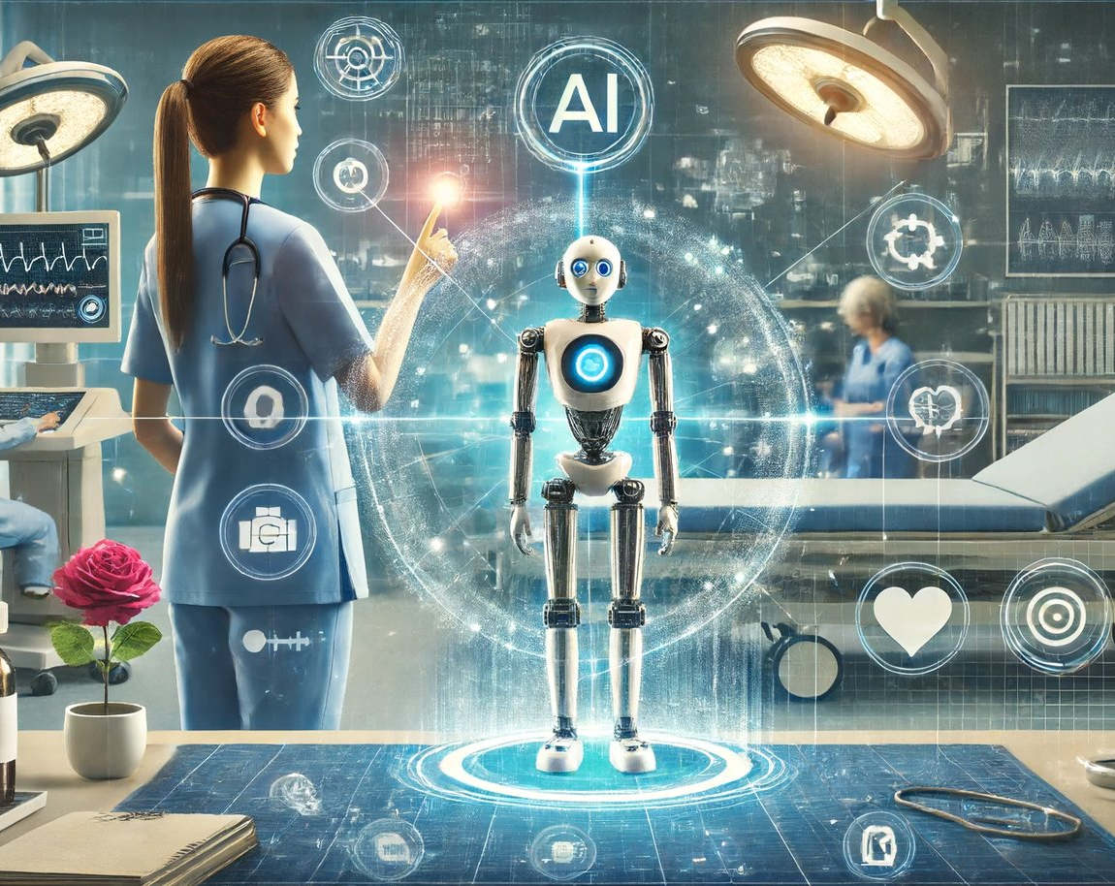
Future of AI in Healthcare
Personalized Medicine, Improved Patient Outcomes, and Enhanced Efficiency
The future of AI in healthcare holds promise for personalized medicine, improved patient outcomes, and enhanced efficiency.
Personalized medicine: Tailored treatment plans based on individual genetic profiles.
Improved patient outcomes: Enhanced diagnosis accuracy and treatment effectiveness.
Enhanced efficiency: Streamlined clinical workflows and reduced administrative burdens.
Image: unite.ai
Revolutionizing Healthcare with Artificial Intelligence
6
Notes:
Image source: https://www.unite.ai/wp-content/uploads/2024/06/AI-Powered-Nursing.webp
Sources:
https://www.unite.ai/ai-powered-nursing-redefining-healthcare-in-the-modern-age/

Slide 7
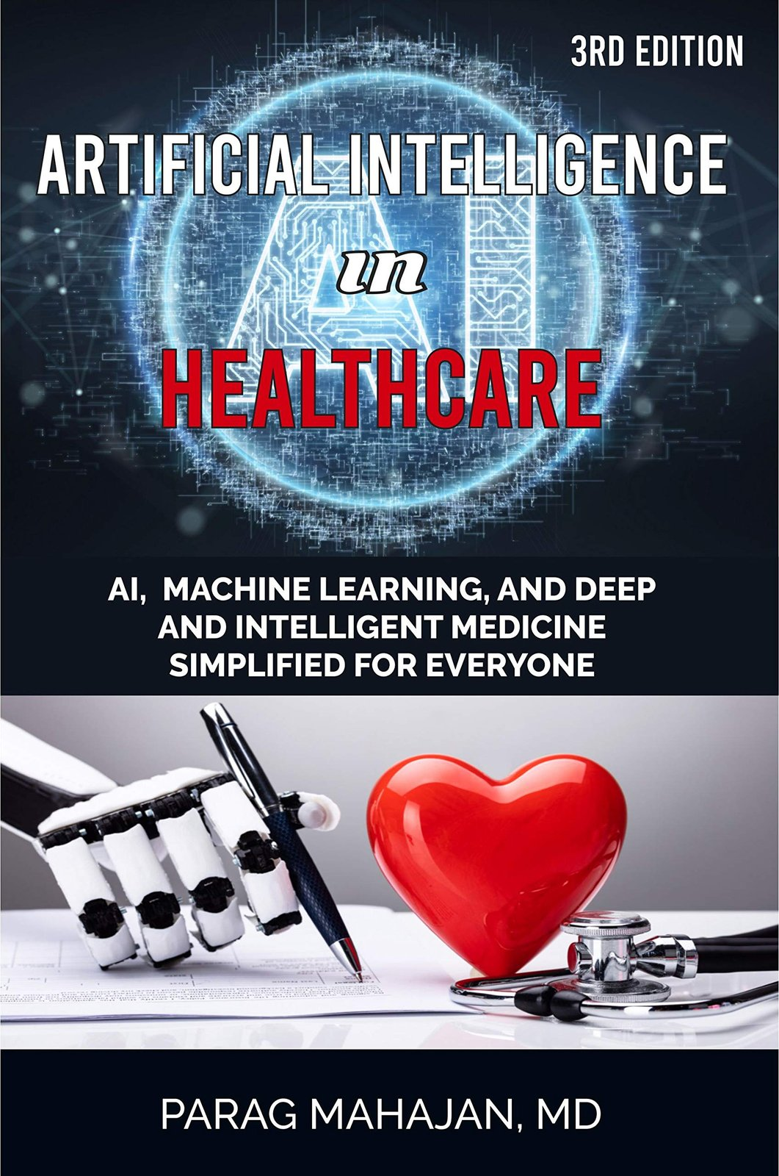
Sources
References for Further Reading
For further reading on AI in healthcare, refer to the sources listed below.
Wikipedia: Artificial Intelligence in Healthcare
Grokipedia: Artificial Intelligence in Healthcare
Mayo Clinic: The Growing Role of Artificial Intelligence in Healthcare
Image: goodreads.com
Revolutionizing Healthcare with Artificial Intelligence
7
Notes:
Image source: https://images-na.ssl-images-amazon.com/images/S/compressed.photo.goodreads.com/books/1615883990i/57430359.jpg
Sources:
https://www.goodreads.com/book/show/57430359-artificial-intelligence-in-healthcare

Slide 8
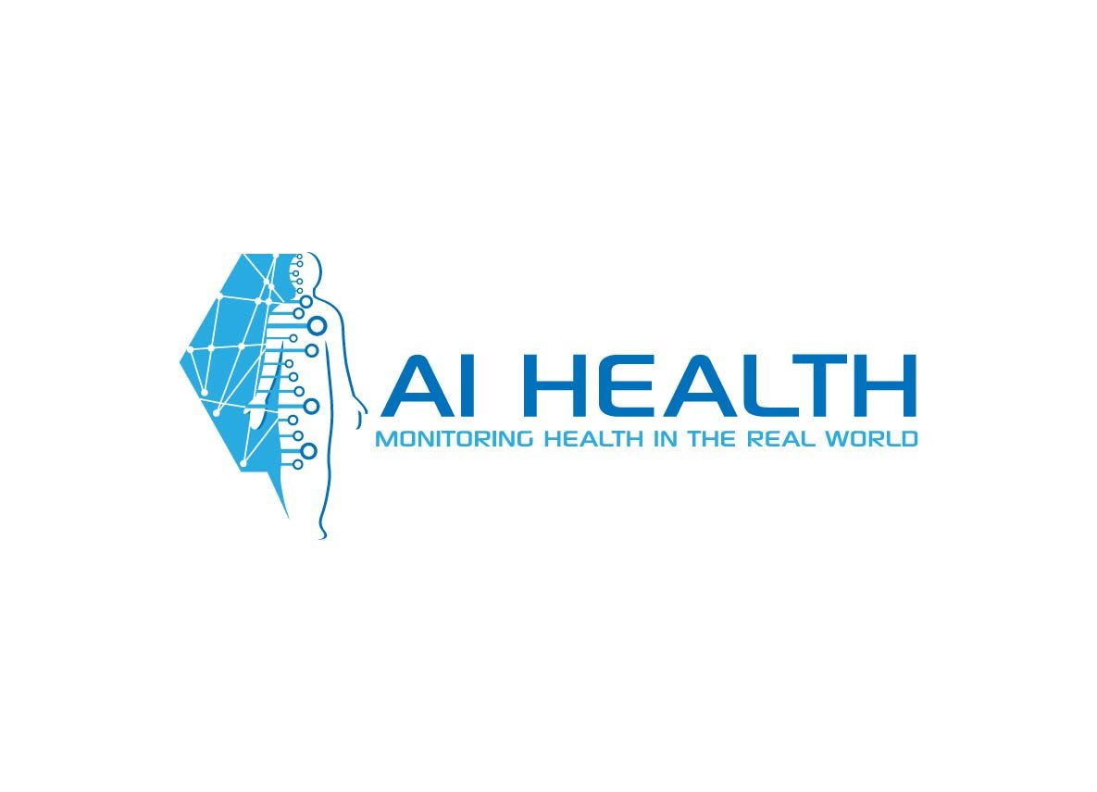
References
Sources for Further Reading
For further reading on AI in healthcare, refer to the sources listed below.
PMc: Artificial Intelligence in Healthcare: A Narrative Review of Recent Developments
Databricks: AI in Healthcare: Applications and Best Practices
table
image_query
Image: designcrowd.com
Revolutionizing Healthcare with Artificial Intelligence
8
Notes:
Image source: https://dcassetcdn.com/design_img/2446232/517402/517402_12835581_2446232_138426d8_image.jpg
Sources:
https://www.designcrowd.com/design/12835581

Slide 9
Conclusion
Key Takeaways and Future Directions
In conclusion, AI is transforming the healthcare industry by improving diagnosis accuracy, streamlining clinical workflows, and enhancing patient care.
1
2
3
AI-powered diagnostic tools improve disease detection and treatment planning.
The healthcare AI market is expected to grow significantly by 2030.
Future directions include personalized medicine, improved patient outcomes, and enhanced efficiency.
Revolutionizing Healthcare with Artificial Intelligence
9

Slide 10
Sources & Image Credits
Research and images used in this presentation
Artificial intelligence in healthcare — en.wikipedia.org/wiki/Artificial_intelligence_in_healthcare
Artificial intelligence in healthcare — grokipedia.com/page/Artificial_intelligence_in_healthcare
The Growing Role of Artificial Intelligence in Healthcare — mayomagazine.mayoclinic.org/2026/04/ai-in-healthcare
Artificial Intelligence in Healthcare: A Narrative Review of Recent ... — pmc.ncbi.nlm.nih.gov/articles/PMC12764347
Artificial intelligence in healthcare: applications, challenges, and ... — pmc.ncbi.nlm.nih.gov/articles/PMC12645148
AI in healthcare: applications and best practices - Databricks — databricks.com/blog/ai-in-healthcare
AI in Healthcare: Uses, Examples & Benefits | Built In — builtin.com/artificial-intelligence/artificial-intelligence-healthcare
PDF Artificial Intelligence (AI) in Health Care - Congress.gov — congress.gov/crs_external_products/R/PDF/R48319/R48319.4.pdf
Image (slide: Revolutionizing Healthcare with Artificial Intelligence) — ohematerials.org — ohematerials.org/artificial-intelligence-in-healthcare-delivery
Image (slide: Applications of AI in Healthcare) — spademarketing.ca — spademarketing.ca/the-ai-revolution-in-medicine-how-artificial-intell…
Image (slide: Challenges and Concerns) — innovaitai.com — innovaitai.com/ai-lead-systems-for-healthcare-practices
Image (slide: Future of AI in Healthcare) — unite.ai — unite.ai/ai-powered-nursing-redefining-healthcare-in-the-modern-age
Image (slide: Sources) — goodreads.com — goodreads.com/book/show/57430359-artificial-intelligence-in-healthcare
Image (slide: References) — designcrowd.com — designcrowd.com/design/12835581
Revolutionizing Healthcare with Artificial Intelligence
10

