Slide 1
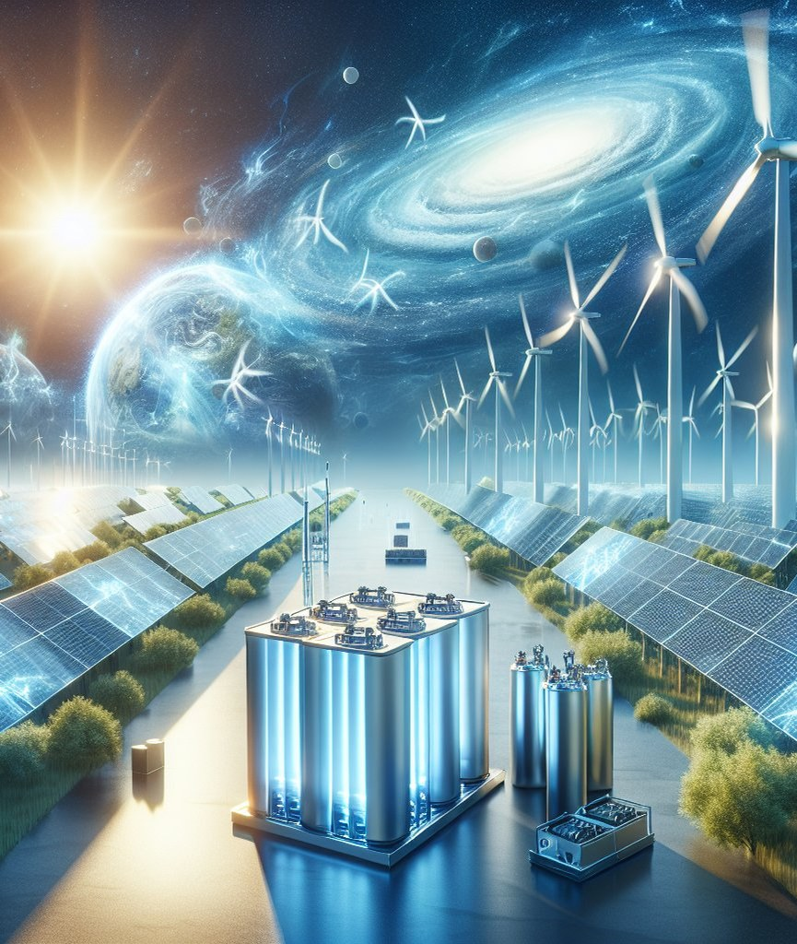
Unlocking Renewable Energy Storage
Harnessing the Power of Clean Energy
Image: discoverengineering.org

Slide 2
Introduction to Renewable Energy Storage
Capturing Excess Energy for a Sustainable Future
Energy storage is crucial for making renewable power reliable and scalable. It helps stabilize grids and reduce dependence on fossil fuels.
• Solid-state cells: higher energy density with lower fire risk
• Lithium-ion batteries: efficient and widely used in renewable systems
• Hybrid systems: combining multiple storage technologies for optimal performance
2 / 11
Unlocking Renewable Energy Storage

Slide 3
Why Renewable Energy Storage Matters
Ensuring Grid Stability and Reliability
The global shift towards clean energy requires efficient storage solutions. Energy storage helps manage power variations from renewable sources.
• Reducing fossil fuel dependence: a cleaner, more sustainable future
• Enhancing grid stability: preventing blackouts and brownouts
• Improving energy efficiency: minimizing waste and maximizing output
3 / 11
Unlocking Renewable Energy Storage

Slide 4
Types of Renewable Energy Storage Systems
From Batteries to Hybrid Solutions
Batteries, supercapacitors, and hybrid systems are the main types of renewable energy storage. Each has its strengths and weaknesses.
Lithium-ion batteries
high energy density, low self-discharge
Supercapacitors
rapid charging, long lifespan
Hybrid systems
combining multiple technologies for optimal performance
4 / 11
Unlocking Renewable Energy Storage

Slide 5
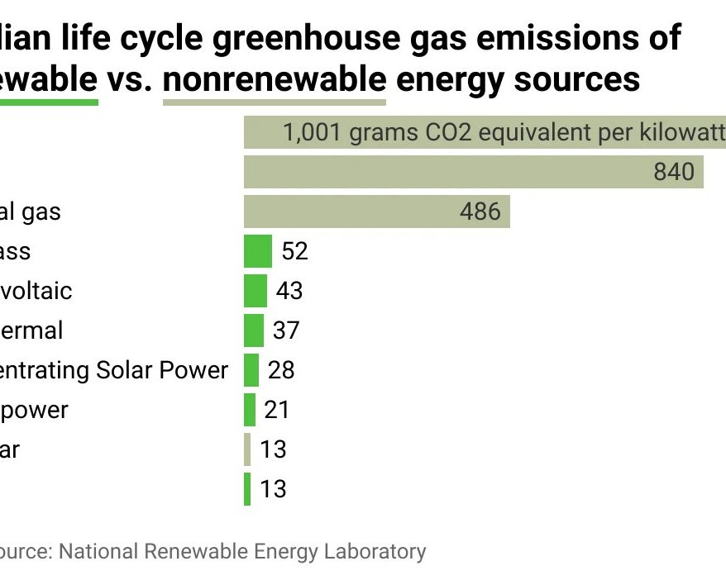
Benefits of Renewable Energy Storage
A Cleaner, More Reliable Future
Renewable energy storage offers numerous benefits, including reduced greenhouse gas emissions and improved grid stability.
• Reducing carbon footprint: cleaner energy for a sustainable future
• Enhancing grid resilience: preventing blackouts and brownouts
• Improving energy efficiency: minimizing waste and maximizing output
Image: digitaljournal.com
5 / 11
Unlocking Renewable Energy Storage

Slide 6
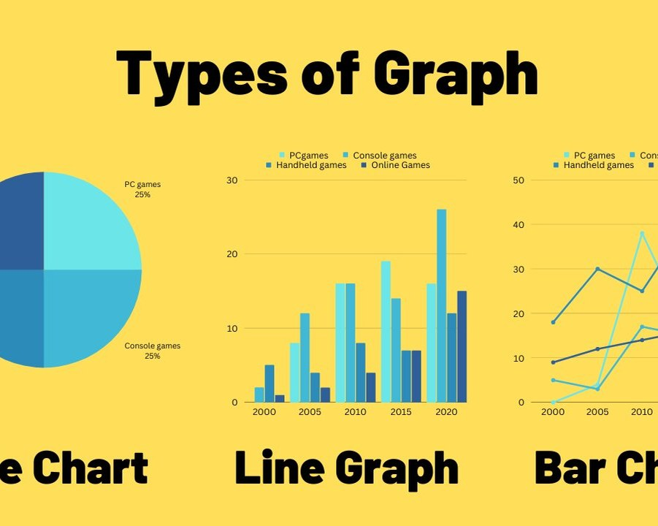
Challenges and Limitations of Renewable Energy Storage
Addressing the Hurdles to a Sustainable Future
Despite its benefits, renewable energy storage faces challenges such as high upfront costs and limited scalability.
• High upfront costs: inhibiting widespread adoption
• Limited scalability: current technologies not yet suitable for large-scale applications
Image: ar.inspiredpencil.com
6 / 11
Unlocking Renewable Energy Storage

Slide 7
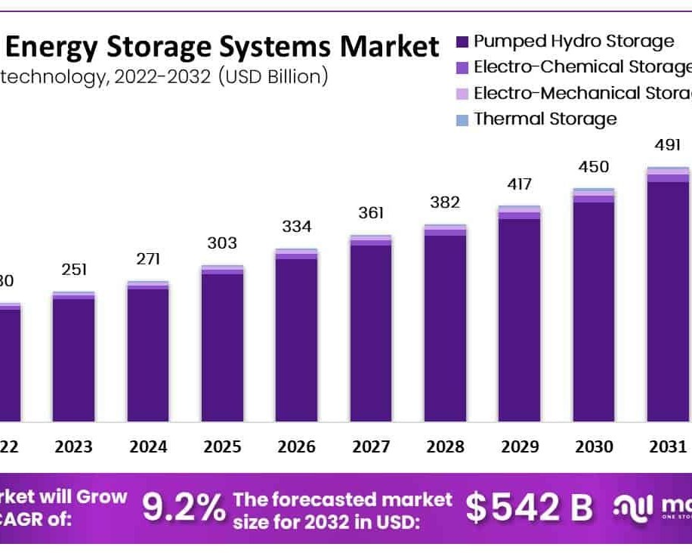
Data: Energy Storage Capacity by Technology (2022)
A Global Perspective on Renewable Energy Storage
The global energy storage market is expected to grow significantly in the coming years.
• Lithium-ion batteries: 54.6 GW/Wh capacity (2022)
• Flow batteries: 3.4 GW/Wh capacity (2022)
• Pumped hydro storage: 1,467 GW/Wh capacity (2022)
Image: globenewswire.com
7 / 11
Unlocking Renewable Energy Storage

Slide 8
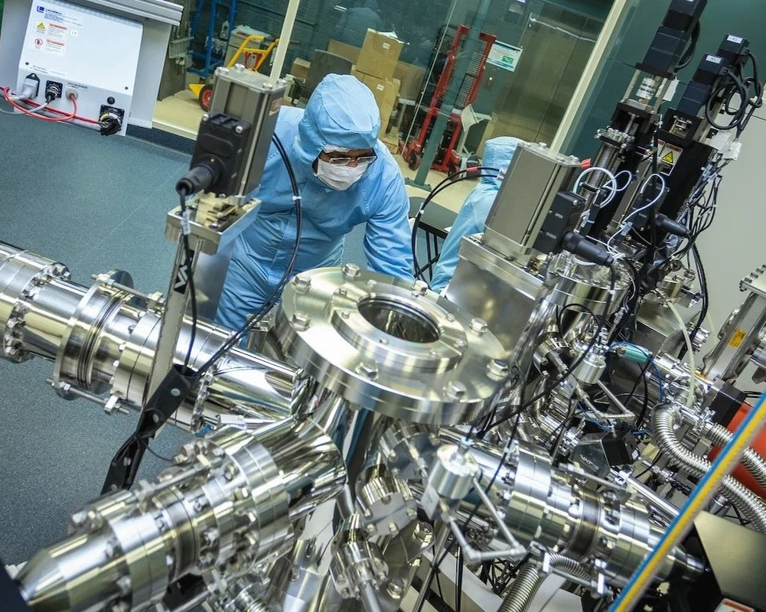
Future Directions for Renewable Energy Storage
Advancing Technologies and Innovations
Research and development are ongoing to improve the efficiency, scalability, and affordability of renewable energy storage.
• Solid-state batteries: higher energy density with lower fire risk
• Advanced materials: improving battery performance and lifespan
Image: azoquantum.com
8 / 11
Unlocking Renewable Energy Storage

Slide 9
Conclusion and Key Takeaways
Unlocking a Sustainable Future with Renewable Energy Storage
Renewable energy storage is crucial for making clean energy reliable and scalable. It offers numerous benefits, including reduced greenhouse gas emissions and improved grid stability.
Solid-state cells
higher energy density with lower fire risk
Lithium-ion batteries
efficient and widely used in renewable systems
Hybrid systems
combining multiple storage technologies for optimal performance
9 / 11
Unlocking Renewable Energy Storage

Slide 10
Sources & Image Credits
Research and images used in this presentation
Source | Link
Renewable energy storage | en.wikipedia.org/wiki/Renewable_energy_storage
Energy Storage: Everything You Should Know - The Renewable Energy Institute | renewableinstitute.org/energy-storage-everything-you-should-know
Renewable Energy Storage Systems - discoverengineering.org | discoverengineering.org/renewable-energy-storage-systems
Energy storage: Powering the future of renewable energy - ISO | iso.org/renewable-energy/storage
Storage solutions for renewable energy: A review - ScienceDirect | sciencedirect.com/science/article/pii/S2772427125000324
Renewable Energy System Storage - an overview | ScienceDirect Topics | sciencedirect.com/topics/engineering/renewable-energy-system-storage
Renewable Energy Storage: Types & How It Works | jackcooper.com/renewable-energy-storage-types-how-it-works
10 / 11
Unlocking Renewable Energy Storage

Slide 11
Sources & Image Credits (continued)
Source | Link
What Are the Types of Energy Storage? (and How They Work) | renewablesb2b.com/2026/08/13/what-are-the-types-of-energy-storage-and…
Image (slide: Unlocking Renewable Energy Storage) — discoverengineering.org | discoverengineering.org/renewable-energy-storage-systems
Image (slide: Benefits of Renewable Energy Storage) — digitaljournal.com | digitaljournal.com/tech-science/how-lifetime-emissions-of-different-e…
Image (slide: Challenges and Limitations of Renewable Energy Storage) — ar.inspiredpencil.com | ar.inspiredpencil.com/pictures-2023/graph-from-2000-to-2010
Image (slide: Data: Energy Storage Capacity by Technology (2022)) — globenewswire.com | globenewswire.com/news-release/2024/01/09/2805992/0/en/Energy-Storage…
Image (slide: Future Directions for Renewable Energy Storage) — azoquantum.com | azoquantum.com/News.aspx
11 / 11
Unlocking Renewable Energy Storage

