Slide 1
What is Industrial AI?
Applying AI to Address Industrial Pain-Points

Slide 2
Key Enablers of Industrial AI
Advancements in Sensors, Computation, and Connectivity
Sensor advancements: enabling real-time monitoring and feedback
Cloud services: outsourcing data management and computing power
More affordable sensors and automated data acquisition More powerful computation capability for complex tasks at faster speeds with lower costs
Unlocking Industry Potential with AI
2

Slide 3
AI Adoption by Industry
Trends and Insights Across Sectors
Healthcare: AI-powered diagnosis and treatment Finance: AI-driven risk management and customer service
Industry | AI Adoption Rate
Healthcare | >75%
Finance | >60%
Retail | >55%
Manufacturing | >50%
Retail: AI-enhanced supply chain management and inventory control
Manufacturing: AI-optimized production planning and quality control
Unlocking Industry Potential with AI
3

Slide 4
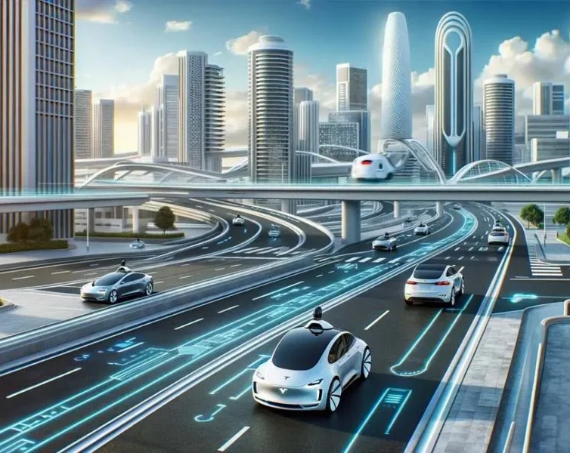
Examples of AI in Industry
Innovative Applications Across Sectors
Smart virtual assistants and self-driving cars Checkout-free grocery shopping and personalized customer service
AI-powered chatbots: improving customer engagement and support
Predictive analytics: optimizing supply chain management and inventory control
Image: newscooper.co.uk
Unlocking Industry Potential with AI
4
Notes:
Image source: https://newscooper.co.uk/wp-content/uploads/2024/05/How-AI-in-Self-Driving-Cars-is-Changing-the-Automobile-Industry-1000x600.webp
Sources:
https://newscooper.co.uk/how-ai-in-self-driving-cars-is-changing-the-automobile-industry-everything-to-know/

Slide 5
The Future of AI in Industry
Trends and Insights from the McKinsey State of AI Survey
Increased adoption across industries Growing demand for AI talent and skills
Industry | AI Adoption Rate
Healthcare | >80%
Finance | >70%
Retail | >65%
Manufacturing | >60%
AI-driven innovation: transforming business models and operations
Ethics and governance: ensuring responsible AI development and deployment
Unlocking Industry Potential with AI
5

Slide 6
Conclusion
Unlocking Industry Potential with AI
1
2
3
Industrial AI is transforming business processes and operations across industries.
Key enablers include advancements in sensors, computation, and connectivity.
AI adoption rates are increasing across sectors, driven by innovation and demand.
Unlocking Industry Potential with AI
6

Slide 7
Slide 7
1
2
AI is revolutionizing industries worldwide, transforming business models and operations.
Key takeaways include the growing demand for AI talent and skills, as well as the need for responsible AI development and deployment.
Unlocking Industry Potential with AI
7

Slide 8
Slide 8
1
2
Industrial AI is a key driver of innovation and growth across industries.
Its adoption rates are increasing, driven by the need for productivity improvement, cost reduction, and site optimization.
Unlocking Industry Potential with AI
8

Slide 9
Slide 9
1
2
The future of AI in industry is bright, with increasing adoption rates and innovative applications across sectors.
However, it also raises important questions about ethics and governance, ensuring responsible AI development and deployment.
Unlocking Industry Potential with AI
9

Slide 10
Sources & Image Credits
Research and images used in this presentation
AI in industry — en.wikipedia.org/wiki/AI_in_industry
Artificial intelligence in industry - Wikipedia — en.wikipedia.org/wiki/Artificial_intelligence_in_industry
AI Sales Agents in the Fitness Industry — grokipedia.com/page/AI_Sales_Agents_in_the_Fitness_Industry
AI Adoption by Industry: How Different Sectors Are Using AI at Scale in ... — codewave.com/insights/ai-adoption-industry-trends-insights
97 Artificial Intelligence Examples Across Industries - Built In — builtin.com/artificial-intelligence/examples-ai-in-industry
The State of AI: Global Survey 2026 | McKinsey — mckinsey.com/capabilities/quantumblack/our-insights/the-state-of-ai
How Businesses Are Using Artificial Intelligence - Forbes — forbes.com/advisor/business/software/ai-in-business
AI revolutionizing industries worldwide: A comprehensive overview of ... — sciencedirect.com/science/article/pii/S2773207X24001386
Image (slide: Examples of AI in Industry) — newscooper.co.uk — newscooper.co.uk/how-ai-in-self-driving-cars-is-changing-the-automobi…
Unlocking Industry Potential with AI
10

