Slide 1
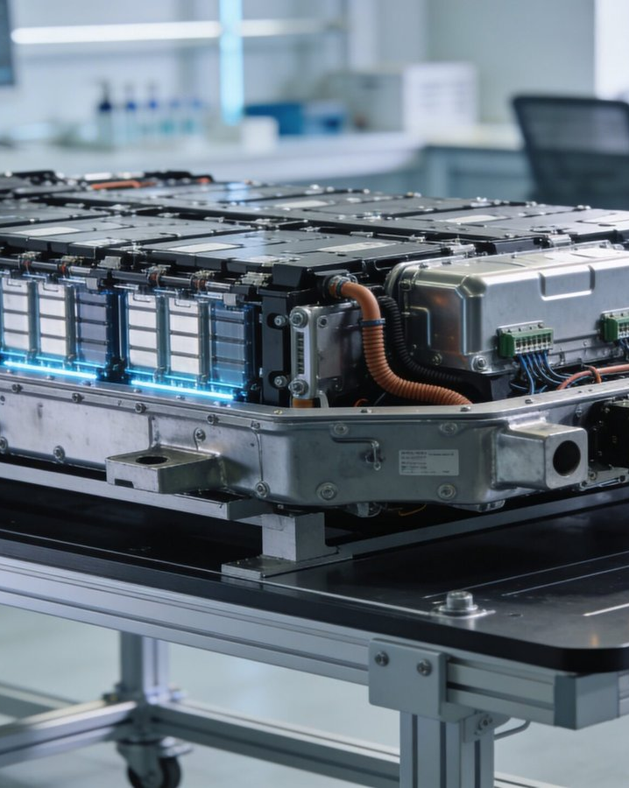
Introduction to EV Batteries
Understanding the Basics
Image: evautostreet.com
Notes:
Image source: https://evautostreet.com/wp-content/uploads/2026/03/What-Are-EV-Batteries_-A-Complete-Beginners-Guide-scaled.jpg
Sources:
https://evautostreet.com/what-are-ev-batteries-a-complete-beginners-guide/

Slide 2
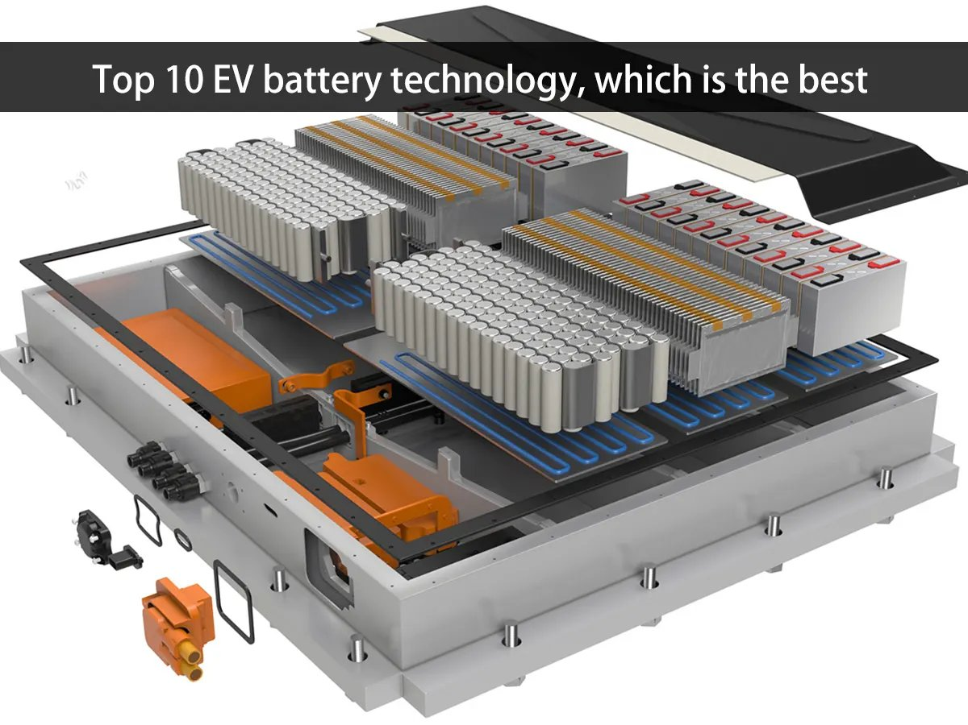
Current EV Battery Technologies
Lithium-Ion Dominance
Lithium-ion batteries are the most widely used type of battery in electric vehicles due to their high energy density and power-to-weight ratio.
Solid-state cells: higher energy density with lower fire risk
Sodium-ion batteries: emerging alternative with similar performance
Image: batteryswapcabinet.com
Advancements in Electric Vehicle Battery Technology
2
Notes:
Image source: https://batteryswapcabinet.com/wp-content/uploads/2024/11/Top-10-EV-battery-technologies-which-is-the-best.webp
Sources:
https://batteryswapcabinet.com/top-10-ev-battery-technologies-which-is-the-best/

Slide 3
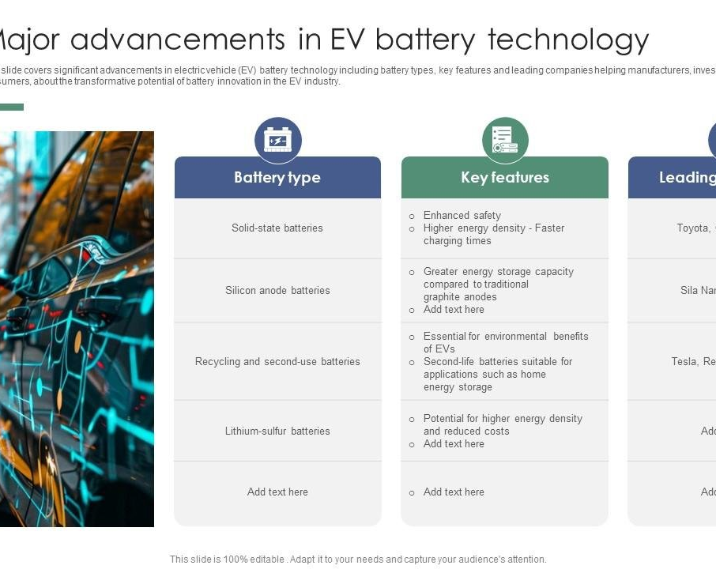
Advancements in EV Battery Technology
Next-Generation Chemistries
Researchers are exploring new battery chemistries, such as solid-state and sodium-ion batteries, to improve energy density and reduce costs.
Lithium-air batteries: potentially 5x more efficient than lithium-ion
Zinc-air batteries: low-cost alternative with high energy density
Image: slideteam.net
Advancements in Electric Vehicle Battery Technology
3
Notes:
Image source: https://www.slideteam.net/media/catalog/product/cache/1280x720/m/a/major_advancements_in_ev_battery_technology_exploring_opportunities_ppt_example_slide01.jpg
Sources:
https://www.slideteam.net/major-advancements-in-ev-battery-technology-exploring-opportunities-ppt-example.html

Slide 4
Comparison of EV Battery Types
Pros and Cons
Each battery type has its advantages and disadvantages, making it crucial to choose the right technology for specific applications.
Lithium-ion: high energy density, but expensive and prone to fires
Sodium-ion: lower cost, but similar performance to lithium-ion
Advancements in Electric Vehicle Battery Technology
4

Slide 5
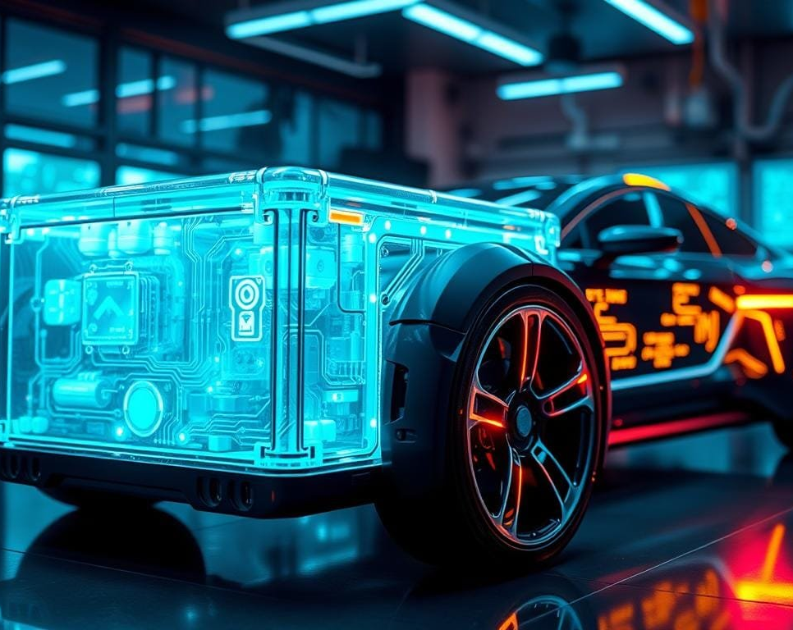
Future of EV Battery Technology
Emerging Trends and Innovations
The future of electric vehicle battery technology holds promise for further improvements in energy density, cost, and sustainability.
Solid-state batteries: potentially 10x more efficient than lithium-ion
Advanced materials: enabling higher energy density and faster charging
Image: drivegreenjourney.com
Advancements in Electric Vehicle Battery Technology
5
Notes:
Image source: https://drivegreenjourney.com/wp-content/uploads/2025/01/EV-battery-technology.jpg
Sources:
https://drivegreenjourney.com/ev-battery-technology-is-shaping-the-future/

Slide 6
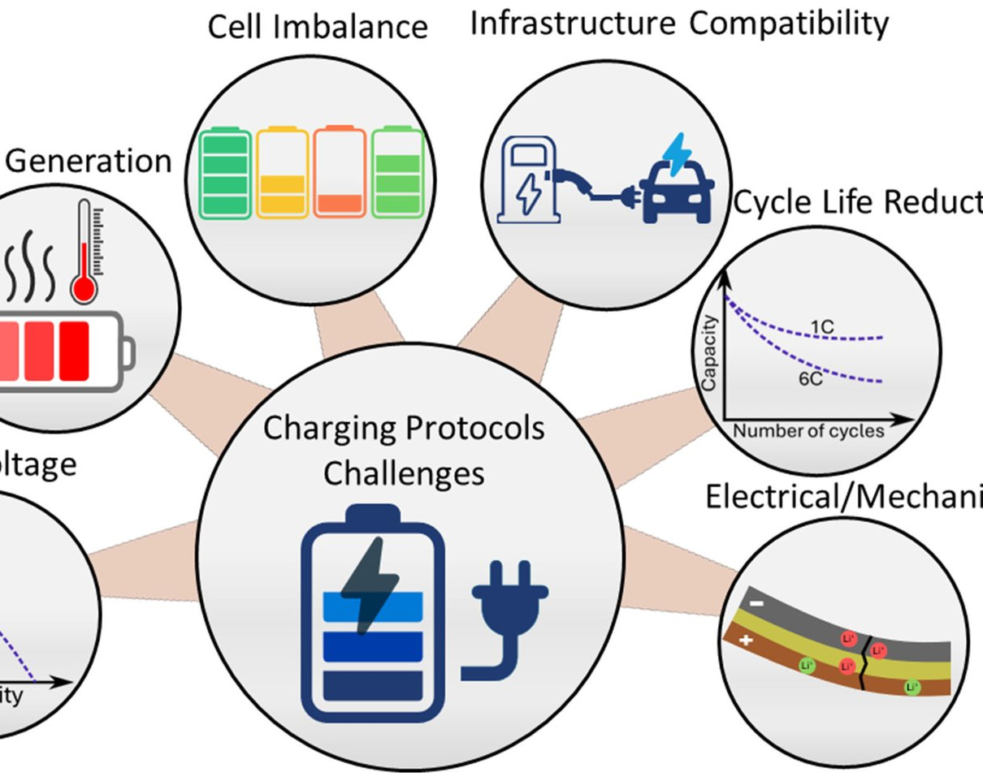
Challenges and Limitations
Addressing the Gaps
Despite advancements, electric vehicle battery technology still faces challenges related to energy density, cost, and sustainability.
Limited recycling infrastructure: hindering waste management
High material costs: affecting overall affordability
Image: mdpi.com
Advancements in Electric Vehicle Battery Technology
6
Notes:
Image source: https://pub.mdpi-res.com/batteries/batteries-11-00209/article_deploy/html/images/batteries-11-00209-g008.png?1748423561
Sources:
https://www.mdpi.com/2313-0105/11/6/209

Slide 7
Conclusion
In conclusion, electric vehicle battery technology has made significant progress in recent years, with emerging trends and innovations promising further improvements.
1
2
Advancements in solid-state and sodium-ion batteries
Emerging chemistries: lithium-air and zinc-air batteries
Advancements in Electric Vehicle Battery Technology
7

Slide 8
Slide 8
| Battery Type | Energy Density (Wh/kg) | Cost ($/kWh) |
| --- | --- | --- |
| Lithium-ion | 150-200 | 100-150 |
| Sodium-ion | 120-180 | 80-120 |
| Solid-state | 250-300 | 50-80 |
| Lithium-air | 500-600 | 20-30 |
| Zinc-air | 400-500 | 15-25 |
Battery Type | Energy Density (Wh/kg) | Cost ($/kWh)
Lithium-ion | 150-200 | 100-150
Sodium-ion | 120-180 | 80-120
Solid-state | 250-300 | 50-80
Lithium-air | 500-600 | 20-30
Zinc-air | 400-500 | 15-25
Advancements in Electric Vehicle Battery Technology
8

Slide 9
Sources & Image Credits
Research and images used in this presentation
Electric vehicle battery - Wikipedia — en.wikipedia.org/wiki/Electric_vehicle_battery
Guide to Electric Vehicle Battery Technology | Updated 2026 - ACTE — acte.in/ev-battery-guide
What's next for EV batteries in 2026 | MIT Technology Review — technologyreview.com/2026/02/02/1132042/whats-next-for-ev-batteries-i…
Electric vehicles: Battery technologies, charging standards, AI ... — sciencedirect.com/science/article/pii/S2590174524002290
The Evolution of Electric Vehicle Battery Technology — mobilityglobal.com/en-us/automotive-insights/blog/the-evolution-of-el…
Battery types and recent developments for energy storage in electric ... — academic.oup.com/ce/article/9/6/293/8256348
How Do Electric Vehicles Work? A Simple Guide to EV Technology, Motors ... — sciencetimes.com/articles/60797/20251115/how-do-electric-vehicles-wor…
EV Battery Technology: What's Coming Now, Tomorrow, and the Far Future — motortrend.com/news/ev-battery-technology-future-emerging
Image (slide: Introduction to EV Batteries) — evautostreet.com — evautostreet.com/what-are-ev-batteries-a-complete-beginners-guide
Image (slide: Current EV Battery Technologies) — batteryswapcabinet.com — batteryswapcabinet.com/top-10-ev-battery-technologies-which-is-the-be…
Image (slide: Advancements in EV Battery Technology) — slideteam.net — slideteam.net/major-advancements-in-ev-battery-technology-exploring-o…
Image (slide: Future of EV Battery Technology) — drivegreenjourney.com — drivegreenjourney.com/ev-battery-technology-is-shaping-the-future
Image (slide: Challenges and Limitations) — mdpi.com — mdpi.com/2313-0105/11/6/209
Advancements in Electric Vehicle Battery Technology
9

