Slide 1
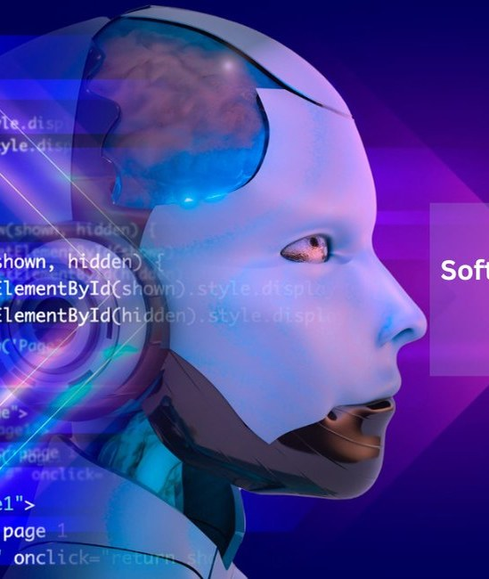
Generative AI and the Future of Software Development
Transforming the Industry with Artificial Intelligence
Image: medium.com

Slide 2
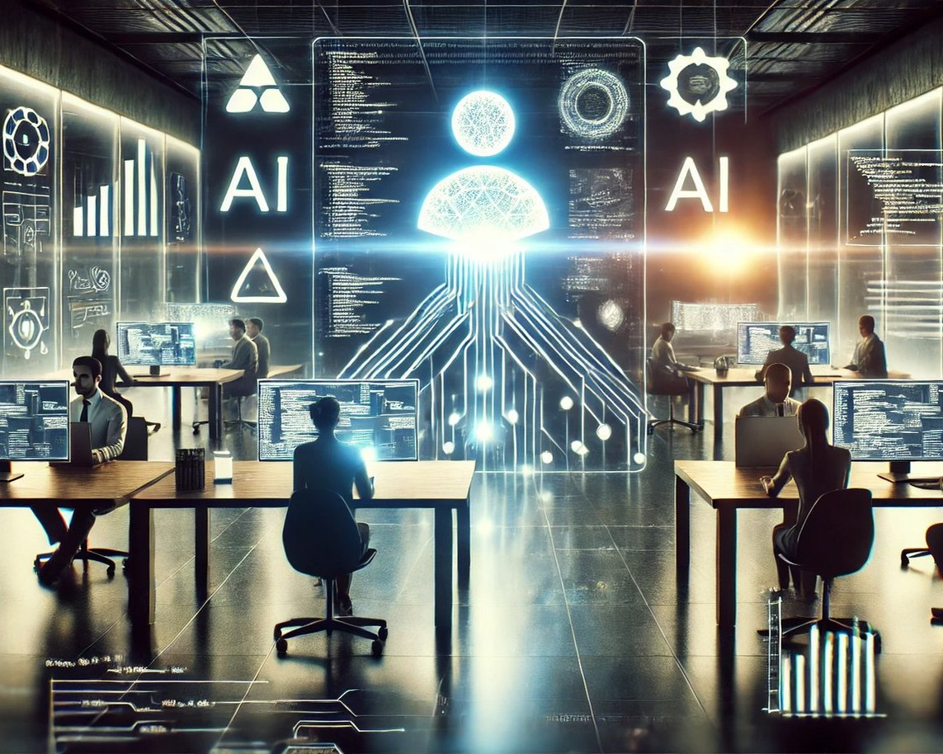
Introduction
The Rise of Generative AI in Software Development
Generative AI is revolutionizing the software development industry by automating key steps and transforming ideas into reality.
• Increased efficiency and productivity
• sources: [1]
• Improved code quality and accuracy
• sources: [5]
• Enhanced collaboration between human developers and AI
Image: unite.ai
2 / 12
Generative AI and the Future of Software Development

Slide 3
Key Concepts
Understanding Generative AI and its Applications
Large Language Models (LLMs)
sources
[1]
Generative Adversarial Networks (GANs)
sources
[]
Agentic Systems
3 / 12
Generative AI and the Future of Software Development

Slide 4
Current Situation
The State of Generative AI in Software Development
According to a recent study, 70% of software development teams are already using generative AI for various tasks.
Benefits | Challenges
Increased efficiency and productivity | Dependence on AI for critical tasks
Improved code quality and accuracy | Potential bias in AI-generated code
Enhanced collaboration between human developers and AI | Job displacement concerns
• Increased adoption of generative AI
• sources: [2]
• Improved code quality and accuracy
• sources: [5]
• Enhanced collaboration between human developers and AI
4 / 12
Generative AI and the Future of Software Development

Slide 5
Applications
Practical Uses of Generative AI in Software Development
Code Generation and Review
sources
[6]
Agentic Coding
sources
[]
AI-Assisted Engineering
5 / 12
Generative AI and the Future of Software Development

Slide 6
Benefits and Challenges
The Pros and Cons of Generative AI in Software Development
Generative AI offers numerous benefits, including increased efficiency and productivity, improved code quality and accuracy, and enhanced collaboration between human developers and AI.
Benefits | Challenges
Increased efficiency and productivity | Dependence on AI for critical tasks
Improved code quality and accuracy | Potential bias in AI-generated code
Enhanced collaboration between human developers and AI | Job displacement concerns
• Increased efficiency and productivity
• sources: [1]
• Improved code quality and accuracy
• sources: [5]
• Enhanced collaboration between human developers and AI
6 / 12
Generative AI and the Future of Software Development

Slide 7
Future Scope
Emerging Trends and Likely Developments
The future of software development with generative AI is expected to be shaped by emerging trends such as increased adoption, improved code quality, and enhanced collaboration.
Expected
Increased adoption of generative AI
sources
[2]
Projected
Improved code quality and accuracy
sources
[5]
Forecasted
Enhanced collaboration between human developers and AI
7 / 12
Generative AI and the Future of Software Development

Slide 8
Applications
Practical Uses of Generative AI in Software Development
Code Generation and Review
sources
[6]
Agentic Coding
sources
[]
8 / 12
Generative AI and the Future of Software Development

Slide 9
Benefits and Challenges
The Pros and Cons of Generative AI in Software Development
Generative AI offers numerous benefits, including increased efficiency and productivity, improved code quality and accuracy, and enhanced collaboration between human developers and AI.
Benefits | Challenges
Increased efficiency and productivity | Dependence on AI for critical tasks
Improved code quality and accuracy | Potential bias in AI-generated code
• Increased efficiency and productivity
• sources: [1]
• Improved code quality and accuracy
• sources: [5]
9 / 12
Generative AI and the Future of Software Development

Slide 10
Future Scope
Emerging Trends and Likely Developments
The future of software development with generative AI is expected to be shaped by emerging trends such as increased adoption, improved code quality, and enhanced collaboration.
Expected
Increased adoption of generative AI
sources
[2]
Projected
Improved code quality and accuracy
sources
[5]
10 / 12
Generative AI and the Future of Software Development

Slide 11
Sources & Image Credits
Research and images used in this presentation
Source | Link
[1] Future of software development with generative AI - Springer | link.springer.com/article/10.1007/s10515-024-00426-z
[2] The future of AI in software development - microsoft.com | microsoft.com/en-us/software-development-companies/resources/articles…
[3] (PDF) Future of software development with generative AI | researchgate.net/publication/378872818_Future_of_software_development…
[4] Generative AI and the Transformation of Software Development ... | arxiv.org/html/2510.10819v1
[5] AI in software development - IBM | ibm.com/think/topics/ai-in-software-development
[6] How GenAI Transforms Software Development in 11 Ways (2026) | index.dev/blog/genai-software-development-use-cases
[7] The Future Of Software Development Is Faster, Smarter, And ... | forbes.com/sites/peterbendorsamuel/2026/04/02/the-future-of-software-…
11 / 12
Generative AI and the Future of Software Development

Slide 12
Sources & Image Credits (continued)
Source | Link
Image (slide: Generative AI and the Future of Software Development) — medium.com | medium.com/@annamathew03/future-of-software-development-inspired-by-g…
Image (slide: Introduction) — unite.ai | unite.ai/how-ai-is-redefining-team-dynamics-in-collaborative-software…
12 / 12
Generative AI and the Future of Software Development

