Slide 1
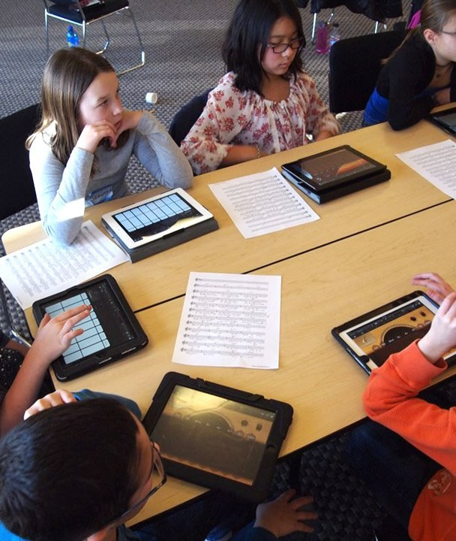
Transforming Education with Technology
Revolutionizing Learning for a Digital Age
Image: quill.com

Slide 2

Introduction to Modern Education
The integration of technology in modern education has become increasingly important as it offers numerous benefits, such as improved accessibility and personalized learning experiences.
• Technology can help bridge the gap between students with different abilities.
• Digital tools enable teachers to create customized lesson plans for each student.
• Online resources provide access to a vast array of educational materials.
• sources
Image: i3-technologies.com
2 / 12
Transforming Education with Technology · Sources [1]

Slide 3
Key Concepts in Technology-Enhanced Education
Personalized Learning
Access to Digital Resources
Virtual and Augmented Reality
sources
3 / 12
Transforming Education with Technology

Slide 4
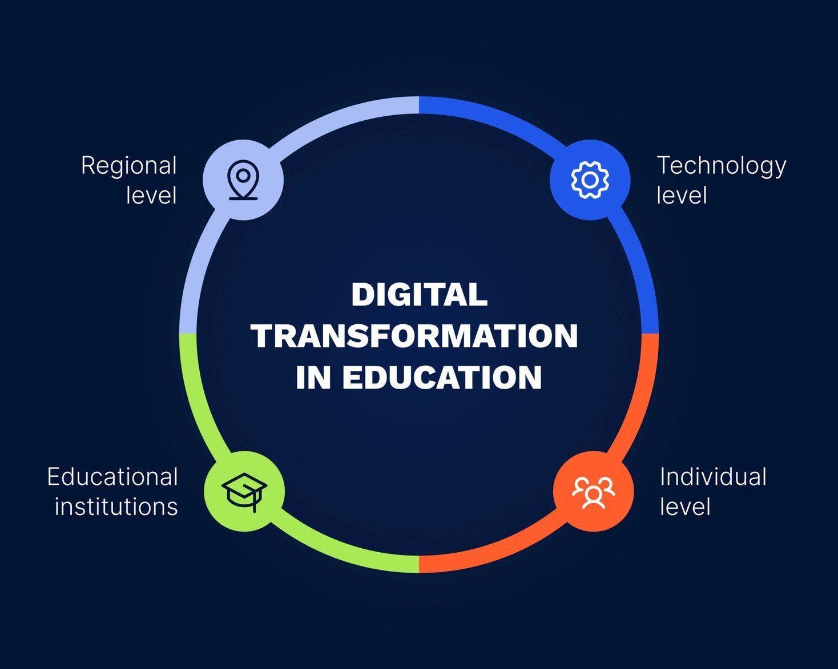
Current Trends in Technology-Enhanced Education
According to a recent study, the use of digital tools has increased by 25% over the past year.
• The number of students using online resources has risen from 50% to 75% in the last two years.
• The adoption rate of virtual reality technology in classrooms is expected to reach 30% by 2025.
• AI-powered learning tools have improved student outcomes by an average of 15%
• sources
Image: effectivesoft.com
4 / 12
Transforming Education with Technology · Sources [2], [3]

Slide 5
Applications of Technology in Modern Education
Virtual classrooms for remote learning.
AI-powered tutoring systems.
Gamification and interactive simulations.
sources
5 / 12
Transforming Education with Technology

Slide 6
Benefits and Challenges of Technology-Enhanced Education
The integration of technology in education has both benefits and challenges.
Benefits | Challenges
Improved accessibility for students with disabilities. | Increased digital divide.
Increased student engagement and motivation. | Potential for over-reliance on technology.
Enhanced teacher-student communication. | Risk of cyberbullying.
• Improved accessibility for students with disabilities.
• Increased student engagement and motivation.
• Enhanced teacher-student communication.
• sources
6 / 12
Transforming Education with Technology

Slide 7
Emerging Trends in Technology-Enhanced Education
The future of technology-enhanced education is expected to be shaped by emerging trends such as AI, blockchain, and the Internet of Things.
Expected
Increased use of AI-powered learning tools.
Projected
Widespread adoption of virtual reality technology.
Forecasted
Integration of blockchain for secure data storage.
Step 4
sources
7 / 12
Transforming Education with Technology

Slide 8
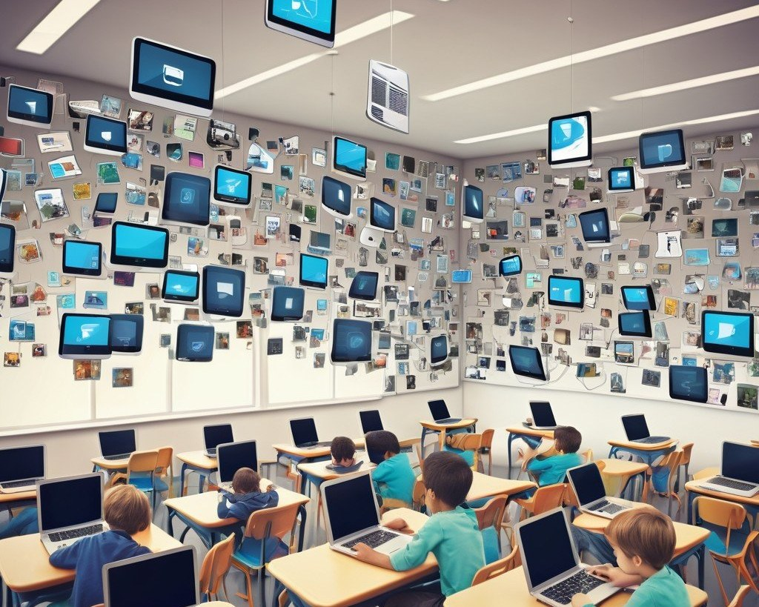
Conclusion and Recommendations
• Key takeaway: Technology has the potential to revolutionize education.
• Recommendation: Educators should prioritize professional development in technology integration.
• sources
Image: stablediffusionweb.com
8 / 12
Transforming Education with Technology · Sources [4]

Slide 9

The Role of Technology in Modern Education
Technology has the potential to transform education by providing access to high-quality educational resources and improving student outcomes.
• Technology can help bridge the gap between students with different abilities.
• Digital tools enable teachers to create customized lesson plans for each student.
• Online resources provide access to a vast array of educational materials.
• sources
Image: teachfind.com
9 / 12
Transforming Education with Technology · Sources [6]

Slide 10
Conclusion and Recommendations
Key takeaway
Technology has the potential to revolutionize education.
Recommendation
Educators should prioritize professional development in technology integration.
sources
10 / 12
Transforming Education with Technology · Sources [5]

Slide 11
Sources & Image Credits
Research and images used in this presentation
Source | Link
[1] 7 Ways Technology Is Impacting Modern Education | theedadvocate.org/7-ways-technology-is-impacting-modern-education
[2] Transforming Education in The Digital Age : How Technology Affects ... | researchgate.net/publication/383795338_Transforming_Education_in_The_…
[3] Embracing the Future: How Technology is Revolutionizing Education | novascholar.org/blog-posts/embracing-future-technology-revolutionizin…
[4] Technology in Education: Transforming Learning Environments | theirworld.org/resources/technology-and-education
[5] How Technology Is Transforming Classrooms Today—and What's Next | technologyhq.org/the-present-and-future-of-classroom-technology
[6] How technology is reinventing education - Stanford GSE | ed.stanford.edu/news/how-technology-reinventing-education
[7] How Technology Transforms Education in 2025 - Public School Review | publicschoolreview.com/blog/how-technology-transforms-education-in-20…
11 / 12
Transforming Education with Technology

Slide 12
Sources & Image Credits (continued)
Source | Link
[8] The Role of Technology in Modern Education — Collective Learning | collectivelearning.info/blog/role-of-technology-in-education
Image (slide: Transforming Education with Technology) — quill.com | quill.com/content/index/resource-center/education/technology/using-ta…
Image (slide: Introduction to Modern Education) — i3-technologies.com | i3-technologies.com/en/blog/stories/education/how-to-successfully-imp…
Image (slide: Current Trends in Technology-Enhanced Education) — effectivesoft.com | effectivesoft.com/blog/digital-transformation-in-education.html
Image (slide: Conclusion and Recommendations) — stablediffusionweb.com | stablediffusionweb.com/image/19370074-modern-classroom-with-digital-t…
Image (slide: The Role of Technology in Modern Education) — teachfind.com | teachfind.com/technology-digital-integration/digital-tools-integratio…
12 / 12
Transforming Education with Technology

