Slide 1
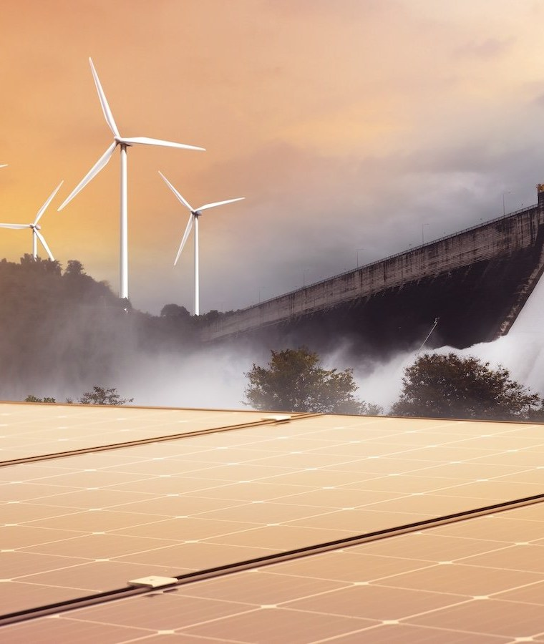
Renewable Energy Solutions for a Sustainable Future
Harnessing Natural Resources for a Cleaner Tomorrow
Image: ar.inspiredpencil.com

Slide 2
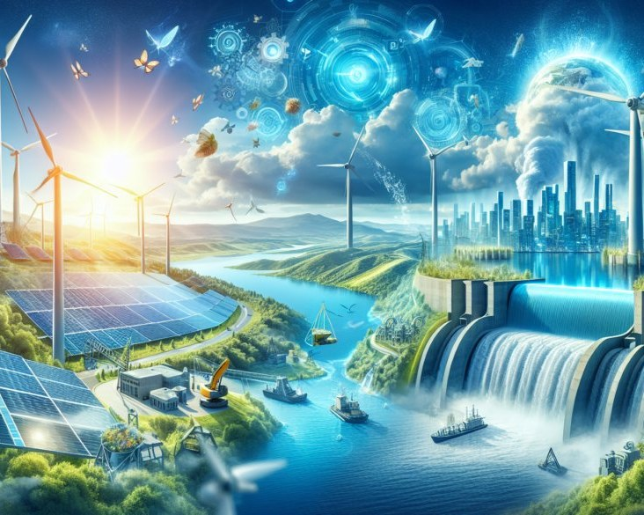
Introduction
The world is shifting towards renewable energy solutions as a sustainable future becomes increasingly important. Renewable energy is derived from natural resources that are abundant and continuously replenished, making it key to a safer, cleaner, and more sustainable world.
• The United Nations emphasizes the importance of renewable energy in powering a safer future
• sources: [2]
• image_query: A diagram illustrating the different types of renewable energy sources
Image: enroniq.com
2 / 12
Renewable Energy Solutions for a Sustainable Future

Slide 3
Key Concepts
Solar Energy
Harnessing the power of sunlight to generate electricity
Wind Energy
Utilizing wind turbines to convert kinetic energy into electricity
Hydropower
Tapping into the energy potential of water to generate electricity
Energy Efficiency
Improving the way we use energy to reduce waste and consumption
3 / 12
Renewable Energy Solutions for a Sustainable Future

Slide 4
Current Situation
According to the ScienceDirect, renewable energy is expected to increase from 11% today to 28% of the total primary energy consumed worldwide by 2050.
Benefits | Challenges
Increased Energy Security | High Upfront Costs
Reduced Greenhouse Gas Emissions | Intermittent Energy Supply
Improved Air Quality | Land Use Requirements
• Renewable energy is fundamental in building a sustainable future
• sources: [4]
• image_query: A graph illustrating the growth of renewable energy consumption over time
4 / 12
Renewable Energy Solutions for a Sustainable Future

Slide 5
Applications
Solar Power
Used in residential and commercial buildings for electricity generation
Wind Power
Utilized in wind farms to generate electricity on a large scale
Hydropower
Tapped into for electricity generation in hydroelectric power plants
5 / 12
Renewable Energy Solutions for a Sustainable Future

Slide 6
Benefits and Challenges
The benefits of renewable energy include increased energy security, reduced greenhouse gas emissions, and improved air quality.
Benefits | Challenges
Increased Energy Security | High Upfront Costs
Reduced Greenhouse Gas Emissions | Intermittent Energy Supply
Improved Air Quality | Land Use Requirements
• Renewable energy is fundamental in building a sustainable future
• sources: [4]
• image_query: A table illustrating the benefits and challenges of renewable energy
6 / 12
Renewable Energy Solutions for a Sustainable Future

Slide 7
Future Scope
Emerging trends in renewable energy include the development of green technologies, such as solar panels and wind turbines.
Step 1
The expected growth of renewable energy by 2050
sources
[4]
image_query
A diagram illustrating the expected growth of renewable energy over time
7 / 12
Renewable Energy Solutions for a Sustainable Future

Slide 8
Applications in Industries
Solar Power
Used in residential and commercial buildings for electricity generation
Wind Power
Utilized in wind farms to generate electricity on a large scale
Hydropower
Tapped into for electricity generation in hydroelectric power plants
8 / 12
Renewable Energy Solutions for a Sustainable Future

Slide 9
Benefits and Challenges
The benefits of renewable energy include increased energy security, reduced greenhouse gas emissions, and improved air quality.
Benefits | Challenges
Increased Energy Security | High Upfront Costs
Reduced Greenhouse Gas Emissions | Intermittent Energy Supply
Improved Air Quality | Land Use Requirements
• Renewable energy is fundamental in building a sustainable future
• sources: [4]
• image_query: A table illustrating the benefits and challenges of renewable energy
9 / 12
Renewable Energy Solutions for a Sustainable Future

Slide 10
Emerging Trends
The future of renewable energy is expected to be shaped by emerging trends, including the development of green technologies and the growth of renewable energy consumption.
Step 1
The projected increase in renewable energy consumption by 2050
sources
[4]
image_query
A diagram illustrating the expected growth of renewable energy over time
10 / 12
Renewable Energy Solutions for a Sustainable Future

Slide 11
Sources & Image Credits
Research and images used in this presentation
Source | Link
[1] Practical solutions for a sustainable future - advancing renewable and ... | sciencedirect.com/science/article/pii/S1364032125008093
[2] Renewable energy - powering a safer future | United Nations | un.org/en/climatechange/raising-ambition/renewable-energy
[3] Renewable Energy Solutions for a Sustainable Future 2025 | manifest.ly/blog/renewable-energy-solutions-for-a-sustainable-future-…
[4] Renewable energy for a sustainable future - ScienceDirect | sciencedirect.com/science/chapter/edited-volume/pii/B9780443134395000…
[5] Renewable Energy Solutions for a Greener Future | emagazine.com/renewable-energy-solutions-for-a-greener-future
[6] Renewable Energy and Sustainability: Complete 2025 Guide | greenlivinganswers.com/renewable-energy-and-sustainability
[7] The Future of Energy: How Green Tech is Shaping Renewable Sources | therenewables.org/how-green-tech-is-shaping-renewable-sources
11 / 12
Renewable Energy Solutions for a Sustainable Future

Slide 12
Sources & Image Credits (continued)
Source | Link
Image (slide: Renewable Energy Solutions for a Sustainable Future) — ar.inspiredpencil.com | ar.inspiredpencil.com/pictures-2023/renewable-energy-wallpaper
Image (slide: Introduction) — enroniq.com | enroniq.com/sustainable-energy-solutions
12 / 12
Renewable Energy Solutions for a Sustainable Future

