Slide 1
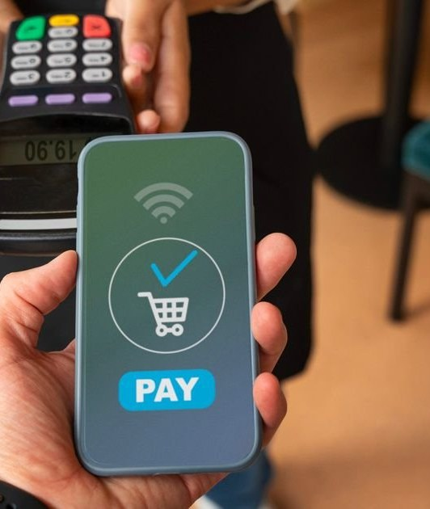
The Rise of Digital Payments and Cashless Economies
Transforming Financial Infrastructure
Image: bulbapp.io

Slide 2
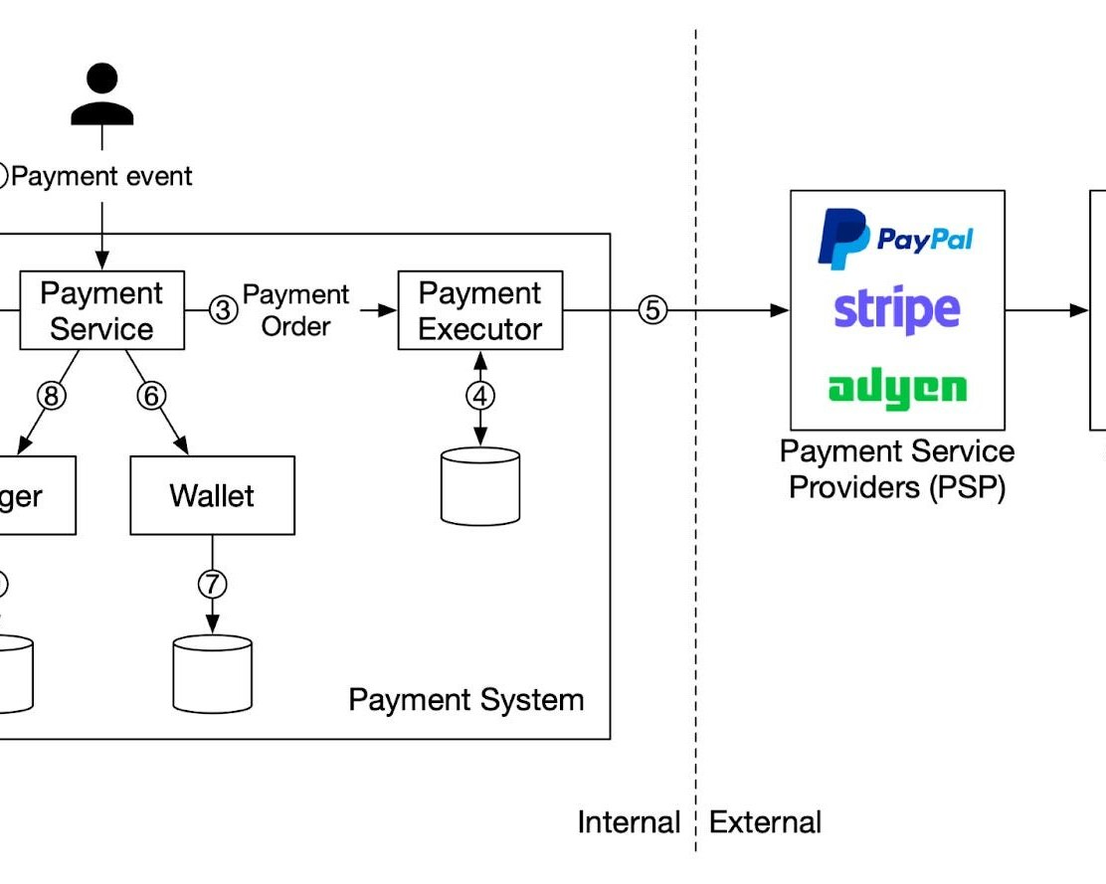
Introduction
The Shift Towards Digital Payments
Digital payments have revolutionized the way we conduct financial transactions. The rise of cashless economies is driven by technological advancements, consumer demand, and policy initiatives.
• Digital payment systems are one of the significant building blocks of modern financial infrastructure.
• Mobile computing, real-time communication networks, cryptography, and API interoperability have enabled digital payments.
• The shift towards cashless economies is transforming the global financial landscape.
Image: newsletter.pragmaticengineer.com
2 / 12
The Rise of Digital Payments and Cashless Economies · Sources [1]

Slide 3
Key Concepts
Essential Components of Digital Payments
Mobile payments and digital wallets.
Cryptocurrencies and contactless transactions.
API interoperability and real-time communication networks.
3 / 12
The Rise of Digital Payments and Cashless Economies

Slide 4
Current Situation
Accelerating Shift Towards Cashless Economies
The rise of digital payments has accelerated the shift towards cashless economies worldwide. According to a recent report, the global digital payment market is expected to reach $14 trillion by 2026.
Benefits | Challenges
Increased efficiency | Cybersecurity risks
Convenience and accessibility | Dependence on technology
Reduced transaction costs | Potential for inequality
• The global digital payment market is projected to reach $14 trillion by 2026.
• Digital payments have increased by 20% in the past year alone.
• Cashless transactions now account for over 50% of all financial transactions worldwide.
4 / 12
The Rise of Digital Payments and Cashless Economies · Sources [2], [3]

Slide 5
Applications
Practical Uses in Various Industries
E-commerce and online shopping.
Mobile banking and financial services.
Contactless payments and digital wallets.
5 / 12
The Rise of Digital Payments and Cashless Economies

Slide 6
Benefits and Challenges
The Pros and Cons of Cashless Economies
While cashless economies offer several benefits, they also pose significant challenges. A recent report highlights the need for balanced policies to mitigate these risks.
Benefits | Challenges
Increased efficiency | Cybersecurity risks
Convenience and accessibility | Dependence on technology
Reduced transaction costs | Potential for inequality
• Increased efficiency and reduced transaction costs.
• Convenience and accessibility for consumers.
• Potential for inequality and cybersecurity risks.
6 / 12
The Rise of Digital Payments and Cashless Economies · Sources [5]

Slide 7
Future Scope
Emerging Trends and Developments
The future of digital payments is expected to be shaped by emerging trends such as cryptocurrencies, contactless transactions, and artificial intelligence.
Step 1
Cryptocurrencies are expected to become increasingly popular for cross-border transactions.
Step 2
Contactless transactions will continue to grow in popularity, especially among younger consumers.
Step 3
Artificial intelligence will play a key role in enhancing the security and efficiency of digital payments.
7 / 12
The Rise of Digital Payments and Cashless Economies · Sources [3]

Slide 8
Future Scope
Emerging Trends and Developments
The future of digital payments is expected to be shaped by emerging trends such as cryptocurrencies, contactless transactions, and artificial intelligence.
Step 1
The use of biometric authentication will become more widespread.
Step 2
Blockchain technology will continue to improve the security and transparency of digital payments.
Step 3
Mobile wallets will play a key role in driving the adoption of cashless economies.
8 / 12
The Rise of Digital Payments and Cashless Economies · Sources [3]

Slide 9
Future Scope
Emerging Trends and Developments
The future of digital payments is expected to be shaped by emerging trends such as cryptocurrencies, contactless transactions, and artificial intelligence.
Step 1
The adoption of cashless economies will continue to grow in developing countries.
Step 2
Digital payment systems will become increasingly integrated with other financial services.
Step 3
The use of AI-powered chatbots will become more common for customer support.
9 / 12
The Rise of Digital Payments and Cashless Economies · Sources [3]

Slide 10
Conclusion
Key Takeaways and Recommendations
The rise of digital payments and cashless economies is transforming the global financial landscape. Key takeaways include the need for balanced policies, increased efficiency, and reduced transaction costs.
Implement policies to balance the benefits and challenges of cashless economies.
Invest in infrastructure to support digital payments and contactless transactions.
Educate consumers about the risks and benefits of digital payments.
10 / 12
The Rise of Digital Payments and Cashless Economies

Slide 11
Sources & Image Credits
Research and images used in this presentation
Source | Link
[1] The Evolution of Digital Payments and the Rise of Cashless Economies ... | ieeexplore.ieee.org/document/11452023
[2] The Rise of Digital Payments and the Cashless Economy | unicaf.org/the-rise-of-digital-payments-and-the-cashless-economy
[3] Digital Payment Systems and the Future of Cashless Economies | researchgate.net/publication/390486728_Digital_Payment_Systems_and_th…
[4] The Rise of Cashless Economies Worldwide - thefinrate.com | thefinrate.com/the-rise-of-cashless-economies-worldwide-trends-and-fu…
[5] Cashless Economy: Advantages and Risks of a Cashless Society | ajg.com/news-and-insights/features/cashless-economies
[6] Digital Payment Systems and the Rise of Cashless Economies | linkedin.com/pulse/digital-payment-systems-rise-cashless-economies-bi…
[7] Cashless Payment Systems: The Cashless Revolution: How ... - FasterCapital | fastercapital.com/content/Cashless-Payment-Systems--The-Cashless-Revo…
11 / 12
The Rise of Digital Payments and Cashless Economies

Slide 12
Sources & Image Credits (continued)
Source | Link
[8] Cashless Economy Statistics 2026: Digital Payment Surge • CoinLaw | coinlaw.io/cashless-economy-statistics
Image (slide: The Rise of Digital Payments and Cashless Economies) — bulbapp.io | bulbapp.io/p/f20c33aa-bd51-42e4-9d53-5d03c3b1518c/the-future-of-payme…
Image (slide: Introduction) — newsletter.pragmaticengineer.com | newsletter.pragmaticengineer.com/p/designing-a-payment-system
12 / 12
The Rise of Digital Payments and Cashless Economies

