Slide 1
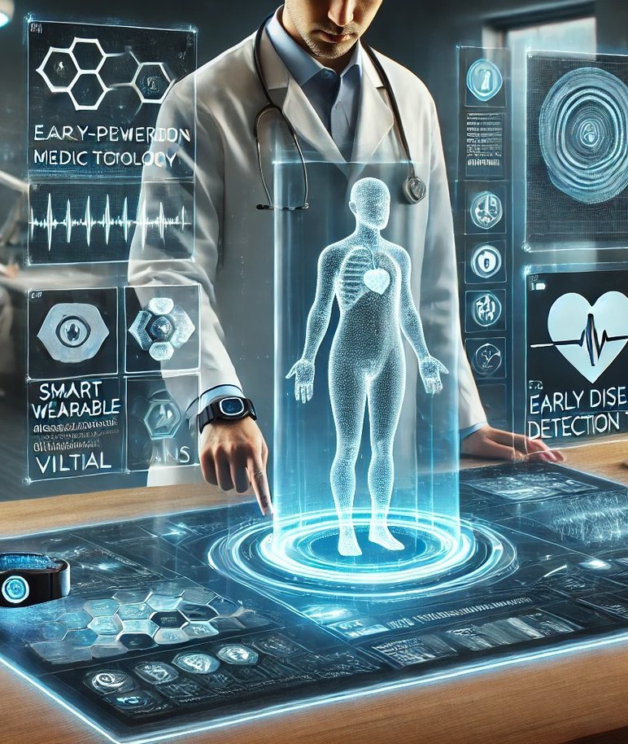
The Role of Artificial Intelligence in Early Disease Detection
Transforming Healthcare with AI-Powered Diagnostics
Image: statusneo.com

Slide 2
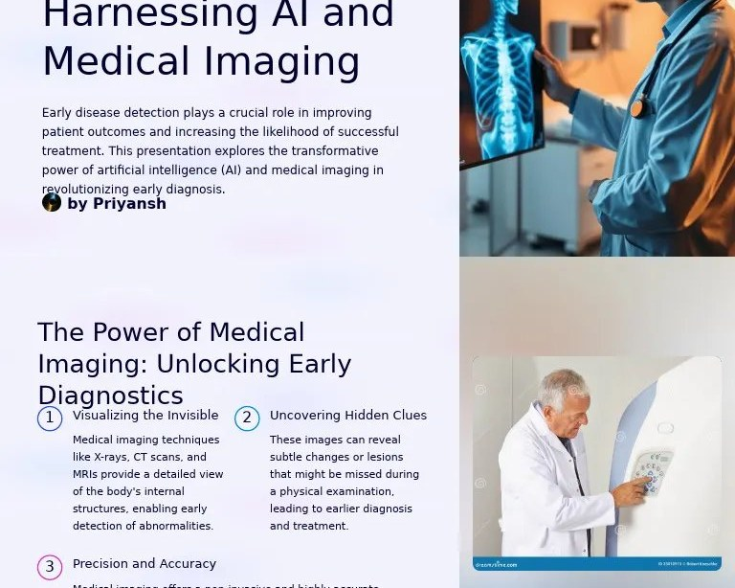
Introduction
The Impact of AI in Early Disease Detection
Artificial Intelligence (AI) is revolutionizing the field of healthcare by enabling early disease detection, which can significantly improve treatment outcomes and patient quality of life.
• Early disease detection is critical for improving treatment outcomes
• AI-powered diagnostics can reduce healthcare costs
• AI can enhance patient quality of life
Image: scribd.com
2 / 12
The Role of Artificial Intelligence in Early Disease Detection · Sources [1], [2]

Slide 3
Key Concepts
Understanding AI in Early Disease Detection
Deep Learning
A subset of machine learning that enables AI systems to learn from data
Natural Language Processing (NLP)
Enabling AI systems to understand and analyze medical texts
Computer Vision
Allowing AI systems to analyze medical images
3 / 12
The Role of Artificial Intelligence in Early Disease Detection

Slide 4
Current Situation
AI Applications in Early Disease Detection
According to a study, AI systems have been shown to detect diseases such as cancer and diabetic retinopathy with high accuracy.
Benefits | Challenges
Improved accuracy in disease detection | High cost of implementing AI systems
Enhanced patient care through early intervention | Risk of bias in AI algorithms
Reduced healthcare costs through early detection | Limited availability of AI expertise
• Cancer detection: AI-powered algorithms can analyze medical images and patient data to identify cancerous tissues
• Diabetic Retinopathy detection: AI systems can analyze retinal scans to detect early signs of the disease
• Mental health issues: AI-powered chatbots can analyze patient conversations to detect mental health issues
4 / 12
The Role of Artificial Intelligence in Early Disease Detection · Sources [3], [4]

Slide 5
Applications
Industry-Specific Use Cases for AI in Early Disease Detection
Cancer diagnosis
AI-powered algorithms can analyze medical images and patient data to identify cancerous tissues
Cardiovascular disease detection
AI systems can analyze ECG and echocardiogram data to detect early signs of the disease
Ophthalmic disease detection
AI-powered algorithms can analyze retinal scans to detect early signs of diseases such as diabetic retinopathy
5 / 12
The Role of Artificial Intelligence in Early Disease Detection

Slide 6
Benefits and Challenges
The Pros and Cons of AI-Powered Diagnostics
According to a study, AI-powered diagnostics can reduce healthcare costs and improve treatment outcomes.
Benefits | Challenges
Improved accuracy in disease detection | High cost of implementing AI systems
Enhanced patient care through early intervention | Risk of bias in AI algorithms
• Improved accuracy in disease detection
• Enhanced patient care through early intervention
• Reduced healthcare costs through early detection
6 / 12
The Role of Artificial Intelligence in Early Disease Detection · Sources [5]

Slide 7
Future Scope
Emerging Trends and Developments in AI-Powered Diagnostics
The use of AI in early disease detection is expected to continue growing, with a projected increase in the adoption of AI-powered diagnostics by 2025.
Expected
Increased use of deep learning algorithms for image analysis
Projected
Improved accuracy in disease detection through the use of natural language processing
Forecasted
Enhanced patient care through early intervention and reduced healthcare costs
7 / 12
The Role of Artificial Intelligence in Early Disease Detection

Slide 8
Applications in Industries
Real-World Use Cases for AI-Powered Diagnostics
Cancer diagnosis
AI-powered algorithms can analyze medical images and patient data to identify cancerous tissues
Cardiovascular disease detection
AI systems can analyze ECG and echocardiogram data to detect early signs of the disease
Ophthalmic disease detection
AI-powered algorithms can analyze retinal scans to detect early signs of diseases such as diabetic retinopathy
8 / 12
The Role of Artificial Intelligence in Early Disease Detection

Slide 9
Benefits and Challenges
The Pros and Cons of AI-Powered Diagnostics
According to a study, AI-powered diagnostics can reduce healthcare costs and improve treatment outcomes.
Benefits | Challenges
Improved accuracy in disease detection | High cost of implementing AI systems
Enhanced patient care through early intervention | Risk of bias in AI algorithms
• Improved accuracy in disease detection
• Enhanced patient care through early intervention
• Reduced healthcare costs through early detection
9 / 12
The Role of Artificial Intelligence in Early Disease Detection · Sources [5]

Slide 10
Future Scope
Emerging Trends and Developments in AI-Powered Diagnostics
The use of AI in early disease detection is expected to continue growing, with a projected increase in the adoption of AI-powered diagnostics by 2025.
Expected
Increased use of deep learning algorithms for image analysis
Projected
Improved accuracy in disease detection through the use of natural language processing
Forecasted
Enhanced patient care through early intervention and reduced healthcare costs
10 / 12
The Role of Artificial Intelligence in Early Disease Detection

Slide 11
Sources & Image Credits
Research and images used in this presentation
Source | Link
[1] The Role of Artificial Intelligence in Early Disease Detection ... | ijsr.net/getabstract.php
[2] The Role of Artificial Intelligence in Early Disease Detection ... | researchcorridor.org/mjh/article/view/52
[3] The Role of Artificial Intelligence in Early Disease Detection: Current ... | gjeac.com/index.php/GJEAIC/article/view/1
[4] PDF The Role of Artificial Intelligence in Early Disease Detection: Current ... | researchgate.net/profile/Noman-Abid/publication/388731133_Global_Jour…
[5] The Role of Artificial Intelligence in Early Disease Detection ... - Neliti | neliti.com/publications/592479/the-role-of-artificial-intelligence-in…
[6] PDF The Role of AI in Early Disease Detection and Diagnostics. | alliedacademies.org/articles/the-role-of-ai-in-early-disease-detectio…
[7] Early Detection of Diseases Using AI: An Overview of ... - ResearchGate | researchgate.net/publication/392959781_Early_Detection_of_Diseases_Us…
11 / 12
The Role of Artificial Intelligence in Early Disease Detection

Slide 12
Sources & Image Credits (continued)
Source | Link
[8] PDF The Role of Artificial Intelligence in Early Disease Diagnosis | rojournals.org/wp-content/uploads/2024/09/ROJBAS-33-P6.pdf
Image (slide: The Role of Artificial Intelligence in Early Disease Detection) — statusneo.com | statusneo.com/tech-for-early-disease-detection-advancements
Image (slide: Introduction) — scribd.com | scribd.com/presentation/821350635/Early-Disease-Detection-Harnessing-…
12 / 12
The Role of Artificial Intelligence in Early Disease Detection

