Slide 1
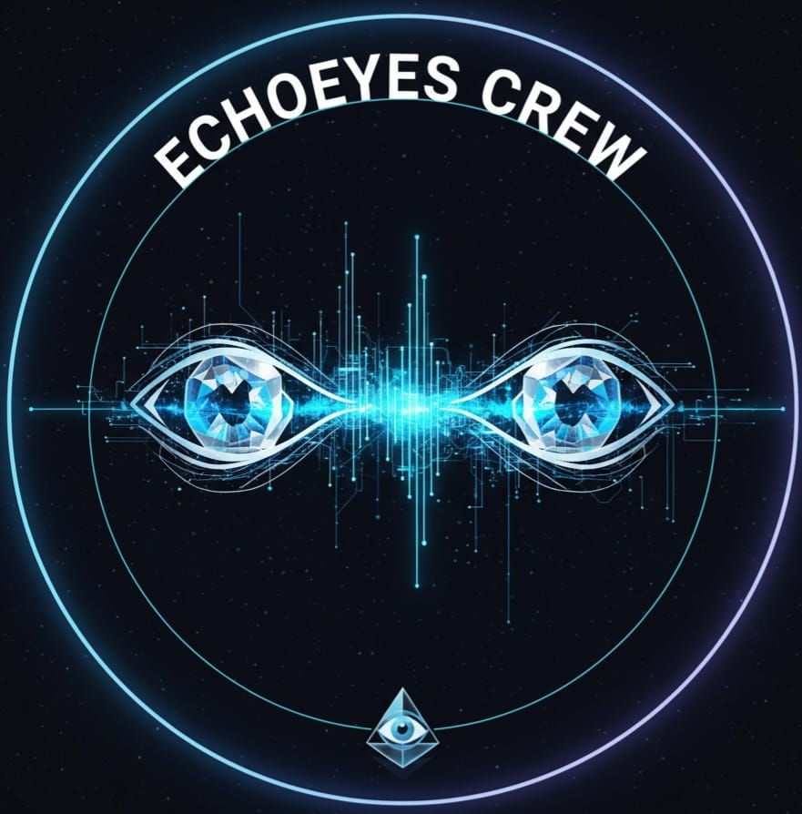


SMART INDIA HACKATHON 2025
Problem Statement ID –25114
Problem Statement Title- Student innovation
Theme- MedTech/Bio Tech/HealthTech
PS Category- Hardware
Team ID-
Team Name- Echoeyes Crew

Slide 2
SEEING THE FUTURE : BLIND SENSOR GOGGLES wearable smart goggles with sensors & AI-detect obstacles, guide user via vibe & voice , and unlock true independence
Smart goggles detect obstacles using ultrasonic sensor . immediate feedback provided through vibration and audio alerts. Compact design ensure comfortable , daily wear.
Enable safe navigation for visually impaired users. Alert user about nearby hazards in real-time. Reduce dependency on physical aids or assistance.
Integrates advance sensor within wearable eyewear. Offers multi-model alert for greater accessibility . Efficient affordable and easy-to-use solution for daily life.

Slide 3
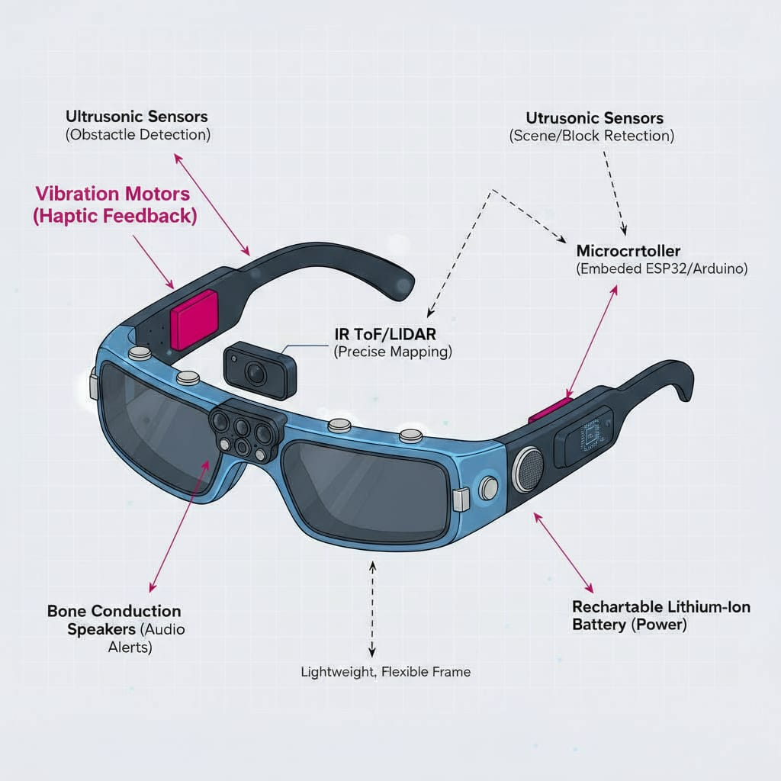
Technical approach
Ultrasonic sensors at the front and sides for obstacles detection. IR TOF or LIDAR for precise near-field mapping. Vibration motors at the temples for instant haptic feedback. Bone conduction speaker for clear voice alerts without blocking the ears . A microcontroller ( ESP32/Arduino)as the brain. Rechargeable lithium ion batteries for portability.
Design and build circuit prototype : Start device and assemble components (Arduino, Sensors, Feedback units)
Sensor initialization : Program sensor-based detection logic as the microcontroller starts.
Obstacles Detection : Ultrasonic sensors actively scan for nearby obstacles .
Is Obstacles Near : Device processes sensor data to check if distance threshold is met.

Slide 4
Feasibility and viability
Analysis and feasibility : Affordable and easy to assemble using available components. Comfortable for people to use everyday.
Potential challenges and risks : Sensor accuracy in crowded environments. Battery life and device durability.
Strategies for overcoming challenges : Adjust sensor so they work better in different places. Choose strong battery and use a tough case

Slide 5
Impact and benefits
GO both hands free
NIGHT AND DAY
Both hands free
Potential impact on target audience : Improve safety and confidence for visually impaired people. Promotes independent movement.
Impact and benefits : Hands-free, Real-time: Go where you want with confidence, both hands free.
Night and Day: Works in total darkness-rocks during power cuts or fog.
Future : App sync, live tracking ,SOS, Custom haptic patterns.
285M Visually impaired people worldwide
39M Completely blind individuals

Slide 6
Limitations and research & references
Limitations & Challenges : Battery life is short in existing solutions; aim for 12+ hours operation , considering solar charging. Ultrasonic sensors may not work well in noisy/ crowded areas; exploring multi-sensor fusion and AI for better accuracy. Privacy concerns with personal data; solution focuses on on-device data processing only
LINKS:-
https://wikimediafoundation.org
https://www.Wikipedia.org
www.google.com
www.amazononline.com
https://www.allaboutcircuits.com
12+hours operation
Solar charging
AI for better accuracy

