Slide 1

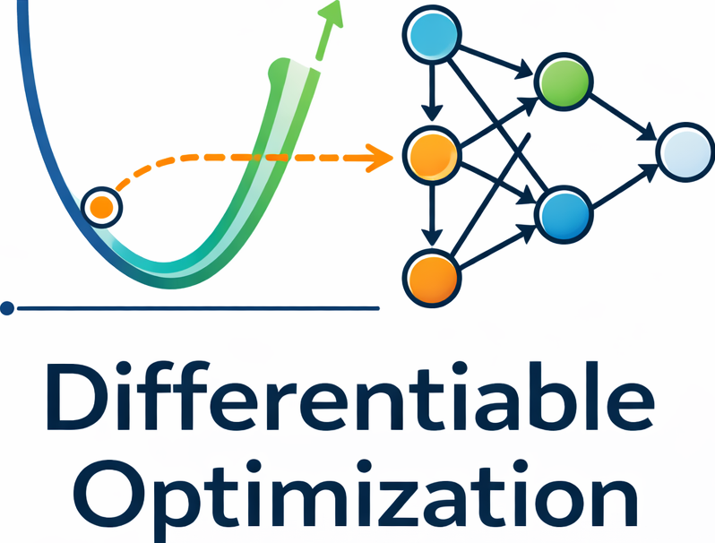

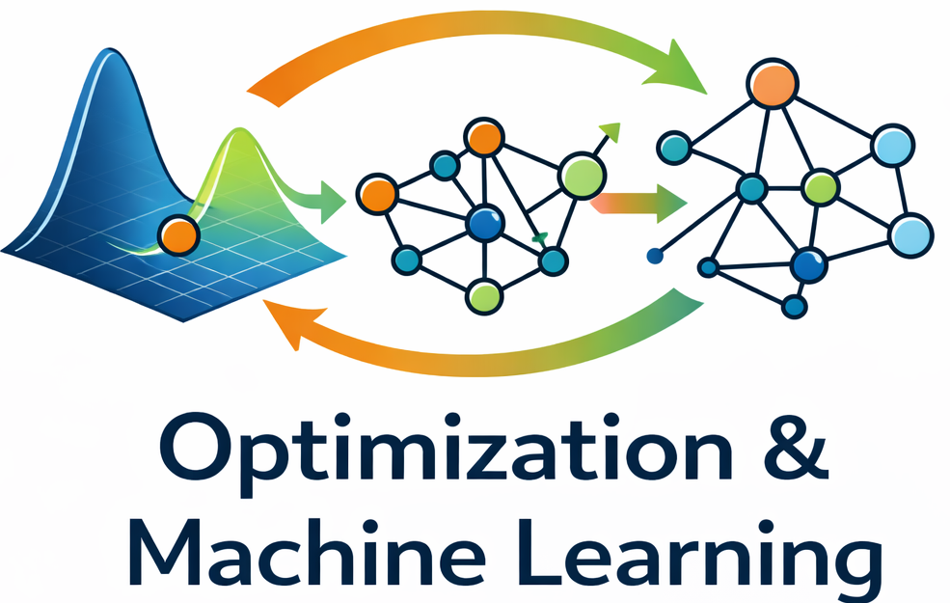

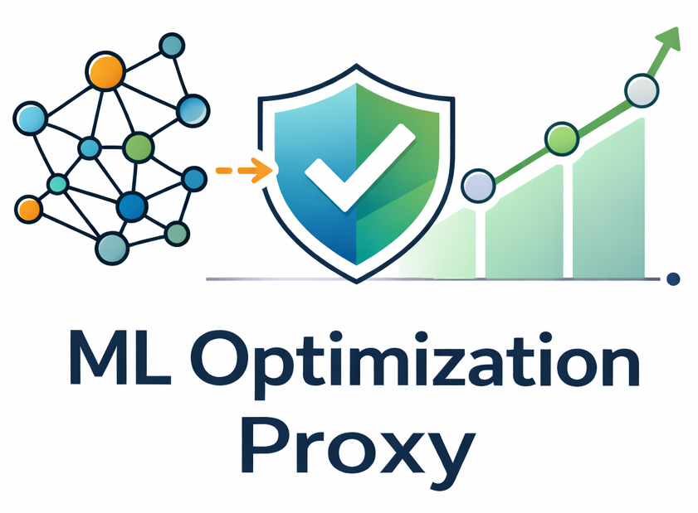


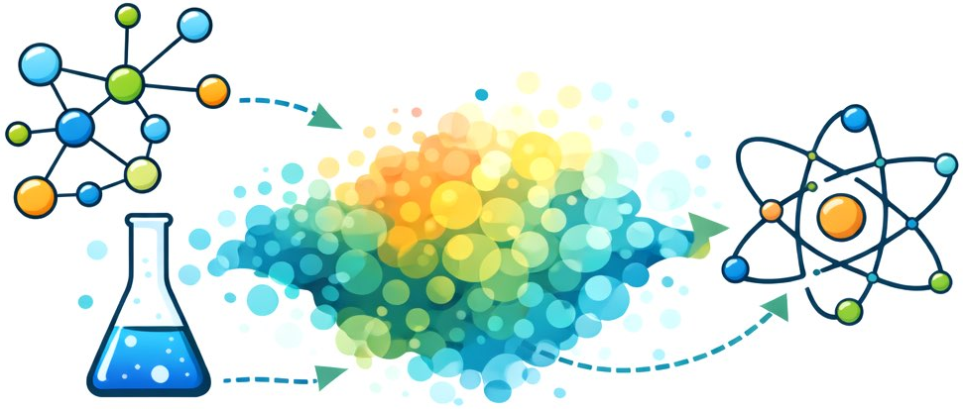
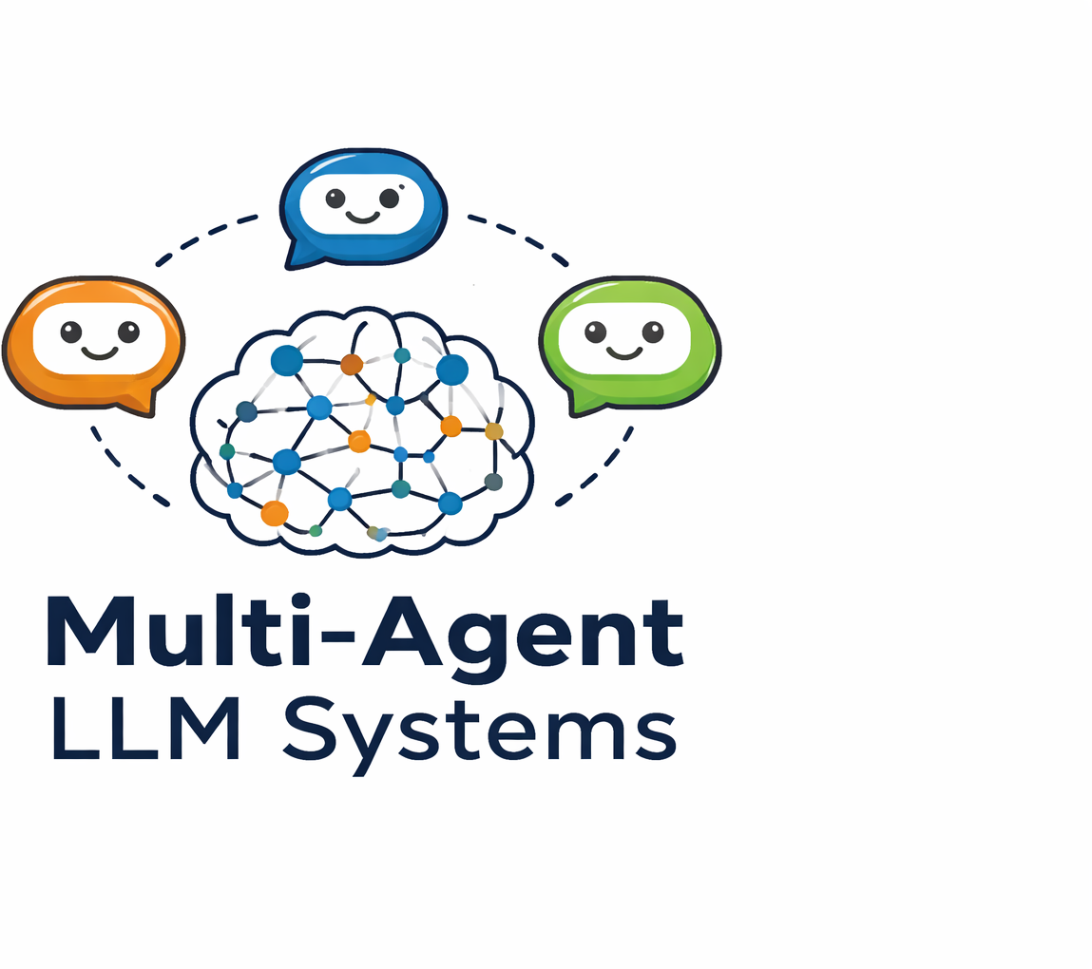
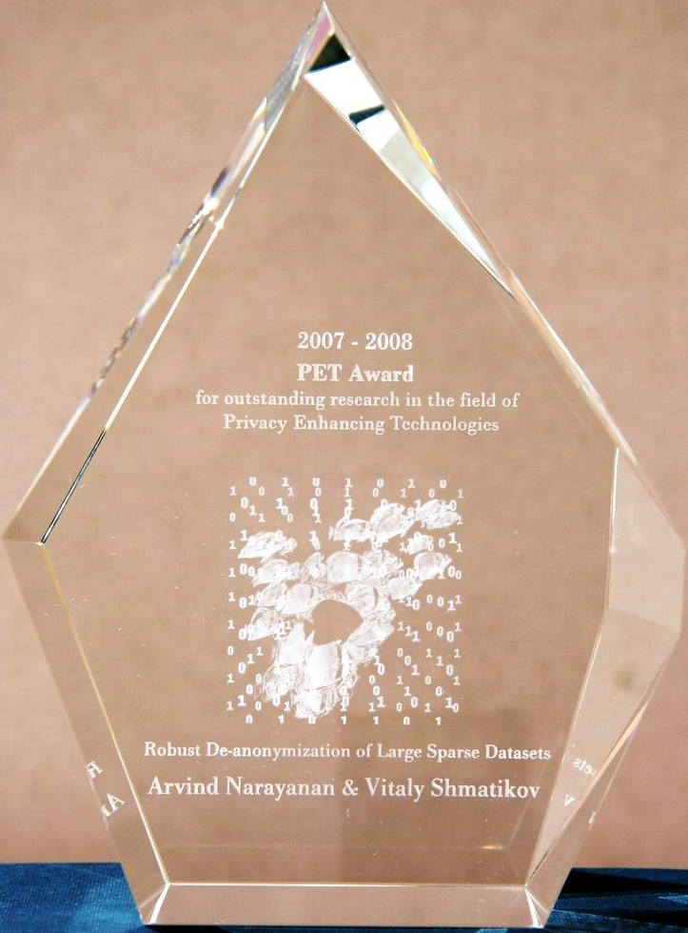
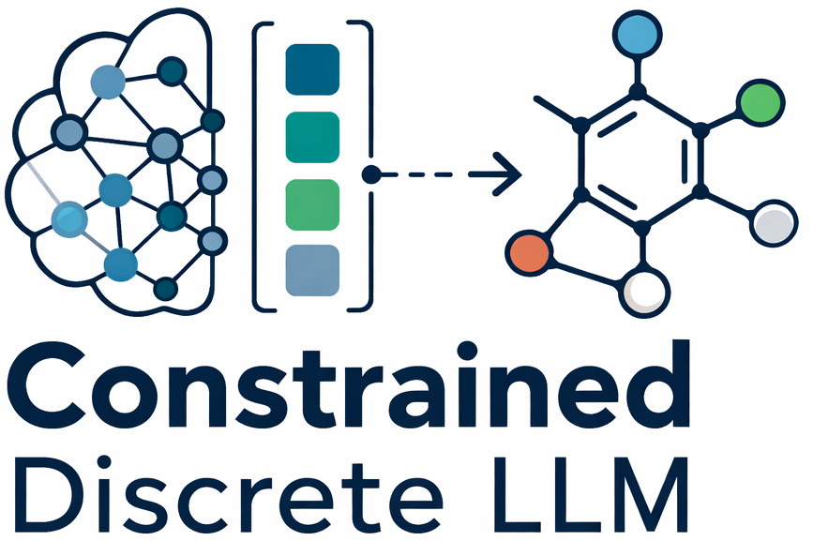
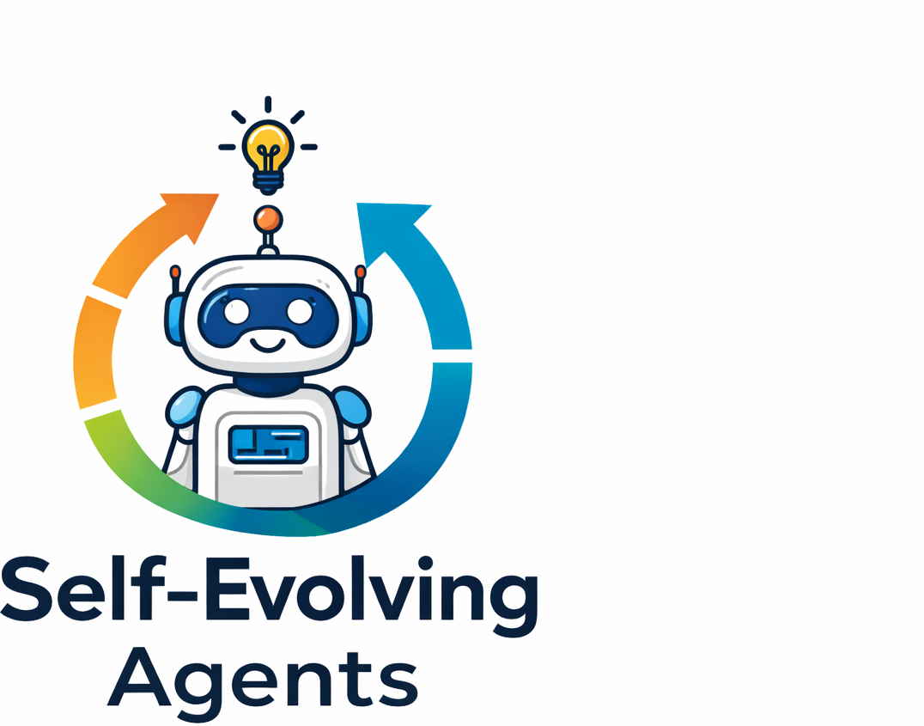

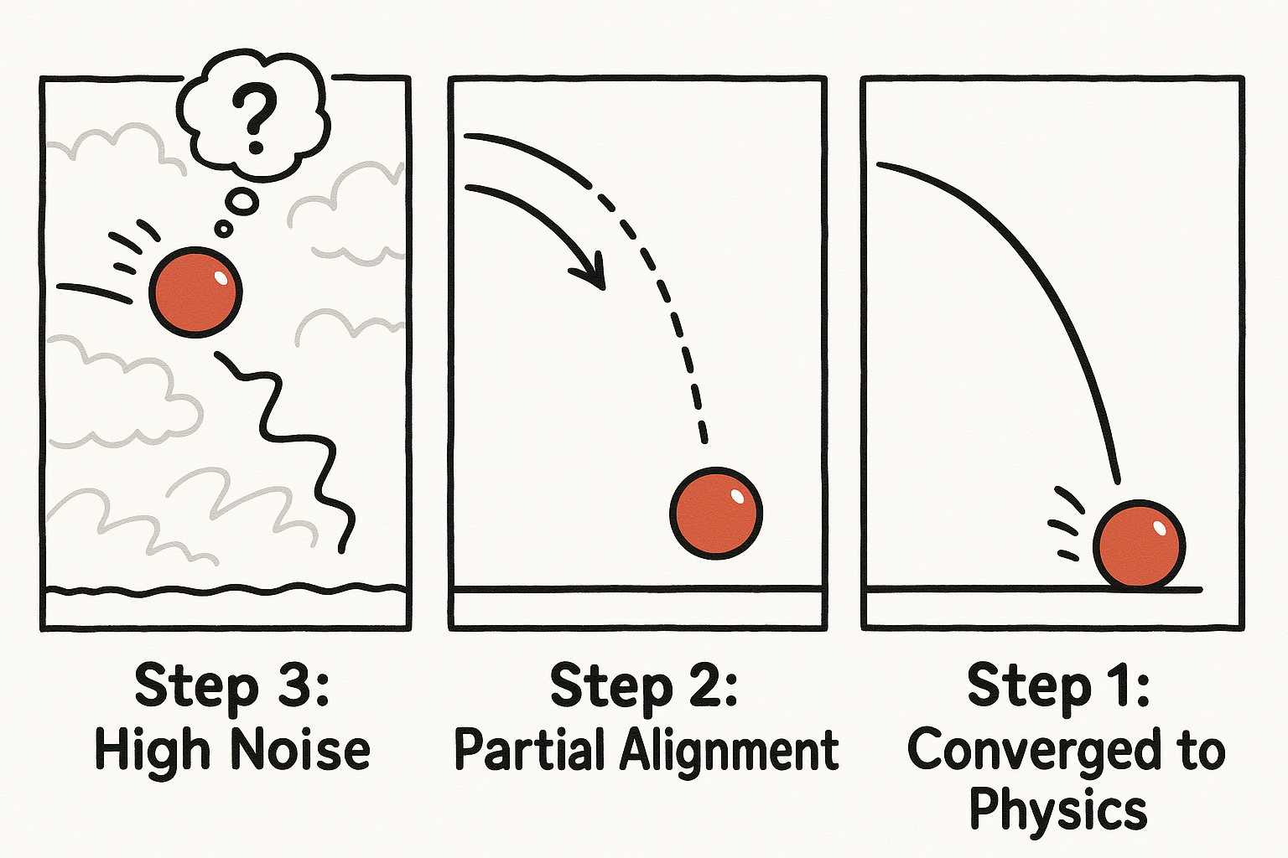

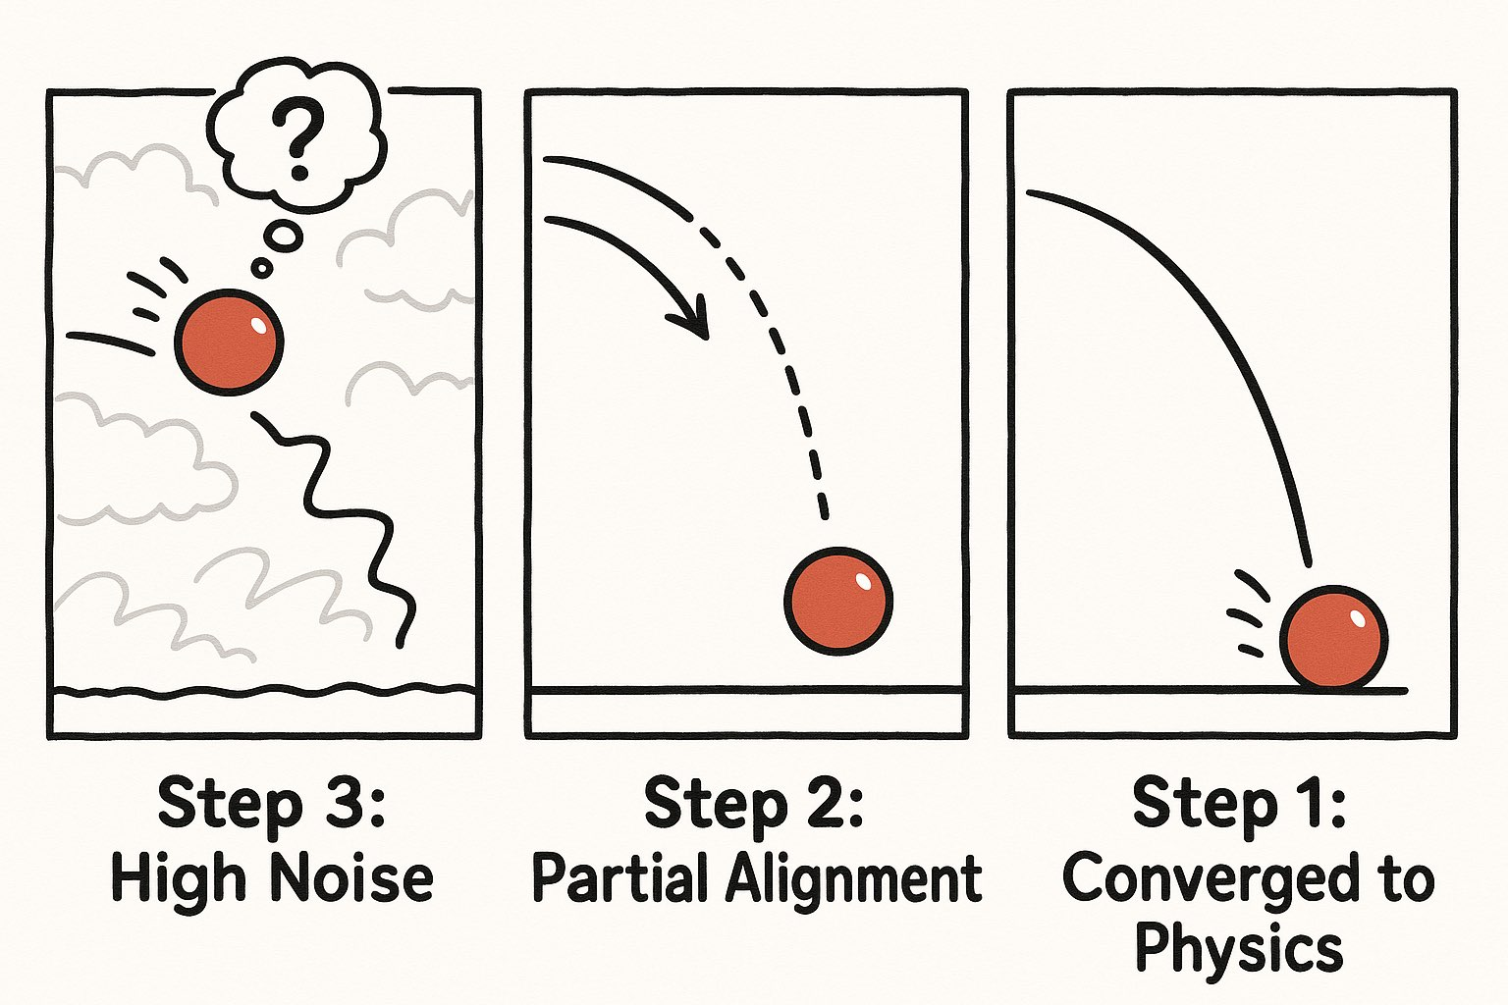

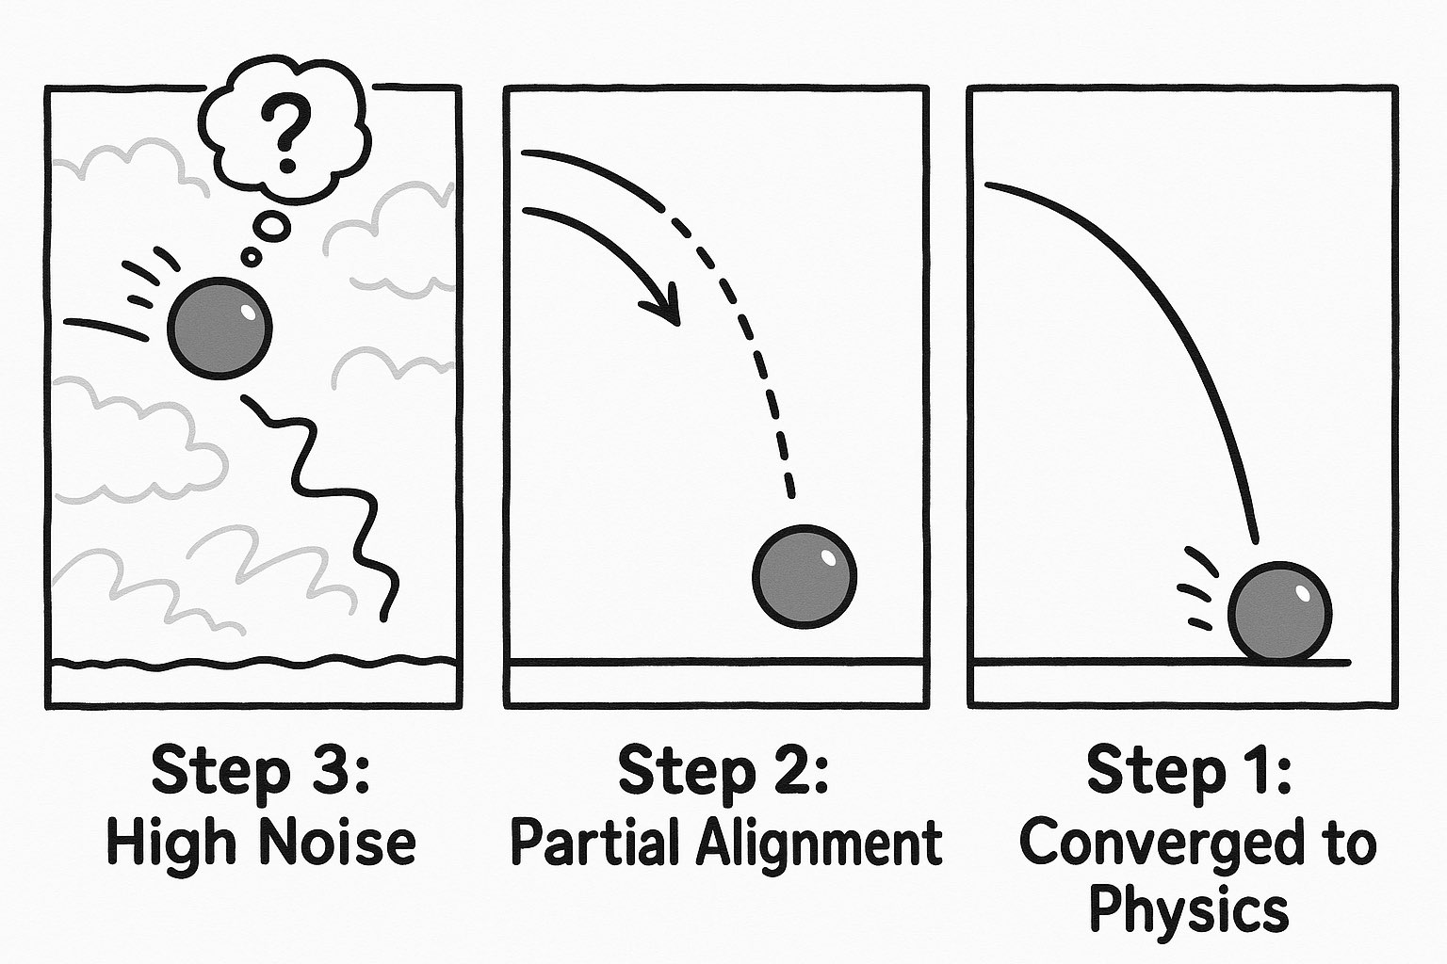


AI for Science and Engineering
Safe AI
Differential Privacy
Fairness
Robustness
Model Pruning
Decision-making
New DP book
[now publisher 2025]
Safety in agentic systems
Caspar Bowden
PET Award 2022
Generative Models
(dynamics)
…
e.g., motion
constraints
constraint
enforcement
Power Systems
Notes:
"To give you a quick map of what we do, my lab focuses on embedding constraints into AI—whether that means forcing a generative model to obey the laws of physics for materials discovery, or guaranteeing differential privacy and safety in self-evolving agents.”
My focus on on foundational Artificial Intelligence (AI) research at the juncture of Machine Learning (ML), optimization, privacy, and ethics. Most of my research to date focuses on two key areas:
Integration of ML and Optimization. It develops the foundations to blend deep learning and constrained optimization to serve the resolution of complex decision tasks and creates novel ways to integrate knowledge, constraints, and physical principles into learning models
Trustworthy ML and Decision Making. It analyzes the equity of machine learning and decision- making algorithms and it designs practical tools to render AI systems more aligned with societal values, focusing especially on differential privacy, fairness, and their interplay
"While my lab actively works across both of these domains, today I am going to dive deep into this bottom-left quadrant: how we are

Slide 2



Key idea
Constrained diffusion
differentiable constraint optimization steps
Novel methodology for integrating differentiable optimization with diffusion processes.
Theoretical grounding for constraint adherence in physics-guided generation.
(dynamics)
…
e.g., motion
constraints
constraint
enforcement
These advances bring forward two key features that are important for the adoption of generative models for trajectory planning:
1. improved assurance
2. ood generalization

Slide 3
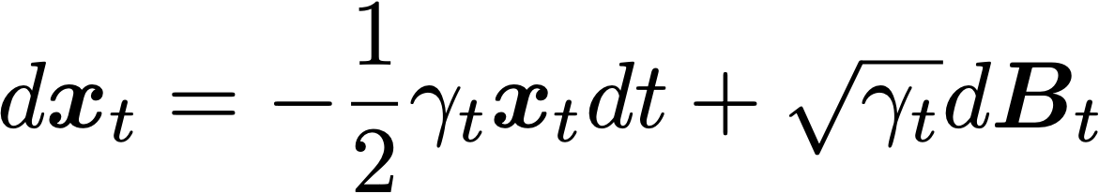
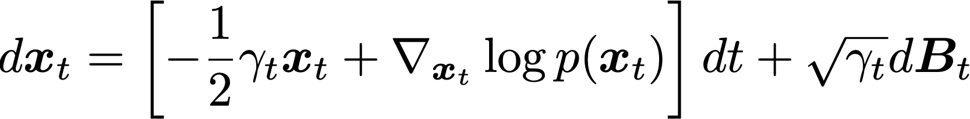
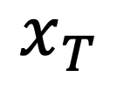

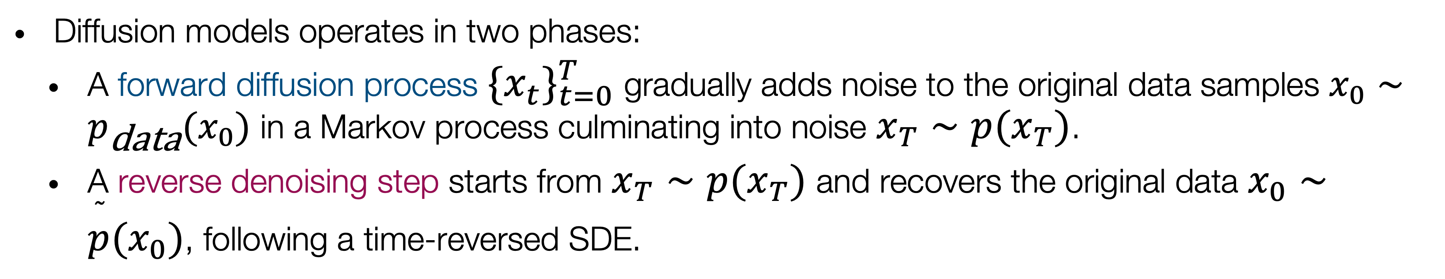
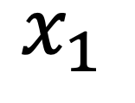
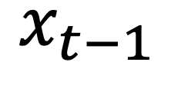
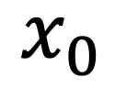
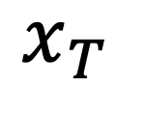
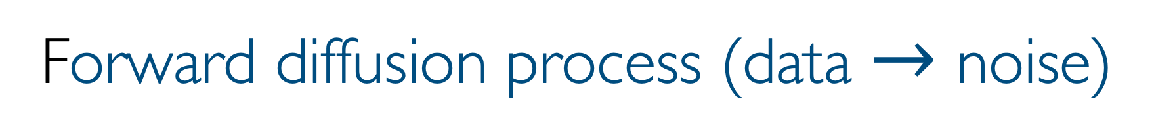
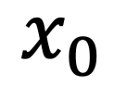
Diffusion models: a short primer
Diffusion models operates in two phases:
  A forward diffusion process $\{x_{t}\}_{t=0}^{T}$ gradually adds noise to the original data samples $x_{0}∼p_{\text{data}}(x_{0})$ in a Markov process culminating into noise $x_{T}∼p(x_{T})$.
  A reverse denoising step starts from $x_{T}∼p(x_{T})$ and recovers the original data $x_{0}∼\overset{˜}{p}(x_{0})$, following a time-reversed SDE.
Forward diffusion process (data $→$ noise)
$$x_{0}$$
$$x_{1}$$
$$x_{T}$$
$$x_{0}$$
$x_{t−1}$
$$x_{T}$$
Reverse denoising process (noise $→$ data)

Slide 4
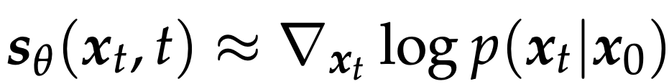
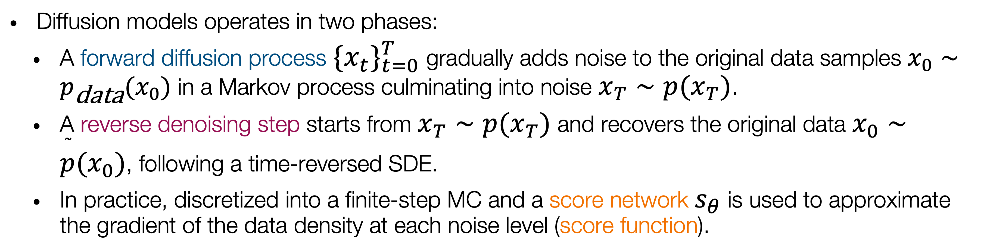
Diffusion models: a short primer
Diffusion models operates in two phases:
  A forward diffusion process $\{x_{t}\}_{t=0}^{T}$ gradually adds noise to the original data samples $x_{0}∼p_{\text{data}}(x_{0})$ in a Markov process culminating into noise $x_{T}∼p(x_{T})$.
  A reverse denoising step starts from $x_{T}∼p(x_{T})$ and recovers the original data $x_{0}∼\overset{˜}{p}(x_{0})$, following a time-reversed SDE.
  In practice, discretized into a finite-step MC and a score network $s_{θ}$ is used to approximate the gradient of the data density at each noise level (score function).
$$x_{0}$$
$x_{t−1}$
$$x_{T}$$
Reverse denoising process (noise $→$ data)
score network
score function

Slide 5
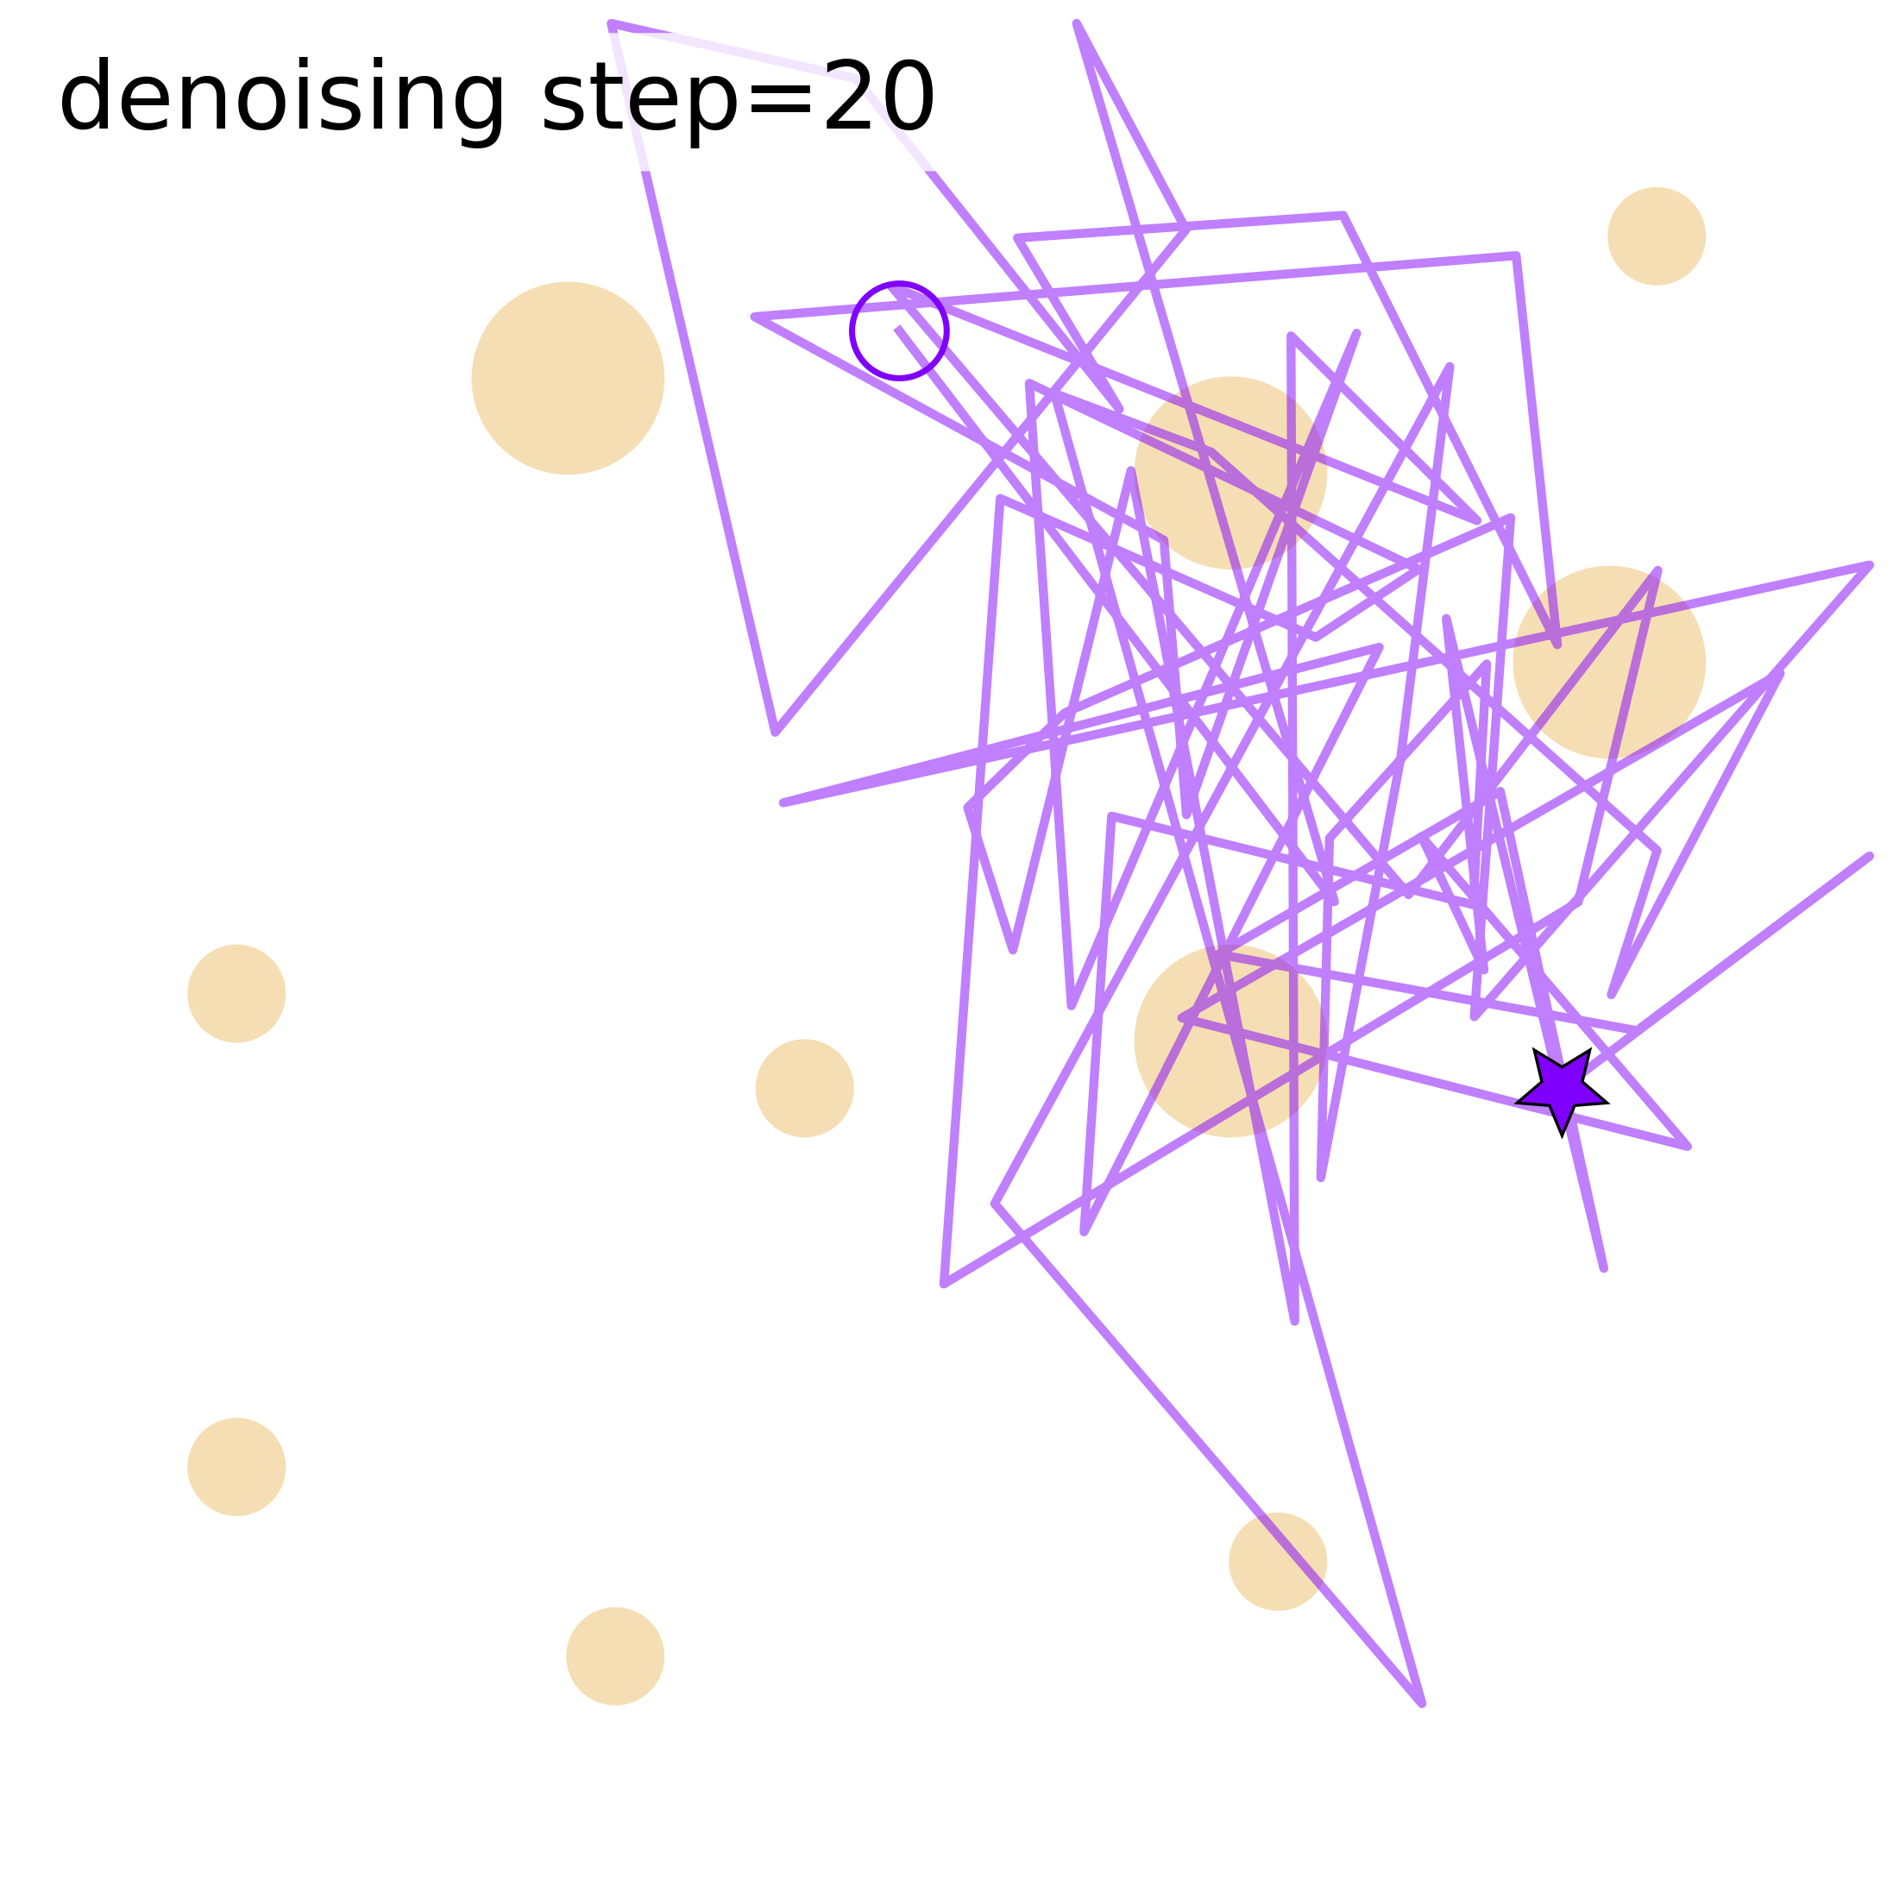
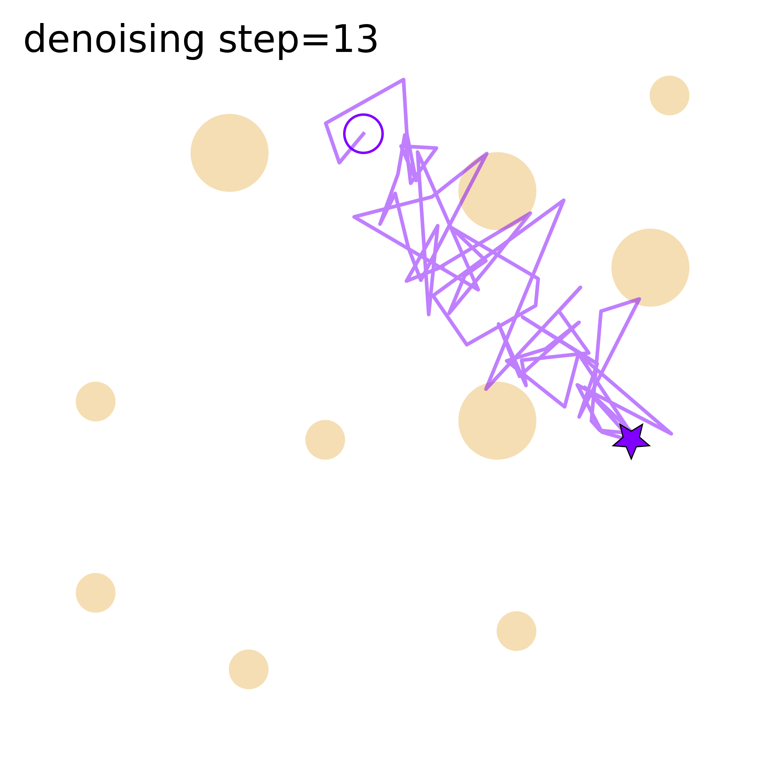
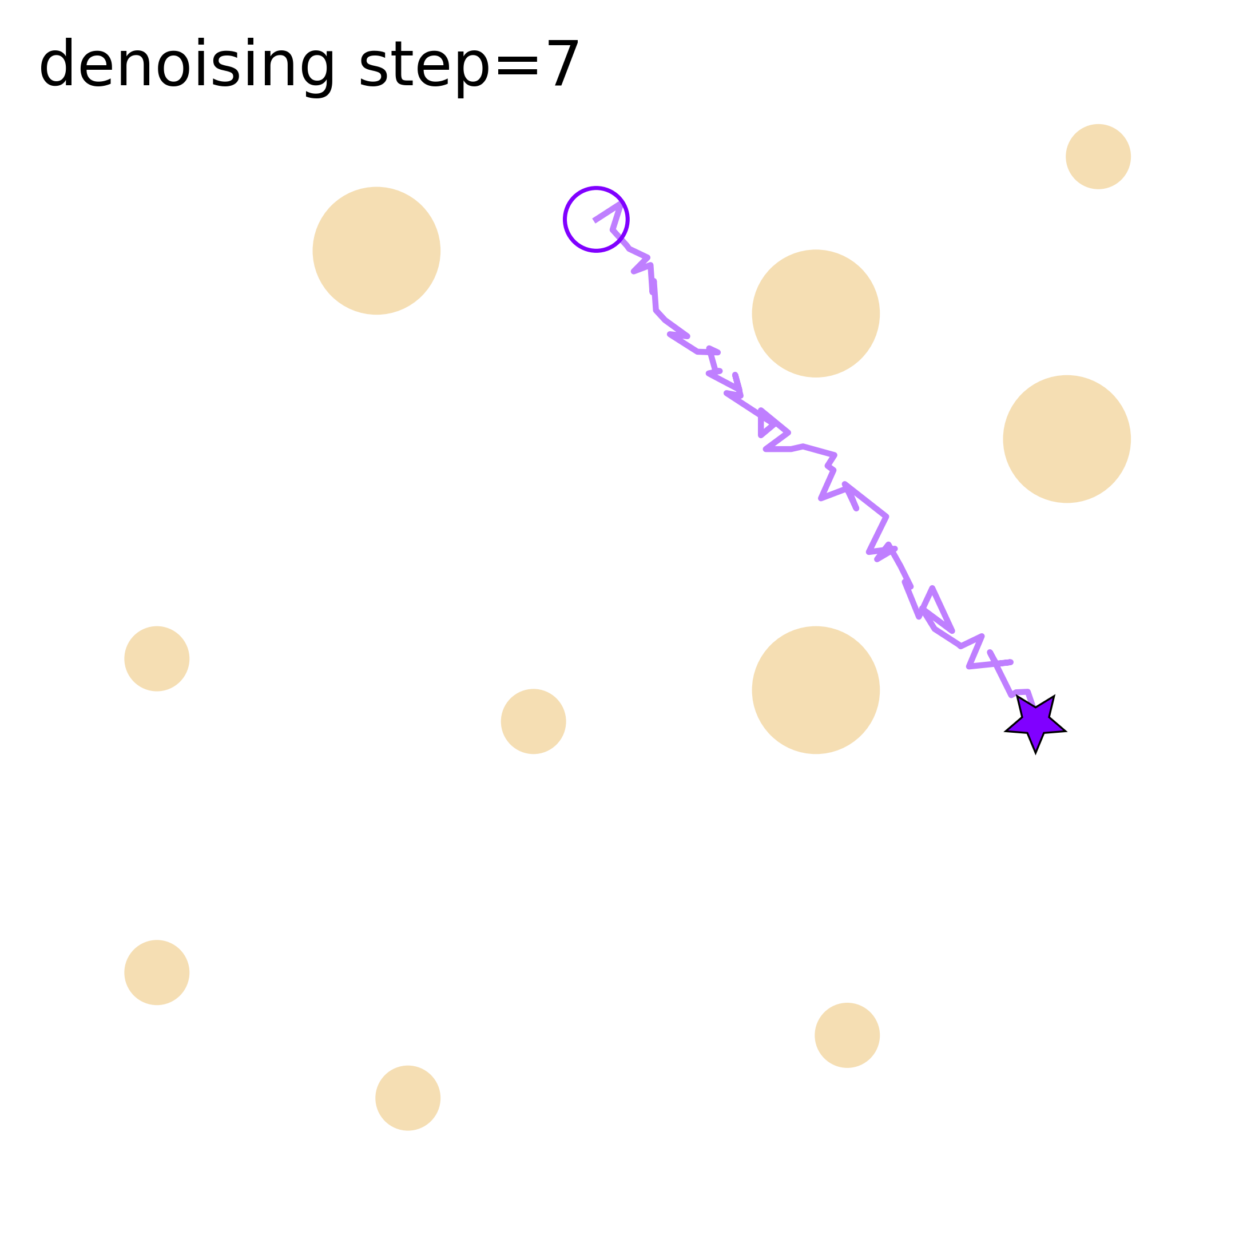
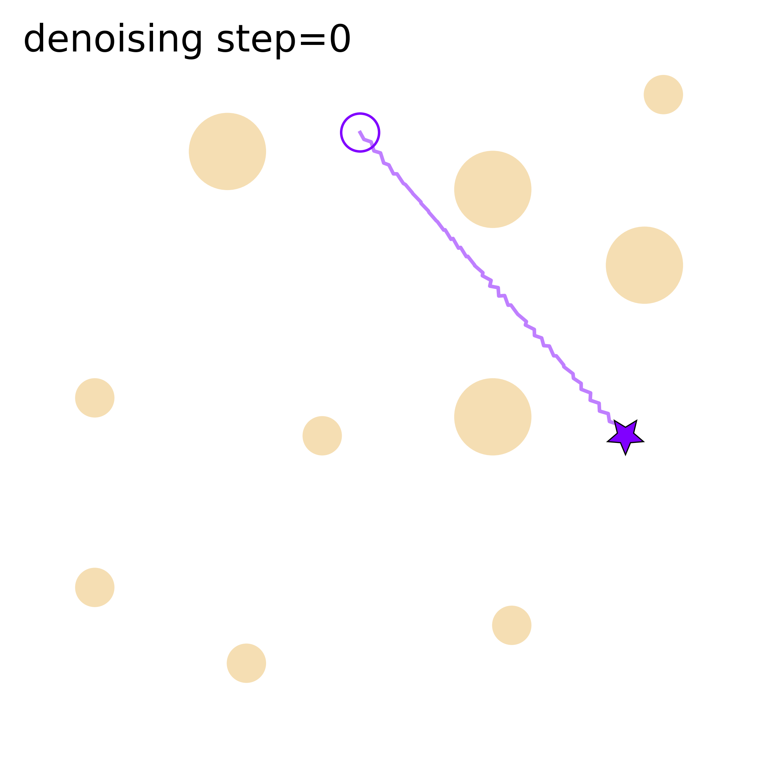
Visualizing the diffusion process for trajectories
Low dimensional data, and much faster to compute than regular image-diffusion.
“Latent” and final dimensions are both in the same geometric manifold

Slide 6
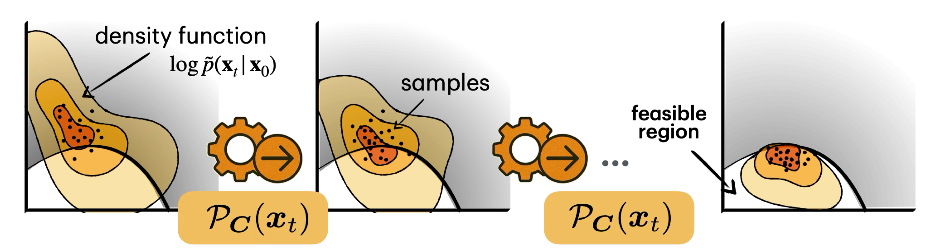
Constraint-aware Diffusion

Slide 7
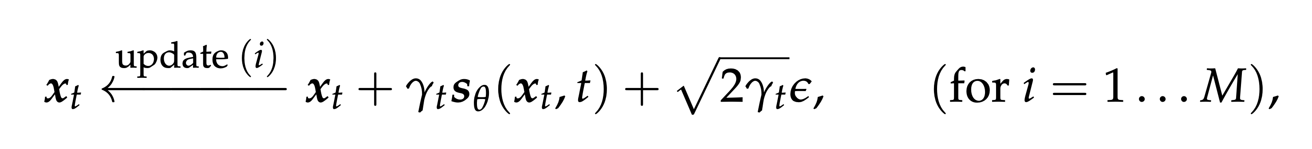
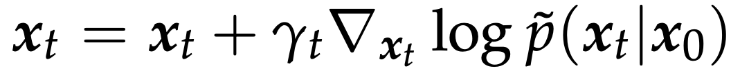

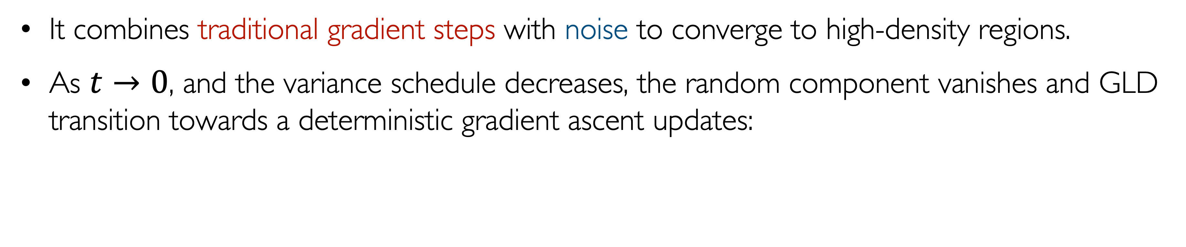
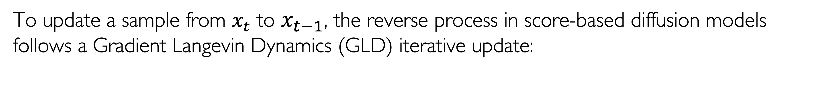
Understanding the reverse diffusion process
To update a sample from $x_{t}$ to $x_{t−1}$, the reverse process in score-based diffusion models follows a Gradient Langevin Dynamics (GLD) iterative update:
Gradient step
Random noise
Current state
It combines traditional gradient steps with noise to converge to high-density regions.
As $t→0$, and the variance schedule decreases, the random component vanishes and GLD transition towards a deterministic gradient ascent updates:
NeurIPS:24

Slide 8
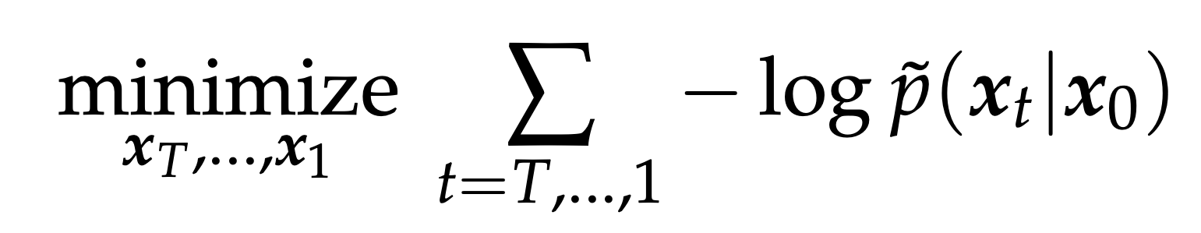

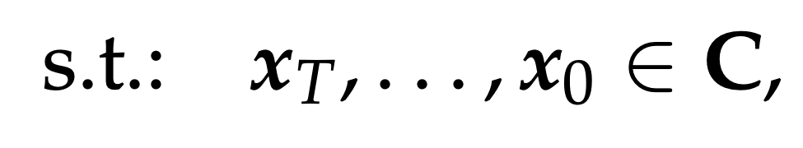
Constrained-based diffusion
Key idea
Recast this sampling process as a sequential optimization problem:
where C defines the feasible region determined by the constraints.
The objective of the reverse diffusion in CADM and traditional score-based models are identical: learning to generate samples that align with the same learned data distribution.
Gradients of the objective function are redly available through the score network!
NeurIPS:24

Slide 9
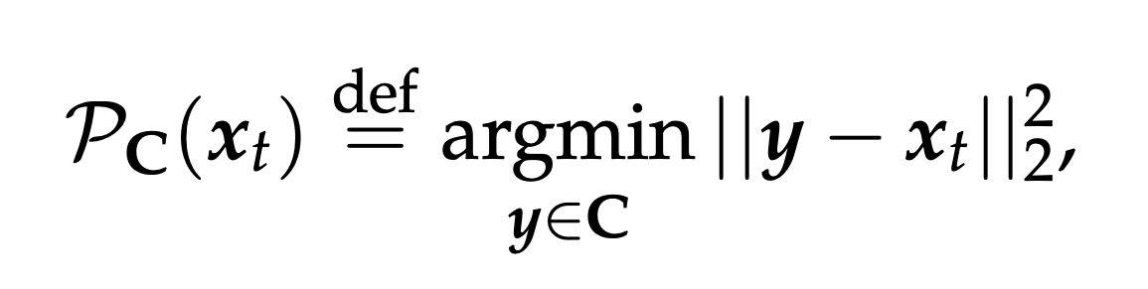
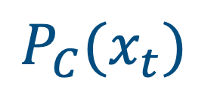
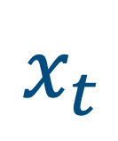
Constrained-based diffusion
Key idea
To maintain feasibility during the iterative updates, we apply a projection-based approach:
(in the case of “continuous” data)
$$x_{t}$$
$$P_{C}(x_{t})$$
NeurIPS:24

Slide 10
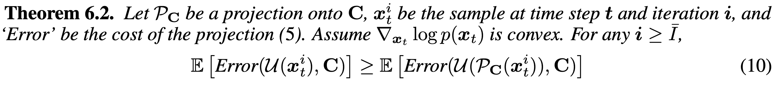
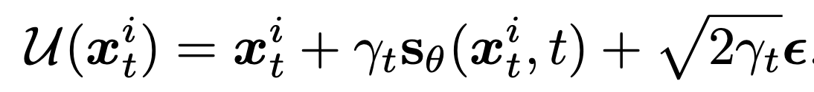
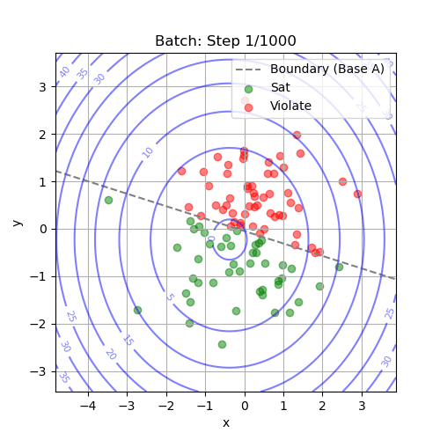
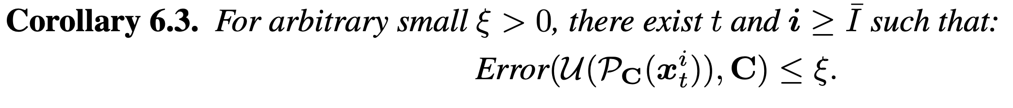
Constrained-based diffusion
Why projecting?
where is a single update step for the sampling process.
CADM projection steps ensure the resulting samples adhere more closely to the constraints as compared to those generated via unprojected methods.
As the step size shrinks, the error reduces, and approaches zero with t, for convex constraints!
CADM guarantees feasibility for convex constraints, which is the case in several of our experiments!
NeurIPS:24

Slide 11
What was previously
out of distribution
in terms of data similarity
becomes in distribution
at the level of the
underlying constraints

Slide 12
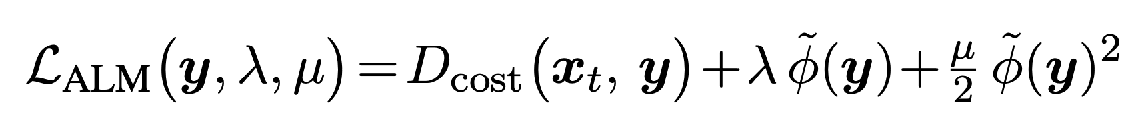
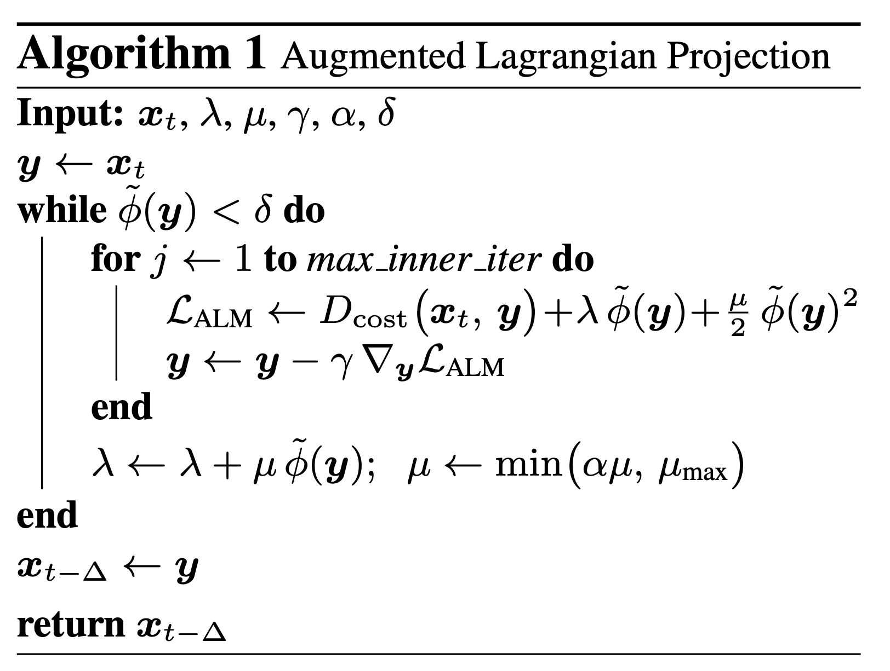
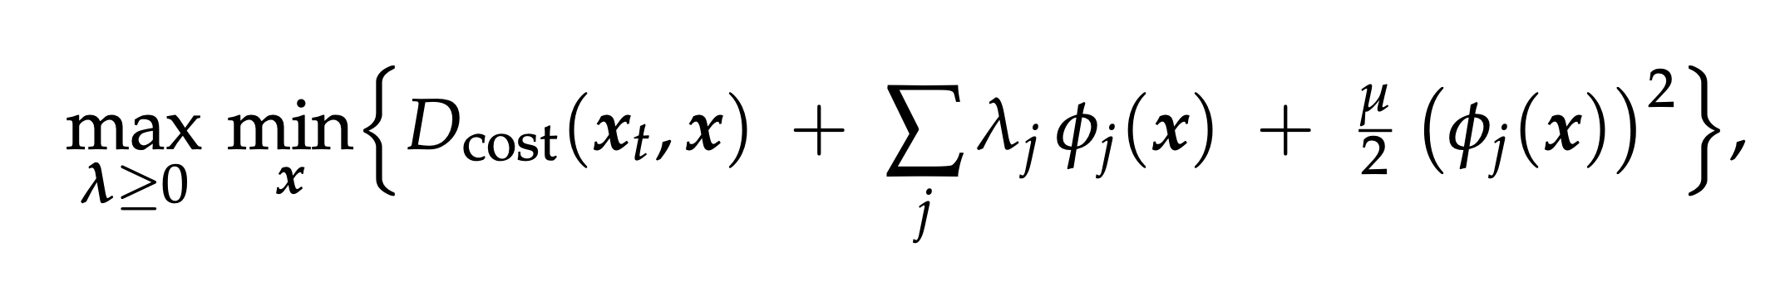
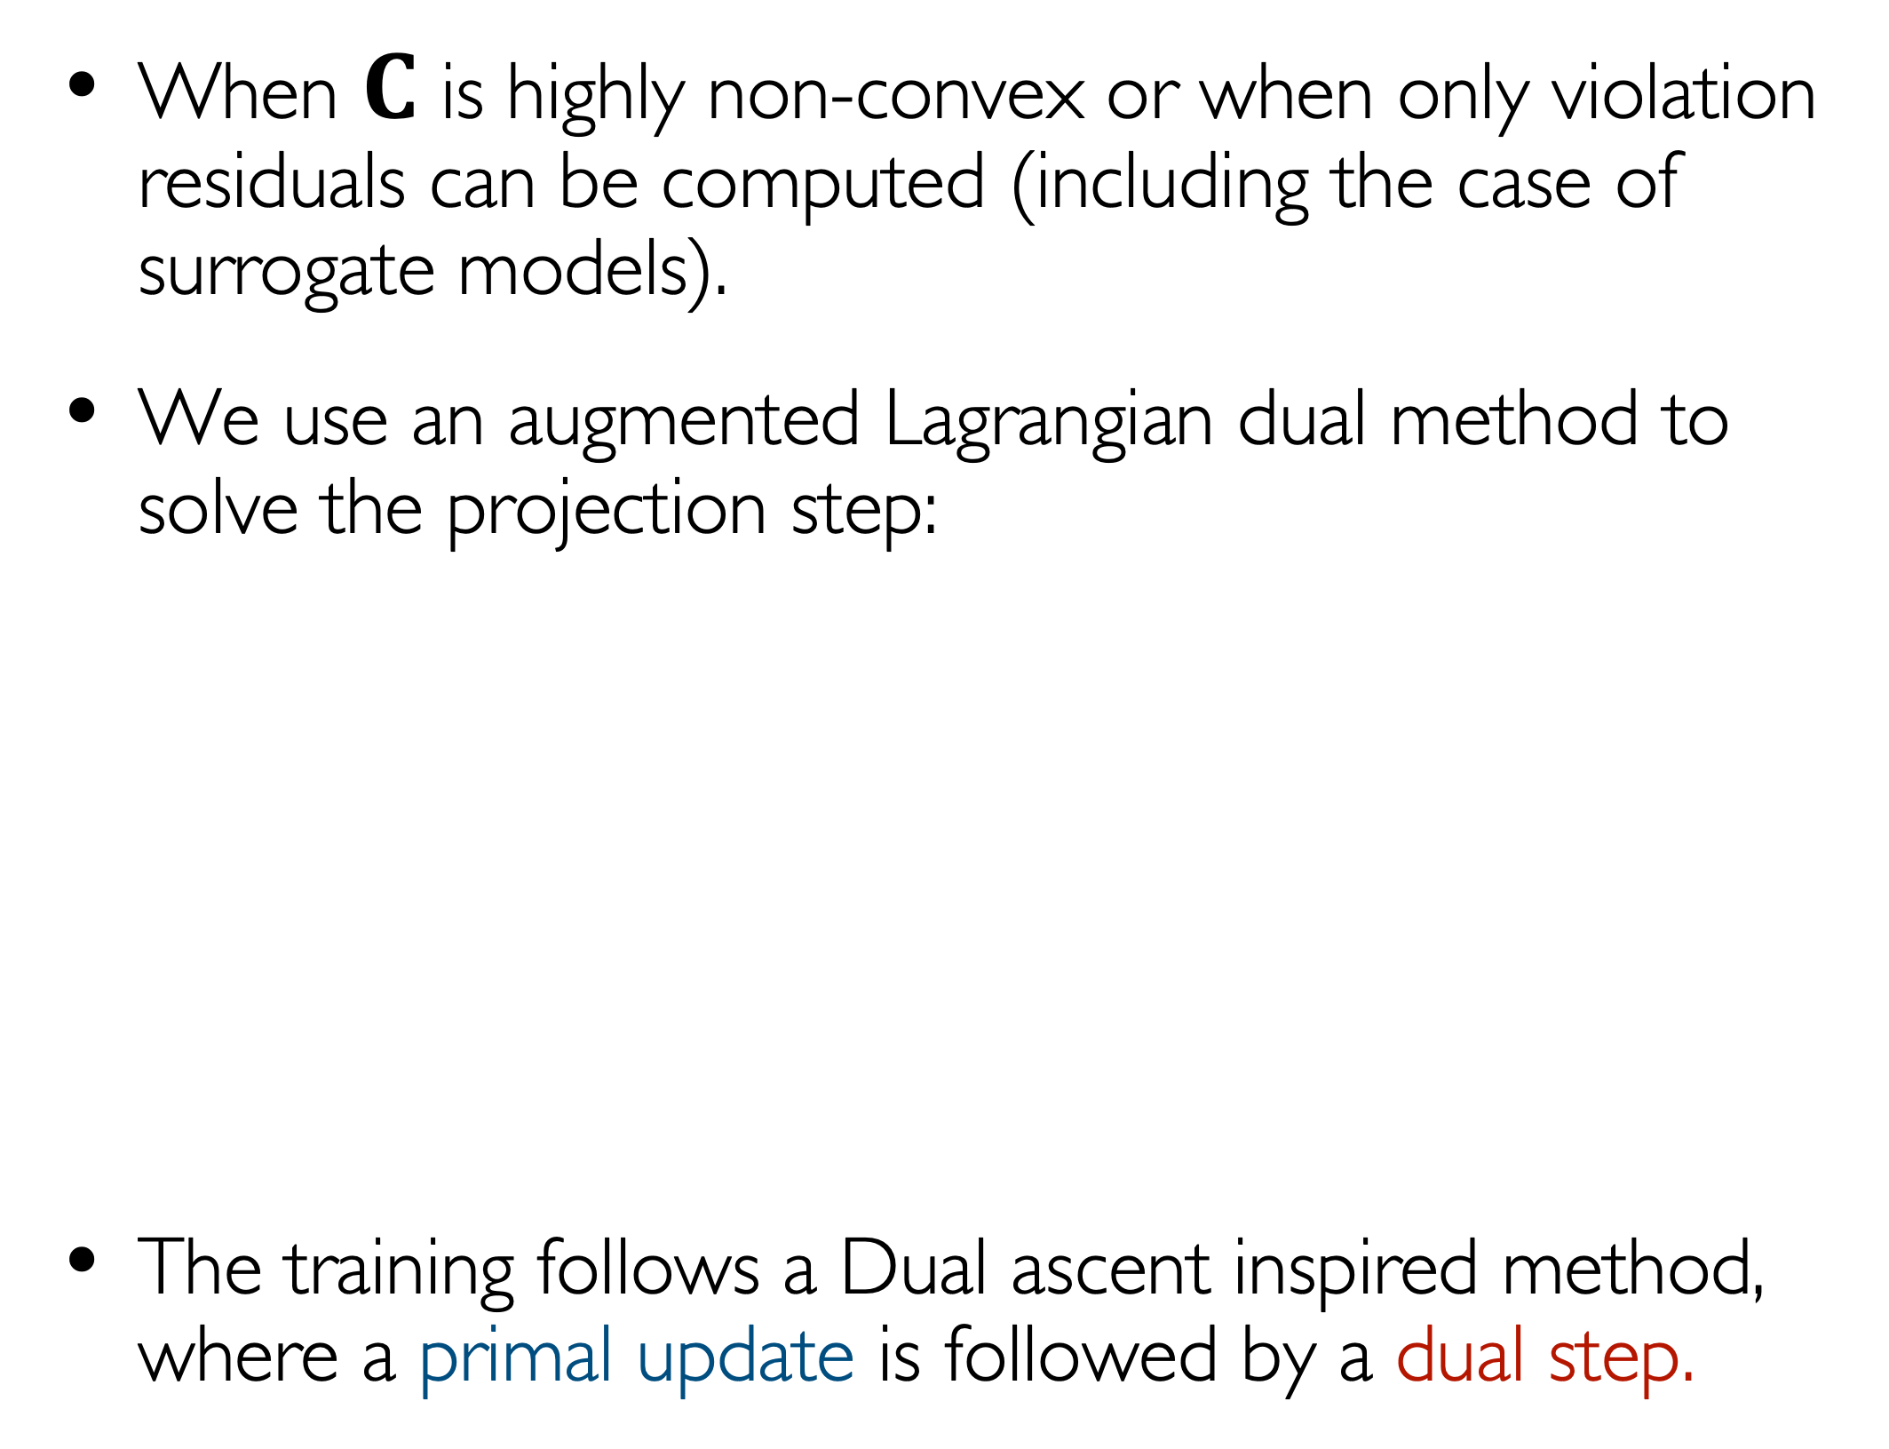
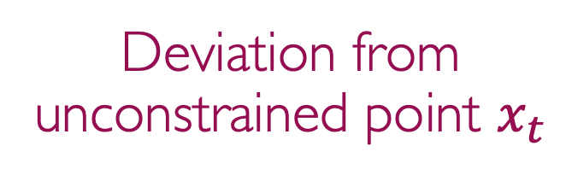
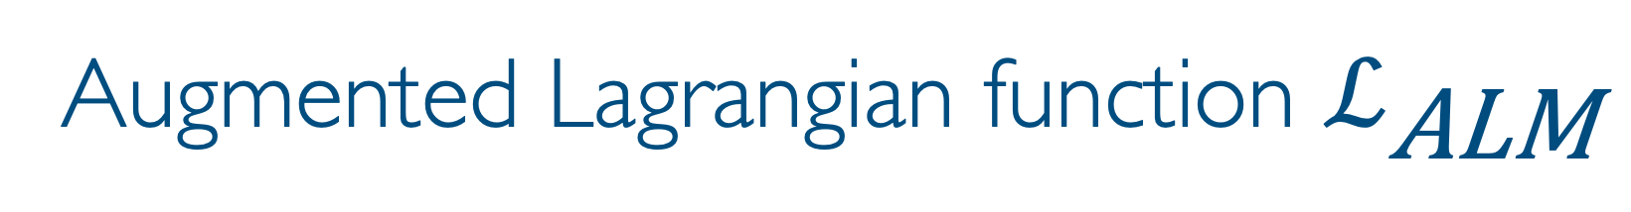
Augmented Lagrangian sampling
When $C$ is highly non-convex or when only violation residuals can be computed (including the case of surrogate models).
We use an augmented Lagrangian dual method to solve the projection step:
The training follows a Dual ascent inspired method, where a primal update is followed by a dual step.
Augmented Lagrangian function $ℒ_{\text{ALM}}$
Lagrangian dual
variables
Deviation from unconstrained point $x_{t}$
Differentiable residual or constraint violation
see our work on differentiable optimization AAAI:20, ECML:20, NeurIPS:23…

Slide 13
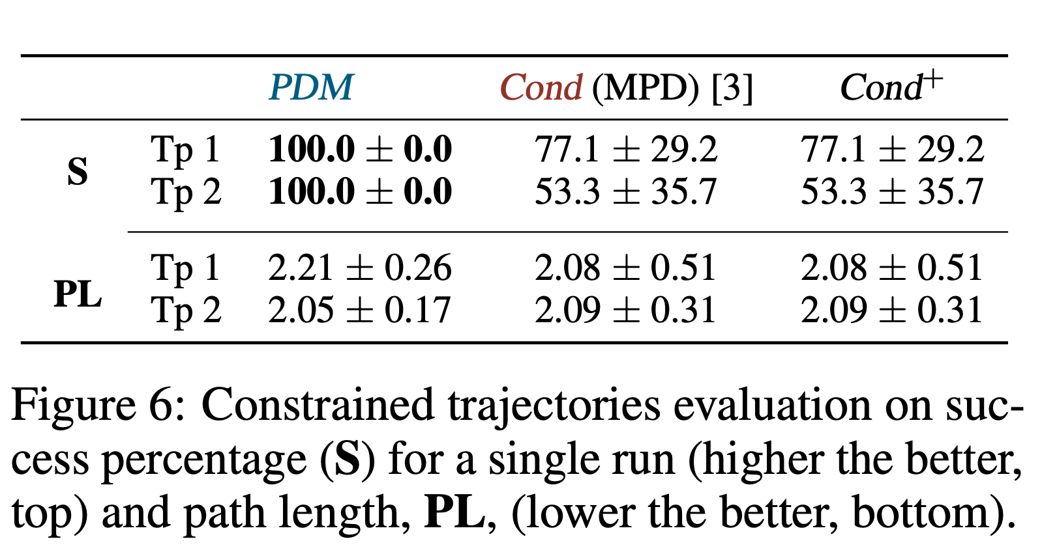
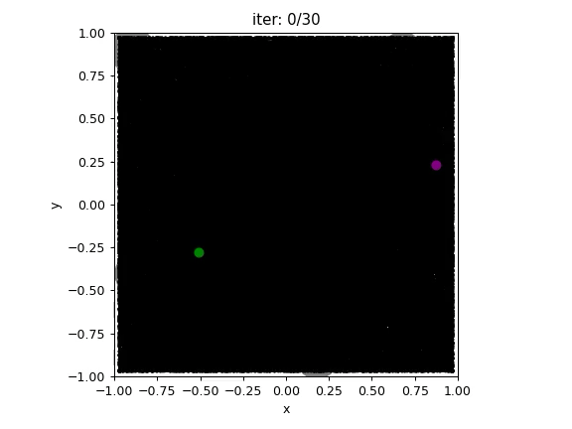
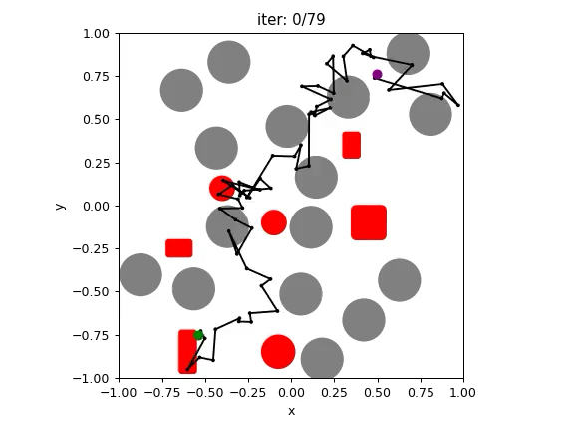
Safe autonomy: constrained trajectory
Experimental results
Key results: 100% non-collision satisfaction rate on the test cases adopted without producing notable degradation to path length.
Conditional (MDP) model
CADM
CADM
Motion Planning Diffusion (MPD)
[Carvalho et al., IROS 2023]
Our work (NeurIPS-24)

Slide 14



Safe autonomy: Multi-robot setting
Key results: high success rates in all scenarios (96-100%) while SOTA models performance significantly decreases when increasing the number of robots < 15%.
Emergent behavior
Multiple agents
ICML:25

Slide 15


Safe autonomy: Scaling to large systems
No collisions using 100 agents!
AAAI:26

Slide 16

Ongoing work: Safe and dynamic control
Handling failures
Imagine the agent encounters a steering issue (e.g., blocked right-turn controller).
How do we handle these situations online?
Idea: we embed a mathematical optimization driven controlled within the diffusion steps so to generate trajectories that are feasible w.r.t. the new feasible action space.
No-go zone

Slide 17


Ongoing work: Decentralized multi-agent setting
S1: agents use their own diffusion model to generate a “partially-safe” trajectory.
S2: given the current observations about other agents’ states, each agent uses their own model to simulate other agents trajectory (belief-aware planning).
Communication vs. simulation tradeoffs.
S3: planning occur using a constrained-aware diffusion model (CADM) considering both static and dynamic constraints.

Slide 18

Ongoing work: Decentralized multi-agent setting
S1: agents use their own diffusion model to generate a “partially-safe” trajectory.
S2: given the current observations about other agents’ states, each agent uses their own model to simulate other agents trajectory (belief-aware planning).
Communication vs. simulation tradeoffs.
S3: planning occur using a constrained-aware diffusion model (CADM) considering both static and dynamic constraints.
Results: 100% success rate with a low communication frequency (avg = 1.76)

Slide 19

Ongoing work: Decentralized multi-agent setting
Need: other agents can strategically block access to a goal.
Challenge: current observations do not reveal whether behavior is benign or adversarial.
Solution: infer intent online, forecast intent-conditioned trajectories, and plan robustly against blocking strategies.

Slide 20

Closed-form diffusion
Why define constraints via score functions?

Slide 21

Closed-form diffusion
Why define constraints via score functions?

Slide 22

Ongoing work: Closed-form diffusion
Examples of analytical score functions

Slide 23



Ongoing work: Closed-form diffusion
Very fast planning time. Great belief-aware planning simulator (S2)
No training data required!

Slide 24

Constraining discrete LLMs
Discrete sequences (natural language, molecular structures) hold tremendous potential for safe autonomy.
In autonomous Labs: they could accelerate scientific discovery by interpreting complex experimental workflows.
In embedded robotics: They enable dynamic contextual reasoning, advanced planning, object manipulation, etc.
Challenges
Safety risks (e.g., jailbreak attacks) can lead to harmful actions, like robot damaging components or breaching safety zones, labs generating hazardous substances.
Other risks include, misuse of knowledge and operational risks in healthcare, manufacturing, and scientific innovation.
Need
  Techniques to ensure that desired safety or control desiderata are met during the LMM generation phase. Ideally, we’d like to deliver provable safeguards against unsafe behaviors.

Slide 25


Discrete diffusion models
AR models struggle to enforce constraints due to their reliance on token-by-token generation.
Discrete diffusion models are rapidly evolving architectures which mirror (continuous) diffusion models but operate on token distributions.
Sahoo et al. (2024)

Slide 26



Constrained-aware discrete diffusion (CDD)
Key Idea: Adapt the projected diffusion process to the discrete denoising process:
where $x_{t}$ is the current token sequence
(e.g., L tokens in $ℝ^{V}$).
Use the KL divergence between the
original $x_{t}$ and the “projected”
sequence $y$.
The constraints are enforced over the
$argmax(y)$ thus, CDD assess valid
outputs at the sequence level!
prompt: This suggestion is […]
NeurIPS:25

Slide 27

Natural language toxicity mitigation
While LLMs have remarkable capabilities in generating human-like text, they can inadvertently create offensive and dangerous outputs.
Post-processing methods do not provide guarantees.
RealToxicity Prompt dataset
NEuS:25

Slide 28



Synthetic chemistry: Molecular generation
Task:
Generate molecules in SMILE format using a discrete diffusion model.
Apply 5 BRENK substructure filters that identify fragments (e.g., aldehydes, three-membered heterocycles) linked to toxicity or reactivity.
Challenges
O.o.d. generalization (novelty constraint)
Rule-based constraints (toxicity filters)
NeurIPS:25

Slide 29



Synthetic chemistry: Molecular generation
CDD
CDD
Key results: CDD achieve perfect adherence to safety constraints, while increasing the frequency of novel, valid, $∧$ non-toxic generation by over 3.5x w.r.t previous SOTA models.
NeurIPS:25

Slide 30
References
Constrained Synthesis with Projected Diffusion Models. Jacob K. Christopher, Stephen Baek, Ferdinando Fioretto.
Advances in Neural Information Processing Systems 37 (NeurIPS 2024)
Motion Planning Diffusion: Learning and Planning of Robot Motions with Diffusion Models. Joao Carvalho, An T. Le, Mark Baierl, Dorothea Koert, Jan Peters
IROS 2023
Simultaneous Multi-Robot Motion Planning with Projected Diffusion Models. Jinhao Liang, Jacob Christopher, Sven Koenig, and Ferdinando Fioretto.
In International Conference on Machine Learning, (ICML 2025).
Discrete-Guided Diffusion for Scalable and Safe Multi-Robot Motion Planning. Jinhao Liang, Sven Koenig, and Ferdinando Fioretto
In AAAI Conference on Artificial Intelligence, (AAAI 2026)
Simple and Effective Masked Diffusion Language Models. Subham Sekhar Sahoo et al. NeurIPS 2024
Constrained Discrete Diffusion Models. Michael Cardei, Jacob K Christopher, Thomas Hartvigsen, Brian R. Bartoldson, Bhavya Kailkhura, and Ferdinando Fioretto. In Advances in Neural Information Processing Systems, (NeurIPS 2025)
Neuro-symbolic Generative Diffusion Models for Physically Grounded, Robust, and Safe Generation. Jacob K. Christopher, Michael Cardei, Jinhao Liang, and Ferdinando Fioretto. In International Conference on Neuro-symbolic Systems (NeuS), 2025
Search-Augmented Masked Diffusion Models for Constrained Generation. Huu Binh Ta, Michael Cardei, Alvaro Velasquez, and Ferdinando Fioretto.
ArXiv 2026

