Slide 1



Asynchronous Federated Learning Literature Review
CIS 700 Final Presentation
David Castello

Slide 2
Outline
Motivation: (very) brief review of federated learning
Background
Literature Review:
Shortcomings of synchronicity
Novel asynchronous protocols
Standout features
Experimental results
Conclusion
Question and Answer

Slide 3
Motivation
Motivation -> Background -> Literature Review -> Conclusion -> Q/A

Slide 4
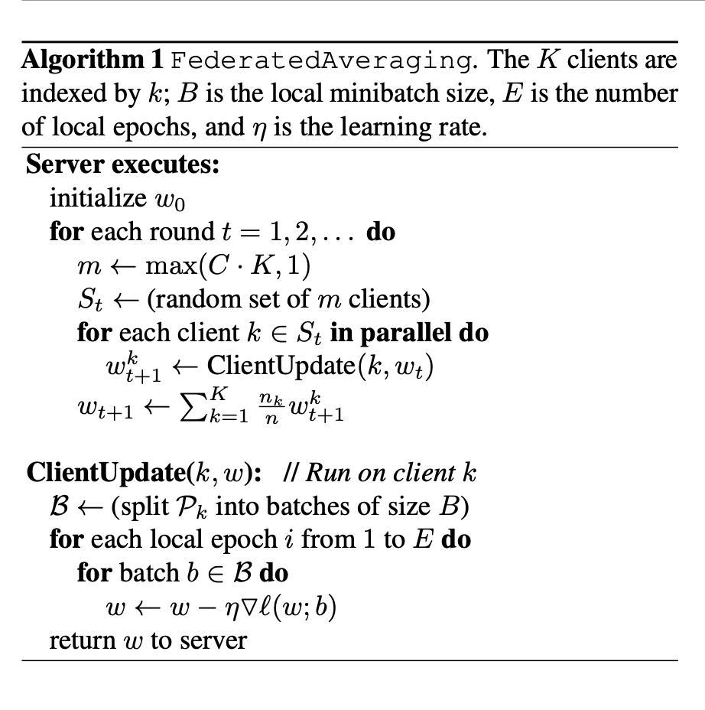
Motivation
Federated optimization:
Data is non-IID
Unbalanced usage across clients
Massively distributed
Communication constraints
And yet…
From “Communication-Efficient Learning of Deep Networks from Decentralized Data”

Slide 5
Background
Motivation -> Background -> Literature Review -> Conclusion -> Q/A

Slide 6
Background
Goal: study the influences behind FederatedAveraging’s design
Any lessons learned regarding synchronization?
Result: identified five papers across three fields
Distributed optimization
Data center machine learning
Privacy

Slide 7
Background – Distributed Optimization
How to train across distributed data?
“Distributed Learning, Communication Complexity and Privacy” – Balcan et al.
Presents a series of protocols and analyzes communication bounds
Largely asynchronous updates
Relevant lessons learned: potential tradeoff
In a synchronized setting, the lack of a message is itself a message
Need additional communication overhead to overcome this

Slide 8
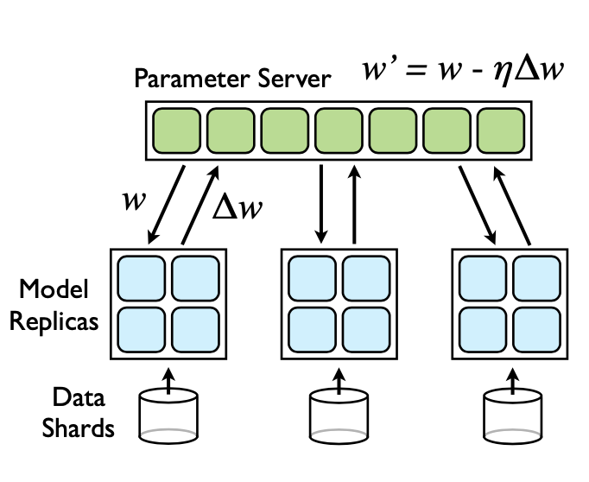
Background – Data Centers
How to train extremely large neural networks on data center compute hardware?
“Large Scale Distributed Deep Networks” – Dean et al.
DistBelief and Downpour SDG
Relevant lessons learned: asynchronicity has advantages
Robustness to hardware failure
Additional stochasticity in learning process
Leading performance… at the time
From “Large Scale Distributed Deep Networks”

Slide 9
Background – Privacy
How to train across distributed data privately?
“Multiparty Differential Privacy via Aggregation of Locally Trained Classifiers” - Pathak, Rane, and Raj
Secure aggregation by un-trusted mediator
Relevant lessons learned: averaging in a single shot is problematic
“Privacy-Preserving Deep Learning” - Shokri and Shmatikov
Distributed stochastic gradient descent with selective parameter sharing
Relevant lessons learned: asynchronicity has advantages here, too
Added stochasticity resembles regularization techniques
Useful for unreliable mobile networks

Slide 10



Background – Quick Recap
Distributed Optimization: asynchronous protocols might introduce communication overhead
Data Centers: asynchronous protocols are robust to hardware failure
Privacy: asynchronous protocols introduce beneficial stochasticity
Big question – will these takeaways carry into asynchronous federated learning?

Slide 11
Literature Review
Motivation -> Background -> Literature Review -> Conclusion -> Q/A

Slide 12
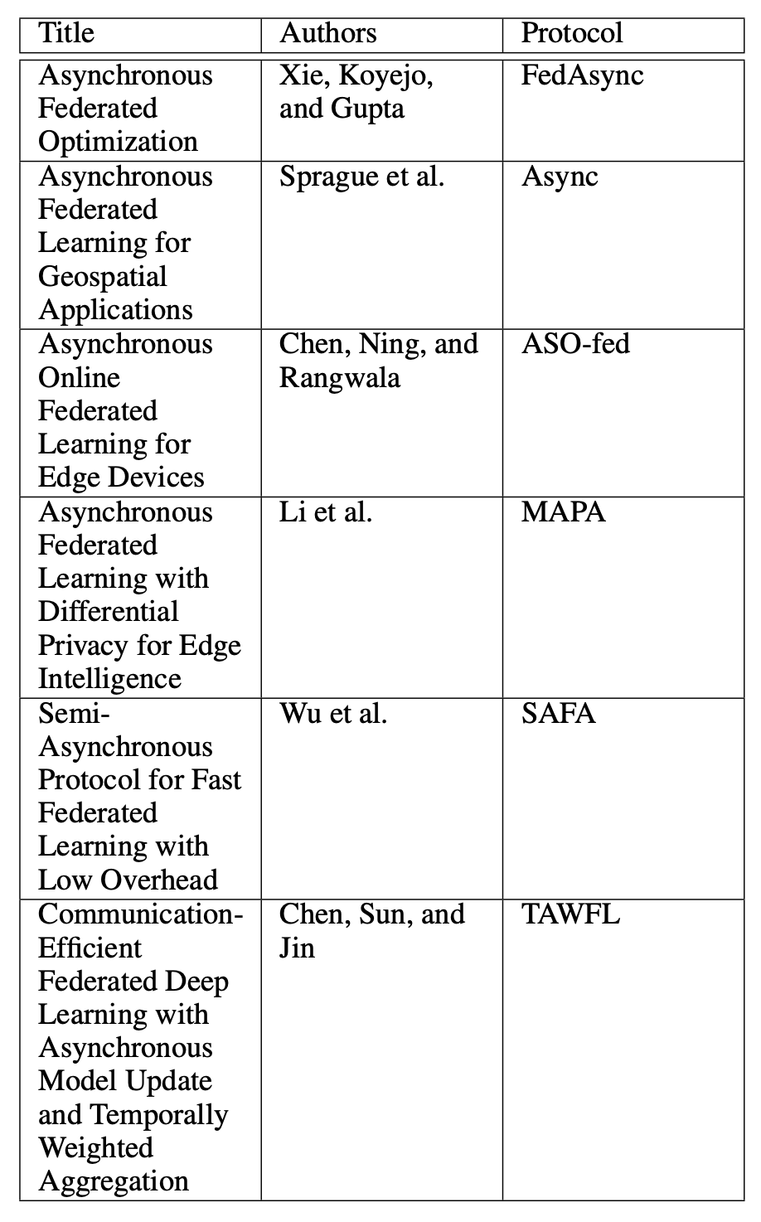
Literature Review – Selected Works
Selected six promising papers
All written within the last year
Most are unpublished
Findings:
Five had novel contributions
One was a little off the mark…
Duplication of effort

Slide 13
Literature Review - Motivations
Downloading global model and uploading local parameters at the same time leads to network congestion
Limits the number of clients that can participate at once
Straggler effect
Client devices are heterogeneous
Hardware, network connections are unreliable
Server needs to wait for the slowest devices to respond
Inefficient use of resources
Not all devices that are ready can participate
Not all devices that are participating will stay ready

Slide 14
Literature Review – Async Protocol
Sprague et al. introduce Async
Simplest algorithm of the bunch
Server immediately aggregates received updates and communicates global model to clients
Aggregation weight
Each paper addresses this concept
Use to control tolerance to staleness
Stale updates threaten stability of convergence
Low tolerance erases benefits of asynchronicity
x_{t} ← (1 − α)x_{t−1} + αx_{local}

Slide 15
Literature Review – FedAsync Protocol
Xie, Koyejo, and Gupta introduce FedAsync
Further explores aggregation weight (which they call mixing weight)
Make mixing weight a function of staleness
Linear
Polynomial
Exponential
Hinge
Communication Overhead
Convergence Speed
Convergence Stability

Slide 16
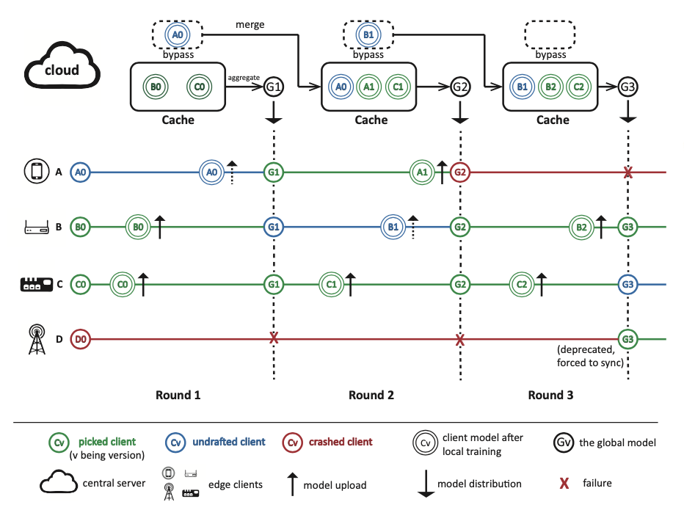
Literature Review – SAFA Protocol
Wu et al. introduce SAFA
Most sophisticated protocol
Unified “lag tolerance” parameter
Three stages:
Model distribution with lag tolerance
“First Come First Merge”
Discriminative aggregation
First paper to reference another in the group
From “SAFA: a Semi-Asynchronous Protocol for Fast Federated Learning with Low Overhead”

Slide 17
Literature Review – Standout Features
Chen, Ning, and Rangwala introduce ASO-fed
Asynchronous online federated learning
Similar to Async protocol, with added support for online learning and dynamic learning step size
Mobile devices have continuous stream of data from on-board sensors
Perform online learning client-side
Exponential moving average to emphasize those data points that are recent

Slide 18
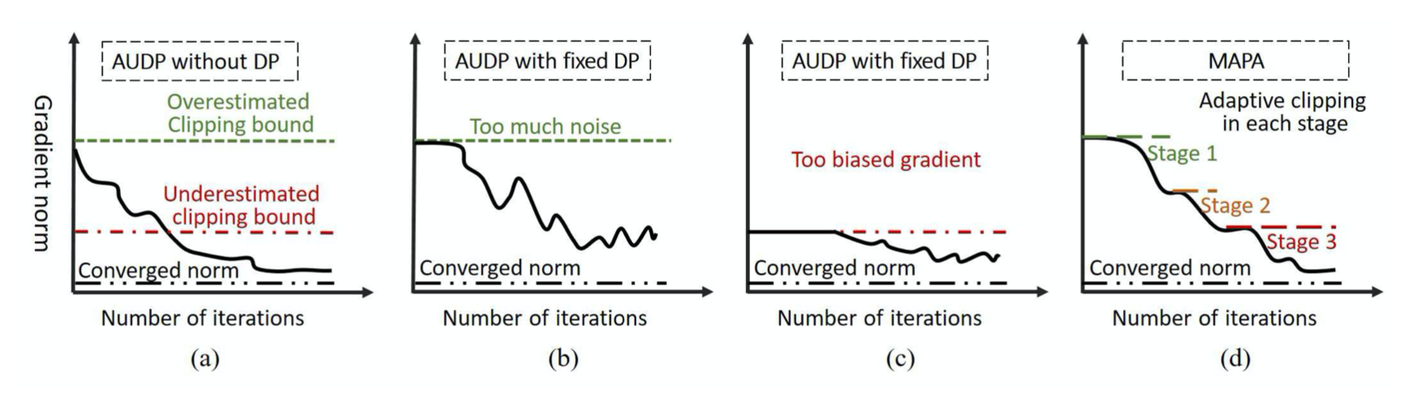
Literature Review – Standout Features
Li et al. introduce MAPA
Multi-stage adjustable private algorithm
Similar to FedAsync protocol, with added support differential privacy
Federated learning is still susceptible to membership inference and model inversion attacks
MAPA adds sample-level differential privacy with adaptive clipping
From “Asynchronous Federated Learning with Differential Privacy for Edge Intelligence”

Slide 19
Literature Review – Standout Features
Proof of convergence
(Xie, Koyejo, and Gupta 2019) present proof of convergence for FedAsync on strongly and weakly convex problems
(Li et al. 2019) present proof of convergence for their baseline differentially-private protocol AUDP
Parameter sharing
(Chen, Sun, and Jin 2019) propose updating the deep and shallow layers of DNNs at different rates to save communication costs
Reminiscent of “Privacy-Preserving Deep Learning”
Might be applicable to other algorithms

Slide 20
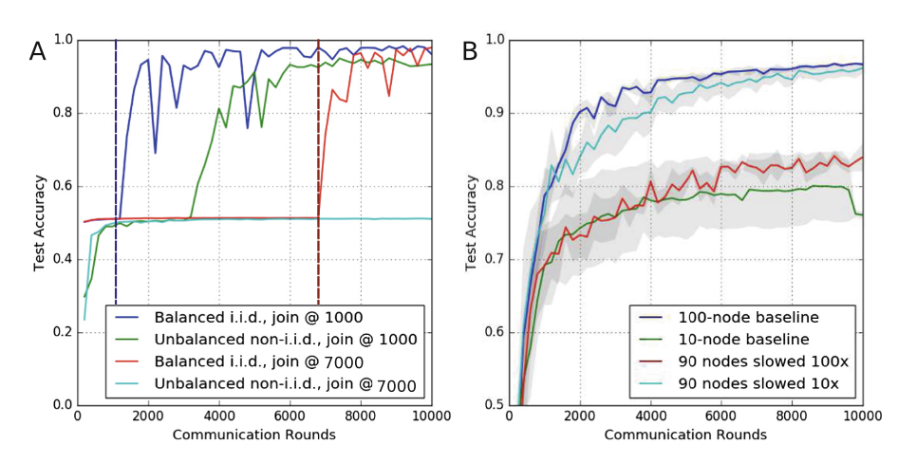
Literature Review – Results
Sprague et al. has robust experimentation
From “Asynchronous Federated Learning for Geospatial Applications”

Slide 21
Literature Review – Results
Sprague et al. test heterogeneous hardware and “drop-in”
From “Asynchronous Federated Learning for Geospatial Applications”

Slide 22
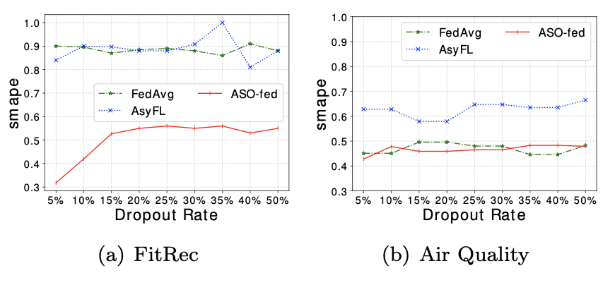
Literature Review – Results
Chen, Ning, and Rangwala test drop-out
From “Asynchronous Online Federated Learning for Edge Devices”

Slide 23
Conclusion
Motivation -> Background -> Literature Review -> Conclusion -> Q/A

Slide 24
Conclusion
Asynchronous federated learning…
Has identified a real need
Has strong theoretical underpinnings
As a community is very young
Very early stages of a conversation
Awaiting “second round of communication”
Will it converge?

Slide 25
Q/A

Slide 26
References
Balcan, M.-F.; Blum, A.; Fine, S.; and Mansour, Y. 2012.Distributed Learning, Communication Complexity and Privacy.arXiv e-printsarXiv:1204.3514.
Brendan McMahan, H.; Moore, E.; Ramage, D.; Hampson,S.; and Ag ̈uera y Arcas, B. 2016. Communication-Efficient Learning of Deep Networks from Decentralized Data.arXive-printsarXiv:1602.05629.
Chen, Y.; Ning, Y.; and Rangwala, H. 2019. Asynchronous Online Federated Learning for Edge Devices.arXiv e-printsarXiv:1911.02134.
Chen, Y.; Sun, X.; and Jin, Y. 2019. Communication-efficient federated deep learning with asynchronous model update and temporally weighted aggregation.ArXivabs/1903.07424.
Dean, J.; Corrado, G.; Monga, R.; Chen, K.; Devin, M.;Mao, M.; aurelio Ranzato, M.; Senior, A.; Tucker, P.; Yang,K.; Le, Q. V.; and Ng, A. Y. 2012. Large scale distributeddeep networks. In Pereira, F.; Burges, C. J. C.; Bottou, L.;and Weinberger, K. Q., eds.,Advances in Neural Informa-tion Processing Systems 25. Curran Associates, Inc. 1223–1231.
Koneˇcn ́y, J.; McMahan, B.; and Ramage, D. 2015. Federated Optimization: Distributed Optimization Beyond the Datacenter.arXiv e-printsarXiv:1511.03575.
Li, Y.; Yang, S.; Ren, X.; and Zhao, C. 2019. Asynchronous Federated Learning with Differential Privacy for Edge Intelligence.arXiv e-printsarXiv:1912.07902.
Pathak, M.; Rane, S.; and Raj, B. 2010. Multiparty differential privacy via aggregation of locally trained classifiers. In Lafferty, J. D.; Williams, C. K. I.; Shawe-Taylor, J.; Zemel,R. S.; and Culotta, A., eds., Advances in Neural Information Processing Systems 23. Curran Associates, Inc. 1876–1884.
Shokri, R., and Shmatikov, V. 2015. Privacy-preserving deep learning. In2015 53rd Annual Allerton Conference on Communication, Control, and Computing (Allerton), 909–910.
Sprague, M. R.; Jalalirad, A.; Scavuzzo, M.; Capota, C.;Neun, M.; Do, L.; and Kopp, M. 2019. Asynchronous federated learning for geospatial applications. In Monreale, A.;Alzate, C.; Kamp, M.; Krishnamurthy, Y.; Paurat, D.; Sayed-Mouchaweh, M.; Bifet, A.; Gama, J.; and Ribeiro, R. P., eds.,ECML PKDD 2018 Workshops, 21–28. Cham: Springer International Publishing.
Wu, W.; He, L.; Lin, W.; Mao, R.; and Jarvis, S. A. 2019.Safa: a semi-asynchronous protocol for fast federated learning with low overhead.ArXivabs/1910.01355.
Xie, C.; Koyejo, S.; and Gupta, I. 2019. Asynchronous Federated Optimization.arXiv e-printsarXiv:1903.03934.
Zheng, S.; Meng, Q.; Wang, T.; Chen, W.; Yu, N.; Ma, Z.-M.; and Liu, T.-Y. 2016. Asynchronous Stochastic Gradient Descent with Delay Compensation.arXiv e-printsarXiv:1609.08326.
https://mistkml.github.io/index.html
Images:
https://www.neweggbusiness.com/smartbuyer/wp-content/uploads/iStock-901001482-server.jpg
https://icdn6.digitaltrends.com/image/digitaltrends/smartphones-1175-1500x993.jpg
https://d33wubrfki0l68.cloudfront.net/13cd4ab6ac36926833f919feadb8668d810c93be/5027c/wordpress/wp-content/uploads/2002/12/old-analogue-clocks.jpg

