Slide 1
GAN Enhanced Anomaly State Detection in Autonomous Systems
Mengyu Liu
Lin Zhang

Slide 2
Problem
Autonomous driving system can be attacked in different ways which violate the security and safety of the whole system
There should be a solution to detect the anomaly to maintain the system

Slide 3
Challenge
Data imbalance and data collection
Recall more important
Theoretical support of data augmentation

Slide 4
Contribution of our Work
A generative neural network has been trained to get more negative data simulating the knowledge exploitation process. The augmented data merge with the original data to a new dataset.
Multiple anomaly detection algorithms were implemented as baselines.
Comparison between implemented anomaly detection model performance on original data and that on dataset with generated data. We built 4 testbeds with multiple sensors and actuators for our experiment to simulate the autonomous car as a cyber-physical system.

Slide 5
Responsibility
Lin worked on the design and engineering of the testbeds; he is also responsible for the data collection part .
Mengyu designed and implemented the experiments and analysis. Mengyu also responsible for the writing of the manuscript.
We discussed the ideas and tech details together.
The detailed manuscript was also included in submission

Slide 6
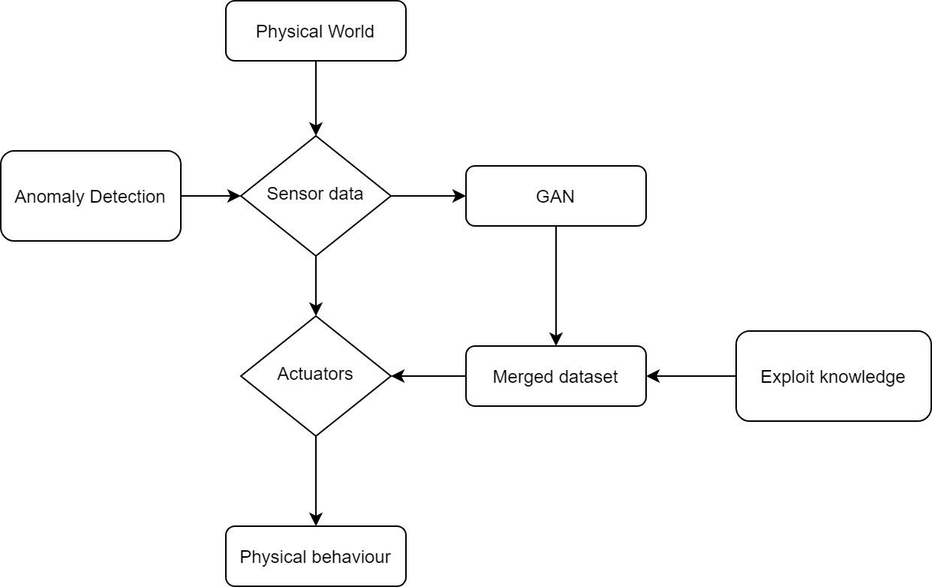
Workflow

Slide 7
Supervised vs Unsupervised
Labeling is the knowledge
We want to show supervised methods have better performance than unsupervised methods in general.
We want to see how the labeling visualized on feature space

Slide 8
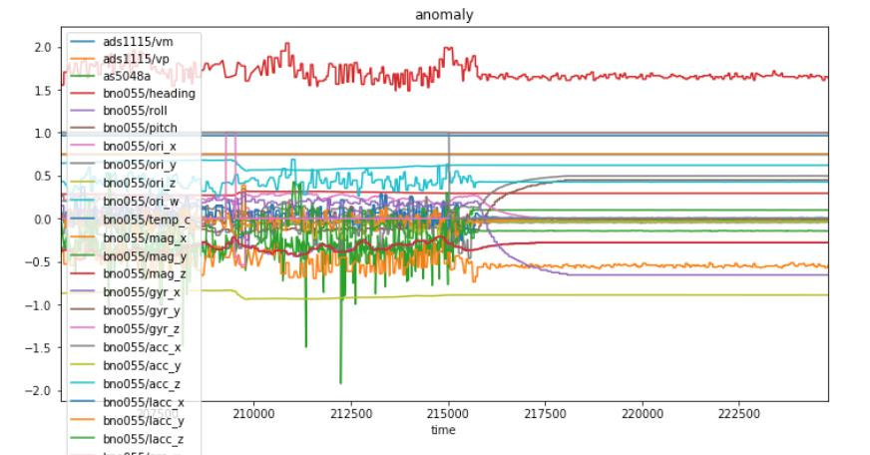
Data

Slide 9
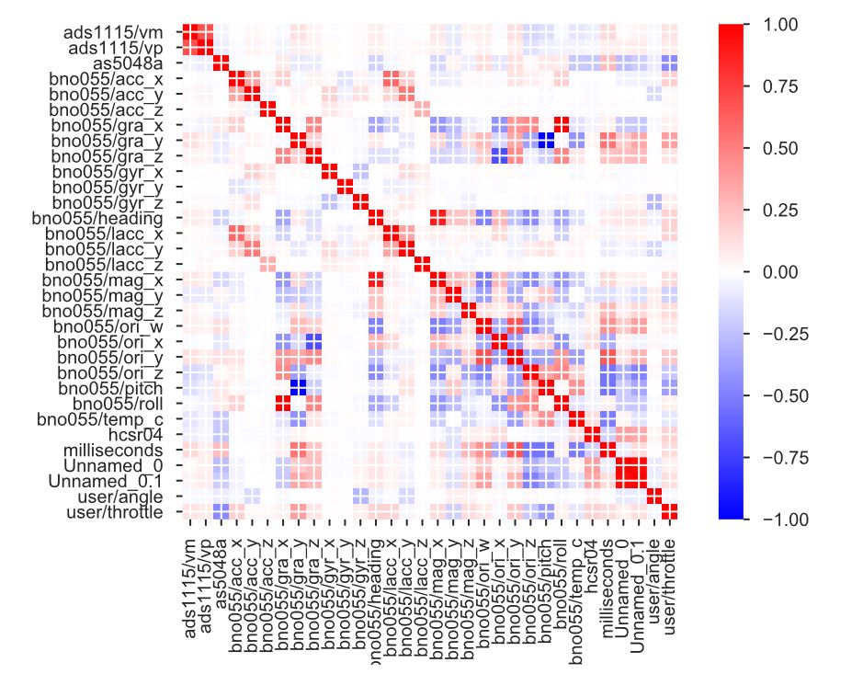
Correlation

Slide 10
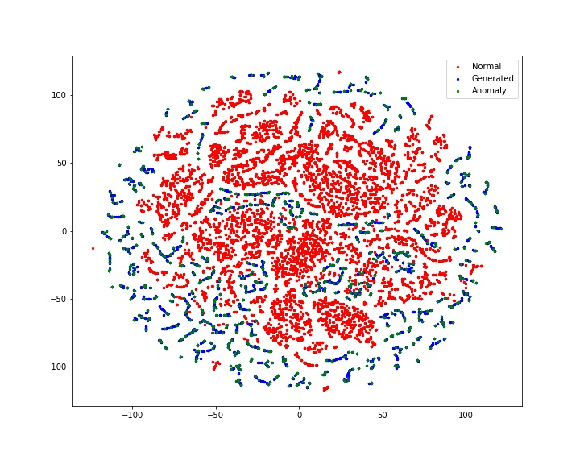
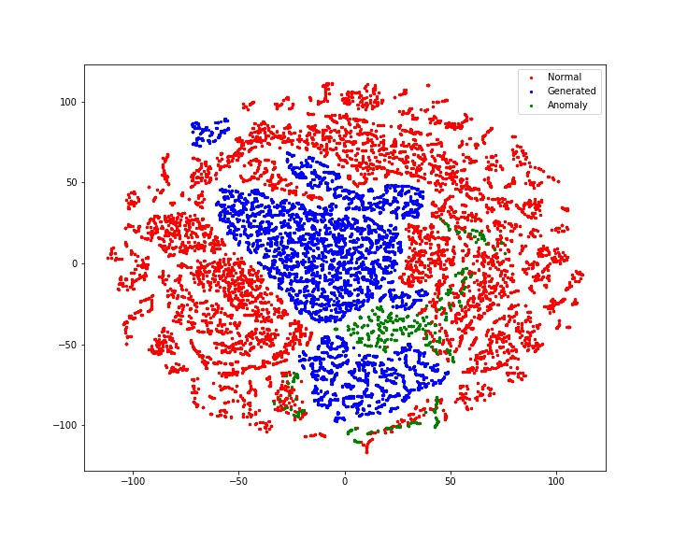
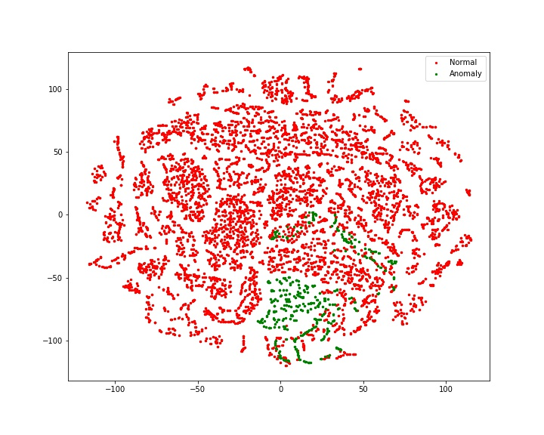
Data Visualization

Slide 11
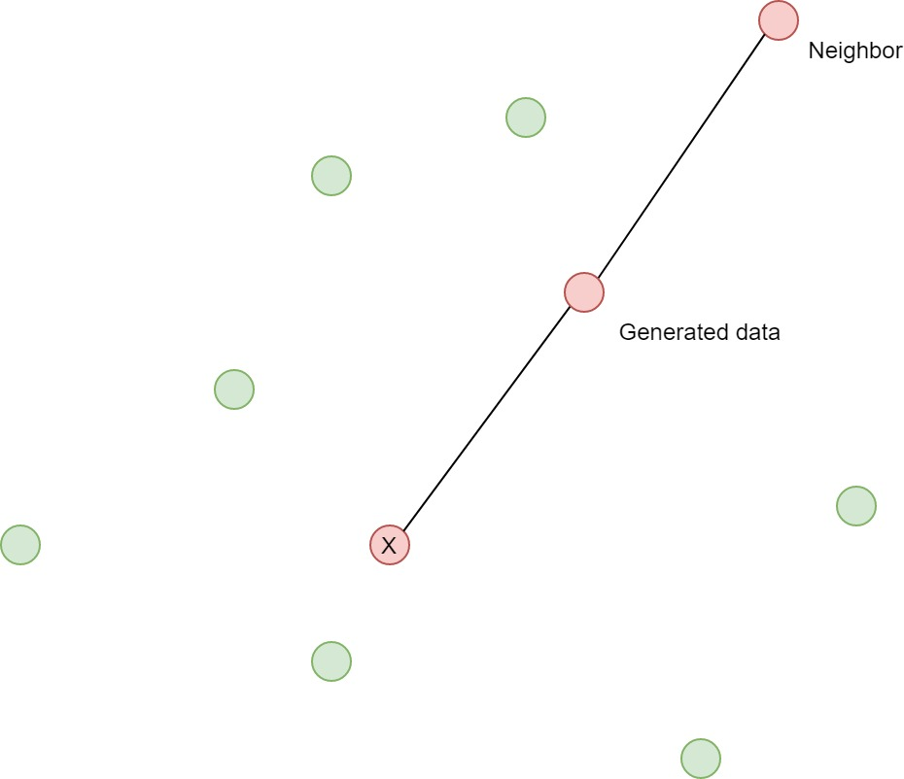
SMOTE

Slide 12
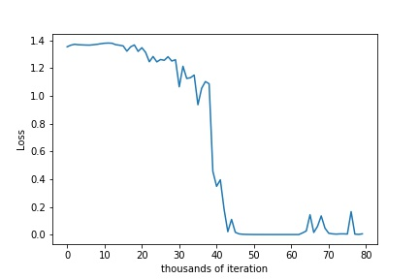
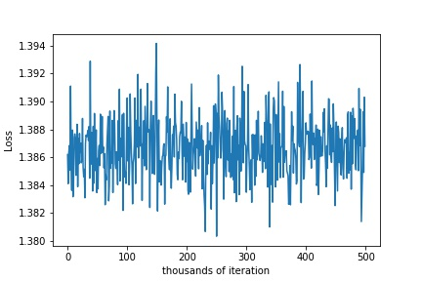
GAN

Slide 13
Modification of Loss
Training not stable
Modified Loss as mentioned in Original paper, performance getting better

Slide 14
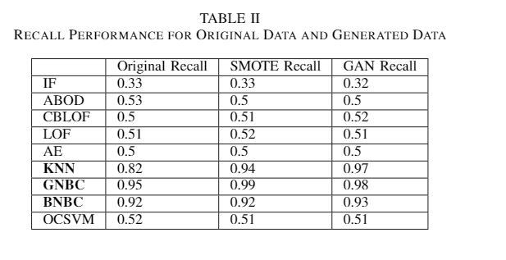
Final Results

Slide 15
Acknowledgement
Thanks to the financial support from our supervisor Dr. Kong
Thanks to Nando’s help with many good opinions
Thanks for the discussion of ideas in our group

