Slide 1
Improved StarGAN for Generating Adversarial Samples
Jindi Wu & Mu Bai

Slide 2
Motivation
Goal: A multi-domain targeted black box attack on facial feature recognition model.
Facial recognition technology has been applied to many real-world scenarios, such as person tracking and device unlocking. So the security of the face recognition model cannot be ignored. However, attack technology is the promoter of security technology.
Most models for generating facial adversarial sample just focus on one domain. But facial images have a lot of features that from different domains, such as gender, age, expression, etc. Therefore, models that focus on one domain cannot efficiently generate fake face images. So this is very interesting that we consider the features of the face from multiple domains with only one model to generate adversarial samples.

Slide 3
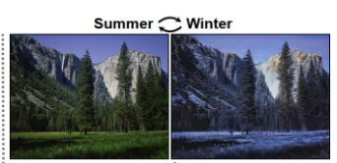
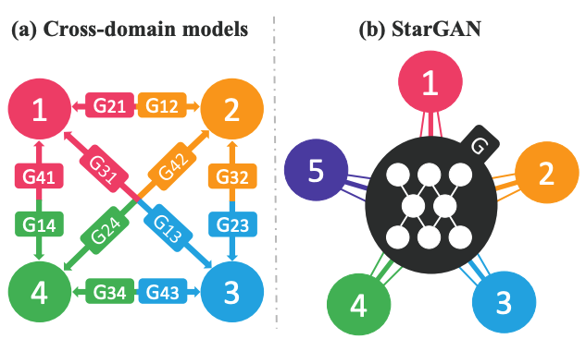
Background
Attributes: meaningful feature inherent in an image, like gender and facial expression.
Attribute value: a particular value of an attribute, like male and female.
Domain: a set of images sharing the same attribtue value.
GAN: Generate fake samples that are indistinguishable from real ones.
Conditional GAN: Generate samples conditioned on certain classes.
Image-to-Image Translation: Change a particular aspect of a given image to another. Recent work (CycleGAN, CoGAN, DiscoGAN) have achieved impressive result, but they are only capable of learning the relations between two different domains at a time.
StarGAN:

Slide 4
Method - Classifier
Dataset: CelebFaces Attributes(CelebA)
202,599 facial images with 40 binary attributes
Randomly select 50,000 images, 4000 among them for training and remaining for testing.
Resize each image as 128x128, choose 2 attributes: Smile and Male.
Classifier
2 Convolutional layers with relu activation funcion and Max pool function, and 2 fully connected layers.
Attribute | Accuracy
Smiling | 0.946
Male | 0.915

Slide 5
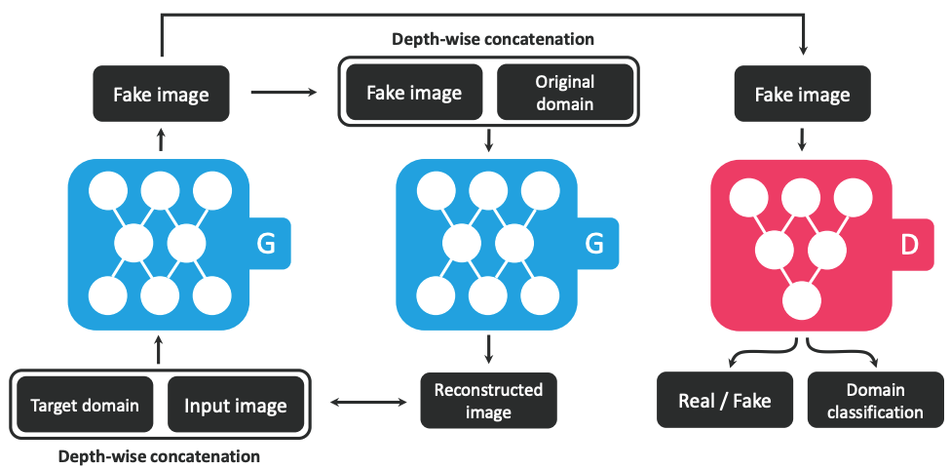

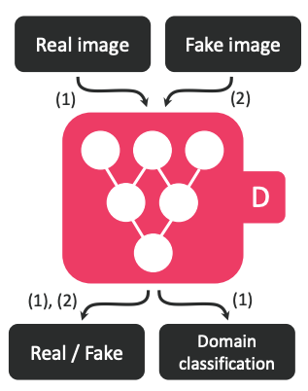



Methods - StarGAN
Adversarial Loss
Domain Classification Loss
Real images -> optimize D
Fake images -> optimize G
Reconsruction Loss

Slide 6
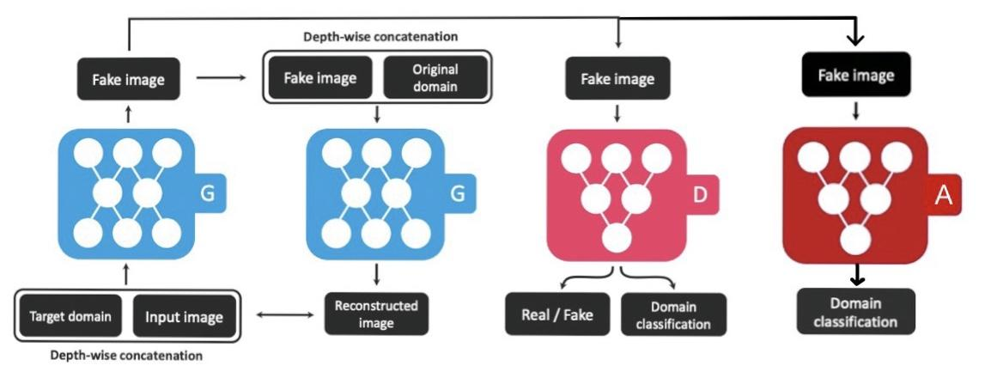


Methods - imporved StarGAN
Reconsruction Loss
Attack Loss
Full Objective

Slide 7
Results

Slide 8
Take-home
The noise of as adversarial sample can be added more explainable.
GAN is hard to train, especially when it has many hyperparameters!

Slide 9
References
Choi, Yunjey, et al. "Stargan: Unified generative adversarial networks for multi-domain image-to-image translation." Proceedings of the IEEE conference on computer vision and pattern recognition. 2018.
Zhu, Jun-Yan, et al. "Unpaired image-to-image translation using cycle-consistent adversarial networks." Proceedings of the IEEE international conference on computer vision. 2017.
Kos, Jernej, Ian Fischer, and Dawn Song. "Adversarial examples for generative models." 2018 IEEE Security and Privacy Workshops (SPW). IEEE, 2018.

