Slide 1
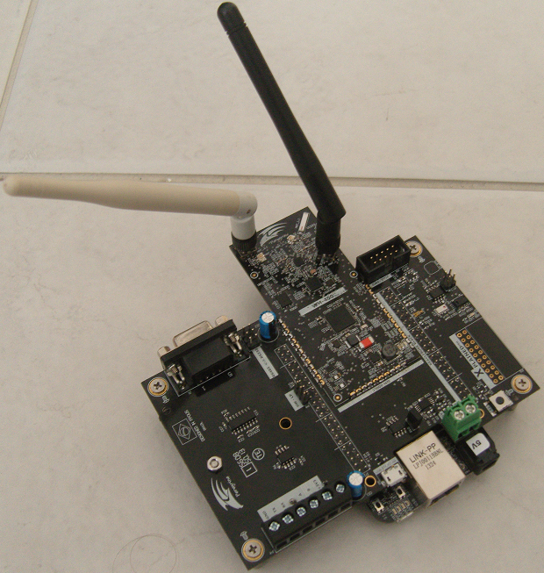
WM-400L
Beaglebone Black Shield
Gerson Fernando Budke
nandojve@gmail.com

Slide 2
Agenda
Overview
Requirements
Play with QTouch
Configure Bleaglebone Black
Serial port demo
Issues?

Slide 3
Overview
The hands on target is provide basic knowledge to use WM-400L Beaglebone Black Shield (BBS) with Beaglebone Black as Host. A Qtouch demo will be presented to advance knowledge about test and programming the board.

Slide 4
Requirements
To complete this Hands On you need:
  Complete ATMEL Studio Hands On
  Must have a WM-400L BBS
  Must have a Beaglebone Black
  A PC that run SAM-BA bootloader
  A PC with ARM GCC

Slide 5
Play with QTouch
Play is only to remember how to compile and download firmware to WM Series with ARM microcontroller, so can step over.

Slide 6
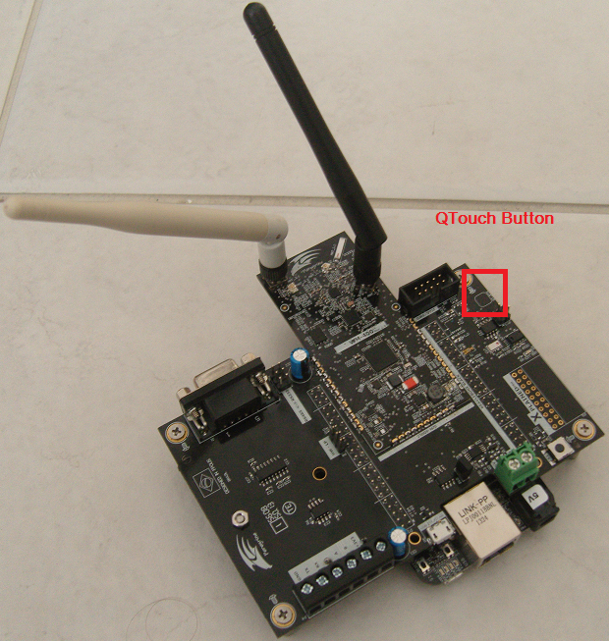
Play with QTouch
Unplug Beaglebone Black from KIT
Access Qtouch demo in <asf dir>\backport\WM400\Qtouch
Build demo code
Run SAM-BA bootloader and upload firmware
Quit SAM-BA bootloader IDE
Restart board
Pressing DFU switch enable LED2
And disable LED1. Unpressing toggle LED0 & LED1
Pressing QT_BTN will enabled LED0 and unpressing disable

Slide 7
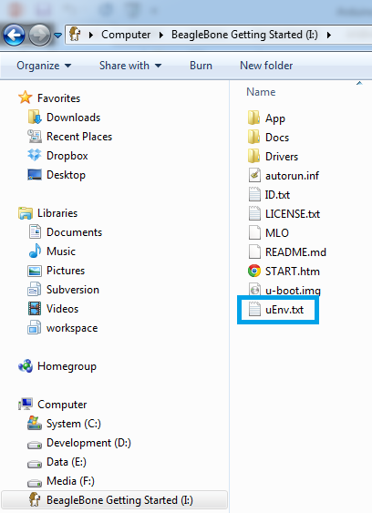
Configure Bleaglebone Black
Unplug WM-400 module
Plug Beaglebone into PC and wait until mass storage be mount.
Open uEnv.txt to change boot definition to enable ttyO1 to communicate with WM-400 module

Slide 8
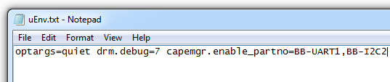
Configure Bleaglebone Black
Add capemgr.enable_partno= variable with:
  BB-UART1,
  BB-I2C2
save

Slide 9
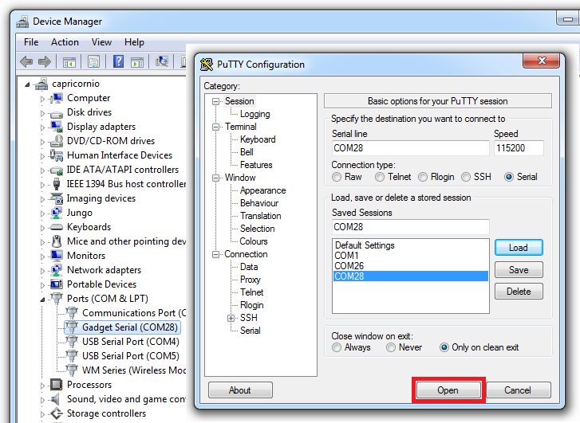
Configure Bleaglebone Black
To access linux open putty terminal with Gadget Serial Port

Slide 10
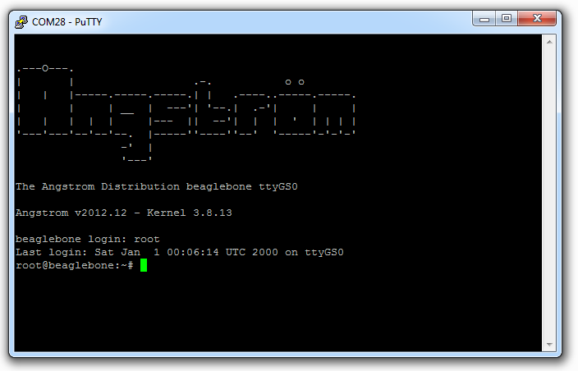
Configure Bleaglebone Black
Press enter
Beaglebone Black will show Angstrom logo
Use root to login
Type “halt”
Close putty
Wait until leds off
Unplug Beaglebone USB cable

Slide 11
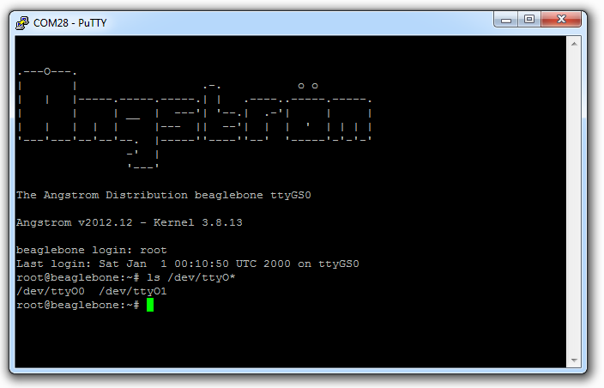
Configure Bleaglebone Black
Connect WM-400 to Beaglebone
Plug Beaglebone USB cable
Wait until mass storage be mounted
Repeat the putty process to access linux
Now, Type “ls /dev/ttyO*” to see serial port 1 was enabled

Slide 12
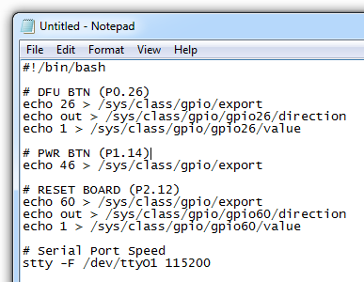
Configure Bleaglebone Black
In PC:
  Write the follow script in notepad
  Select ALL and Copy to transfer area
In Putty Shell:
  Type “vim gpio.sh”
  Type “i”
  Type “SHIFT Insert”
  Type “ESC”
  Type “:x!”
  Type “chmod 755 gpio.sh”

Slide 13
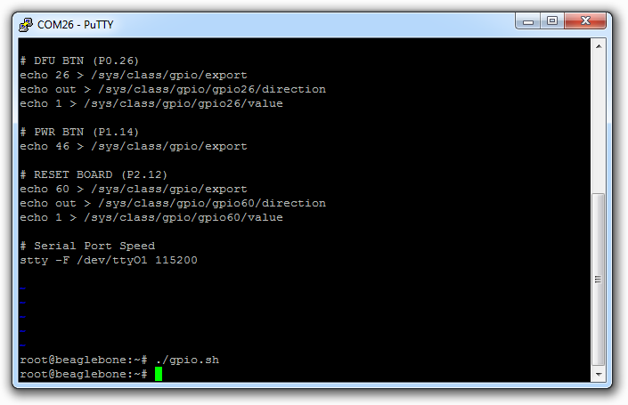
Configure Bleaglebone Black
Type “./gpio.sh”
This script will configure:
  GPIO to Reset board
  GPIO to Power Management
  ttyO1 speed to 115200 8N1
WM-400 will start after running gpio.sh

Slide 14
Configure Bleaglebone Black
Reset sequence:
echo 0 > /sys/class/gpio/gpio60/value
  This reset WM-400 board
echo 1 > /sys/class/gpio/gpio60/value
  This start WM-400 board
The DFU button is represented by gpio26. If you need simulated a button press proceed like reset sequence change gpio60 to gpio26

Slide 15
Serial port demo
Plug WM-400 USB cable
Access USART_BBBS demo in <asf dir>\backport\WM400\USART_BBBS
Build demo code
Use GPIOs to simulated SAM-BA DFU sequence
Run SAM-BA bootloader and upload firmware
Quit SAM-BA bootloader IDE
Use GPIOs to reset board
Type “cat /dev/ttyO1” to see what WM-400 send to Beaglebone
“CTRL+C” to quit demo
“halt” to shutdown linux

Slide 16
Issues?
nandojve at gmail dot com

