Slide 1



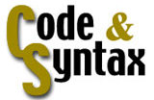
Metadata for multilingual content management
A practical experience with the SARE-Bi system
Translating and the Computer 25
Díaz, Abaitua, Jacob, Quintana^{[1]} y Araolaza^{[2]}
DELi (Universidad de Deusto)^{[1]}, CodeSyntax^{[2]}
www.deli.deusto.es www.codesyntax.com

Slide 2
Problem description
Goal: rapid multilingual delivery of publishable documents
    still a challenge, because
    automatically translated text usually needs post-editing
Multilingual document publication
    is not only translation
      requires more functions than those offered by MT
    text quality is a must in some environments

Slide 3
Case study
University of Deusto (Bilbao, Spain)
    generates high number of administrative documents
    most of them in Spanish and Basque (euskara), official languages of Basque Country
    some also in English, French, Italian...
Administrative documents
    large (statutes, regulations, reports...)
    small (calls, announces, minutes, letters...)
    one sentence (“Please, do not smoke here”)

Slide 4
Case study
Who reads the documents?
    a Department (e.g. 20 people)
    the employees (a thousand people)
    the students (20,000 people)
Document quality is a concern
    independent of the number of readers
    independent of the importance/size of the document
    “politically incorrect” to publish a faulty document, either in Spanish or in Basque

Slide 5
Case study: fieldwork
Procedure (almost fixed)
    a “writer” writes original document (in one language)
    he sends it to a “translator”
    the “translator” produces the other language version
    she sends it back to the “writer”
    he publishes the multilingual document
Almost 100% of original writing in Spanish
    Basque: a minority language
    many can read/understand, only a few can write

Slide 6
Case study: fieldwork
Cost of translation
    mainly an economic concern (institution can only afford to translate “important” documents)
    but also a problem of time (urgent documents)
Key: many docs. have a fixed structure
    short letters, calls, invitations...
    published weekly, monthly, yearly...
    small changes (date, place, name...)
  “writers” take advantage of this: they REUSE
  but “translators” MAY NOT REUSE

Slide 7
How can MT help?
Goal: to increase the number of multilingual documents generated in our University
No Spanish to Basque MT tool yet
    although a big research effort is being made
    anyway, ¿quality?
    translation is an important step, but not the only one
Translators use some MAT tools
    term-bases
    translation memories (not fully implemented yet)

Slide 8
Solution (1): a document management system
To organise documents
    cumulative document repository
    classified under several criteria
Multilingual functionality
    the textual correspondence between parts (segments) of documents is explicitly shown
Collaborative system
    writers and translators share the documents
    allows to implement other stages in the publication procedure

Slide 9
Solution (2): translation memories
Experience of DELi
    automatic extraction of translation memories from bilingual (es-eu) docs (XTRA-Bi project, 2000-2001)
    several Gigabytes of TMX files
    unorganised chunks of texts segments
Multilingual segmented document system
    not only the document as a whole
    if we show the corresp. of multilingual segments
    then the system is also a translation memory (TMX) repository

Slide 10
Solution (3): metadata
Chaotic accumulation of contents
    difficult management, search, retrieval...
Metadata
    document = content + metacontent
    semantic web, ontologies, content syndication...
    XML technology
TEI (Text Encoding Initiative)
    not so much for the purpose of linguistic mark-up
    for structural and cataloguing aspects (TEI header)

Slide 11
SARE-Bi: a first tour
SARE-Bi
  multilingual document management system
  allows incremental compilation of documents
  allows users to work collaboratively
  uses metadata as a conceptual mechanism
  can also be seen as a memory-based machine translation system
Demo

Slide 12
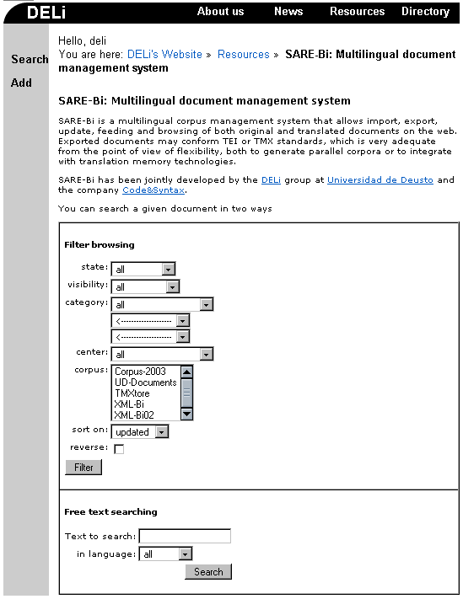
SARE-Bi: functions
Retrieving docs.
  filtering
    based on metadata
  searching
    free text
    any language

Slide 13
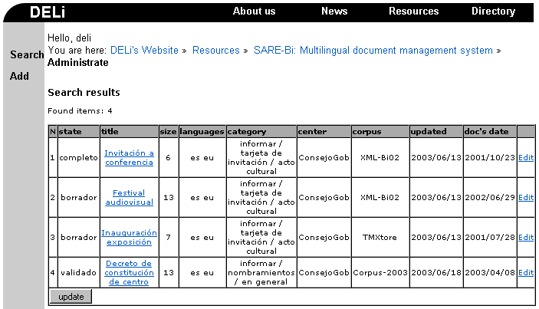
SARE-Bi: filter results
A row for each document
  visualisation link modification link

Slide 14
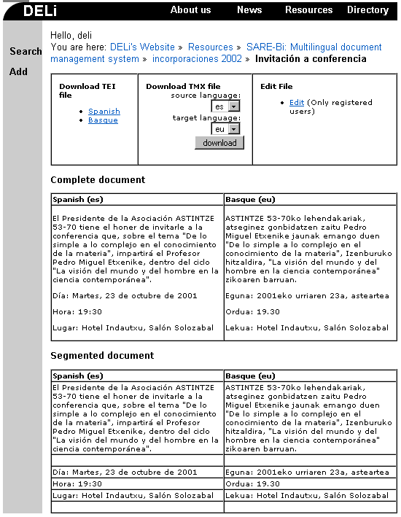
SARE-Bi: visualisation
Export tool
  TEI & TMX
Complete doc.
  to retrieve full contents
Segmented doc.
  to see language correspondence

Slide 15
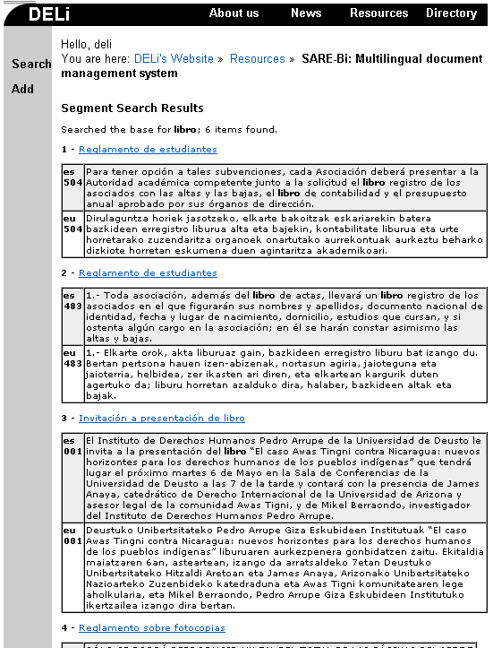
SARE-Bi: search results
Found segments
  in all document languages
  equivalent to translation memory browsing
Includes visualisation link

Slide 16
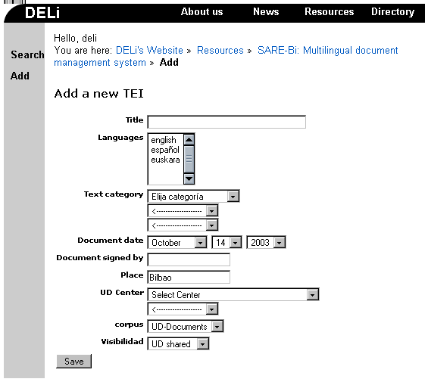
SARE-Bi: adding a document (first step)
User provides:
  values for metadata
  languages of the document
  (may be just one)

Slide 17
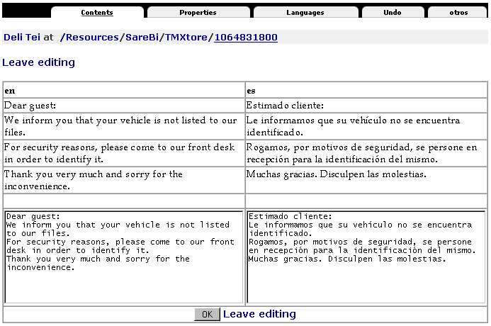
SARE-Bi: adding a document (second step)
User input Metadata management
Segmentation and alignment
  user can
  verify that
  these tasks
  are OK
Same page
for document
modification

Slide 18
SARE-Bi: components
(general)
Corpus of multilingual documents
    annotated (TEIsh), segmented, and aligned
    segments are paragraphs
Metadata associated to each document
    guidelines of the TEI header
    usual data: title, dates, author, place, centre...
  Most important metadata:
    category, state, visibility

Slide 19
SARE-Bi: metadata
(categorisation of documents)
Hierarchical taxonomy of several levels
  3 functions, 25 genres, and 256 topics (UD)
  e.g. a certificate of attendance at a short course has:
    1-function informative
    2-genre certificate
    3-topic attendance
30000/inquirir
31100/ ficha
31101/ aceptación o renuncia de beca
31102/ boletín de inscripción
31103/ datos de viaje
31104/ modelo de pago
31105/ relación de coordinadores
departamentales
31106/ planificación actividad de profesores
31107/ prácticas
31108/ datos estadísticos
31109/ boletín subscripción revista
31200/ impreso
31201/ de solicitud de beca
31202/ de solicitud de expediente
31203/ de solicitud de admisión
31204/ de solicitud de alojamiento
31205/ de programa Sócrates
31206/ de matrícula
31207/ factura
31208/ recibí
31209/ petición de fotocopias

Slide 20
SARE-Bi: metadata
(state and visibility)
Dynamic behaviour
    users change state/visibility during the edition cycle
    to show the composition/multilingual condition of the document
    metadata other than these are static (fixed values)
State
    non-validated, validated, normative
Visibility
    rough draft, confidential, shared, public

Slide 21
SARE-Bi: components
(users)
Mainly associated to tasks in the system
  guests, writers, translators, administrators
But also related to permissions
  document owner: user that added it
Complex set of permissions
  a rule for each task, that involves:
    owner
    metadatum state
    metadatum visibility

Slide 22
SARE-Bi: typical edition cycle
A writer adds a monolingual document
    on creation: visibility draft, state non-validated
    on finish: visibility shared (for example)
    he calls the translator
A translator does the translation
    assigns state as validated
    she calls back the writer
The writer retrieves the bilingual document
    and publishes it

Slide 23
SARE-Bi: edition cycle variations
Bilingual writers
    can develop bilingual documents
    the translator’s work is greatly simplified: she only has to revise the translation
Normative document
    model or template in its category
    state normative assigned by the translator
    a bilingual writer could use it for a new document without translator intervention
    frequent in administrative environment

Slide 24
SARE-Bi: implementation
Web application (based in Zope server)
    multilingual (es-eu-en localised) web interface
    optimal information/contents management
    complex system of user management
Object-oriented database
    classes: documents, subdocuments, segments
    attributes: metadata (managed in disjoint sets)
Full XML functionality
    export into TEI and TMX formats

Slide 25
SARE-Bi: conclusions
In full experimental use since May 2003
    six writers / two translators
    no quantitative measures, but
    sustained increment in the number of documents
    mostly positive comments of the users
Improving the system (X-Flow project)
    automation of the workflow tasks
    document versioning (XLIFF)
    integration of linguistic engineering technologies

Slide 26
SARE-Bi: conclusions
SARE-Bi has been funded by:
  Autonomous Basque Government
    Dept. of Industry (project X-Flow, 2002-2003)
    Dept. of Education, Universities, and Research (project XML-Bi, PI1999-72, 2000-2001)
  CodeSyntax (Eibar, Spain)
Acknowledgements
  Josu Gómez, Arantza Domínguez (DELi, UD)
  Luistxo Fernández (CodeSyntax)

Slide 27
Metadata for multilingual content management
A practical experience with the SARE-Bi system
Translating and the Computer 25
Díaz, Abaitua, Jacob, Quintana^{[1]} y Araolaza^{[2]}
DELi (Universidad de Deusto)^{[1]}, CodeSyntax^{[2]}
www.deli.deusto.es www.codesyntax.com

