Slide 1



“Genre discovery” in a document management system
CULT – BCN 2004
Abaitua, Díaz, Jacob, Quintana^{[1]} y Araolaza^{[2]}
DELi (Universidad de Deusto)^{[1]}, CodeSyntax^{[2]}
www.deli.deusto.es www.codesyntax.com
DELi

Slide 2
Contents
Case study: University of Deusto
Objectives
SARE-Bi: a mulitilingual corpus management system
Document classification: Functions, genres and topics
Metadata: TEI, TMX, XLIFF
Future developements

Slide 3
Case study: UD
Official bilingualism (trilingualism for the web)
    Almost 100% of original writing in Spanish
    Basque: minority even in EH
    Passive biling.: many can read/understand, only a few can write
Target-users and readers?
    departments (e.g. 20 people)
    Univ. staff (1,000 people)
    students (20,000 people)

Slide 4
Case study: UD
Multilingual publishing
    generates high number of administrative documents
    most of them in Spanish and Basque (euskara), some also in English, French, Italian...
Administrative documents
    large (statutes, regulations, reports...)
    small (calls, announces, minutes, letters...)
    short messages (“Inquires in room 422. Sorry for any inconvenience”)

Slide 5
Case study: UD
Translation procedure (inefficient)
  original document (in one language)
  the writer mails it to “translators”
  “translators” produce other language versions
  translations mail back to the “writer”
  writer “prints” the multilingual document

Slide 6
Objectives:
Implement a more efficient publishing process: Multilingual publication procedure
Rapid delivery of multilingual documents
Develop a system for corpus management
    repository + document life cycle
Design a taxonomy for document classification
    use of metadata (for document classification)

Slide 7
Objectives: Multilingual publication procedure
  in the chain: composition > translation > publication; translating is not enough
    eg. requires more functions than those offered by MT:
    revision, adaptation, versioning, classification, reutilization, standardisation
  users: writers, translators, editors, documentalists, publishers, readers
  web-centric, work-flow, document sharing
  other uses: education, translators training, documentalists

Slide 8
SARE-Bi (1): a document management system
Document-base
    cumulative document repository
    classified through metadata
Multilingual functionality
    textual correspondence between documents and segments
Collaborative system
    users share documents + working space
    work-flow control (X-Flow project, 2002/03)

Slide 9
SARE-Bi (2): translation memory
Experience
    automatic extraction of translation memories from bilingual (es-eu) docs (XTRA-Bi project, 2000-2001)
    several Gigabytes of TMX files
    unorganised chunks of texts segments
Multilingual segmented document system
    not only the document as a whole
    if we show the corresp. of multilingual segments
    then the system is also a translation memory (TMX) repository

Slide 10
SARE-Bi (3): metadata
Metadata
    document = content + metacontent
    semantic web, ontologies, content syndication...
    XML technology
TEI (Text Encoding Initiative)
    not so much for the purpose of linguistic mark-up
    for structural and cataloguing aspects (TEI header)
TMX, XLIFF
    for TM exchange and work-flow control

Slide 11
SARE-Bi: a first tour
SARE-Bi
  multilingual document management system
  allows incremental compilation of documents
  allows users to work collaboratively
  uses metadata as a conceptual mechanism
  can also be seen as a memory-based machine translation system
Demo

Slide 12
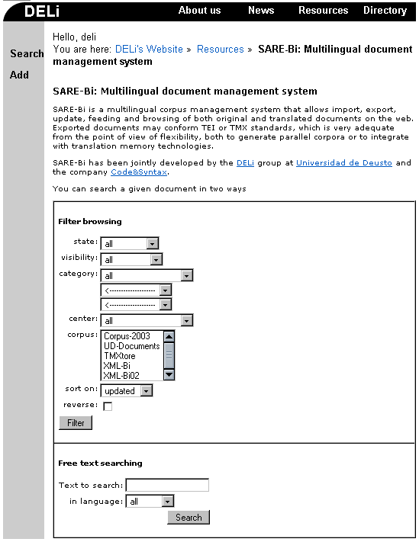
SARE-Bi: functions
Retrieving docs.
  filtering
    based on metadata
  searching
    free text
    any language

Slide 13
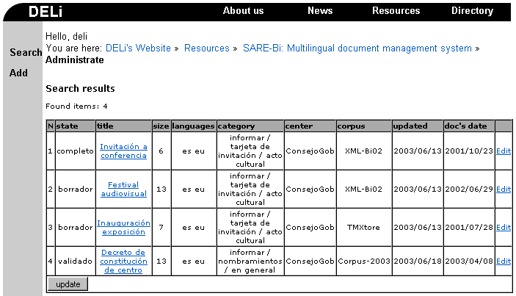
SARE-Bi: filter results
A row for each document
  visualisation link modification link

Slide 14
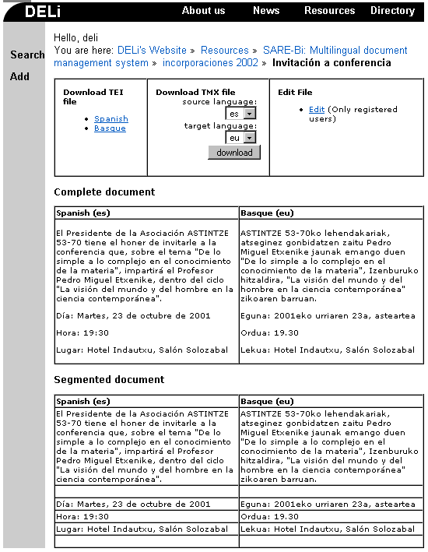
SARE-Bi: visualisation
Export tool
  TEI & TMX
Complete doc.
  to retrieve full contents
Segmented doc.
  to see language correspondence

Slide 15
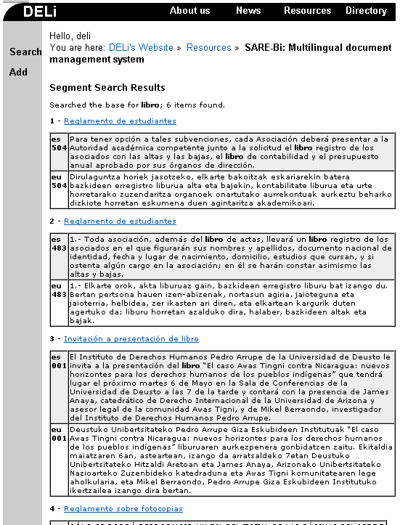
SARE-Bi: search results
Found segments
  in all document languages
  equivalent to translation memory browsing
Includes visualisation link

Slide 16
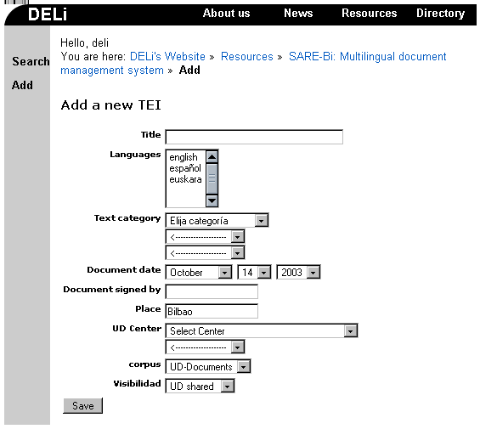
SARE-Bi: adding a document (first step)
User provides:
  values for metadata
  languages of the document
  (may be just one)

Slide 17
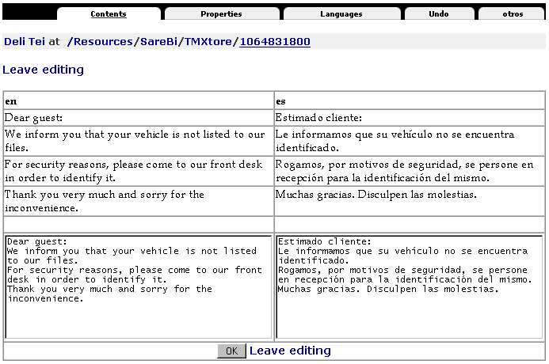
SARE-Bi: adding a document (second step)
User input Metadata management
Segmentation and alignment
  user can
  verify that
  these tasks
  are OK
Same page
for document
modification

Slide 18
SARE-Bi: components
(general)
Corpus of multilingual documents
    annotated (TEIsh), segmented, and aligned
    segments are paragraphs
Metadata associated to each document
    guidelines of the TEI header
    usual data: title, dates, author, place, centre...
  Most important metadata:
    category, state, visibility

Slide 19
SARE-Bi: metadata
(state and visibility)
Dynamic behaviour
    users change state/visibility during the edition cycle
    to show the composition/multilingual condition of the document
    metadata other than these are static (fixed values)
State
    non-validated, validated, normative
Visibility
    rough draft, confidential, shared, public

Slide 20
SARE-Bi: components
(users)
Mainly associated to tasks in the system
  guests, writers, translators, administrators
But also related to permissions
  document owner: user that added it
Complex set of permissions
  a rule for each task, that involves:
    owner
    metadatum state
    metadatum visibility

Slide 21
SARE-Bi: metadata
(classification of documents)
Hierarchical taxonomy of several levels (based on Trosborg 1997)
1st version of taxonomy only:
  genres (45)
  topics (150)
4th version of taxonomy:
  communicative function (3)
  genre (25)
  topic (250)

Slide 22
SARE-Bi: metadata
(classification of documents)
Hierarchical taxonomy at 3 levels
  e.g. a subscription reply card has:
    3-function inquirir
    11-genre ficha
    09-topic boletín subscripción
30000/inquirir
31100/ ficha
31101/ aceptación o renuncia de beca
31102/ boletín de inscripción
31103/ datos de viaje
31104/ modelo de pago
31105/ relación de coordinadores
departamentales
31106/ planificación actividad de profesores
31107/ prácticas
31108/ datos estadísticos
31109/ boletín subscripción revista
31200/ impreso
31201/ de solicitud de beca
31202/ de solicitud de expediente
31203/ de solicitud de admisión
31204/ de solicitud de alojamiento
31205/ de programa Sócrates
31206/ de matrícula
31207/ factura
31208/ recibí
31209/ petición de fotocopias

Slide 23
SARE-Bi: metadata
(classification of documents)
Hierarchical taxonomy at 3 levels
  e.g. a subscription reply card has:
    3-function inquirir
    11-genre ficha
    09-topic boletín subscripción
30000/inquirir
31100/ ficha
31101/ aceptación o renuncia de beca
31102/ boletín de inscripción
31103/ datos de viaje
31104/ modelo de pago
31105/ relación de coordinadores
departamentales
31106/ planificación actividad de profesores
31107/ prácticas
31108/ datos estadísticos
31109/ boletín subscripción revista
31200/ impreso
31201/ de solicitud de beca
31202/ de solicitud de expediente
31203/ de solicitud de admisión
31204/ de solicitud de alojamiento
31205/ de programa Sócrates
31206/ de matrícula
31207/ factura
31208/ recibí
31209/ petición de fotocopias

Slide 24
Classification procedures
Categorisation into “concept” hierarchies (Sebastiani 1999, Bouquet et al 2003)
  “into topical categories on the basis of content [...] within the general machine learning paradigm”
  “semantic mappings across hierarchical classifications of content”
Library cataloguing systems: MARCS, UDC
  metadata (author, title, series, subject, physical description)
  subjects (e.g. 8 Language, 82 Literature, 82.06 Translation)
Text typology (Trosborg 1997):
  speech acts, communicative funcitions, genres

Slide 25
Classification Hierarchies – CH (Magnini 2003)
Taxonomic organization of documents
Easy to build: no formal language is required
Widespread used:
  Web directories (Google, Yahoo!, Looksmart, portals)
  Market place catalogues for product classifications
  File systems
  Local Ontologies
Documents are classified at all levels of the hierarchy
CHs structure reflect both the documents and world knowledge

Slide 26
CH (Magnini 2003)
Semi-structured: relations among nodes are not formally defined.
Document dependent: CHs are organized according to the documents that have to be classified.
Specificity criterion: a document is classified in the more specific node of the hierarchy.
Vacation
2001
2000
Mountains
Sea
Sea
Lake
Tuscany
Spain
USA

Slide 27
CH: e.g. organizing papers on a file system:
Work
Knowledge about the domain is used
Classification schema are repeated
Labels are interpreted in their context
(Magnini 2003)
WSD
QA
Experiments
Projects
Papers
Senseval-2
ACL-02
Submission
Camera ready
Submission

Slide 28
Interoperability among CHs (Magnini 2003)
Scientific interest. Various terms have been recently used, including:
  Meaning negotiation
  Semantic coordination
  Mapping between domain models
  Semantic mediation
  Ontology merging, integration or alignment
  Integration of hierarchical categorization
Fits well in the Semantic Web perspective
Commercial interest: Distributed Knowledge Management in corporations
Common goal: find mappings between nodes of two classification hierarchies

Slide 29
Interoperability among CHs
Source CH
Target CH
Sea holidays
Vacation
2001
2000
Mountains
Sea
Sea
Lake
Italy
in Europe
Tuscany
Spain
USA

Slide 30
Interoperability among CHs
Source CH
Target CH
Sea holidays
Vacation
2001
2000
Mountains
Sea
Sea
Lake
Italy
in Europe
Tuscany
Spain
USA

Slide 31
Matching Google and Yahoo! :
(Magnini 2003)
Architecture
Medicine
Pr. Re.
Pr. Re.
Equivalence
.71 (.60) .10 (.10)
.78 (.71) .13 (.10)
More general
.51 (.61) .91 (.62)
.60 (.67) .78 (.69)
More specific
.85 (.96) .49 (.48)
.88 (.93) .46 (.43)
Google: Architecture/History/Periods_and_Styles/Gothic
Is More specific than
Yahoo: Architecture/History/Medieval

Slide 32
Experiments
Web directories: build a reference benchmark for evaluating matching algorithms.
  Include Looksmart
  Google English vs Google Italian
File systems
  Collaboration Edamok, SWAP, MEANING
Domain specific applications
  Medical classification: integration of UML in the algorithm
  Public Administration: matching document classification hierarchies for automatic routing

Slide 33
SARE-Bi: adding a document (document classification: metadata)
Title
Languages
Text cat.
Date
Author
Place
Center
Collection
Visibility

Slide 34
SARE-Bi: metadata
(Text categories)
Hierarchical taxonomy of 3 levels
  communicative function
  genre
  topic
  (Trosborg 1997)
30000/inquirir
31100/ ficha
31101/ aceptación o renuncia de beca
31102/ boletín de inscripción
31103/ datos de viaje
31104/ modelo de pago
31105/ relación de coordinadores
departamentales
31106/ planificación actividad de profesores
31107/ prácticas
31108/ datos estadísticos
31109/ boletín subscripción revista
31200/ impreso
31201/ de solicitud de beca
31202/ de solicitud de expediente
31203/ de solicitud de admisión
31204/ de solicitud de alojamiento
31205/ de programa Sócrates
31206/ de matrícula
31207/ factura
31208/ recibí
31209/ petición de fotocopias

Slide 35
SARE-Bi: Categories genres
“reflect differences in external format and situations of use, and are defined on the basis of systematic non-linguistic criteria” (Trosborg 1997)
“coded and keyed events set within social communicative process”(Todorov 1976, Fowler 1982, Swales 1990).
UD-corpus: 25 genres
Not effective for rapid interaction

Slide 36
SARE-Bi: Categories genres
11000/autorización
11100/acuerdo
11200/instrucciones
11300/normativa
11400/bases
11500/plan
11600/ceremonial
21100/aviso
21200/carta (está firmada)
21300/saluda (no se rubrica)
21400/certificado (por)
21500/convocatoria
21600/tarjeta de invitación
21700/folleto (imprenta)
21800/guía
21900/memoria
22000/catálogo
23000/actas
23100/anuncios en prensa
23200/carteles de propaganda
23700/nombramientos
31100/ficha
31200/impreso
31300/cuestionario
31400/instancia

Slide 37
SARE-Bi: Categories genres divided into topics
21400/certificado (por)
21401/matrícula de curso
21402/asistencia a curso 21403/participación en curso 21404/plaza en programa 21405/admisión en estudios 21406/derechos de título pagados 21407/asignaturas de carrera superadas y prueba de conjunto pendiente
21408/asignaturas de carrera y prueba de conjunto superadas 21409/superación de pruebas 21410/suficiencia investigadora
21421/oyente en actividad (congreso, jornada, seminario...) 21422/organizador de actividad 21423/ponente en actividad 21424/evaluador en actividad 21425/miembro de comité científico en actividad
21441/participación en informe 21442/participación en proyecto de investigación
21443/financiación para proyecto 21444/participación en comisión 21445/prácticas
21446/solicitud de beca 21447/especialidad-itinerario

Slide 38
SARE-Bi: Categories Communicative functions
classification according to the purpose of the dicourse (aka rethorical strategies)
¿the discourse intends to
      inform
      express an attitude
      persuade
      create a debate ?
  UD documents:
      regulate
      informe
      request (for information)
  Longacre (1976, 1982), Smith (1985) and Biber (1989)

Slide 39
SARE-Bi: Categories genres grouped by functions
10000/reglamentar
11000/autorización
11100/acuerdo
11200/instrucciones
11300/normativa
11400/bases
11500/plan
11600/ceremonial
30000/inquirir
31100/ficha
31200/impreso
31300/cuestionario
31400/instancia
20000/informar
21100/aviso
21200/carta (está firmada)
21300/saluda (no se rubrica)
21400/certificado (por) 21500/convocatoria
21600/tarjeta de invitación
21700/folleto (imprenta)
21800/guía
21900/memoria
22000/catálogo
23000/actas
23100/anuncios en prensa
23200/carteles de propaganda
23700/nombramientos

Slide 40
SARE-Bi: adding a document (category selection)
Menu-driven selection:
  communicative function
  genre
  topic (name)

Slide 41
SARE-Bi: implementation
Web application (based in Zope server)
    multilingual (es-eu-en localised) web interface
    optimal information/contents management
    complex system of user management
Object-oriented database
    classes: documents, subdocuments, segments
    attributes: metadata (managed in disjoint sets)
Full XML functionality
    export into TEI and TMX formats

Slide 42
SARE-Bi: conclusions
In full experimental use since May 2003
System’s new features (X-Flow, OAC projects)
    Work-flow control
    document versioning (XLIFF)
    automatic document categorisation
    discourse segmentation (RST)
    open taxonomy ML
    protocol for metadata harvesting (OAI-PMH)
On Internet: www.tumatxa.com
    CodeSyntax

Slide 43
SARE-Bi: conclusions
SARE-Bi has been funded by:
  Autonomous Basque Government
    Dept. of Industry (project X-Flow, 2002-2003)
    Dept. of Education, Universities, and Research (project XML-Bi, PI1999-72, 2000-2001)
  CodeSyntax (Eibar, Spain)
Acknowledgements
    Josu Gómez, Arantza Domínguez (DELi, UD)
    Luistxo Fernández, Eneko Astigarraga, Roberto Quero (CodeSyntax)

Slide 44
“Genre discovery” in a document management system
CULT – BCN 2004
Abaitua, Díaz, Jacob, Quintana^{[1]} y Araolaza^{[2]}
DELi (Universidad de Deusto)^{[1]}, CodeSyntax^{[2]}
www.deli.deusto.es www.codesyntax.com
DELi

