Slide 1
TITLE
SENTIMENT ANALYSIS ON TELUGU-ENGLISH CODE MIXED DATA
BY USING BI LINGUAL DICTIONARY AND LANGUAGE TRANSLATION
By
A.Gopi Krishna ( N170887 )
B.Arjunamma ( N170102 )
Ch.Keerthi Sri ( N170035 )
B. Hari Nandini ( N170429 )
K. Anusha ( N170244 )

Slide 2
Outline
Abstract
Introduction
Related Works
Proposed Method
Experimental Results
Conclusions
Future Scope

Slide 3
Abstract
There is an increasing demand for sentiment analysis of text from social media which are mostly code-mixed. Systems trained on monolingual data fail for code-mixed data due to the complexity of mixing at different levels of the text. However, very few resources are available for code-mixed data to create models specific for this data. Although much research in multilingual sentiment analysis has used semi-supervised or unsupervised methods, supervised methods still performs better. Sentimental Analysis on code mix social media data helps us to understand the underlying sentiment of the phrase or the sentence, which can have many practical use cases in the real world.

Slide 4
Introduction
In recent times, huge volumes of data are being generated on social media and online blogging . Code Mixed can be easily extracted from various online platforms like social media and blogs using APIs and various web scrapping tools. In spite of having huge amount of data , performing sentimental analysis on it is still challenging because of its unstructured and noisy nature. Hence, it requires robust preprocessing techniques to normalize this unstructured data.
We analyse and classify each sentence into three sentiments , positive, negative and neutral. The reason for choosing English as our secondary language for the code mixed data is because we observed that most of the Telugu available in social media is very often code mixed with English.

Slide 5
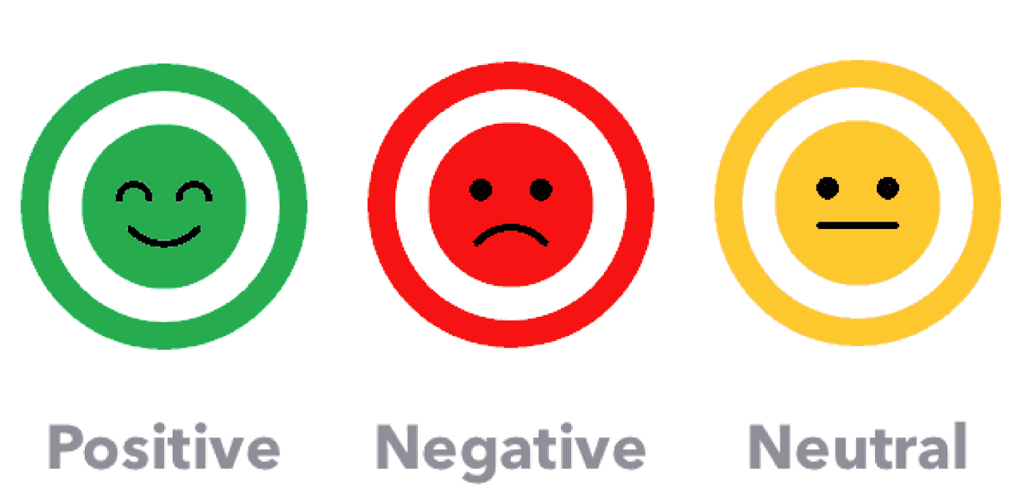
NLP in sentimental analysis
Sentiment analysis is a natural language processing (NLP) technique used to determine the polarity of a text(positive, negative, neutral) but it also goes beyond polarity to detect specific feelings and emotions(angry, happy, sad etc).Sentiment analysis is often performed on textual data to help businesses monitor brand and product sentiment in customer feedback, and understand customer needs.

Slide 6
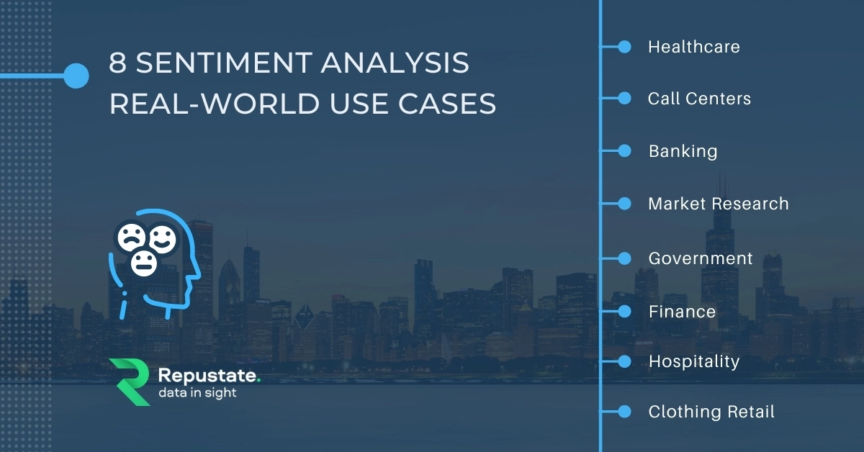
Real world Applications

Slide 7
Related Work
For the task of sentimental analysis Telugu-English text, subrahamanyam used a novel unsupervised data normalization with a Multilayer Perceptron Model. Choudary et al.(2018) proposed clustering of code mixed word variation with skip-gram vectors based on similarity .Sentiment Identiﬁcation in Code-Mixed Social Media Text has 3 classiﬁcation. They focused on the actual taxonomy and isolation of terms with an emotional connotation. Identifying the semantic polarity (positive vs. negative connotation) of words hasbeen done using different approaches. Some of the works (knowledge-based) explicitly attempted to ﬁnd features indicating that subjective language is being used. Hatzivas-siloglou and McKeown made use of corpus statistics, Wiebe used linguistictools such as WordNet, and Liu et al. used lexicon-based classiﬁer. Turneyand Littman work on classiﬁcation of reviews was based on using an unsupervisedlearning technique.

Slide 8
Limitations
The Major Problem of Working with Code-Mixed Data is , we are not able to generate Contextual Word embeddings our traditional approach assigns a same word embedding for a particular word .
For Example the word fair is different in Fun Fair and Fair Play . One means an outdoor event at which there are various kinds of games, rides, and entertainment. the other means respect for the rules or equal treatment of all concerned.

Slide 9
Proposed Method
The Proposed Method consists of the following steps:
1.Data Collection
2.Data Preprocessing
3.Tagging the Text into classes like Positive, Negative , Neutral
4. Bilingual Dictionary
5. Bilingual Text to Partially Translated Text Conversion Using Bilingual Dictionary
6. Partially Translated Text to Complete Monolingual Text Using Translation API by Google
7. Grammatical Correction of Monolingual Text Using Transformers
8.Training and Evaluating the Model Using different Deep learning models.

Slide 10
1) Data Collection
The Data is collected from Youtube and Twitter Using Google Youtube API and Twitter API .Around 40K comments are collected.
2)Data Preprocessing:
Some major Problems of Code Mixed Telugu English Text
•Long vowels : People tend to transliterate long vowels in many ways , for example the word tinnava is transliterated into tinnaaaavaa or just tinnava .
Similar to long vowels, even double consonants are transliterated in many ways. For example, తిన్నావా is transliterated into tinnava, tinava or సరిగ్గా into sariggaa, sarigaa.
•Elongation:To express certain sentiments like excitement, users stretch some words in an informal setting. For example: hellooo, niceeee, gooood, okayyy, bagundhiii , ichaavv.

Slide 11
●Normalizing Aspirated Consonants
Aspirated Consonants are the syllables which require a burst of breath to pronounce. In Telugu ఖ,ఛ,ఘ,భ,ధ, are the some aspirated consonants. In Code Mixed Telugu English Text , we observed that these characters are transliterated in multiple ways. For example, ధర is transliterating into dhara or dara.
●Elongation Normalization
To deal with the problem of Elongation, we convert each character to lowercase, and then limit the repetitions of sequential characters to two. For example, helloooo to helloo, gooood to good and bagundhiiii to bagundhii. Errors persisting after this step like helloo and bagundhii are treated as spelling errors and are normalized in the next steps.
● Normalizing English Words
To address spelling and typing errors, we have used dictionary-based spell-check with to address and typing errors,we have used SysSpell to address spelling and typing errors.

Slide 12
3 .Tagging the Text into classes like Positive, Negative , Neutral :
The preprocessed data is Manually tagged as Positive , Negative and Neutral .
For example,
kick movie chala bagundi - Positive
macbook air 2020 assalu bagoledhu - Negative
naku work cheyadam istam - Neutral
The tags are represented as
Negative - 0
Neutral - 1
Positive - 2
4. Bilingual Dictionary:
Bilingual Dictionary consists of translations of the Code Mixed Telugu word in both Telugu and their Corresponding translation in English. Using this dictionary the Transcripted telugu word is translated to telugu first and then finally translated to english and substituted in the text.

Slide 13
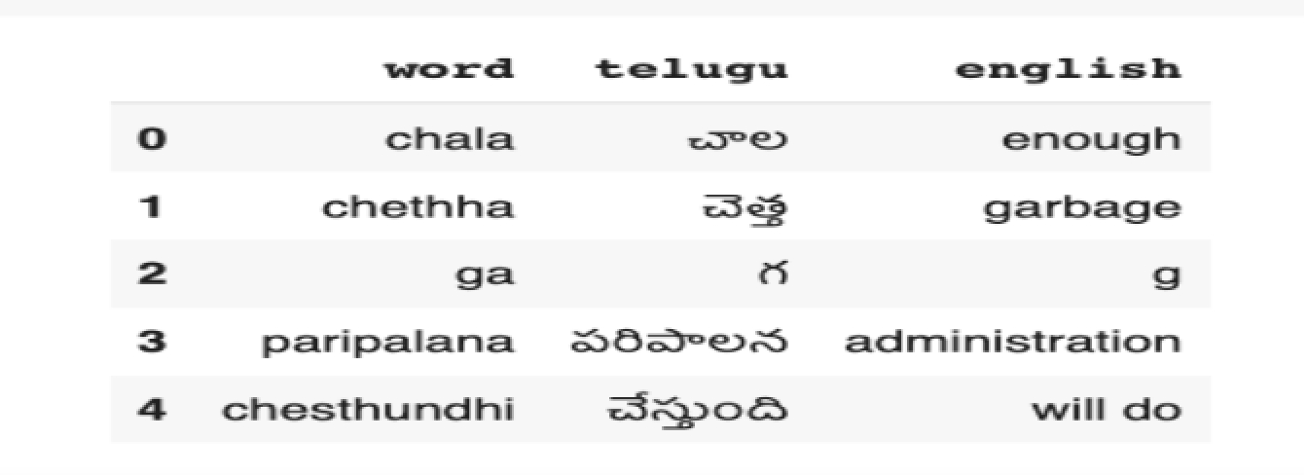
Bilingual Dictionary

Slide 14
5.Bilingual Text to Partially Translated Text Conversion Using Bilingual Dictionary:
The Transcripted Telugu word is first looked in the bilingual dictionary if the word is found in the dictionary then it is replaced with the corresponding translated English word. If the word is not found in the dictionary then it is kept as it is and it is processed in the later phases.
6.Partially Translated Text to Complete Monolingual Text Conversion Using Translation API by Google:
The partially translated text is converted to monolingual (english ) using the Google Translation API . For that we used the googletrans module provided by python. and using this we translated the partially translated text to completed monolingual text .
7.Grammatical Correction of Monolingual Text Using Transformers:
The Translated Text is further processed for the Grammatical Correction Using the HappyTranformer provided by the Huggingface. The minimum edit distance for the grammatical correction is given as 1. and the final translation is used for training the model and evaluating the model.
8.Training and Evaluating the Model Using different Deep learning models.
The model chosen for this project is Bi-LSTM.
80 % of the data is chosen for the model training and the remaining 20 % of the data is chosen for testing the model.The same data is trained and evaluated on other models like Conv1D , Simple RNN, LSTM , GRU.

Slide 15
BILSTM MODEL
Bi-LSTM:(Bi-directional long short term memory):
Bidirectional recurrent neural networks(RNN) are really just putting two independent RNNs together. This structure allows the networks to have both backward and forward information about the sequence at every time.
Using bidirectional will run your inputs in two ways, one from past to future and one from future to past and what differs this approach from unidirectional is that in the LSTM that runs backward you preserve information from the future and using the two hidden states combined you are able in any point in time to preserve information from both past and future.

Slide 16
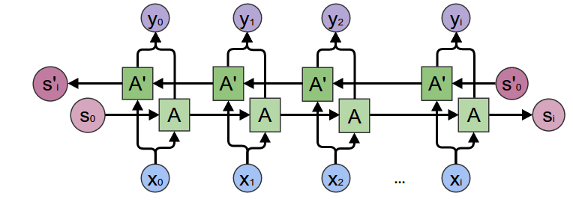
Bidirectional LSTM

Slide 17
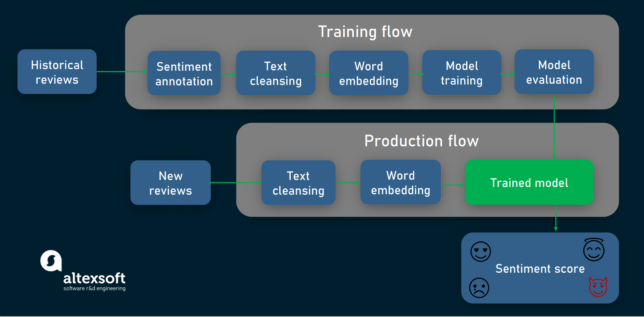
FlowChart

Slide 18
Historical Reviews
We have observed that youtube videos contain user comments expressing their sentiment of the movie or the video and the twitter users tweet in Code-Mixed Telugu English Text on different aspects such as movies , sports , and politics.
We used Twitter public streaming API and youtube comment API to collect this data.
Sentiment Annotation
The objective of this phase is to annotate each sentence.
We adapted three-class classification for the sentiment of the sentences
Positive - 2
Neutral - 1
Negative - 0

Slide 19
Text cleansing
We removed irrelevant text such as removing extra spaces, emoticons , and emojis manually.
To lowercasing the data and removing punctuations we used URLs and markup text, using regex-based pattern matching to ensure basic data quality.
With the help of NLTK Tokenizer, we tokenized each sentence into words.
We observed various transliterations like Double Constants , Aspirated Constants , Homophones , Informal Language and Elongation.
Later we convert bilingual codemixed data into monolingual data (English) using Google Translate and Happy Transformer.

Slide 20
Word Embedding
Word Embedding is a language modelling technique to represents the words or phrases as vectors.
The words are grouped together to get similar representation for words with similar meaning. It learns the relationship between the words to construct the representation.
Word Embeddings are given as a Layer to the Model Architecture.
Model Training
Model Training is a process in which a machine learning algorithm is fed with training data from which it can learn by quickly processing huge volumes of data and identify patterns.

Slide 21
we divided the data set with the 80/20 pattern, meaning that 80% of instances (15894 comments) is used for training a model and the other 20% (3974 comments) for its further testing.
Model Evaluation
To evaluate the model while building and tuning we split 80% of the data set for training and 20% of the data set for testing.
The three main metrics used to evaluate a classification model are accuracy , precision, and recall.

Slide 22


Trained Model
The process of training an ML model involves providing an ML algorithm (that is, the learning algorithm) with training data to learn from.
Conv1D ,LSTM ,RNN ,GRU, Bi-LSTM Models are trained on considered Dataset and among these Bi-LSTM , and Conv1D gives the Best Results.
Sentiment Score
It is a scaling system that reflects the emotional depth of emotions in a piece of text
Childhood is for playing games - 1
Project Guide appreciated us for the good presentation - 2

Slide 23
Experimental Results
Libraries
Natural Language Toolkit
Pandas
Numpy
Seaborn
Tensorflow
Matplotlib
happytransformer
symspellpy
Technologies
Transformers
Deep Learning

Slide 24
Datasets
IIIT Hyderabad Code-Mixed dataset for sentiment analysis
Datasets collected from various sources
System Hardware
Processor: 64-bit, quad-core, 2.5 GHz minimum per core.
RAM: 4 GB or more.
HDD: 20 GB of available space or more.
Display: Dual XGA (1024 x 768) or higher resolution monitors.
Keyboard: A standard keyboard

Slide 25
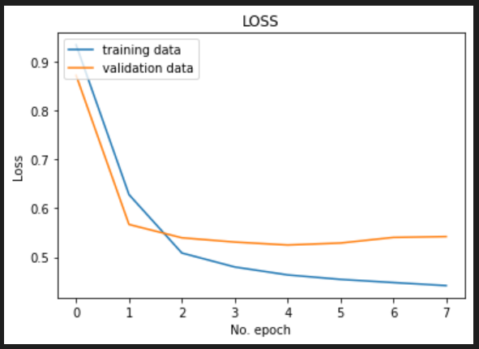
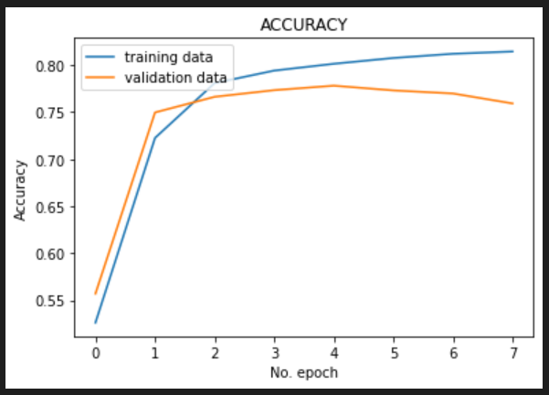
Evaluation Results of Best Performed Model (BiLstm)
Loss Vs No of Epochs Graph
Accuracy vs No of Epochs Graph

Slide 26
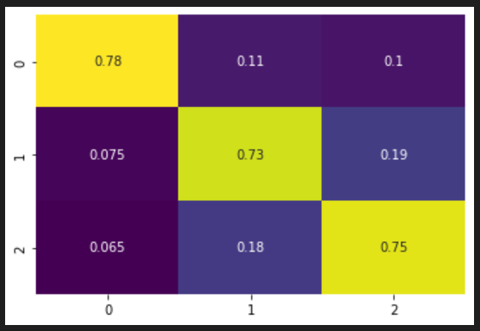
Confusion Matrix

Slide 27
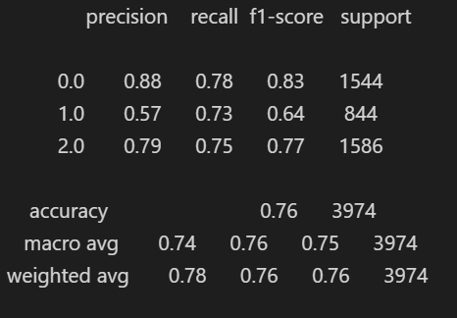
Classification Report

Slide 28
Result Comparison
Recurrent Neural Network -50%
Long Short Term Memory – 39%
Grade Recurrent Unit – 39%
Bidirectional Long Short Term Memory – 76%
Convolution 1D – 77%
Conclusion
We got the accuracy of 77% for Convolution 1D and 76% for Bidirectional Long Short Term Memory.

Slide 29

Future Scope
Future scopes that need to be solved like ambiguity problems and aspect-based sentiment analysis in text . Detect Fake and spam review further research is expected to improve accuracy in sentiment analysis of code-mixed language.
Also, we would like to extend our work to several other language pairs of code-mixed data. It would be interesting to utilize the rich features of individual languages to help identifying sentiments in their code-mixed version.

Slide 30
THANK YOU

