Slide 1
CyberFox: A Comprehensive Cyberforensic Tool

Slide 2
Table of contents
ABSTRACT
PROBLEM DEFINITION
FORMULATION OF OBJECTIVES
INTRODUCTION
LITERATURE SURVEY
DESIGN & ARCHITECTURE
METHODOLOGY
ALGORITHM
RESULTS AND DISCUSSION
CONCLUSION
FUTURE SCOPE
REFERENCES
2
CyberFox: A Comprehensive Cyberforensic Tool

Slide 3
ABSTRACT
Introducing a comprehensive suite of forensic tools designed for digital investigations. Starting from foundational tools like Hex Calculation and Steganography Detector, the suite progresses to advanced capabilities such as Brute Force Attack and Custom Password Generator. It includes essential utilities like Data Recovery Tool and Malware Analysis Tool, alongside cryptographic aids like HashCracker and Hash Calculator. The cornerstone is the Tree View tool, offering a holistic view of system activities. Together, these tools provide a systematic approach to digital forensics, contributing to cybersecurity and justice in the digital age.
3
CyberFox: A Comprehensive Cyberforensic Tool

Slide 4
PROBLEM DEFINITION
The increasing number of cybersecurity breaches and digital crimes presents significant challenges in investigating and mitigating these incidents. The lack of robust and comprehensive cyber forensic tools makes it difficult to conduct investigations effectively. This project aims to address these issues by developing a suite of tools that cover various aspects of cyber threats, such as bruteforce attack, data recovery solutions, system and file information analysis, cracking, and calculation, malware analysis frameworks, and hex viewer utilization. This project aims to empower investigators and forensic experts to efficiently investigate and mitigate cyber threats and digital crimes
7
CyberFox: A Comprehensive Cyberforensic Tool

Slide 5
FORMULATION OF OBJECTIVES
Streamline Digital Forensic Processes:
Work towards optimizing the overall performance and user experience of the tool, aiming to streamline digital forensic investigations and accelerate the discovery of evidentiary information.
Enhance Brute-Force Attack Capabilities:
Develop and optimize custom brute-force attack algorithms within the Cyber Forensic Tool to improve efficiency and effectiveness in password retrieval and system access.
9
CyberFox: A Comprehensive Cyberforensic Tool

Slide 6
FORMULATION OF OBJECTIVES
Implement Hex Viewer Enhancement:
Enhance the Hex Viewer functionality within the tool, improving its user interface and features to facilitate manual inspection and interpretation of hexadecimal data during forensic examinations.
Advance Password Generation Techniques:
Research and implement advanced password generation methods to strengthen the tool's ability to simulate and crack complex password structures during forensic investigations.
10
CyberFox: A Comprehensive Cyberforensic Tool

Slide 7
INTRODUCTION
CyberFox: A Comprehensive Cyberforensic Tool
Objective: To provide a comprehensive suite of forensic tools for digital investigation and analysis, enhancing cybersecurity and facilitating the pursuit of justice in the digital realm
Features:
Foundational tools including Hex Calculation and Steganography Detector for uncovering hidden data within images.
Advanced capabilities like Brute Force Attack and Custom Password Generator for password recovery and security analysis.
Data Recovery Tool for retrieving lost or deleted JPEG images, bolstering data restoration versatility.
10
CyberFox: A Comprehensive Cyberforensic Tool

Slide 8
INTRODUCTION
Malware Analysis Tool for threat detection and neutralization using signature-based methods.
Cryptographic utilities such as Hash Cracker and Hash Calculator for decryption and data integrity verification.
Tree View tool offering a comprehensive overview of system activities, empowering thorough digital investigations.
Scope: The suite covers a wide range of forensic tasks including file analysis, data recovery, threat detection, and cryptographic analysis, providing a holistic approach to digital investigation
10
CyberFox: A Comprehensive Cyberforensic Tool

Slide 9
INTRODUCTION
Target Users: Digital forensic investigators, cybersecurity professionals, law enforcement agencies, and legal experts involved in digital evidence analysis.
Outcome: Enhanced capabilities in digital investigation and analysis, leading to improved cybersecurity measures and effective resolution of digital crimes.
10
CyberFox: A Comprehensive Cyberforensic Tool

Slide 10
LITERATURE SURVEY
NAME | AUTHOR | YEAR | DESCRIPTION
Computer Forensic First Responder Tools | A. Sankara Narayanan; M. Mohamed Ashik | 2012 | This paper examines the computer forensics first responder and shows that open source tools may more clearly and comprehensively meet the guidelines than closed source tools.
The Research of Data Recovery on Windows File Systems | Na Zhang; Ying Jiang; Jia Wang | 2020 | This article addresses data loss on Windows file systems due to security concerns
8
CyberFox: A Comprehensive Cyberforensic Tool

Slide 11
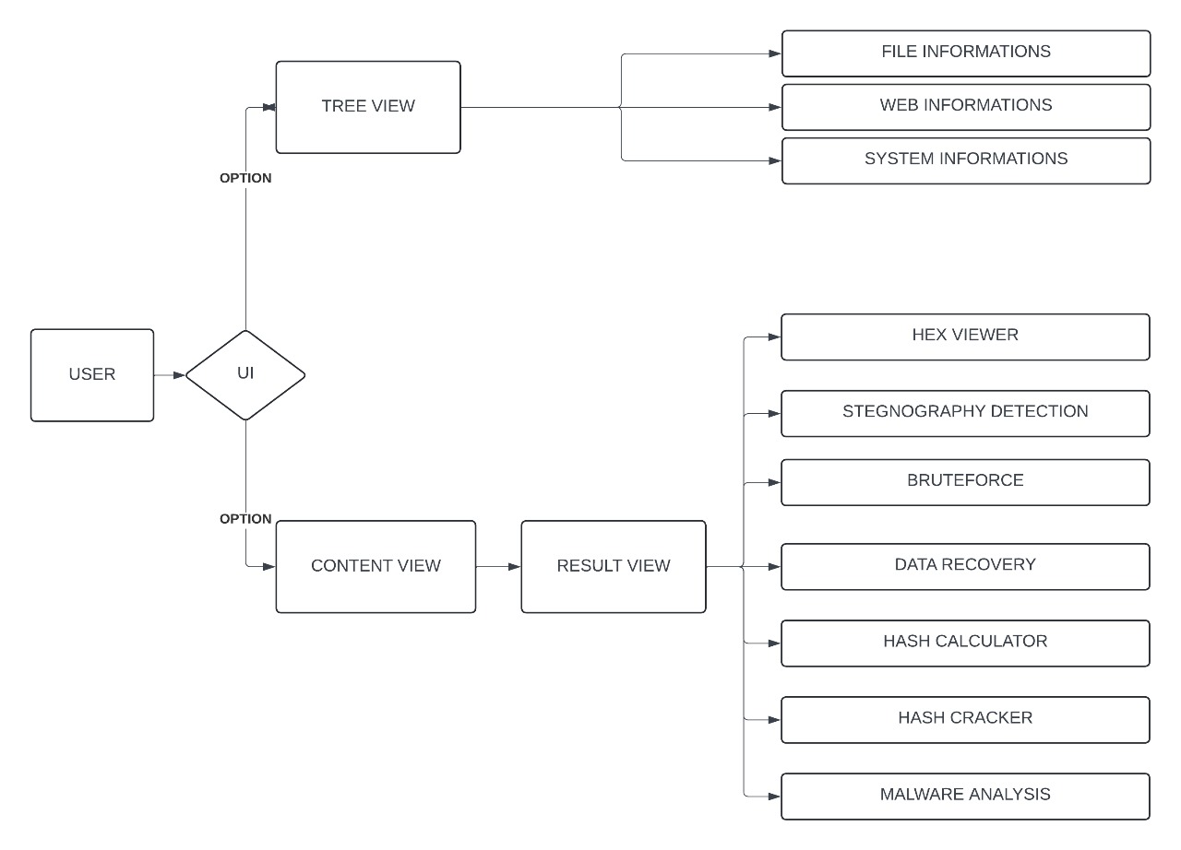
DESIGN
11
CyberFox: A Comprehensive Cyberforensic Tool

Slide 12
METHODOLOGY
Planning & Tool Selection:
Gather digital evidence following forensic protocols.
Maintain chain of custody and evidence integrity.
Evidence Collection:
Gather digital evidence following forensic protocols.
Maintain chain of custody and evidence integrity.
Data Acquisition & Imaging:
Utilize imaging tools for bit-by-bit data copies.
Verify image integrity through checksums.
18
CyberFox: A Comprehensive Cyberforensic Tool

Slide 13
METHODOLOGY
4. Analysis & Examination:
Employ forensic tools for file analysis and metadata examination.
Use hex editors, steganography detectors, and hash calculators for in-depth analysis.
5. Reporting & Documentation:
Document findings, procedures, and methodologies.
Generate detailed reports summarizing analysis results.
6. Compliance & Improvement:
Ensure legal compliance and adherence to standards.
Continuously evaluate and enhance forensic processes.
19
CyberFox: A Comprehensive Cyberforensic Tool

Slide 14
ALGORITHM
Brute Force Attack Algorithm:
Generate and test potential passwords iteratively until successful authentication or exhaustion, tracking progress and results, then analyze and take post-attack actions based on outcomes.
JPEG Recovery Algorithm:
Scan for JPEG signatures, verify headers and footers, assemble fragments, extract metadata, reconstruct files, assess quality, generate output, document process.
Hash Cracker Algorithm:
Generate hashes iteratively using brute force, compare with target hash, repeat until match found or password space exhausted.
19
CyberFox: A Comprehensive Cyberforensic Tool

Slide 15
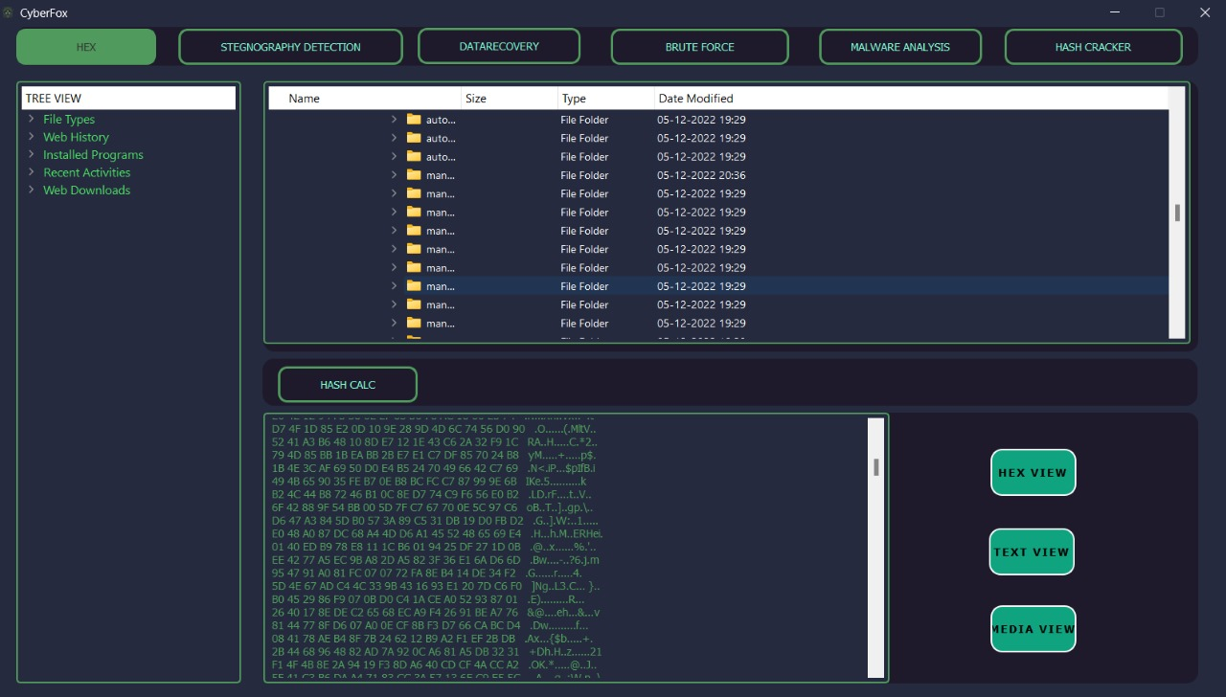
RESULT AND DISCUSSION
HEX CALCULATOR
20
CyberFox: A Comprehensive Cyberforensic Tool

Slide 16
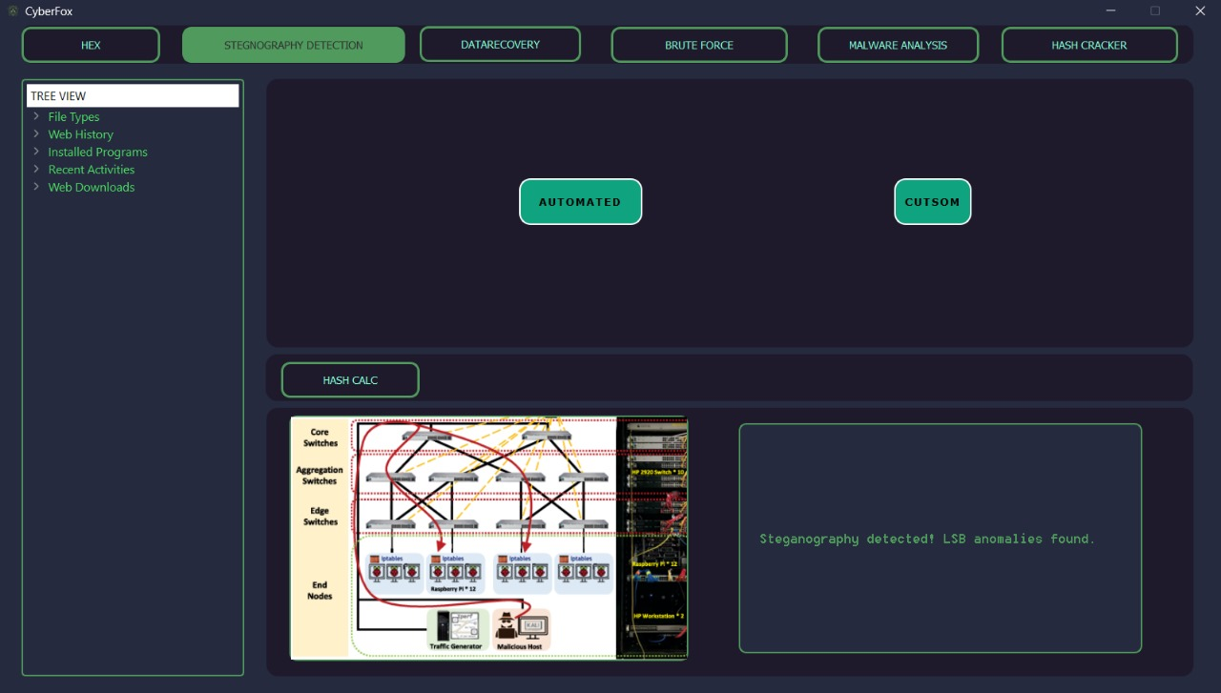
RESULT AND DISCUSSION
STEGANOGRAPHY DETECTION
20
CyberFox: A Comprehensive Cyberforensic Tool

Slide 17
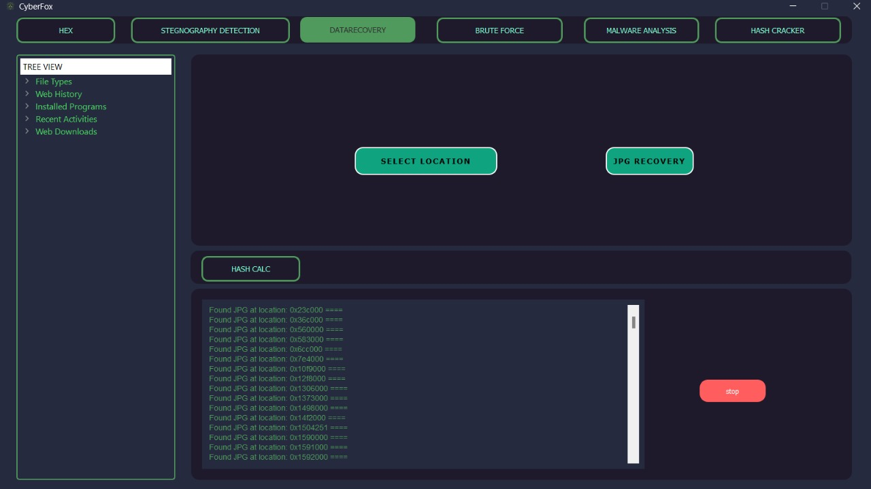
RESULT AND DISCUSSION
DATA RECOVERY
20
CyberFox: A Comprehensive Cyberforensic Tool

Slide 18
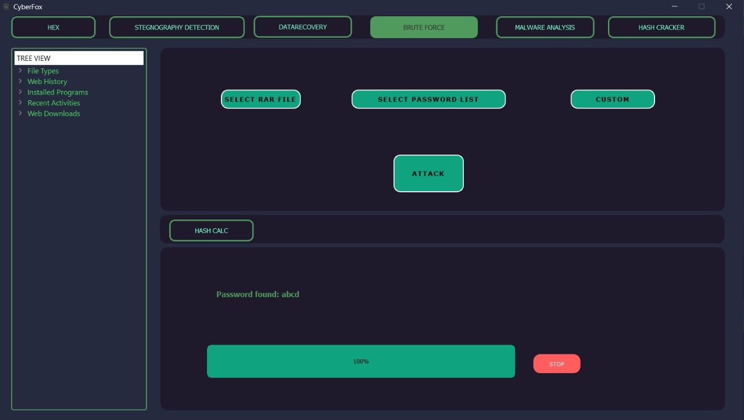
RESULT AND DISCUSSION
BRUTE FORCE
20
CyberFox: A Comprehensive Cyberforensic Tool

Slide 19
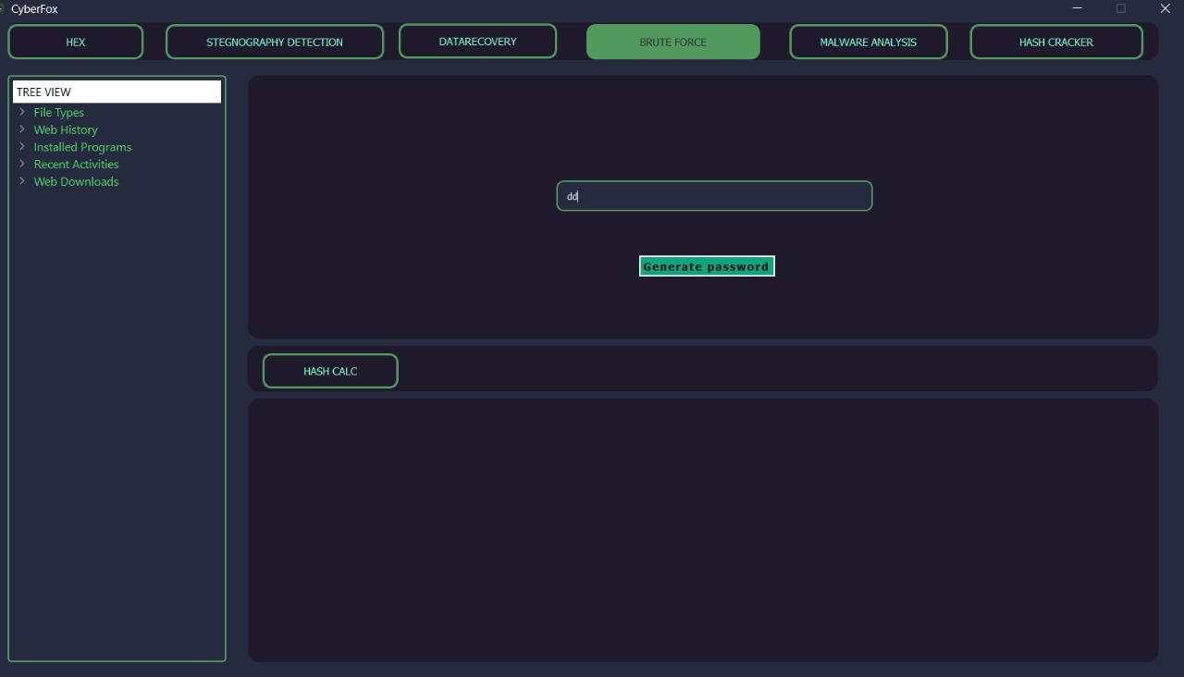
RESULT AND DISCUSSION
BRUTE FORCE
20
CyberFox: A Comprehensive Cyberforensic Tool

Slide 20
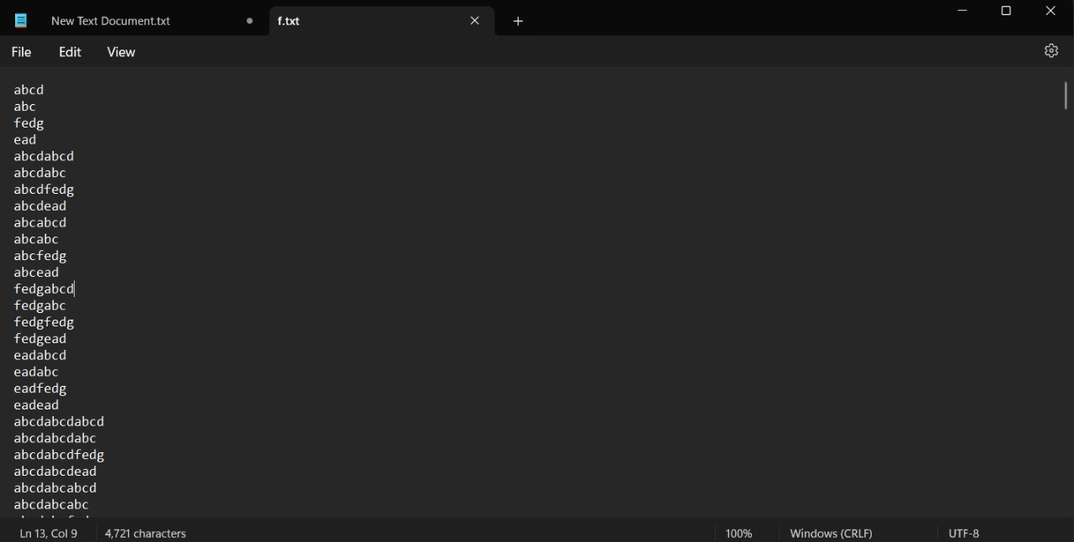
RESULT AND DISCUSSION
BRUTE FORCE
20
CyberFox: A Comprehensive Cyberforensic Tool

Slide 21
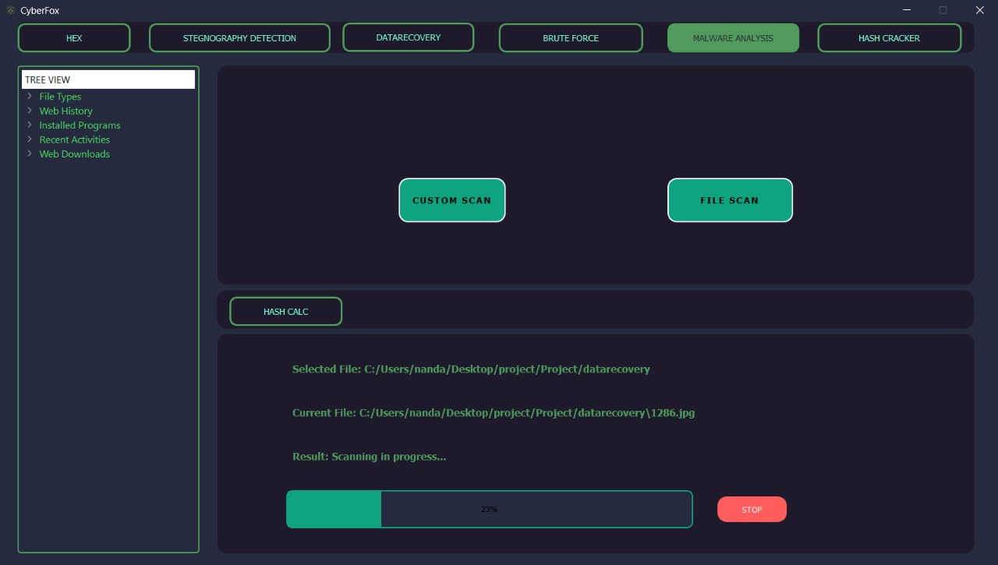
RESULT AND DISCUSSION
MALWARE ANALYSIS
21
CyberFox: A Comprehensive Cyberforensic Tool

Slide 22
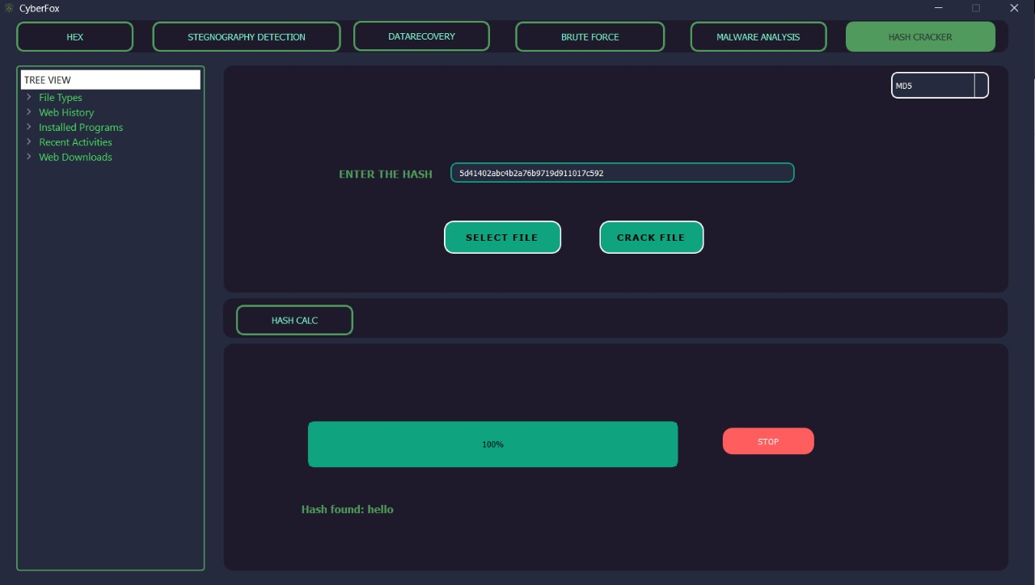
RESULT AND DISCUSSION
HASH CRACKER
22
CyberFox: A Comprehensive Cyberforensic Tool
CyberFox: A Comprehensive Cyberforensic Tool

Slide 23
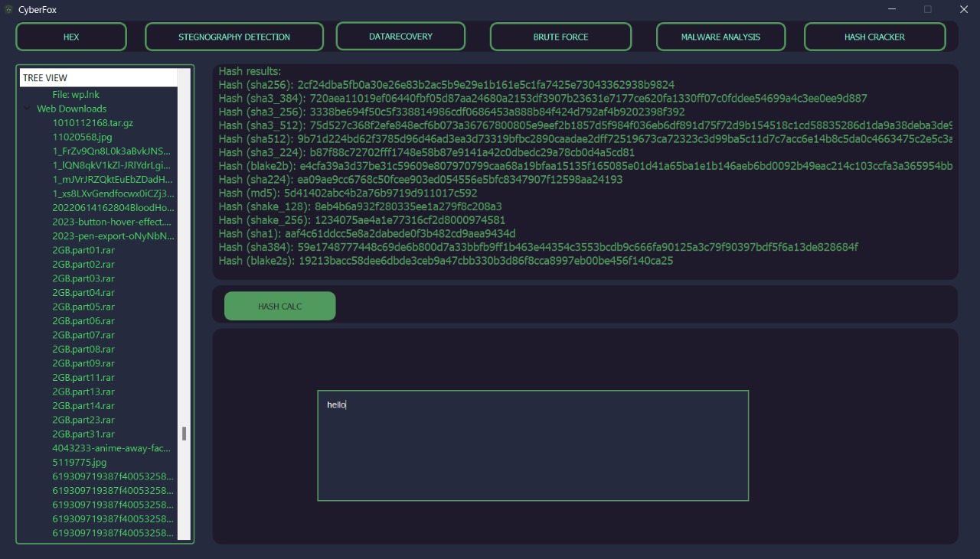
RESULT AND DISCUSSION
HASH CALCULATOR
23
CyberFox: A Comprehensive Cyberforensic Tool

Slide 24
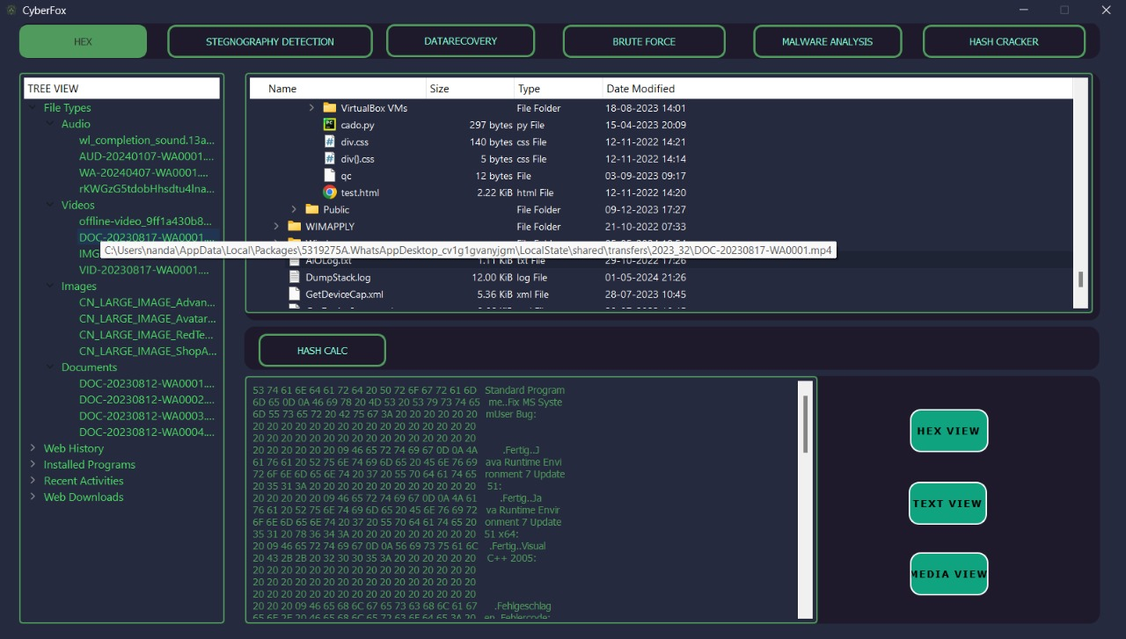
RESULT AND DISCUSSION
SYSTEM AND FILE INFORMATIONS
23
CyberFox: A Comprehensive Cyberforensic Tool

Slide 25
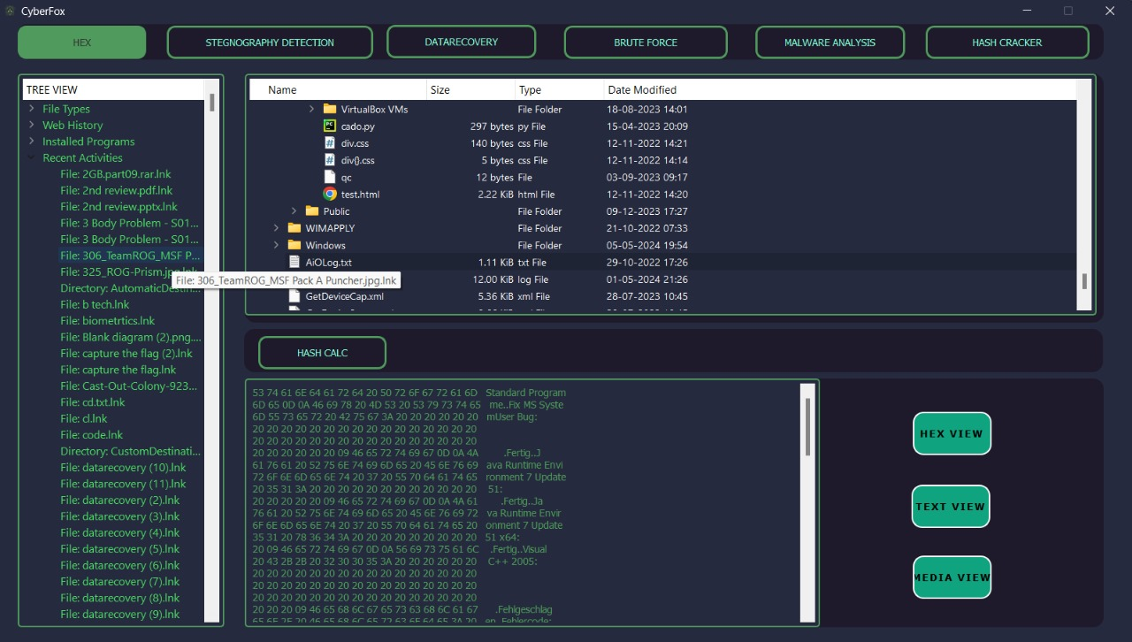
RESULT AND DISCUSSION
SYSTEM AND FILE INFORMATIONS
23
CyberFox: A Comprehensive Cyberforensic Tool

Slide 26
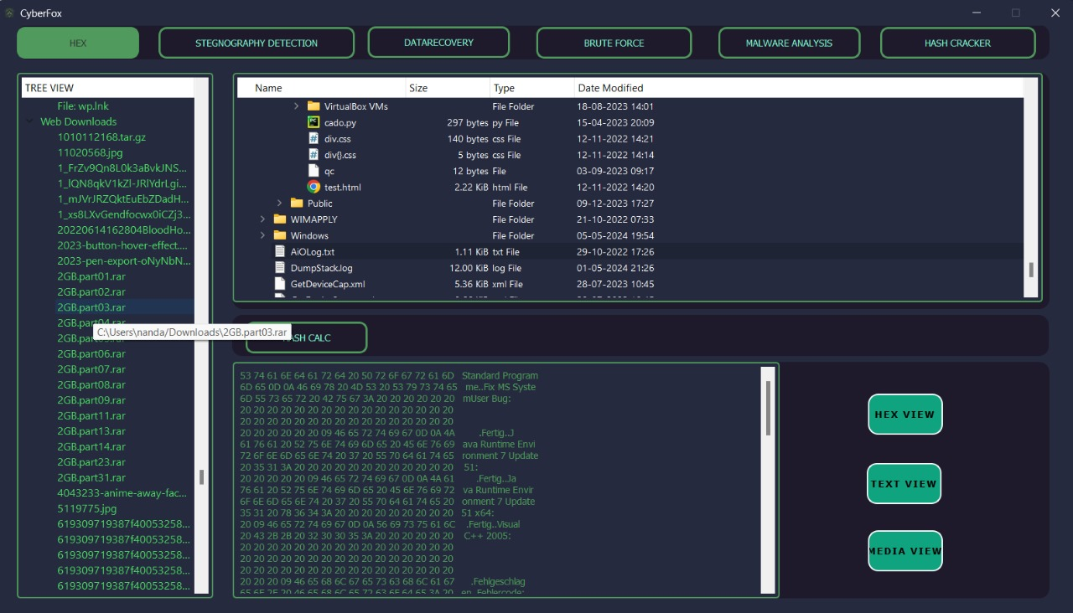
RESULT AND DISCUSSION
SYSTEM AND FILE INFORMATIONS
23
CyberFox: A Comprehensive Cyberforensic Tool

Slide 27
CONCLUSION
Comprehensive Toolbox: The suite offers a robust arsenal of forensic tools, spanning from foundational to advanced capabilities, ensuring a systematic approach to digital evidence analysis.
Foundational Tools: Includes Hex Calculation and Steganography Detector, essential for uncovering hidden data within images and laying the groundwork for investigation.
Advanced Capabilities: Features BruteForce Attack and Malware Analysis for tackling sophisticated threats and identifying malicious software, enhancing investigative depth.
Versatility: Addresses a wide spectrum of forensic challenges, encompassing file structure analysis, password recovery, data restoration, and threat detection, ensuring adaptability to diverse investigation needs.
23
CyberFox: A Comprehensive Cyberforensic Tool

Slide 28
CONCLUSION
Cryptographic Utilities: Employs Hash Cracker and Hash Calculator to decrypt hashed data, verify data integrity, and maintain the accuracy of investigative findings.
Holistic View: Incorporates the Tree View tool, providing investigators with a comprehensive overview of system activities, enabling effective reconstruction of timelines and tracing of digital footprints.
Contribution to Cybersecurity: By equipping investigators with precise and efficient means to navigate complex digital environments and unravel intricate digital trails, the suite significantly advances cybersecurity measures.
Support for Justice: Facilitates the pursuit of justice in an increasingly digital world by enhancing investigators' capabilities to gather evidence, identify perpetrators, and ensure accountability for digital crimes.
23
CyberFox: A Comprehensive Cyberforensic Tool

Slide 29
FUTURE SCOPE
Advanced Machine Learning and AI Integration
Expanded Cryptographic Support
Enhanced Data Visualization
Cloud Forensics
Privacy and Ethics Considerations
23
CyberFox: A Comprehensive Cyberforensic Tool

Slide 30
REFERENCE
[1] A. Sankara Narayanan & M. Mohamed Ashik , “Computer Forensic First Responder Tools ,” International Conference on Advances in Mobile Network, Communication and Its Applications 2012.
[2] Na Zhang; Ying Jiang & Jia Wang, “The Research of Data Recovery on Windows File Systems”, International Conference on Intelligent Transportation, Big Data & Smart City (ICITBS) 2020.
CyberFox: A Comprehensive Cyberforensic Tool

Slide 31
THANK YOU
CyberFox: A Comprehensive Cyberforensic Tool

