Slide 1
IBM University Engagement Project Submission
“Exploring the Power of Agentic AI with IBM Granite and IBM Bob”

Slide 2

Project Title- Course Content Simplification agent
Domain of Project -Education
Student Name | Recent Passport Photo | Email ID | Mobile number
Nandu Telukuntla |  | telukuntlanandu@gmail.com | 7386774403

Slide 3
Problem Statement - Course Content Simplification agent
The Challenge – Educational materials often vary in complexity and are not always accessible to learners with different levels of prior knowledge. Students may struggle to grasp key concepts due to jargon-heavy or overly advanced explanations in faculty notes and textbooks. The challenge is to develop an AI-powered agent that can intelligently analyze academic content and reframe explanations based on the learner's current proficiency—ranging from beginner to expert. This would support more inclusive learning and personalized education delivery at scale
The Objective
Build an AI-powered agent that simplifies course content based on the learner’s proficiency level.
Accept and analyze course material
Identify key concepts and learner level
Simplify or expand explanations
Provide examples and summaries
Answer follow-up questions
Preserve the original meaning

Slide 4
Proposed Solution
An AI-powered Course Content Simplification Agent that transforms complex educational material into learner-friendly explanations.
Analyzes course material and identifies key concepts.
Adapts explanations to beginner, intermediate, or expert levels.
Simplifies jargon and provides examples or analogies.
Generates summaries and answers follow-up questions.
Preserves the original meaning of the content.

Slide 5
Technology Used
IBM Bob – AI-powered tool for developing, debugging, and improving the application.
IBM Granite Model – For understanding and simplifying course content.
IBM watsonx.ai – For AI model integration and deployment.
IBM Cloud – For hosting and deploying the application.
GitHub – For storing and managing project code.

Slide 6
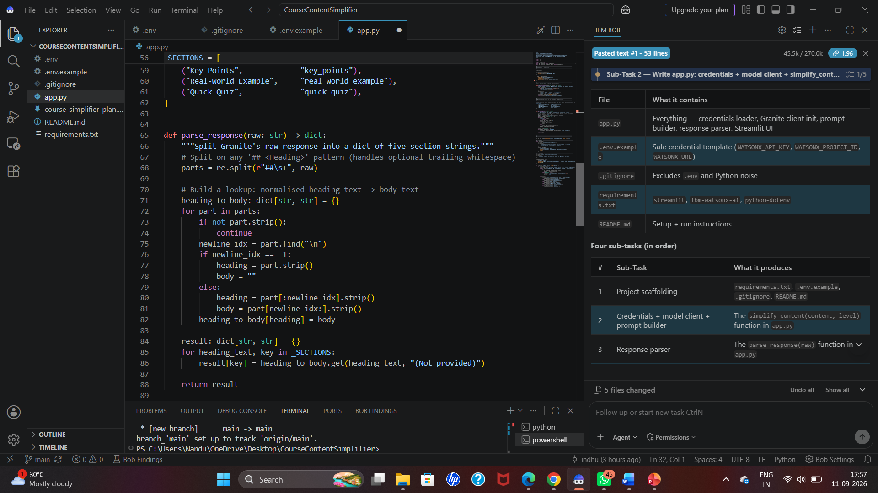
IBM Bob :

Slide 7
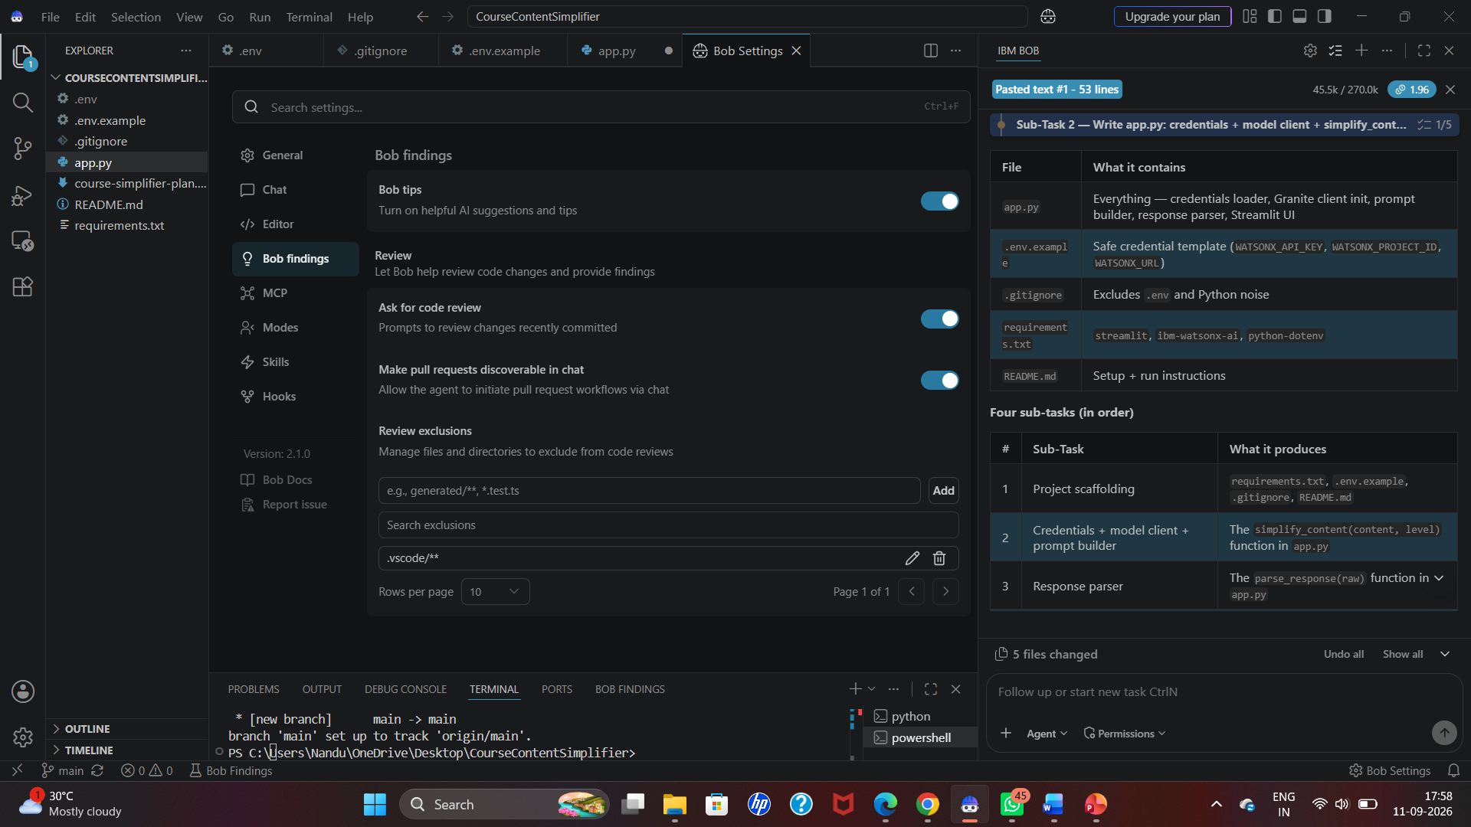

Slide 8
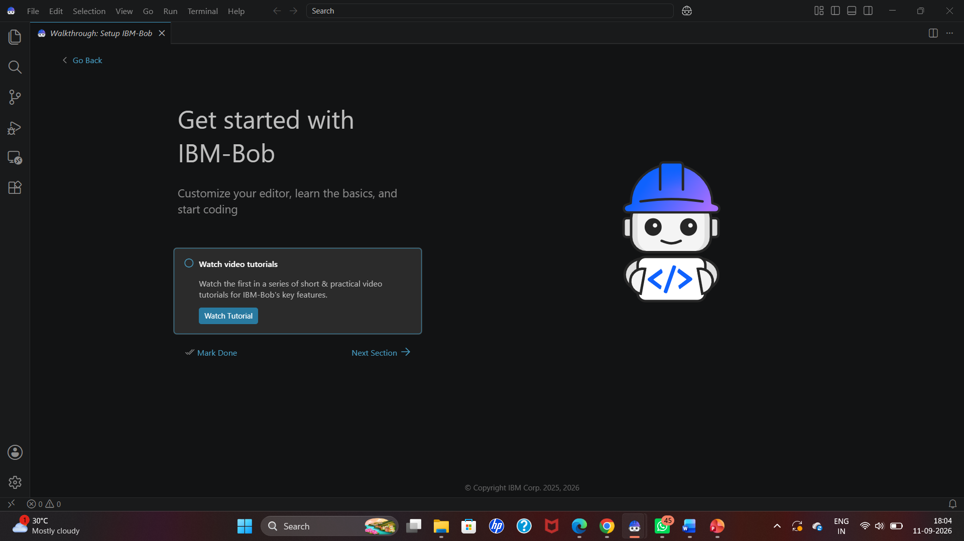

Slide 9
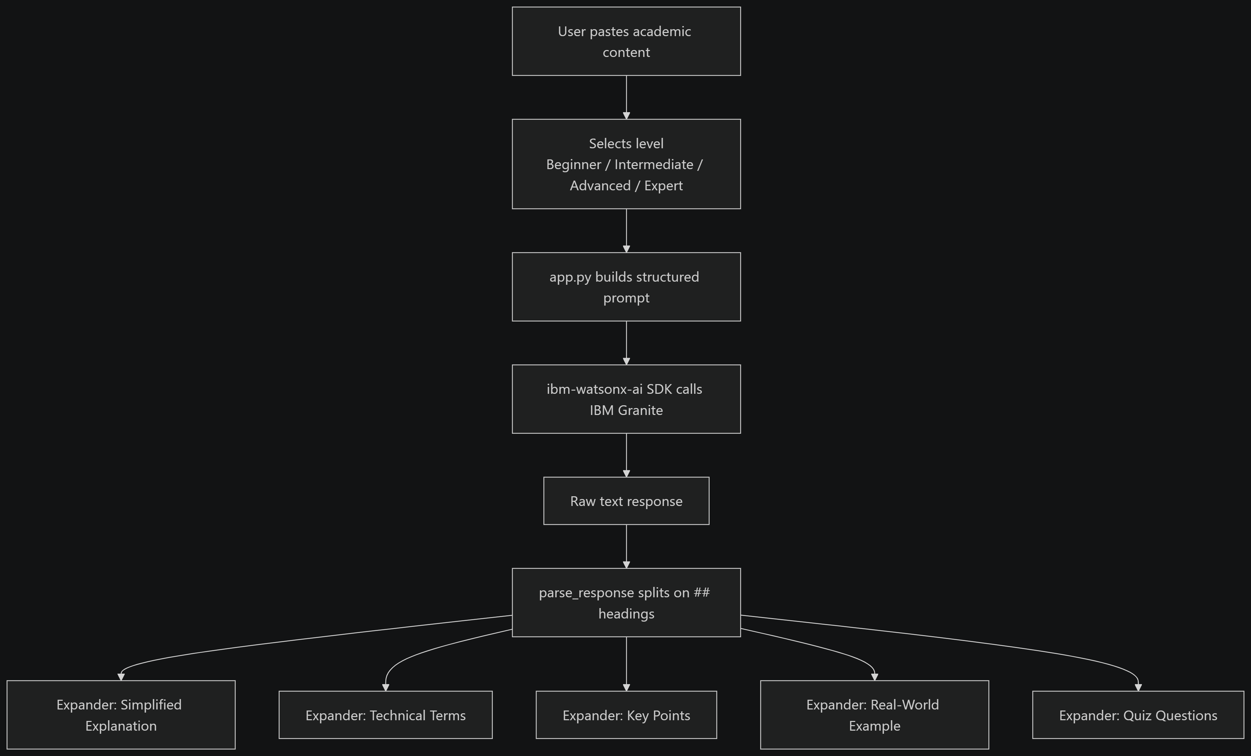
Architecture

Slide 10
Role of Agentic AI in the solution
Agentic AI enables the Course Content Simplification Agent to intelligently analyze educational content and adapt the response to the learner.
Content Analysis – Identifies important concepts from the course material.
Level Adaptation – Adjusts the explanation for beginner, intermediate, or expert learners.
Personalized Explanation – Simplifies jargon and provides suitable examples and analogies.
Interactive Learning – Answers follow-up questions based on the learning context.
Goal-Oriented Response – Generates summaries and key points while preserving the original meaning.
In short: Agentic AI makes the system adaptive, personalized, and interactive, rather than just a basic chatbot.

Slide 11
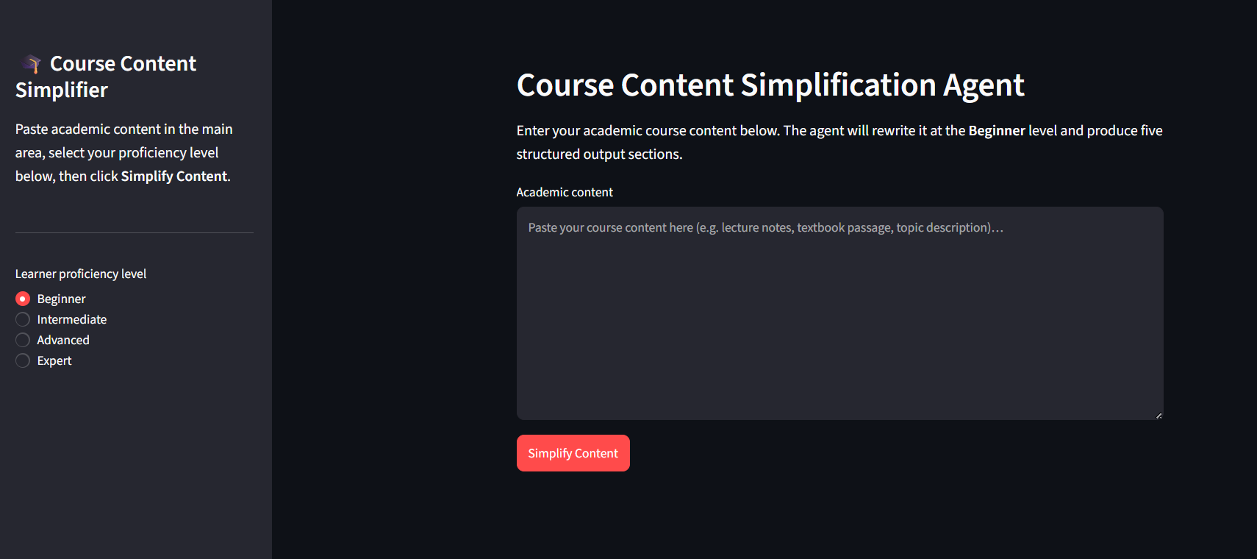
Output:

Slide 12
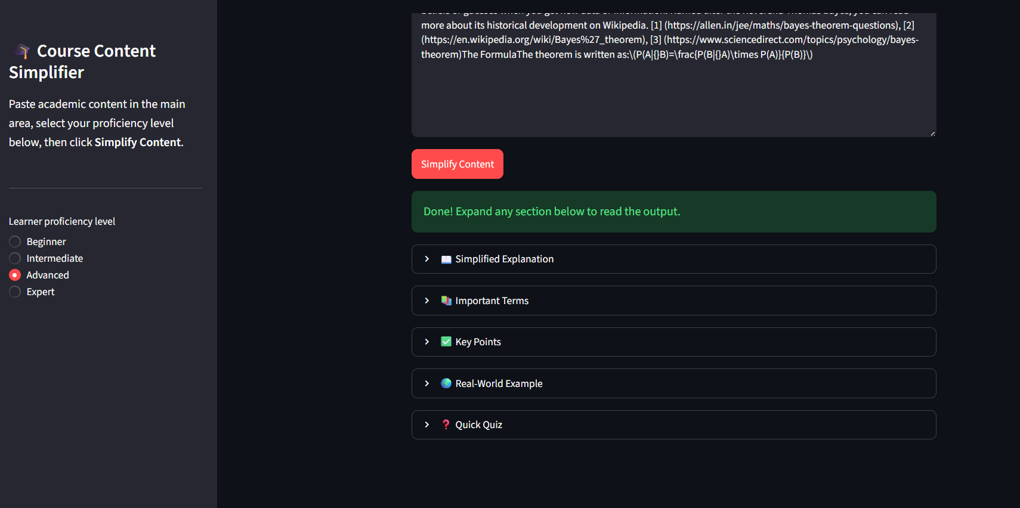

Slide 13
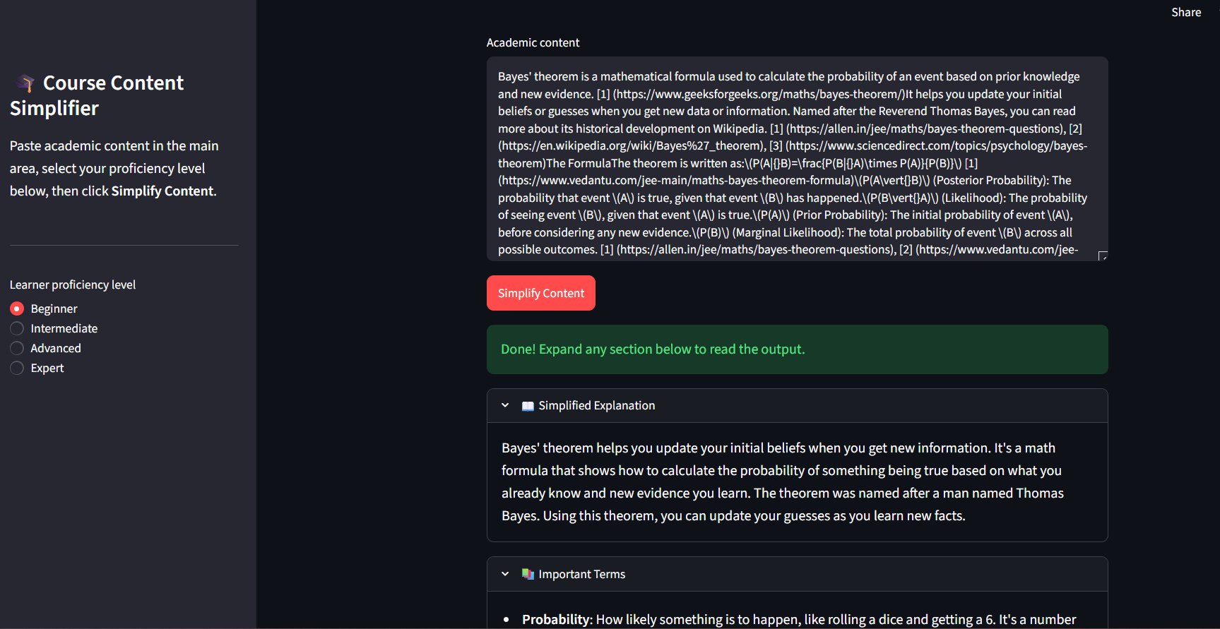

Slide 14
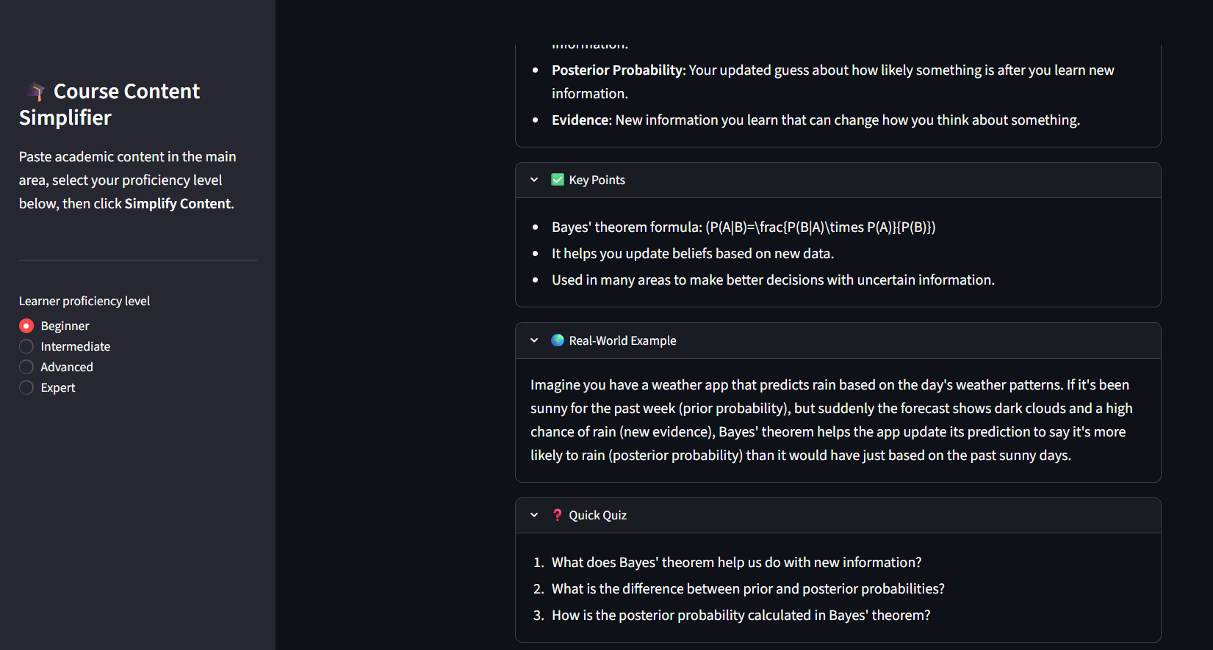

Slide 15
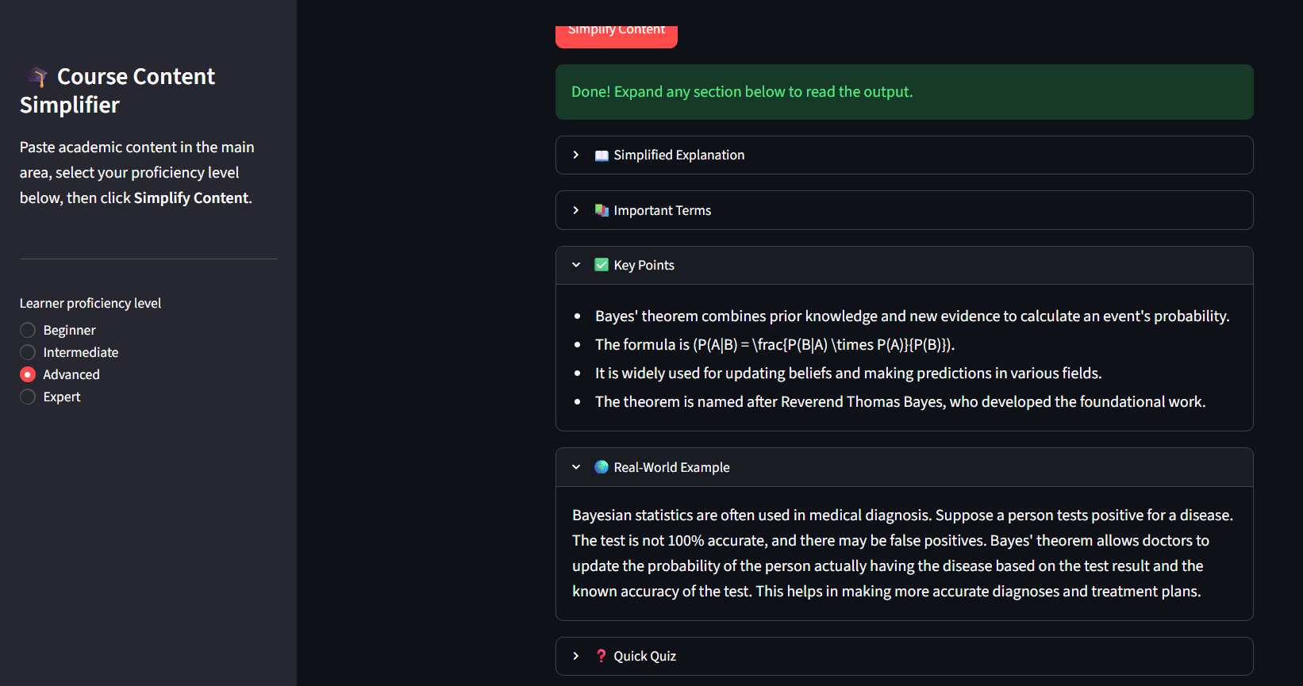

Slide 16
Novelty and Uniqueness
Adaptive Learning – Adjusts content according to the learner’s proficiency level.
Personalized Explanations – Provides suitable language, examples, and analogies for each learner.
Jargon Reduction – Converts complex technical terms into easy-to-understand language.
Interactive Learning – Answers follow-up questions based on the course content.
Meaning Preservation – Simplifies content without changing the original concept.
Multi-Level Learning – Supports beginner, intermediate, and expert explanations.

Slide 17
GitHub link:
https://github.com/nandu7386/course-content-simplifier

Slide 18
Future Scope:
Multilingual Support – Explain course content in regional languages such as Telugu and Hindi.
Voice-Based Learning – Allow students to ask questions and receive explanations using voice.
Personalized Learning – Track learning progress and automatically adapt the difficulty level.
Quiz Generation – Generate MCQs and practice questions based on the studied topic.
Multiple Content Formats – Support PDFs, images, presentations, and other educational materials.
Exam Preparation Mode – Provide exam-oriented explanations, important points, and revision materials.

Slide 19
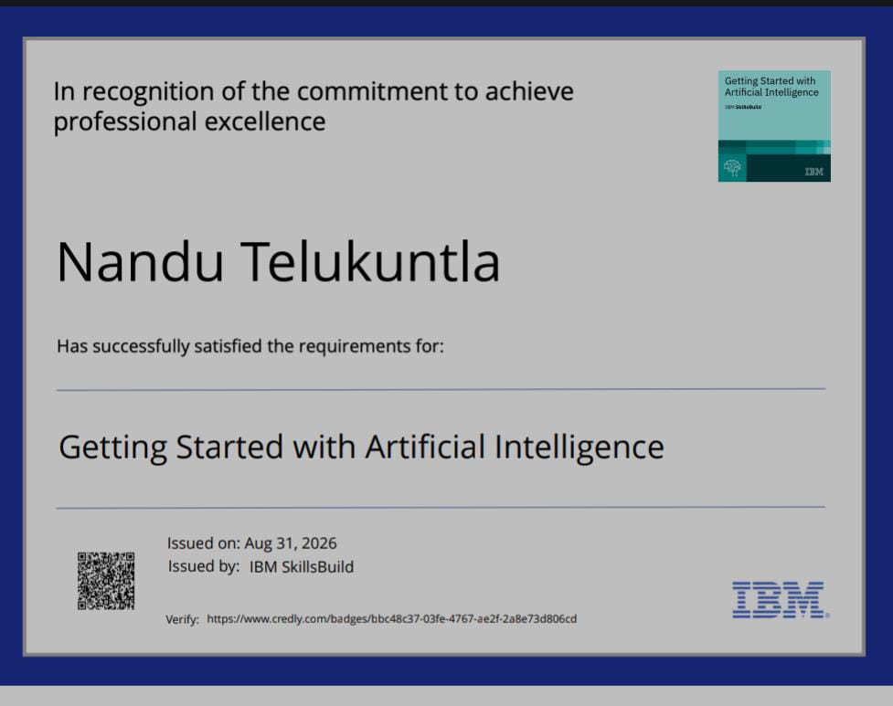
Certificates Earned: Artificial Intelligence

Slide 20
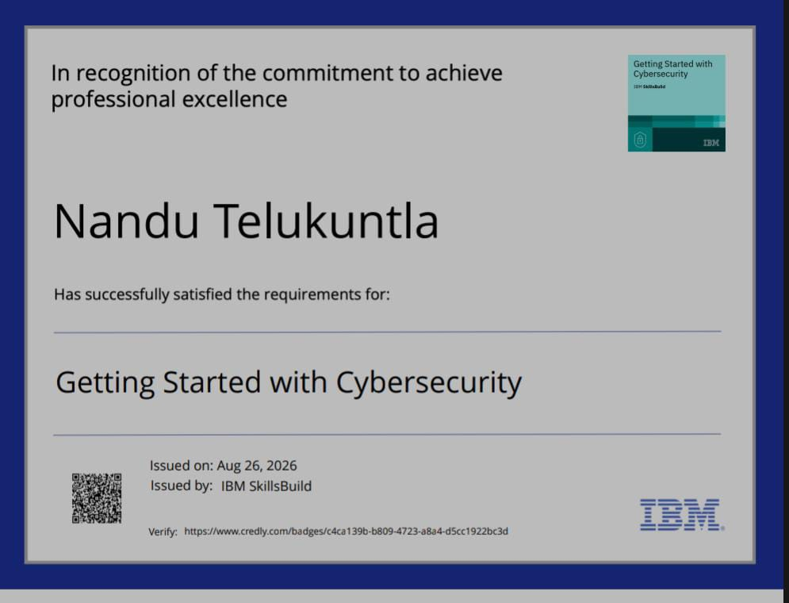
Cybersecurity:

Slide 21
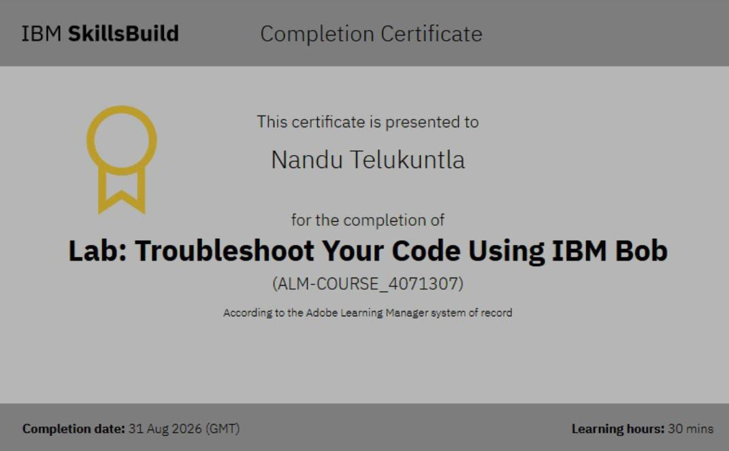
IBM Bob:

Slide 22
Thank You!

