Slide 1
ECHOVERSE
AN AI – POWERED AUDIO BOOK

Slide 2
ECHOVERSE AI-POWERED AUDIOBOOK
EchoVerse is a generative AI-based audiobook creation system that transforms user-provided text into expressive, downloadable audio content. It is designed for accessibility, convenience, and content reusability, helping students, professionals, and visually impaired users.

Slide 3
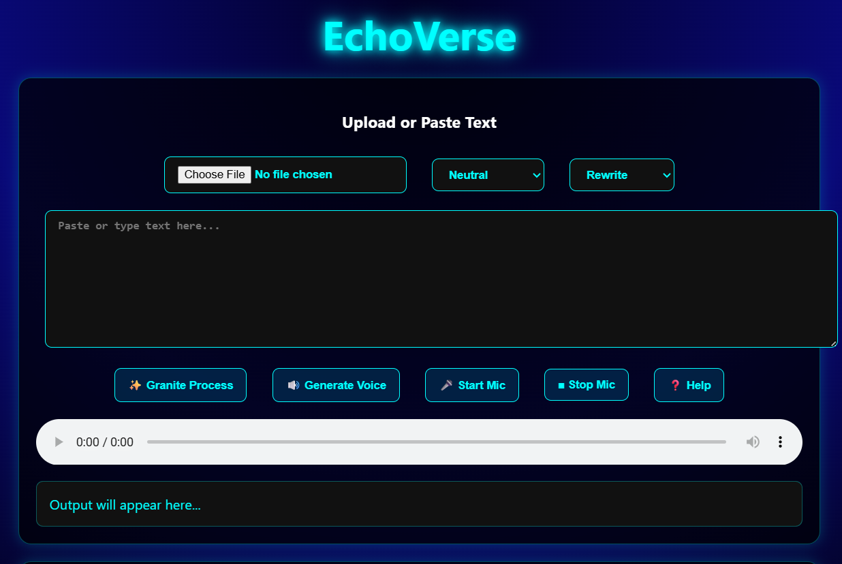
INTERFACE

Slide 4
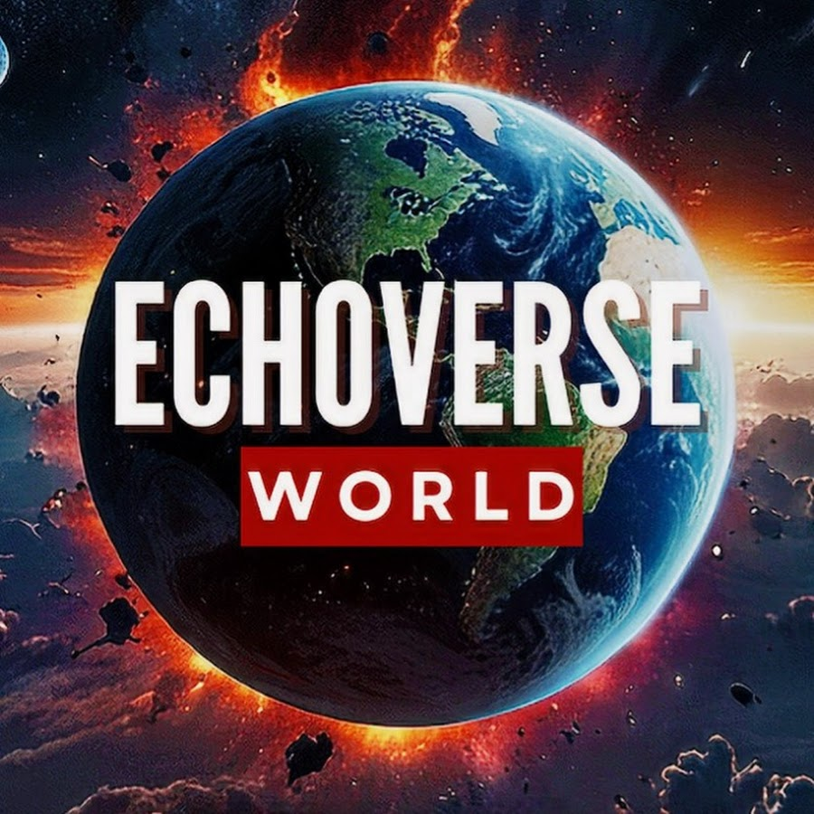
1. User provides text input or uploads a .txt file 2. Text is displayed in the interface 3. User selects tone: Neutral, Suspenseful, or Inspiring 4. IBM Watsonx Granite LLM rewrites text with prompt chaining 5. IBM Watson Text-to-Speech converts rewritten text into narration 6. Audio is generated and made downloadable
Architecture

Slide 5
Solution
EchoVerse leverages IBM Watsonx Granite large language models and advanced text-to-speech technology to deliver:
- Natural-sounding audiobook narrations
- Tone-adaptive rewriting while preserving meaning
- Customizable voices and tones
- Accessibility for visually impaired users
- Convenience and content reusability

Slide 6
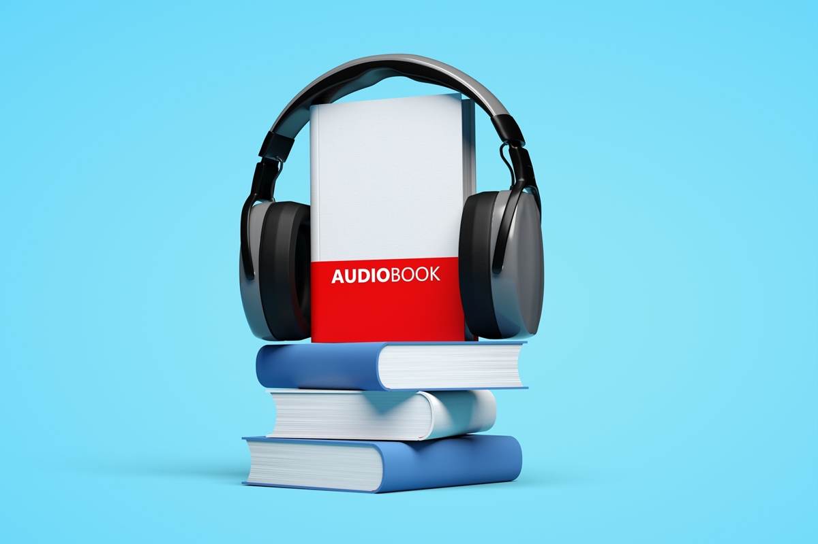
Future Scope
- Support for multiple languages and regional voices
- Mobile app version for on-the-go audiobook generation
- Integration with e-learning platforms and digital libraries
- Advanced editing tools for narration styles
- Real-time audiobook generation

Slide 7

Conclusion
EchoVerse provides an innovative and accessible way to convert written text into expressive audio. By combining AI-driven tone rewriting with natural voice narration, it ensures inclusivity, engagement, and convenience. The system has strong potential for future growth across education, accessibility, and professional content creation.

