Slide 1
Exploring Mental Health Data: Predicting Depression with Data Science
A Machine Learning approach and comprehensive data journey from Requirements to Business Insights
Presented by Anand CJ; 10-Dec-24

Slide 2
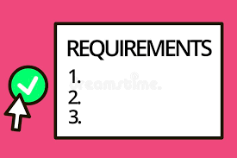











Intros….
Client:
Provides requirements and data files
Project Manager: Coordinates Project
Business Analyst: Data Mining, Preprocessing, EDA and Feature Engineering
Development Team: Develops Machine Learning models and tests performance
Testing team: Validates models and provides feedback
Deployment Team: Production deployment

Slide 3
Client Requirements
Objective:
Predict Depression based on mental health survey data to identify key influencing factors.
Deliverables:
Machine learning models to predict depression.
Visual representation of model performance [esp. Accuracy Score]
Provided data files:
Training Data
Test Data
Sample Submission template

Slide 4
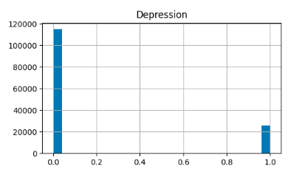
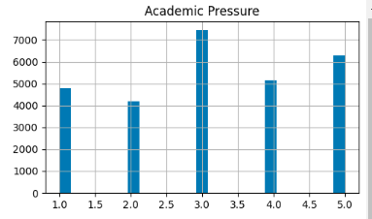
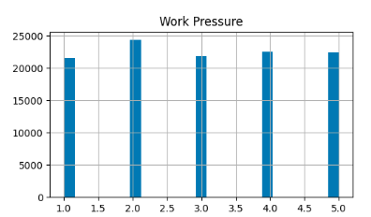
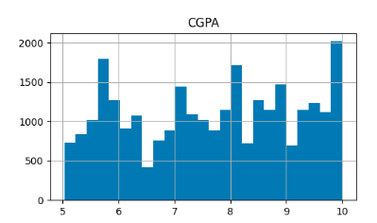
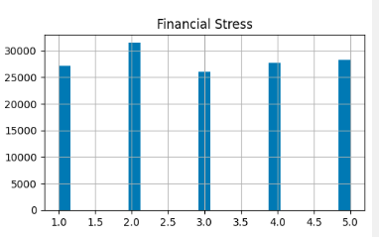
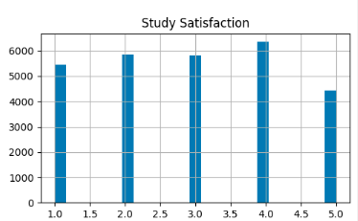
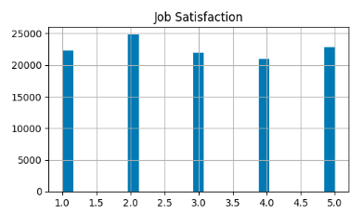
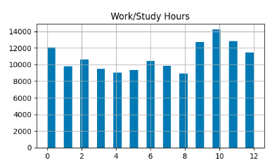
Exploratory Data Analysis (EDA)
Project Manager
Business Analyst
Key details about dataset:
Target variable: Depression (binary classification)
Size: # Rows – 140700; # Features - 19
Types of features: Numerical, Categorical

Slide 5
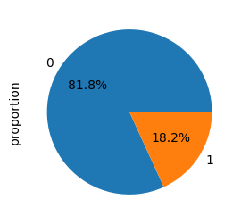
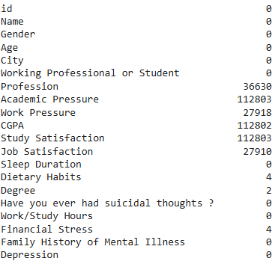
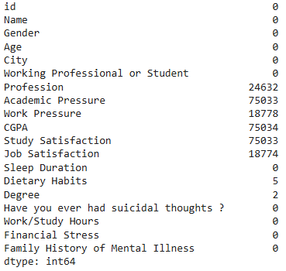
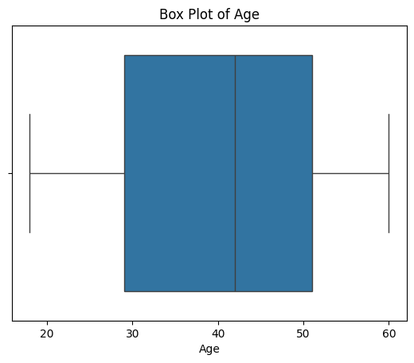
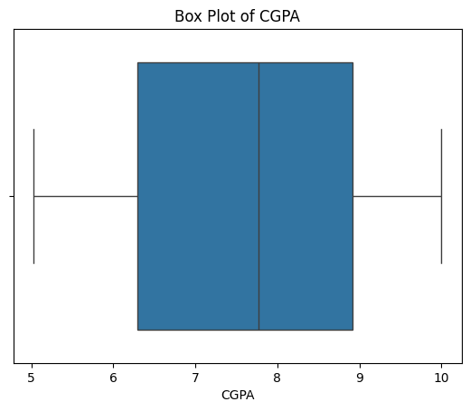
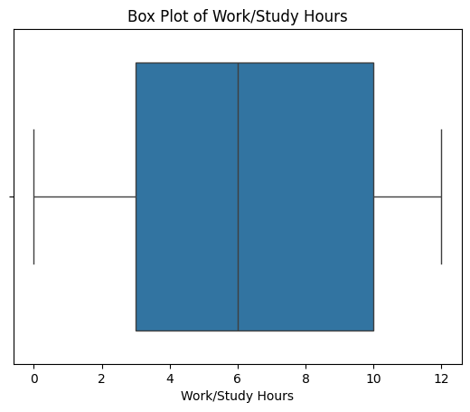
Exploratory Data Analysis (EDA) [Cont….]
Project Manager
Business Analyst
Majority Class: Proportion of Depressed vs Not Depressed
Missing Data Insights
Train Missing values
Test Missing values
Boxplots for some of the categorical predictors
Feature relationship: Correlation heatmap of numerical features

Slide 6
Data Preprocessing and Cleaning
Project Manager
Business Analyst
Recommendations:
Handle missing data - Median imputation for numerical features, frequent value imputation for categorical features
Scaling - Standardize numeric features
Encoding - One-hot encode of categorical variables
Feature selection – Remove irrelevant columns (Name, City)
Model selection
Logistic Regression – provides baseline for comparison
Decision Tree – provides Feature Importance and metrics for performance
Cross Validation – check how it helps in comparing model behavior

Slide 7
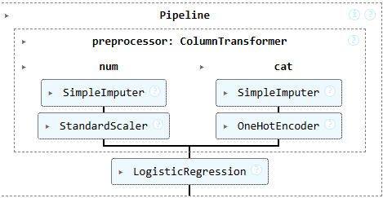
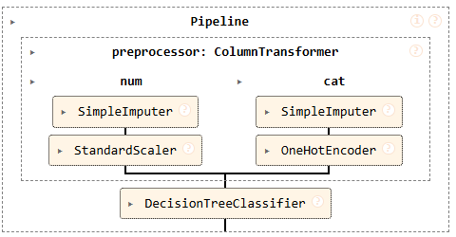
Model Development
Project Manager
Development Team
Models developed following the preprocessing recommendations

Slide 8
Model Development
Project Manager
Development Team
Models developed following the preprocessing recommendations -
Training and Validation - 80 – 20 split
Preprocessing pipelines
Logistic Regression
Accuracy Score from Logistic Regression: 0.9364250177683013
Cross validation accuracy: 0.9386780383795308
Decision Tree – Hyperparameter tuning – Tuned Max depth
Accuracy Score from Decision Tree: 0.928820184790334
Cross validation accuracy: 0.925373134328358

Slide 9
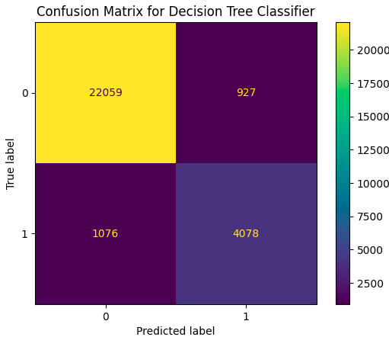
Results – Model Performance
Project Manager
Development Team
Metrics | Precision | Recall | F1-Score
0 | 0.95 | 0.96 | 0.96
1 | 0.81 | 0.79 | 0.80
AUC Score
Logistic Regression: 0.8857500901242007
Decision Tree: 0.8754506083421533

Slide 10
Testing and Validation
Project Manager
Testing team
Model Testing
Applied test dataset to evaluate performance.
Prepare and save submission file
Size: # Rows – 93800; # Features - 17

Slide 11
Business Insights / Summary
Interpreting model behavior:
Logistic regression has performed well, even though considered for baseline
Precision-recall trade offs with Decision Tree based on if predicting ‘Depression’ or ‘No Depression’ is important
Feature importance from Decision Tree – Top 5
Project Manager
Business Analyst

Slide 12
Next Steps
Project Manager
Regularly retrain models with updated data
Explore advanced models like Random forests or Gradient boosting
More visuals for the next iteration
Proposed actions for deployment
ETA for the final presentation 4-Feb-25

Slide 13
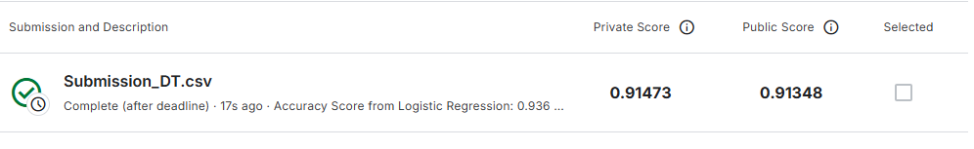
Kaggle score
Project Manager

Slide 14




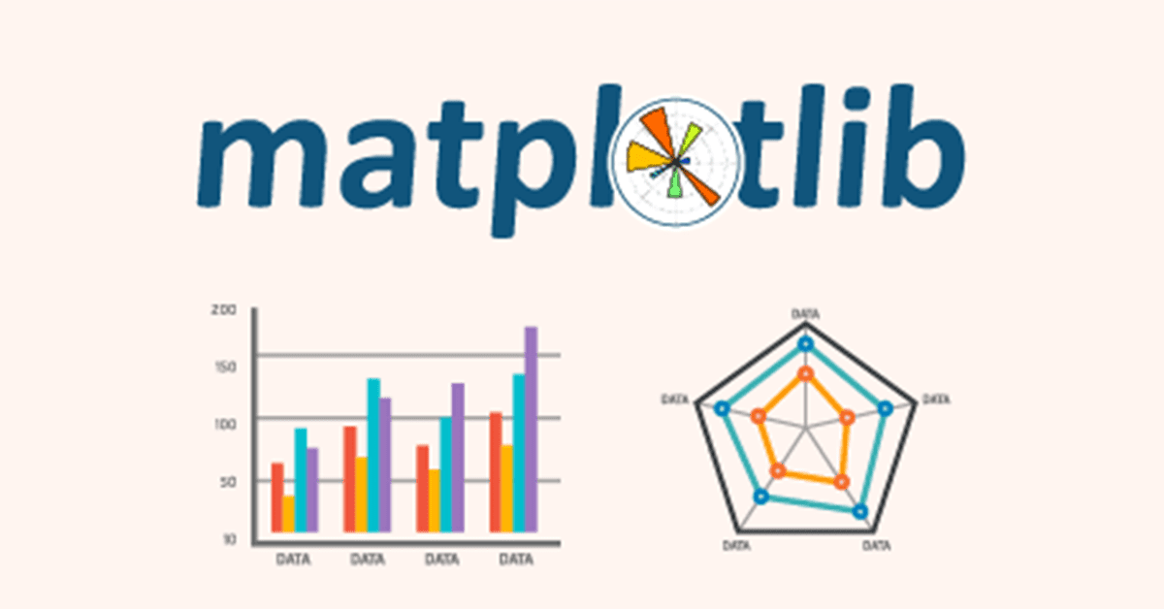


References
Some of the references

