Slide 1
Regression with Insurance Data: Predict insurance premiums based on various factors
A Machine Learning approach and comprehensive data journey from Requirements to Business Insights
Presented by Anand CJ; 08-Feb-25

Slide 2
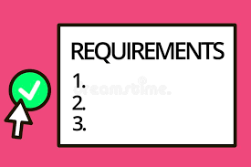











Intros….
Client:
Provides requirements and data files
Project Manager: Coordinates Project
Business Analyst: Data Mining, Preprocessing, EDA and Feature Engineering
Development Team: Develops Machine Learning models and tests performance
Testing team: Validates models and provides feedback
Deployment Team: Production deployment

Slide 3
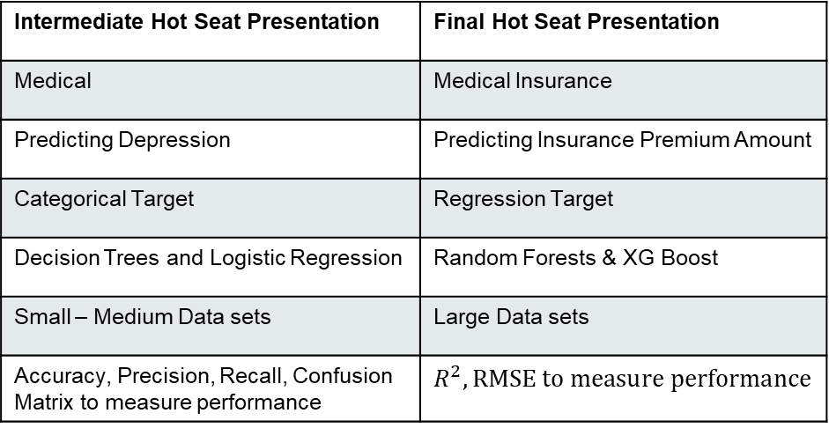
Comparing two use cases….
Intermediate Hot Seat Presentation | Final Hot Seat Presentation
Medical | Medical Insurance
Predicting Depression | Predicting Insurance Premium Amount
Categorical Target | Regression Target
Decision Trees and Logistic Regression | Random Forests & XG Boost
Small – Medium Data sets | Large Data sets
Accuracy, Precision, Recall, Confusion Matrix to measure performance | $$R^{2}, RMSE to measure performance$$

Slide 4
Exploratory Data Analysis (EDA)
Understanding Data Structure
Project Manager
Business Analyst
21 features in the training set and 20 in the test set
Target: Premium Amount (Regression)
Large data set: Train – 1.2 Million; Test – 0.8 Million
Train & Test Data are synthetic but based on real-world data. Synthetically generated by a trained deep learning model.

Slide 5
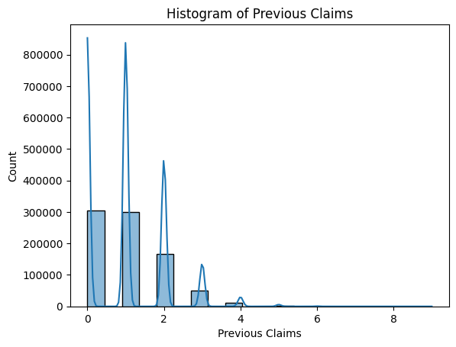
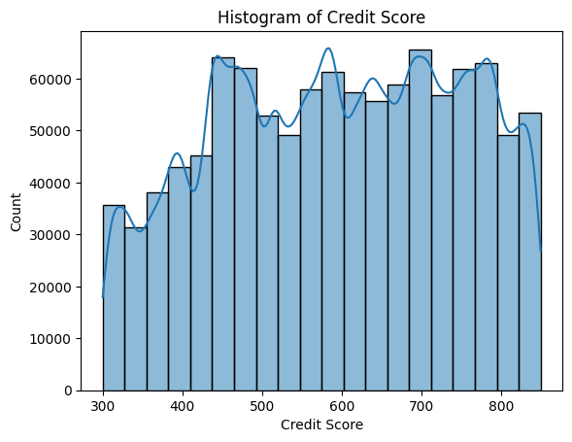
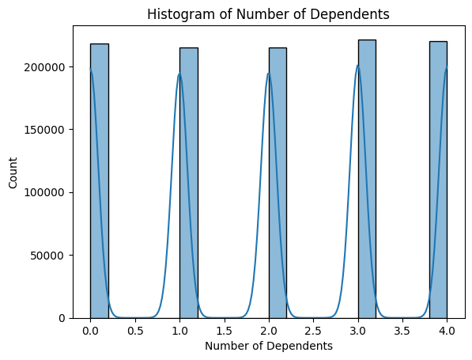
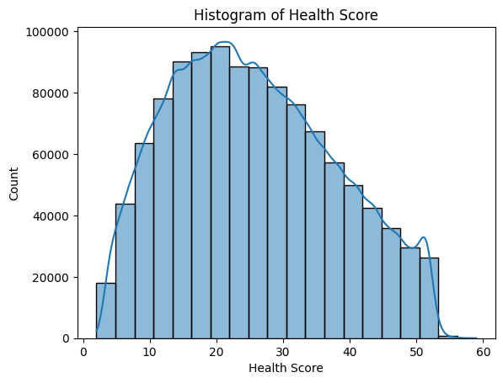
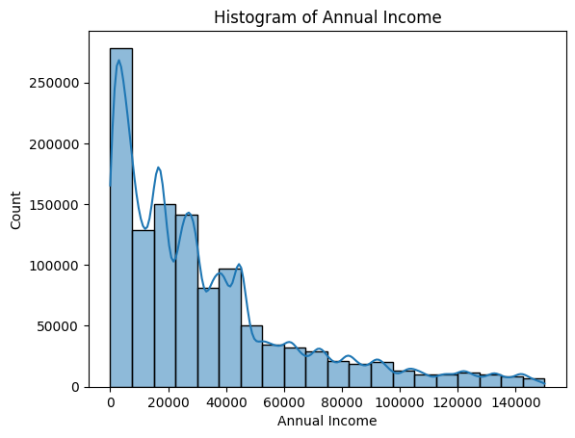
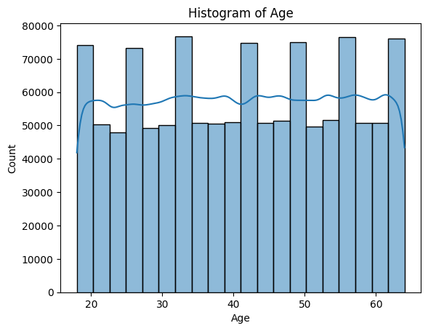
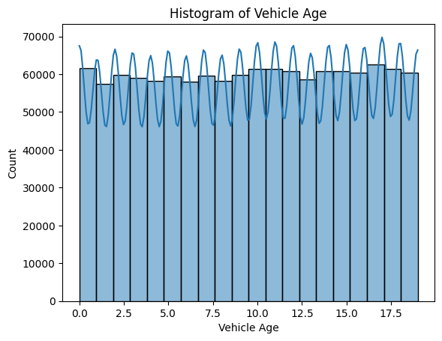
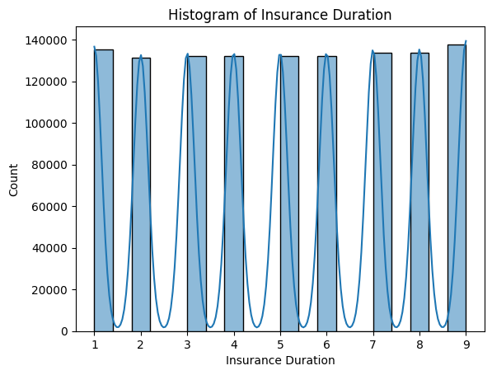
EDA [Contd….]
Distributions of numerical features - Histograms
Right Skewed
Transformation
Near Normal
No Transformation
Near Uniform
No Transformation
Periodic
No Transformation
Right Skewed
Transformation
Distinct peaks
Periodic
No Transformation
Near Uniform
No Transformation

Slide 6
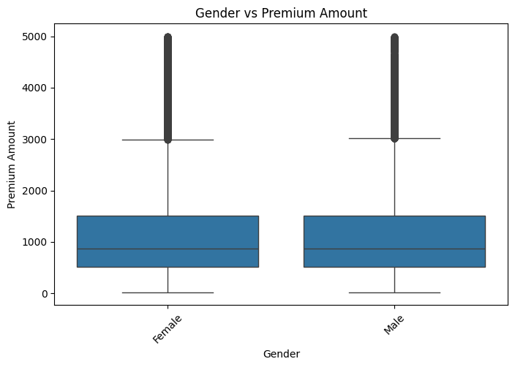
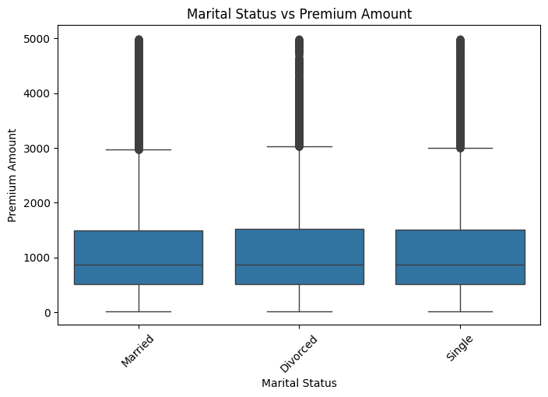
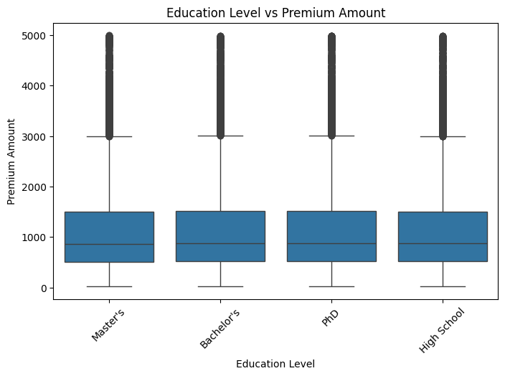
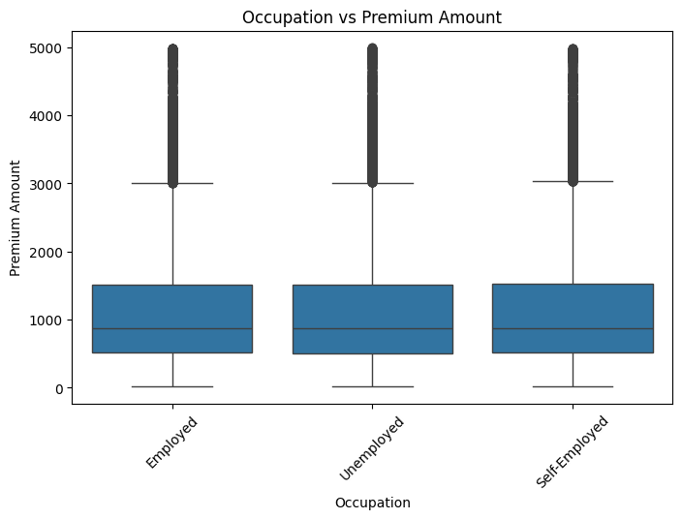
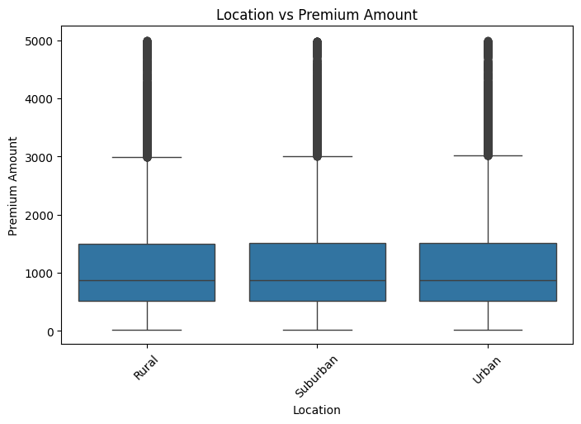

EDA [Contd….]
Distribution of Categorical features – Box Plots
20% Sampled Data (Seed: 42)

Slide 7
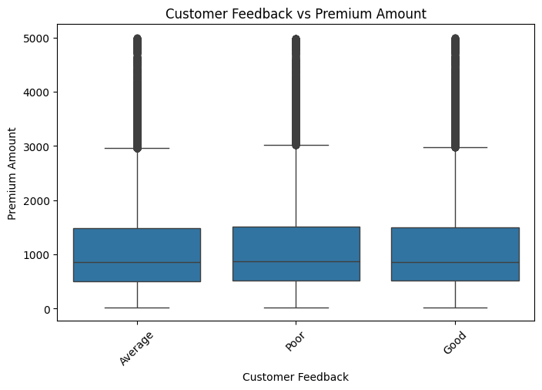
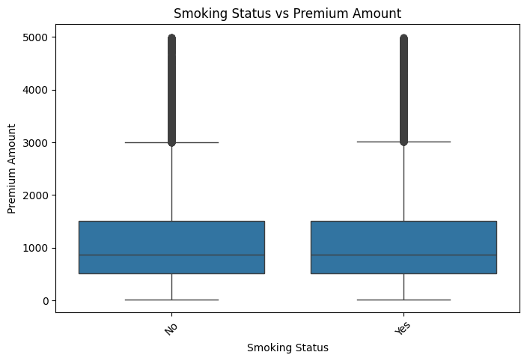
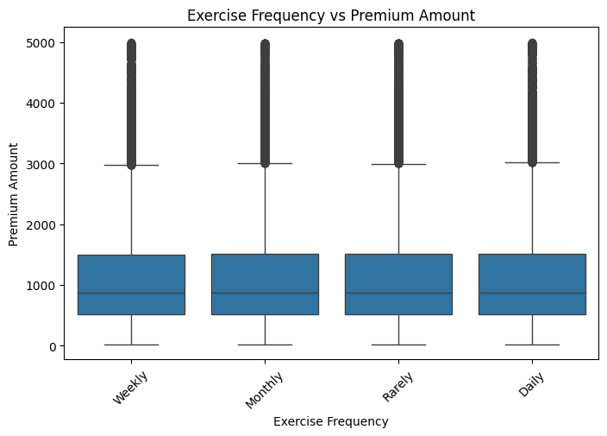
EDA [Contd….]
Distribution of Categorical features – Box Plots
20% Sampled Data (Seed: 42)

Slide 8

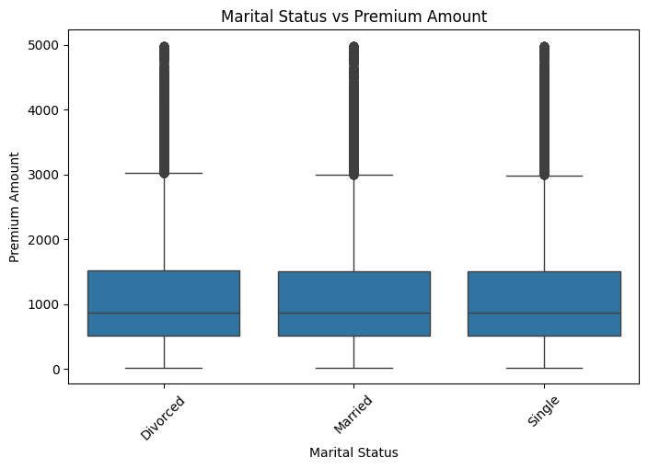
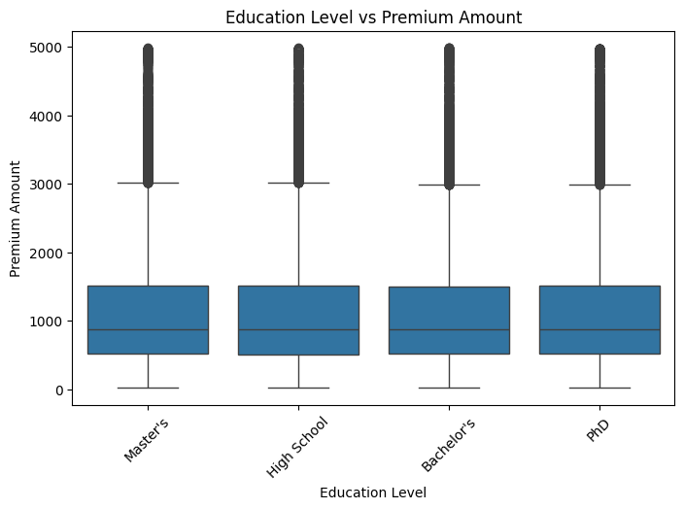



EDA [Contd….]
Distribution of Categorical features – Box Plots
20% Sampled Data (Seed: 100)

Slide 9
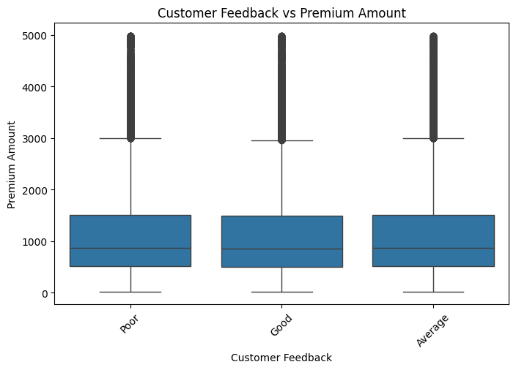
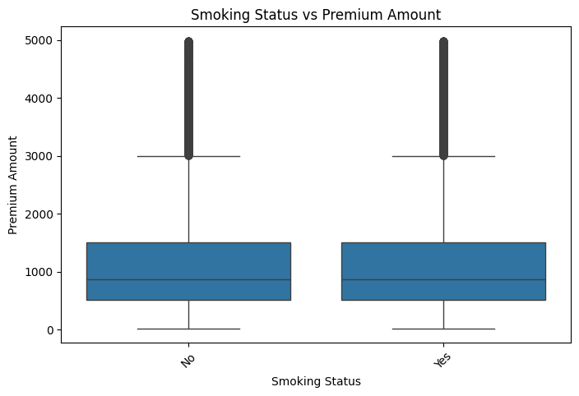

EDA [Contd….]
Distribution of Categorical features – Box Plots
20% Sampled Data (Seed: 100)

Slide 10
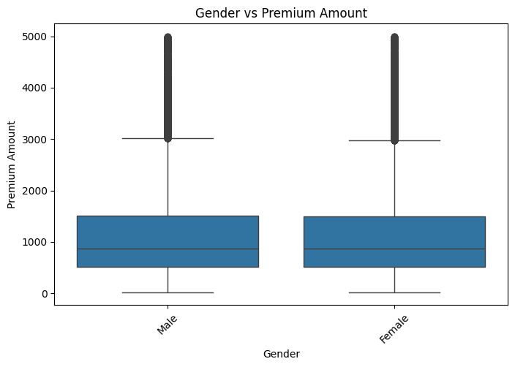
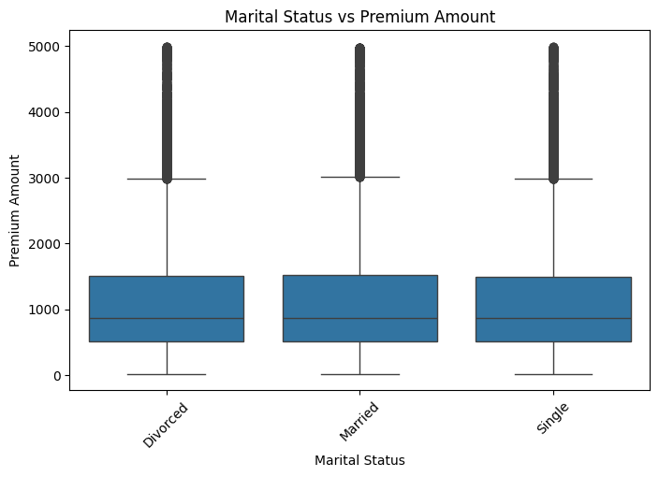




EDA [Contd….]
Distribution of Categorical features – Box Plots
20% Sampled Data (Seed: 2024)

Slide 11
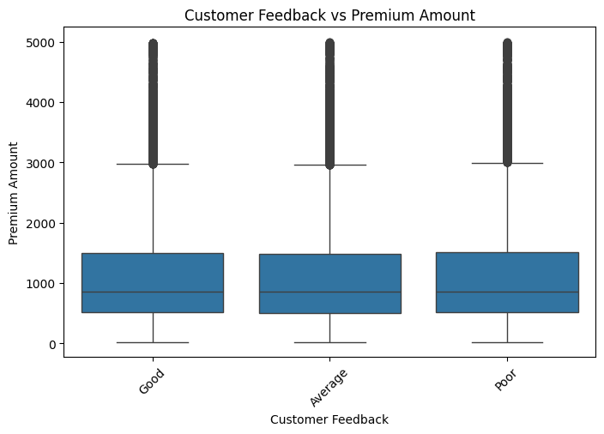


EDA [Contd….]
Distribution of Categorical features – Box Plots
20% Sampled Data (Seed: 2024)
Similar distributions
No major difference across different values of categories
No clear pattern

Slide 12
EDA [Contd….]
Skewness of numerical features
Numerical Feature | Skewness score | Observation | Transformation | Threshold 0.5
Annual Income | 1.470 | Highly Right Skewed | Log, Square Root | |Skewness| ≥ 1
Premium Amount | 1.241 | Highly Right Skewed | Log, Square Root | |Skewness| ≥ 1
Previous claims | 0.905 | Moderately Right Skewed | Square Root | 0.5 ≤ |Skewness| < 1
Health score | 0.282 | Normal |  | |Skewness| < 0.5
Insurance duration | -0.009 | Left Skewed |  | |Skewness| < 0.5
Age | -0.013 | Left Skewed |  | |Skewness| < 0.5
Number of Dependents | -0.013 | Left Skewed |  | |Skewness| < 0.5
Credit Score | -0.114 | Left Skewed |  | |Skewness| < 0.5

Slide 13
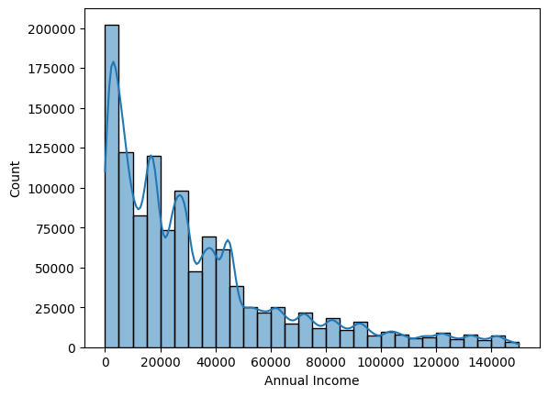
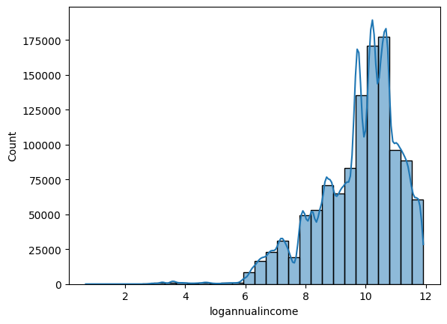
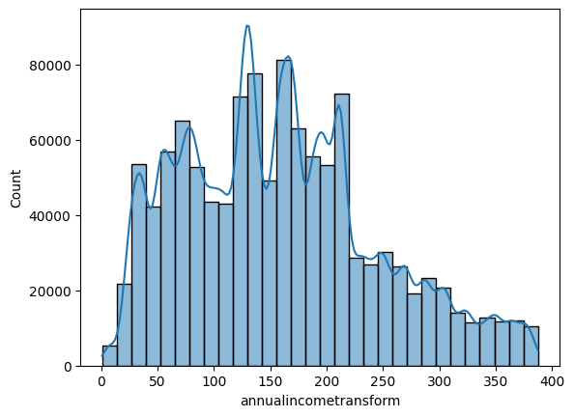
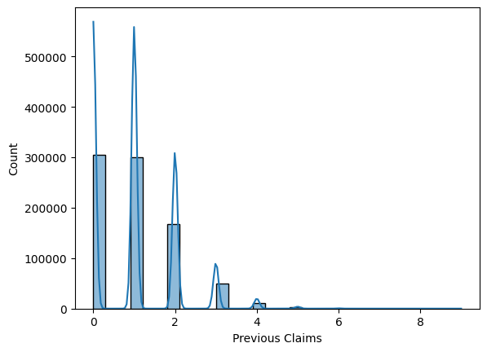
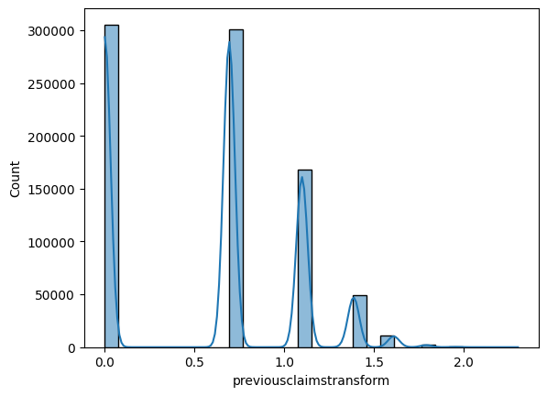
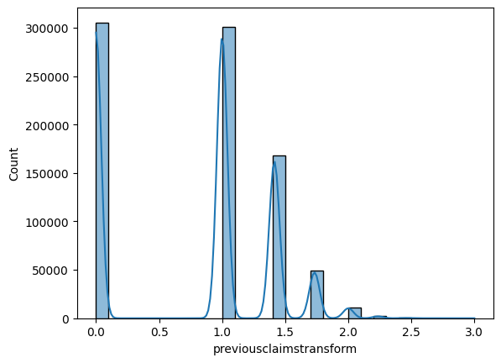
EDA [Contd….]
Skewness of numerical features
Before
After sqrt transformation; consider this one
After log transformation; not helping
After log transformation; better
After sqrt transformation; consider this one
Before

Slide 14
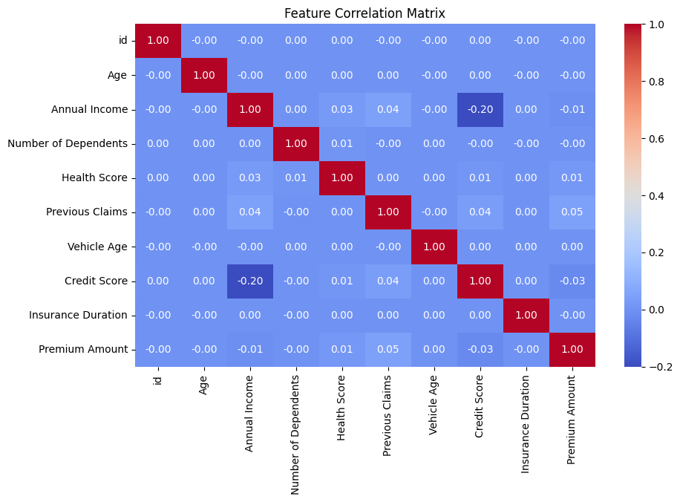
EDA [Contd….]
Correlation of numerical features
|correlation| < 0.1
Weak or no Correlation with Target Premium Amount
Highest correlation is 0.05. which is still weak
None of the features have a strong linear relationship with Premium Amount.
Low Correlation between features
Credit Score vs. Annual Income (-0.20) is the only slightly negative correlation, but it's still weak.
Linear models may not work well
Try Tree based models – Random Forest, XGBoost which handle non-linear relationships better.

Slide 15
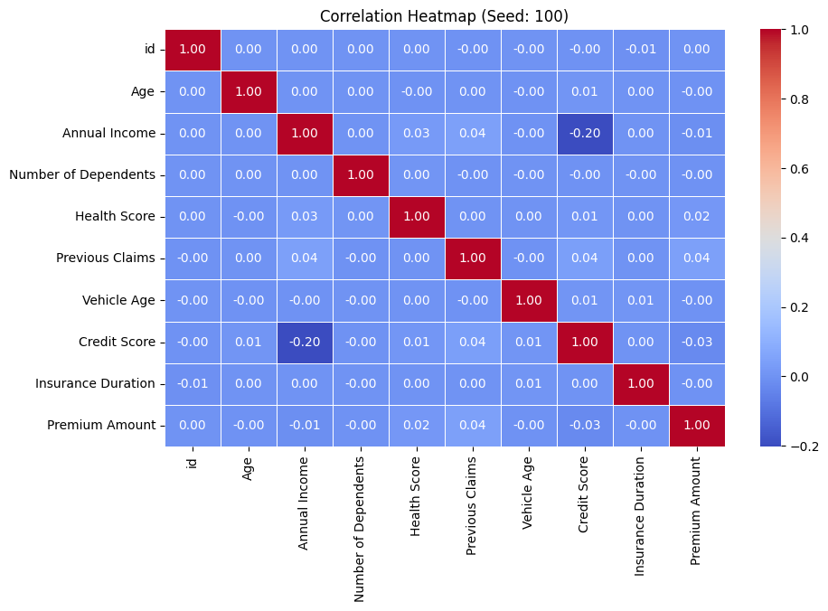
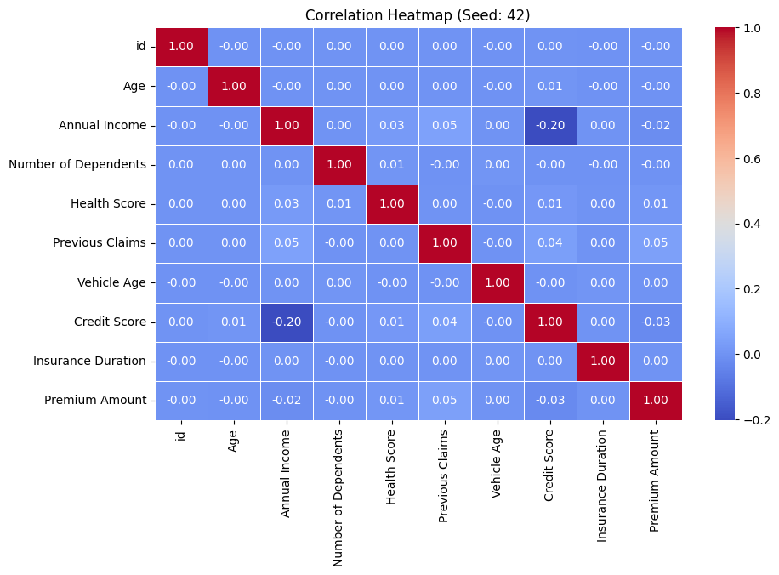
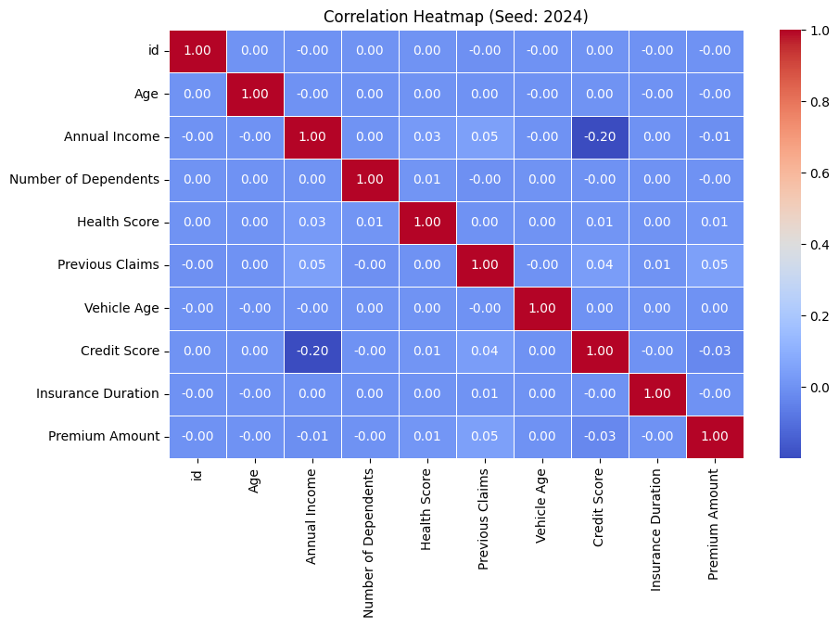
EDA [Contd….]
Correlation of numerical features for 20% sample data and different seeds

Slide 16
EDA [Contd….]
Correlation with Target for Categorical features
Chi-Square Test
Categorical Feature | Values | Type | Encoding recommendation | Chi-Square / Statistically significant (p-value < 0.05)
Gender | Male, Female | Binary | Ordinal Encoding | 5400.10 / Yes
Marital Status | Single, Married, Divorce | Ordinal | Ordinal Encoding | 11296.30 / Yes
Education Level | High School, Bachelor’s, Master’s, PhD | Ordinal (Higher education may impact premium) | Ordinal Encoding | 16260.40 / Yes
Occupation | Employed, Self-Employed, Unemployed | Nominal | One-Hot Encoding | 10791.40 Yes
Location | Suburban, Urban, Rural | Nominal | One-Hot Encoding | 10675.23 / Yes
Policy Type | Basic, Premium, Comprehensive | Nominal | One-Hot Encoding | 10543.96 / Yes
Customer Feedback | Poor, Average, Good | Ordinal (Good > Average > Poor) | Ordinal Encoding | 10950.53 / Yes
Smoking Status | Yes, No | Binary | Ordinal Encoding | 5236.524 / Yes
Exercise Frequency | Rarely, Monthly, Weekly, Daily | Ordinal (More exercise may impact health/premium) | Ordinal Encoding | 16490.20 / Yes
Property Type | Apartment, House, Condo | Nominal | One-Hot Encoding | 10804.58/ Yes

Slide 17
Data Preprocessing and Cleaning
Recommendations: Handling Missing values
Numerical Feature | Mean / Median Values | Outliers & Skew | Recommended Imputation | Reasoning
Previous Claims | Both 1.0 | Some Outliers, right skewed | Median | Right Skewed - Median is less sensitive to Outliers
Credit Score | Mean 592.92 and Median 595.0 | No Outliers | Mean | Nearly uniform distribution – Mean maintains balance
Number of Dependents | Both 2.0, Mode 3.0 | No Outliers | Mode | Discrete. Most frequent value can be used
Health Score | Mean 25.61 and Median 24.57 | No Outliers | Mean | Near normal distribution. Mean works better
Age | Mean 41.14 and Median 41.0 | No Outliers | Mean | Mean Median close. Mean might be a good choice
Annual Income | Mean 32745.21 and Median 23911.0 | Some Outliers, right skewed | Median | Right Skewed - Median is less sensitive to Outliers
Categorical Feature | Recommended Imputation | Reasoning
Occupation, Customer Feedback, Marital Status | Mode [Most Frequent] | Small set of unique categories; missing values are less than 40%

Slide 18
Data Preprocessing and Cleaning
Recommendations: Scaling
Numerical Feature | Distribution | Scaling
Annual Income | Right Skewed | Transformation
Previous claims | Right Skewed | Transformation
Health score | Near Normal | Standard Scaler
Insurance duration | Distinct Peaks | No Scaling
Age | Near Uniform | MinMax
Number of Dependents | Periodic / Discrete | No Scaling
Credit Score | Near Uniform | MinMax
Vehicle Age | Uniform | MinMax

Slide 19
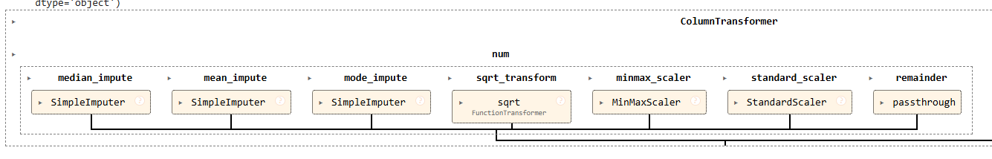
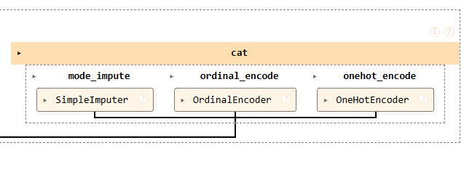
Model Development
Project Manager
Development Team
Models developed following the preprocessing recommendations -
Training and Validation - 80 – 20 split
Various strategies applied – Transformation, Imputing, Encoding, Scaling
XG Boost – Hyperparameter tuning – n_estimators, learning_rate, max_depth, subsample, colsample_bytree, reg_lambda, reg_alpha, random_state, n_jobs

Slide 20
Results – Model Performance
Project Manager
Development Team
R2 Score and RMSE not improving beyond these levels – tried with multiple options:
Full and Partial training data
Different hyperparameters tuning
Feature engineering options, filtering for high impact features, dropping low impact features
Target transformations
RandomizedSearchCV
Train R2 Score: 0.126
Validation R2 Score: 0.041
Train RMSE: 809.470
Validation RMSE: 847.399
Overfitting and lack of generalization

Slide 21
Testing
Project Manager
Testing team
Model Testing
Applied test dataset to evaluate performance.
Prepare and save submission file
Save the XGBoost Model for deployment
Size: # Rows – 800000; # Features - 20

Slide 22
Deployment
Project Manager
Deployment team
Joblib for saving and loading models (via Google Collab)
Gradio for Easy web deployment and get an instant shareable public link
Open the Gradio link
Enter values and get predictions
No local installation
Instant cloud deployment
Works on any device

Slide 23
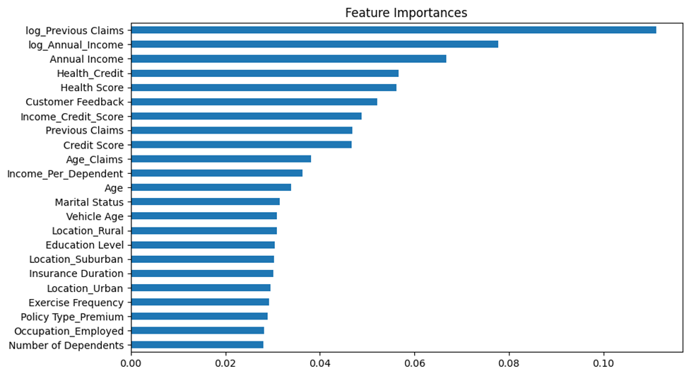
Business Insights / Summary
Project Manager
Business Analyst
Insurance premiums depend on complex interactions between variables, but no single feature strongly predicts premiums
Traditional linear models fail due to weak correlations, making tree-based models a better fit
While our model performance wasn’t optimal, it provided valuable insights into insurance risk modeling and premium estimation
Future work could include exploring deep learning, ensemble stacking, additional feature engineering etc., to improve accuracy

Slide 24
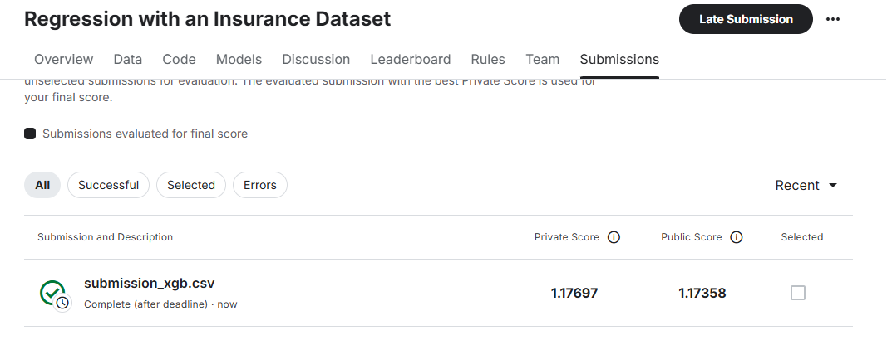
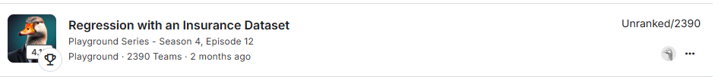
Kaggle score
Project Manager

Slide 25









References

Slide 26
EDA [Contd….]
Understanding Data Structure
Target (Premium Amount) seems to represent Medical/Health Insurance
Health Related Features | Personal & Financial Features | Policy type & Duration
Health Score | Age | Policy Type
Smoking Status | Annual Income | Insurance Duration
Exercise Frequency | Credit Score
Previous Claims | Number of Dependents
 | Occupation
Unlikely to be Vehicle Insurance
No Vehicle Type
No Vehicle Model/Make
No data related to driving or Accidents
Exercise Frequency
Previous Claims
Unlikely to be Home Insurance
No Property value
No Construction related details
No Security related
No claims history on property
Highly likely, this dataset is for Health Insurance Premium Prediction. Some features may indicate a mix of Home & Health Insurance, but health-related attributes dominate.

Slide 27
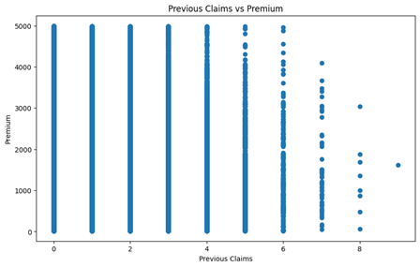
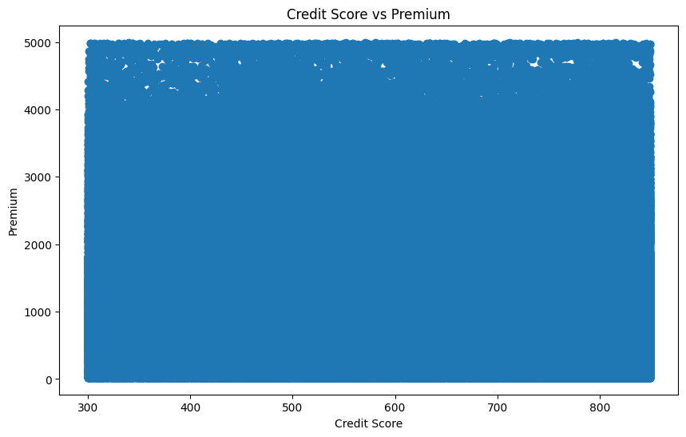
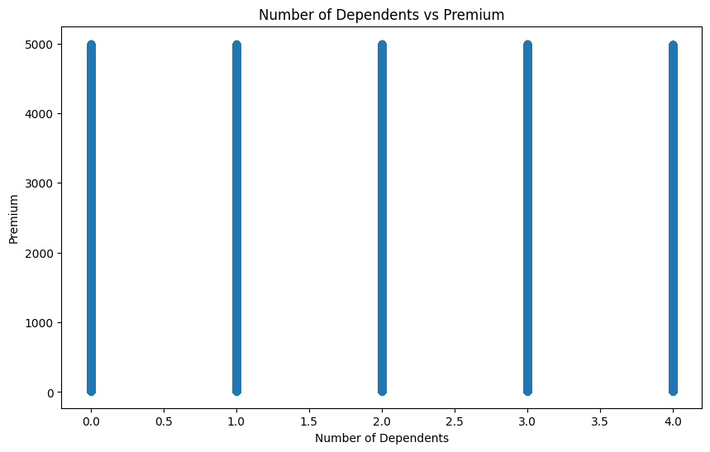
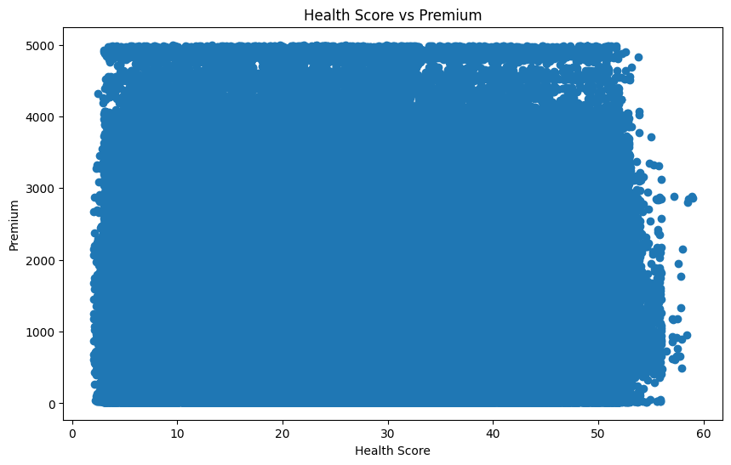
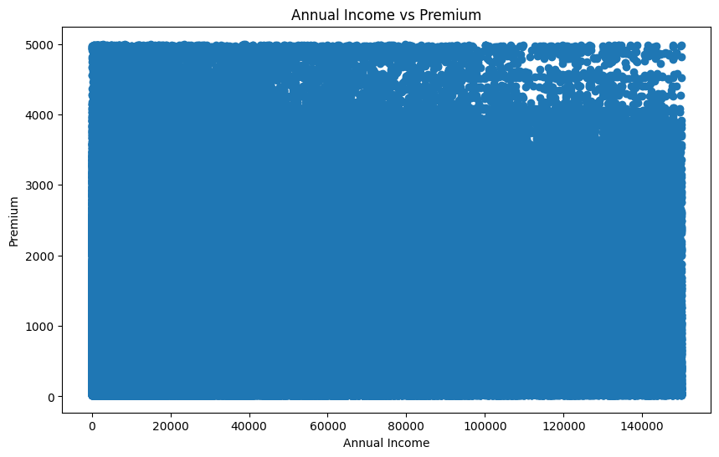
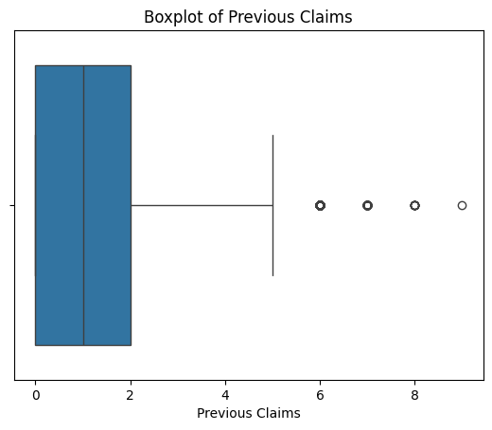
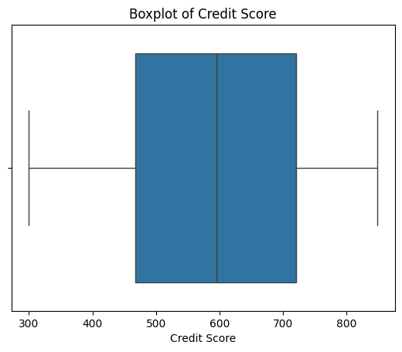
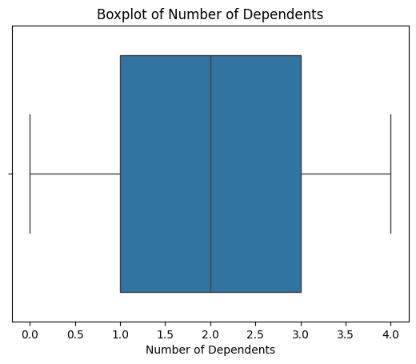
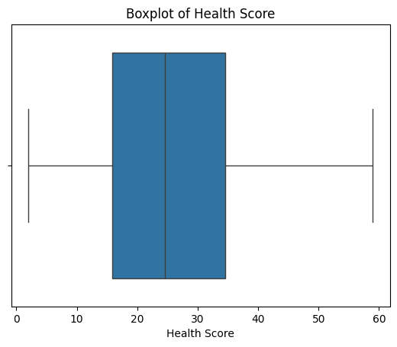
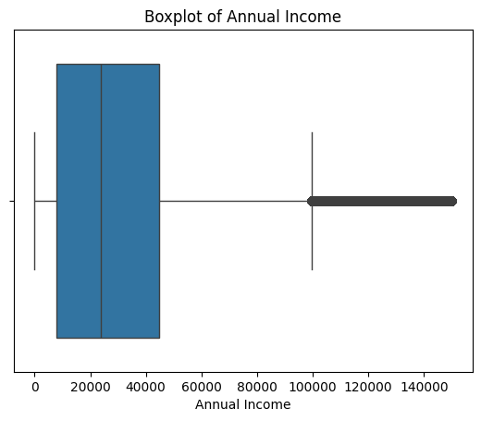


Data Preprocessing and Cleaning
Recommendations: Handling Missing values
Project Manager
Business Analyst
Previous claims
Credit Score
Number of Dependents
Health Score
Annual Income
Age

