Slide 1
CE889 GROUP PROJECT PRESENTATION Team no-4 Ali ahmed, olumide fadahunsi, Manuel verduzco valenzuela,shreya Tirunagari, sourana maji, Deepak nandula

Slide 2
Pre-Processing What data did you use and why?
Notes:
Nan replacing with zero :
Prmom2Sinceweek
Promo2SinceYear
PromoInterval
CompetitionbOpenSinceMonth
CompetitionOpenSinceYear

Slide 3
How did you process this data?
Training Dataset
Remove samples in which store is closed, 83% of data the store is open
Split dateTime to year, month and day
Adding seasonality to data,
Find Outliers (We don’t remove outliers as it will break seasonality trend)
Fill Na data with median in CompetitionDistance
Fill other Na with 0’s
Merge Store and training
Dropping open column
Implementing Wrapper method For Feature Extraction
Store Data
Notes:
3-5; Spring
6-7; Summer
9-11;Fall
12-2- Winter
Drop Open column as value is always ‘0’ when store is closed

Slide 4
Was there any data you didn’t use and why?
Customers Dropping columns that are highly correlated to Promo2
Promo2SinceWeek
Promo2SinceYear
PromoInterval
Dropping one of the Competition Open Columns and Customers
CompetitionOpenSinceMonth
Customers

Slide 5
Type of deep nn Why, did you use that one?
Tested with DNN as a baseline to see what type of score to beat with other architectures
Final NN is a RNN with LSTM architecture. RNN’s are ‘powerful for modeling sequence data such as time series or natural language’, we have a time series problem, so we decided to use an RNN.

Slide 6
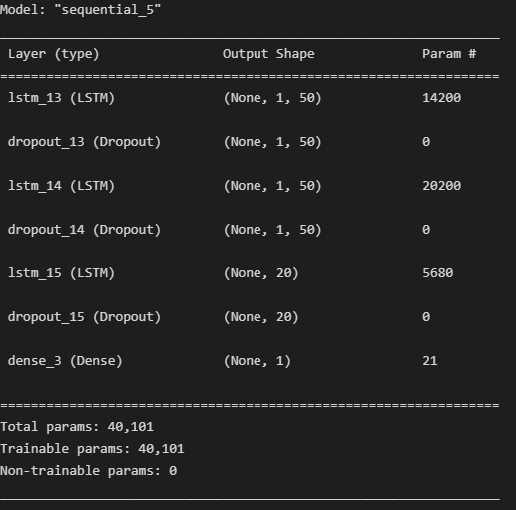
Architecture
Notes:
Dropout layer before dense, its not returning the sequence its returning a vector
Dropping out 20% of the nodes at each layer to avoid overfitting the network to the training data

Slide 7
Score that we achieved on the kaggle

Slide 8
Each team member contribution to the task

Slide 9
* THANK YOU *

