Slide 1


Cisco Network Testbed Project
(Team 6)
Mentor
Daniel Egger
Members
Yi-Chen Lee
Prabhakar Nanduri
Leidan Ruan
Shakti Vachhani

Slide 2
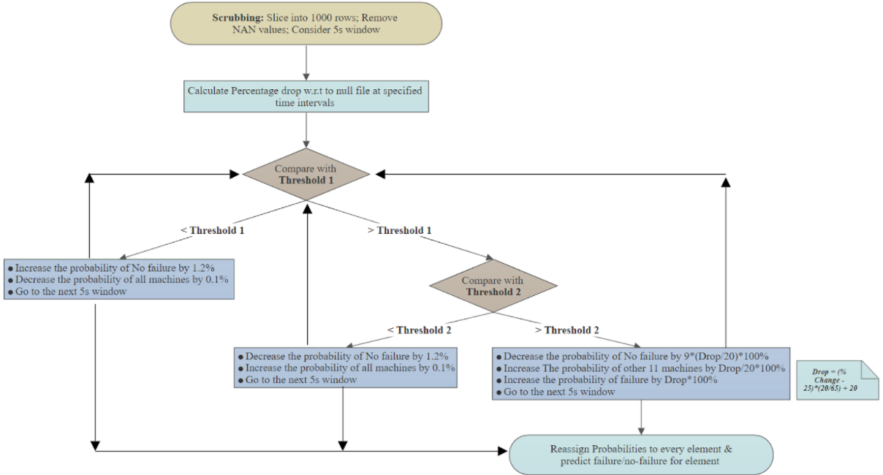
Model Description

Slide 3
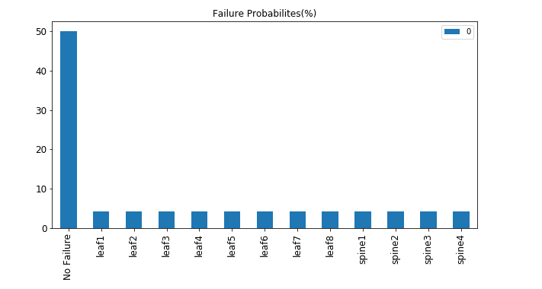
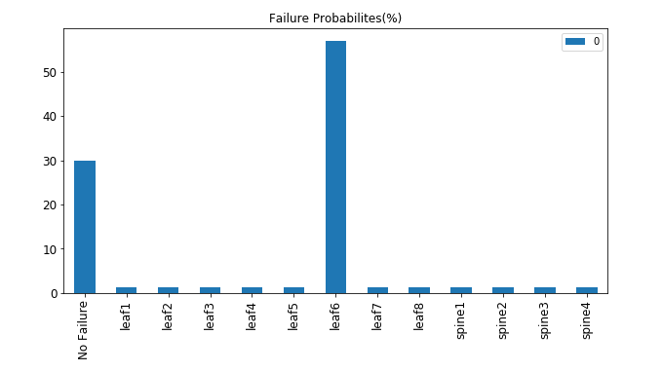
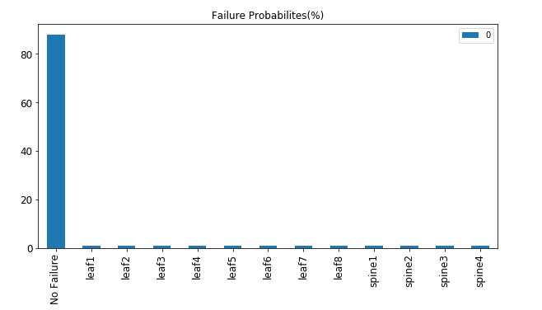
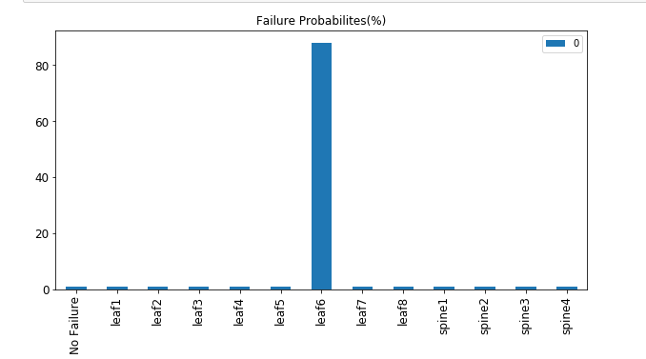


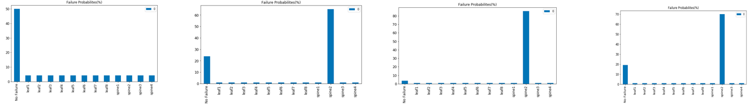

Performance on Training Set
Picture1: File1 start
Picture2: File1 after 10000 rows
Picture4: File2 start
Picture5: File2 after 10000 rows
Picture3: File1 reaching conclusion
Picture6: File2 reaching conclusion
Picture7: File3 start
Picture8: File3 after 10000 rows
Picture9: File3 reaching conclusion
Picture10: File3 showing recovery

Slide 4
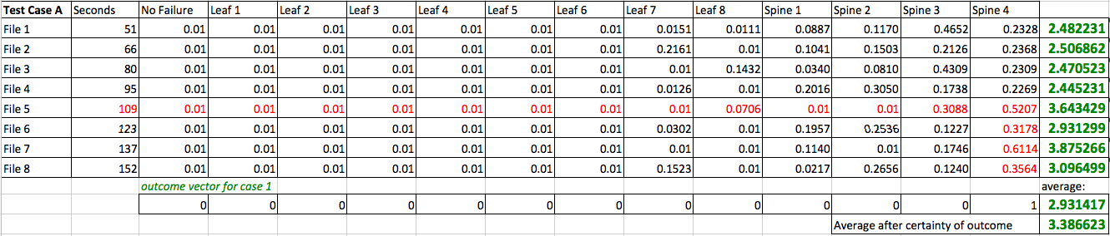
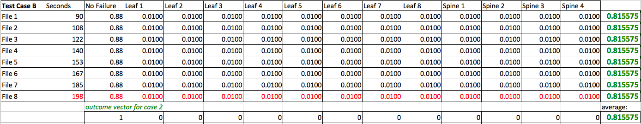
Performance on Test Set
Outcome from Case A
Outcome from Case B

Slide 5
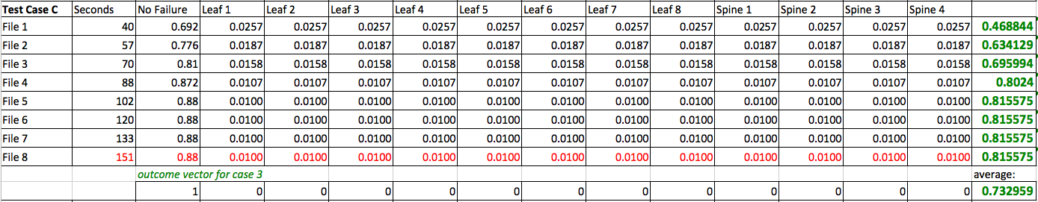
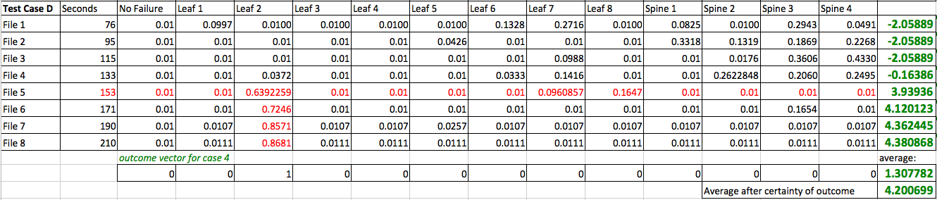
Performance on Test Set
Outcome from Case C
Outcome from Case D

Slide 6
Further Work
Further Work:
The historical data can be used to optimize the two thresholds (based on the outcome obtained) for better probabilistic predictions.
It means that improving the model to enable it to LEARN from test data (that can be now interpreted as training data).
Reference (Model Code Repository):
https://github.com/nanduriprabhakar/Data_Science_Team_Project

Slide 7
Team member
Contribution
Programming
Prabhakar Nanduri
Model Development
Prabhakar Nanduri
Leidan Ruan
Model Validation & Optimization
Yi-Chen Lee
Shakti Vachhani
Report & Presentation
Yi-Chen Lee
Leidan Ruan
Shakti Vachhani

Slide 8
Thank you！
Credits to Cisco for providing open source data for this project！

