Slide 1
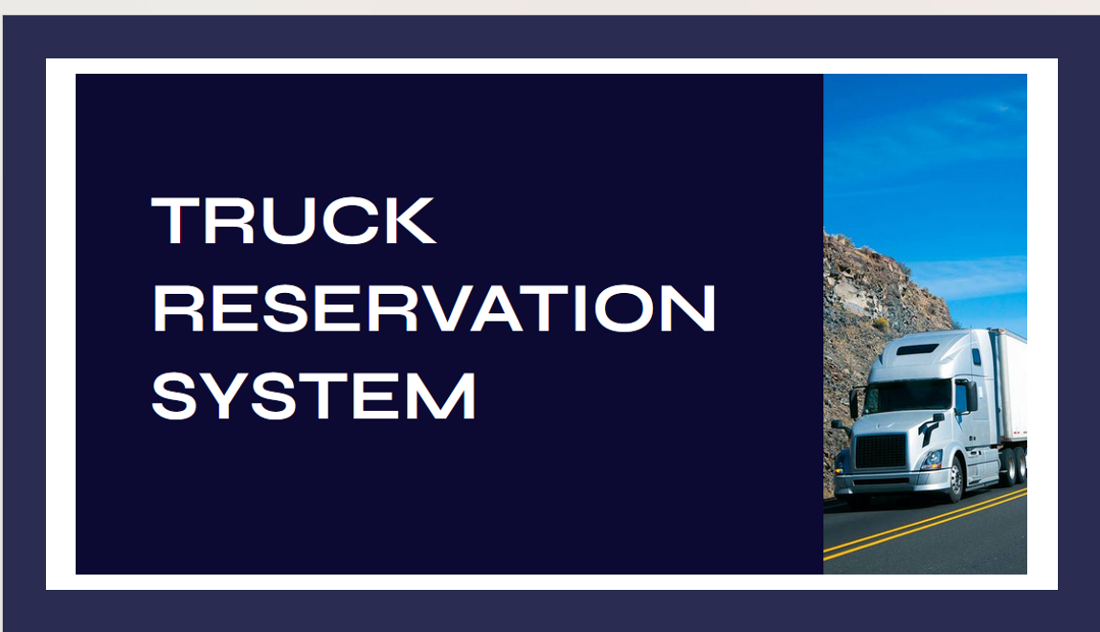
Madhumitha E 3122 22 5001 068
Micheal Berdinanth M 3122 22 5001 071
Nandhalal S 3122 22 5001 075

Slide 2
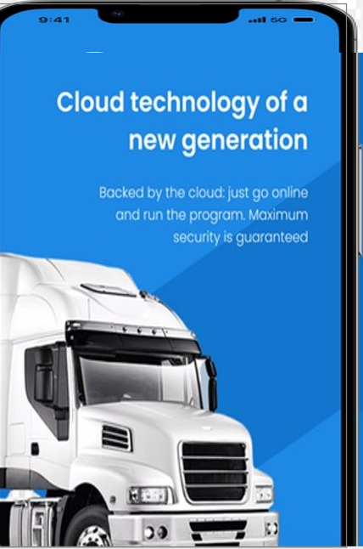
Problem Statement
Our objective is to develop a Truck Reservation System. that automates the logistics and transportation industry. Designed for logistics providers, truck owners, and agencies, ensuring seamless cargo transportation through efficient booking and management. Experience optimized truck utilization, minimizing costs and environmental impact.
Stay in control with real-time status updates, ensuring a responsive and reliable logistics network.

Slide 3

Motivation for the Truck Reservation System:
Logistics Industry Challenges:
Aims to address challenges faced by the logistics and transportation sector.
Seeks to automate and streamline truck reservation processes.
Enhancing Efficiency:
Motivated by the goal of enhancing overall efficiency in cargo transportation.
Intends to reduce manual efforts through automation.
Centralized Platform:
Provides a centralized platform for users involved in cargo transportation.
Aims to bring all relevant stakeholders onto a unified system.
Unique Focus on Freight Logistics:
Unlike traditional reservation systems for passengers, this system uniquely focuses on the logistics and freight industry.
Tailored to meet the specific needs of businesses engaged in cargo transportation.
Optimizing Cargo Movement:
Motivated by the desire to optimize the movement of goods.
Seeks to streamline truck reservations for a more efficient and tailored solution.
Business-Centric Solution:
Targets businesses and entities involved in cargo transportation rather than individual passengers.
Aims to provide a solution aligned with the requirements of freight logistics.

Slide 4
Scope
and Limitations
Efficient Cargo Management:
Streamlined truck reservations for diverse cargo needs.
Accommodates various truck types, enhancing flexibility.
Comprehensive Platform:
Serves Logistics Users, Truck Owners, and Agencies.
Offers a centralized system for managing reservations.
Financial Transaction Integration:
Inclusion of a wallet system for seamless payments.
Provides a user-friendly method for balance management.
Geographical Limitations:
System effectiveness tied to specific geographical areas.
Potential challenges in expanding to less developed logistics infrastructure areas.
Dependency on Truck Owners:
Reliability influenced by truck owners' active participation.
Fluctuations in truck availability may impact overall dependability.
Setup Challenges and Technical Dependence:
Initial implementation requires collaboration with stakeholders.
Technical issues, like server outages, could disrupt the reservation process.

Slide 5
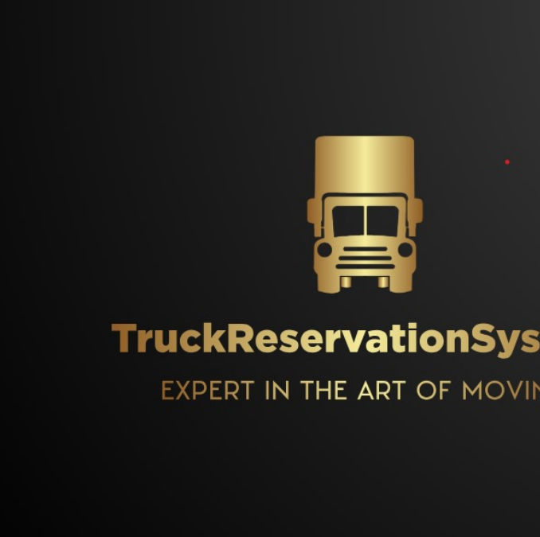
Analysis using class Diagram

Slide 6
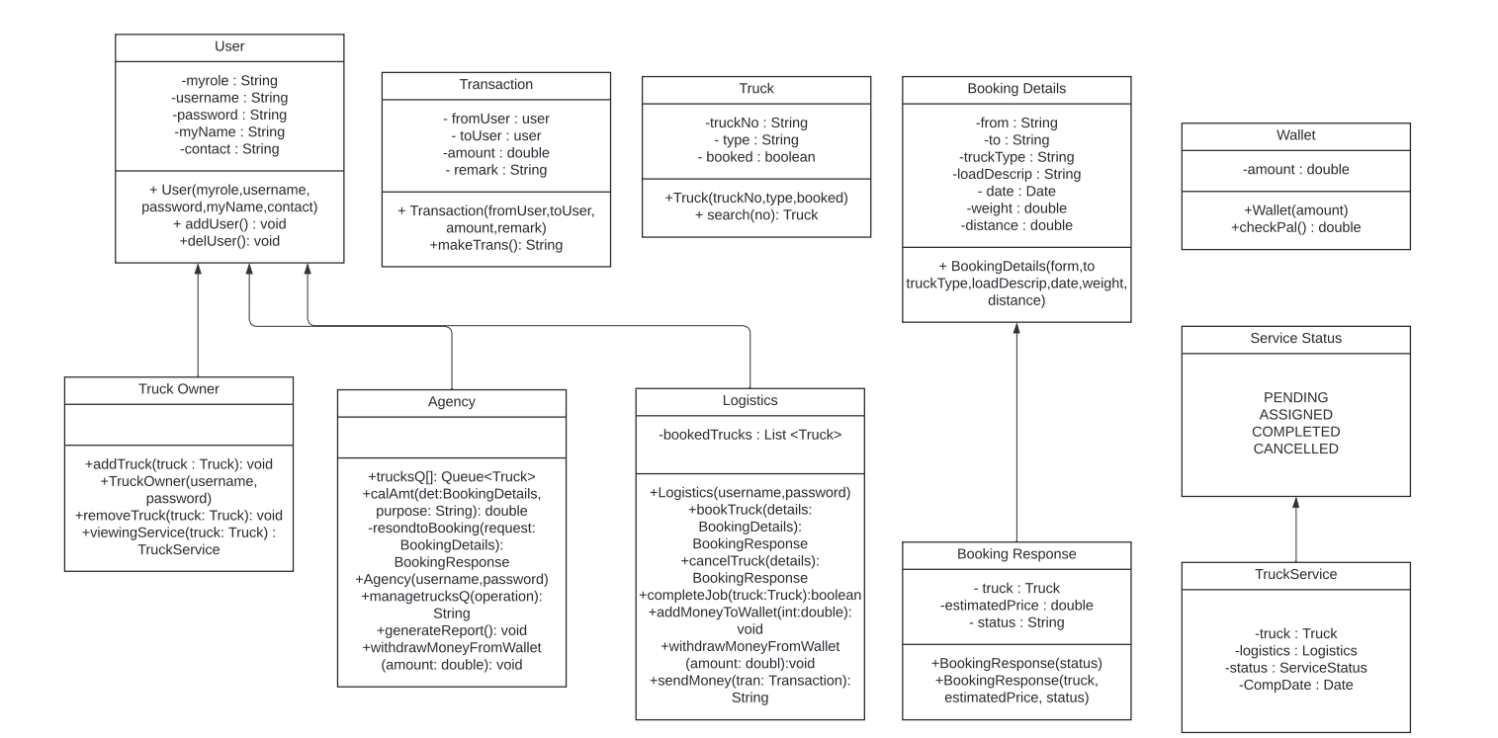
DESIGN OF CLASS DIAGRAM
Design of the Solution (Class Diagram)

Slide 7
The Truck Reservation System's user interface allows seamless logins or sign-ups, accommodating three key roles: logistics, agency, and truck owner. Users can tailor their experience by selecting their role, enhancing efficiency in truck booking and management. This dual functionality, combined with role-based access, boosts user accessibility. Moreover, the system goes beyond, integrating banking features. Logistics professionals, agencies, and truck owners effortlessly manage finances, including adding money to wallets, withdrawals, and secure transfers. This integrated banking system not only enhances the user experience but also provides a centralized platform for efficient financial transactions within the truck reservation system.Once the booking process is done, we will send an email to the user regarding booking confirmation with truck details.
Logistics
The Logistics class, extending User, emphasizes logistics and booking management. Logistics users can book and cancel truck bookings, complete jobs, manage booked trucks, and handle financial transactions.
TruckOwner
The Truck Owner class, also extending User, focuses on truck-related operations. Truck owners can add and remove trucks, as well as view services related to their trucks.
Agency
The Agency class, extending the User class, introduces a queue of trucks (trucksQ[]) and additional functionalities. This class can calculate amounts, respond to booking requests, manage the truck queue, generate reports, and perform financial transactions such as withdrawing money from the wallet.

Slide 8
System Architecture:
Centralized Approach: A single server manages reservations, simplifying coordination.
Decentralized Framework: Distributed databases boost fault tolerance but may add complexity.
Database Choices:
Traditional Relational Databases: (e.g., MySQL, PostgreSQL) for structured data like user information.
NoSQL Database Option: (e.g., MongoDB) for flexibility with unstructured or semi-structured data.
User Interface:
Web-Based Interface: Ensures broad compatibility via browsers.
Mobile App Development: Facilitates convenient on-the-go access for users.
Payment Integration:
Third-Party Payment Gateway: (e.g., PayPal, Stripe) simplifies financial transactions.
Real-Time Updates:
Push Notifications: Deliver real-time updates to users.
Polling Mechanism: Periodically checks for updates as an alternative approach.
User Authentication:
Strong Authentication Measures: Implementation, possibly with multi-factor authentication, for heightened security.
Design Alternatives

Slide 9

Identification of process / modules / algorithms
Authentication and Authorization:
Secure user access with a robust authentication process.
Role-based authorization for user types (e.g., Logistics, TruckOwner, Agency) to control specific functionalities.
Truck Booking Process:
Perform Booking method matches user requests with available trucks.
Real-time updates to the truck list through methods like perform AddTruck and perform RemoveTruck.
Immediate user feedback via System.out.println for successful bookings.
Payment Processing:
Integrated within the perform Booking method, ensuring accurate and secure financial transactions.
Wallet balance check, deduction of booking amount, and exception handling for insufficient funds.
Identification of process / modules / algorithms

Slide 10
Agency Operations:
performAgencyOperations method enables agencies to manage booking requests and trucks.
Specific algorithms cater to agency functionalities, allowing for effective operations.
Wallet Management:
Wallet class facilitates balance viewing, fund addition, withdrawal, and user-to-user money transfers.
Database Interaction, Security Measures, and Email Notification:
Data interactions managed by the FileHandler class, providing a simple form of database interaction.
Basic security measures for user authentication and authorization.
Email notification sent to users after the booking process is completed, confirming details.

Slide 11
Object oriented features used for the application
Data Abstraction
Data abstraction is achieved through the creation of classes such as Truck, User, and its subclasses (Logistics, TruckOwner, Agency). These classes encapsulate the essential attributes and behaviors, allowing the system to represent real-world entities in a simplified manner.
Inheritance
Inheritance is prominently utilized to establish a hierarchy among user types. The User class serves as the base class, while Logistics, TruckOwner, and Agency classes inherit common attributes and methods. This promotes code reuse and ensures a consistent structure.
Data Encapsulation
Data encapsulation is achieved by defining private attributes in classes and providing public methods (getters and setters) for controlled access to these attributes. This ensures that the internal details of a class are hidden, promoting information hiding.
Multi-Threading
Multi-threading has been employed to enhance the user experience during the booking process. A separate thread is initiated to simulate a typewriter effect when displaying messages like "Please wait for agency confirmation" and "Booking in progress." This approach ensures a visually engaging and responsive user interface.

Slide 12
Method Overloading and Overriding​
Method overloading is evident in the calculate Price method, which is overloaded based on the truck type. Method overriding is used in the toString method of the Booking Details class, providing a specific implementation for object representation.​
Exception Handling
Exception handling is implemented to enhance the robustness of the system. For example, the InsufficientFundsException is thrown and caught in the performBooking method, ensuring proper handling of insufficient funds scenarios.
Collection Framework
The Collection Framework is employed for managing collections of objects. Lists, such as trucks, services, and bookings, are used to store and manipulate instances of trucks, services, and booking details. This facilitates efficient data storage and retrieval.
JAVA Mail API
Java Mail API is used for sending and receiving emails in Java applications. In the Truck Reservation System,we used Java Mail API to notify users about their bookings and confirmations. This enhances communication and keeps users informed.
​

Slide 13
Integration of modules
User Interaction Module:
Defined interface for user interactions, including booking details, cargo specifications, and transaction confirmations.
Booking Management Module:
Manages the entire booking lifecycle, utilizing helper methods for truck availability, pricing, and status updates.
Truck and Truck Owner Management Module:
Adds and removes trucks, maintains availability status, and assigns trucks to booking requests.
Agency Operations Module:
Enables agency users to handle booking requests, manage truck fleets, and perform wallet operations.
Multi-Threading Module:
Implements multi-threading for enhanced user feedback during time-consuming processes.
Example: Separate thread for simulating a typewriter effect during progress messages.
File Handling and Exception Handling Modules:
Manages data persistence for crucial information like truck details and booking history.
Ensures data integrity and system stability through robust exception handling mechanisms.

Slide 14
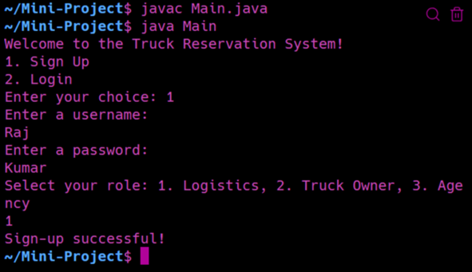
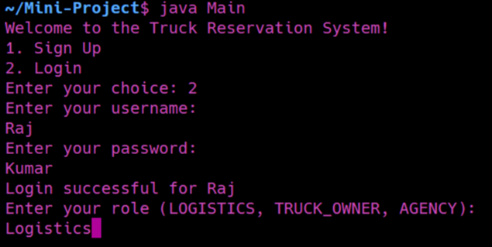
Various Test Cases and Output screenshots
Signing up as a new user.
Logging in as existing user.

Slide 15
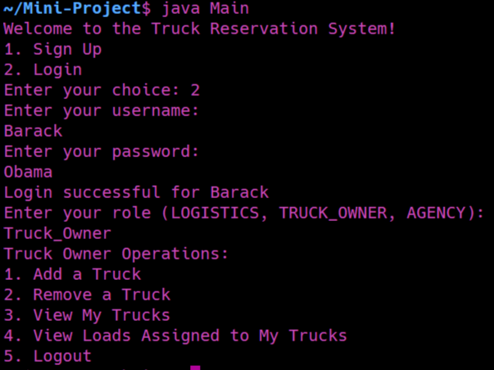
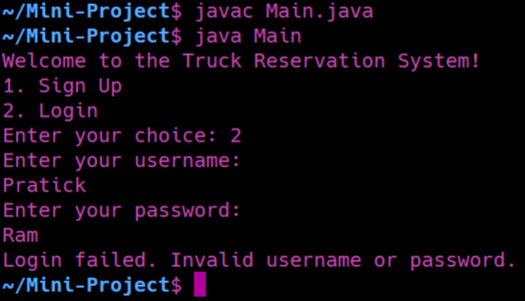
Logging in without creating an account (without signing in).
Truck Owner’s Operations

Slide 16
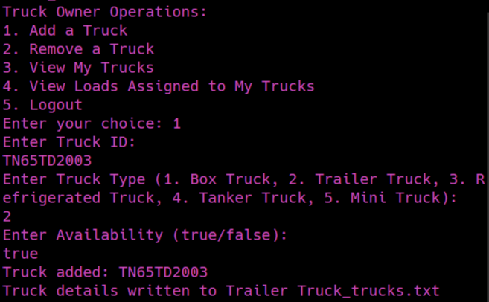
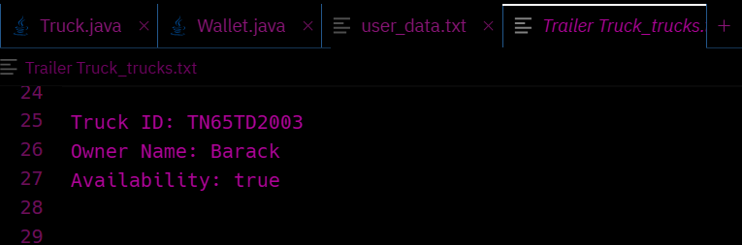
Adding a new truck
These truck details are written in the text file.

Slide 17
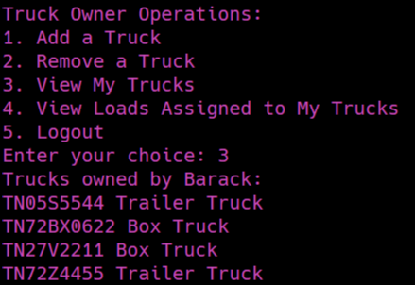
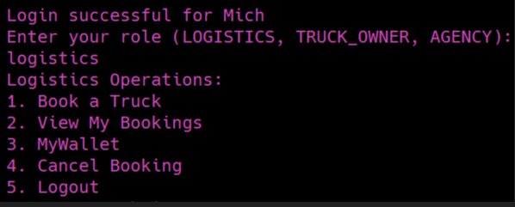
Viewing trucks and its details by the truck owner
Logging in as logistics and logistic operations

Slide 18
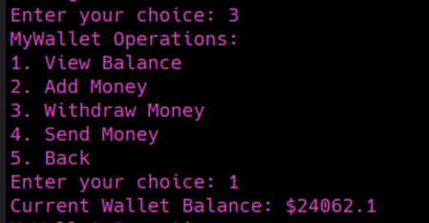
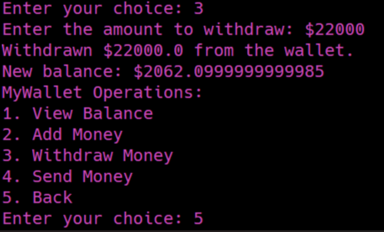
Viewing MyWallet, seeing current balance
Withdrawing money

Slide 19
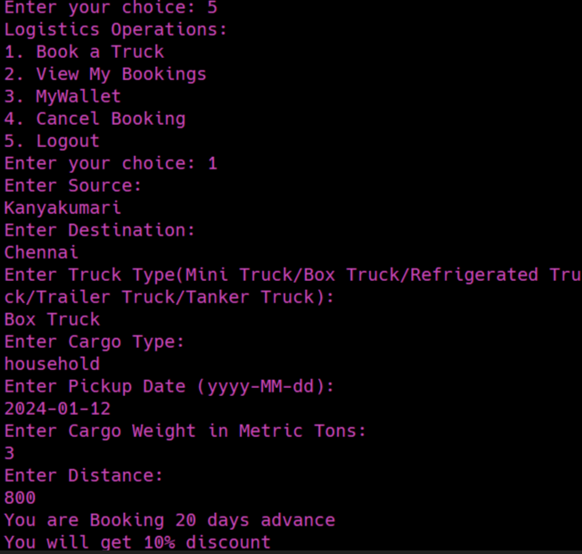
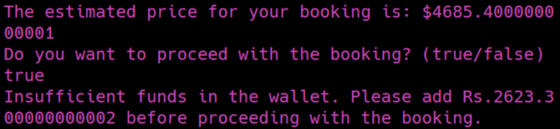
Booking process (You get 10 percent discount if you book in advance)
Insufficient money in the wallet.

Slide 20
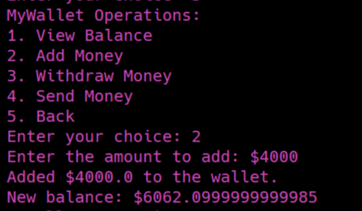
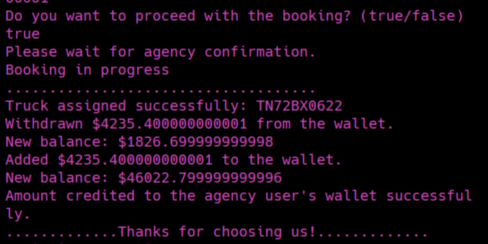
Adding money to my wallet
Booking process

Slide 21
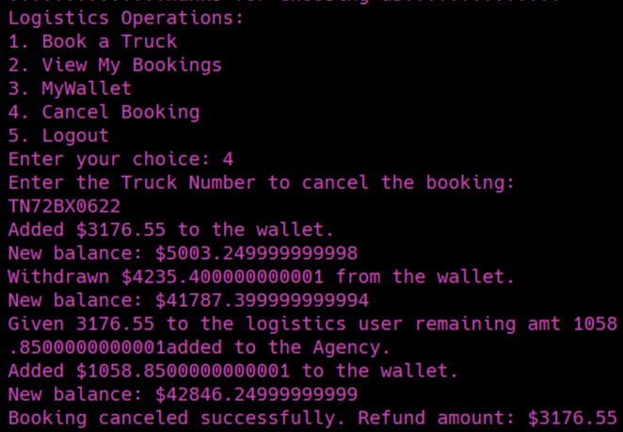
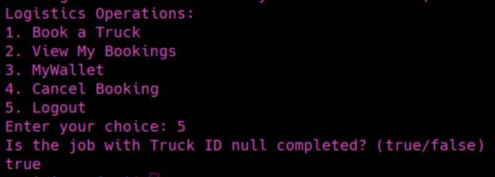
Cancel Booking (Money added to the wallet of logistics and agency)
Asking whether job competed before quitting

Slide 22
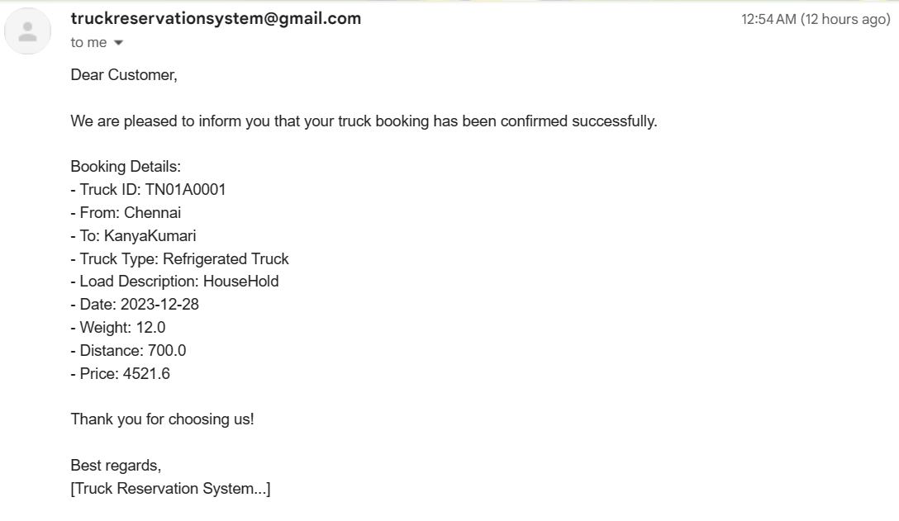
Email sent to the customer once he has done the booking
All the details are written in text files.

Slide 23
Inference
The development of the Truck Reservation System has proven to be a valuable learning experience.
The system effectively meets its objectives, offering a user-friendly platform for logistics and truck owners. Overcoming technical challenges, the project team successfully implemented features such as real-time booking, truck assignment, and wallet management.
Throughout the development process, skills in Java programming, object-oriented design, and multithreading were honed, contributing to personal and professional growth.
The project management approach demonstrated adaptability, allowing for adjustments to the initial plan.

Slide 24
Future extension
Improvements to the user interface for more visually appealing experience.
Advanced booking options, such as recurring bookings, custom cargo handling,
or real-time tracking.
Integrating the system with external databases.
Developing a mobile application.
Inclusion of data analytics features.
Making the system adaptable to different languages and regions.

Slide 25
Learning Outcomes
This project helped us strengthen our knowledge in Object Oriented Programming
using Java language.
It helped us in designing the idea by doing class diagram which is the basis of our project.
Applied and reinforced knowledge of object-oriented design principles such as encapsulation, inheritance, polymorphism, and abstraction to create modular and maintainable code.
Demonstrated proficiency in multi-threading concepts to enhance user experience during time-consuming operations, showcasing responsiveness in the application.
Implemented robust exception handling mechanisms to identify and address potential issues, contributing to the reliability of the system.
Acquired knowledge of user interface design by creating an interactive and user-friendly system for booking trucks.
Gained insights into the logistics and truck reservation domain, understanding the complexities and requirements of a real-world application.

Slide 26
References
GeeksforGeeks | A computer science portal for geeks
Online Truck Booking India, Transporters, Logistics services (truckguru.co.in)
Online Load, Truck Booking, Transporters, Logistics - Trukky
Logic First Tamil - YouTube channel

