Slide 1


SHELTER ANIMAL OUTCOMES
Nanditha Raja
Jagannathan C L

Slide 2
About the project
Every year, approximately 7.6 million companion animals end up in US shelters. Many animals are given up as unwanted by their owners, while others are picked up after getting lost or taken out of cruelty situations. Many of these animals find forever families to take them home, but just as many are not so lucky. 2.7 million dogs and cats are euthanized in the US every year.
Using a dataset of intake information including breed, colour, sex, and age from the Austin Animal Center, we were asked to predict the outcome for each animal (Adoption, Died, Euthanasia, Return to owner, and Transfer).

Slide 3
Contents
About the project
The Datasets & Project Goal
Demographic representations
Pre-processing steps
The Analysis - Conclusion

Slide 4
The Data sets & the Project goal
The data comes from Austin Animal Centre from October 1st, 2013 to March, 2016. Outcomes represent the status of animals as they leave the Animal Centre. All animals receive a unique Animal ID during intake.
The train and test data are randomly split. The features included in the training sets were identified as: AnimalID, Name, DateTime, AnimalType, Breed, Color, OutcomeType OutcomeSubtype, SexuponOutcome, AgeuponOutcome.
The main label that needed to be predicted was OutcomeType which was divided into multiple classes, namely: Adoption, Died, Euthanasia, Return to owner, and Transfer.
Goal:
The goal of this project is to use over 26K outcome records from animal shelters to predict outcomes for an additional 11K animals. There are 5 possible outcomes which we saw above.

Slide 5
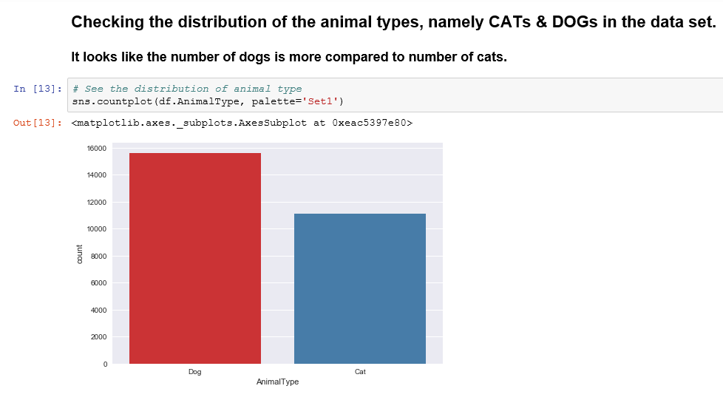
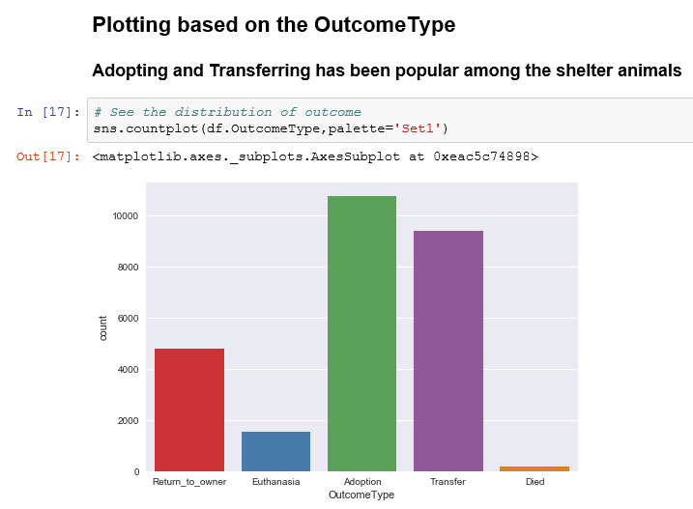
Demographic representations
Checking the count of animal types
Plotted the outcome (Label)types

Slide 6
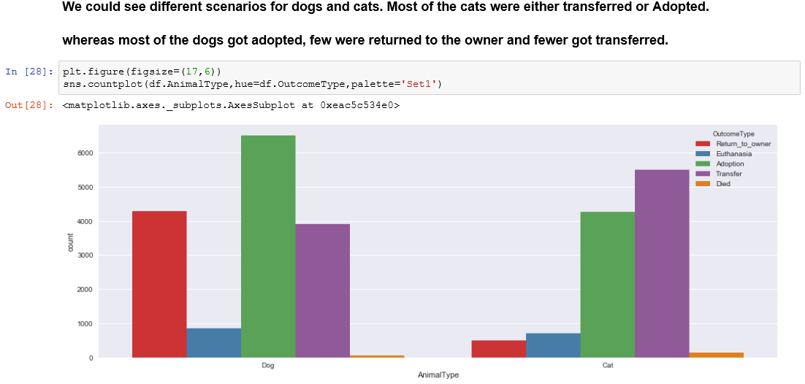
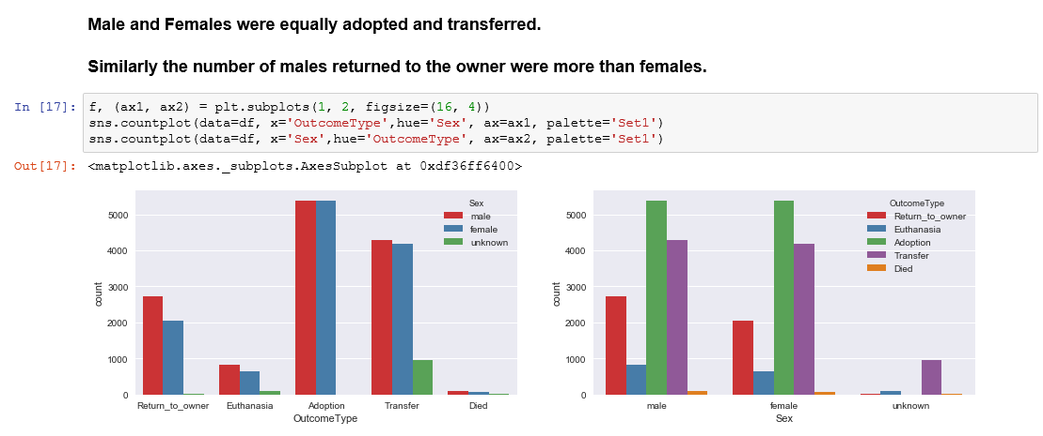
Animal type
vs
outcome type
Comparing outcome type with gender

Slide 7
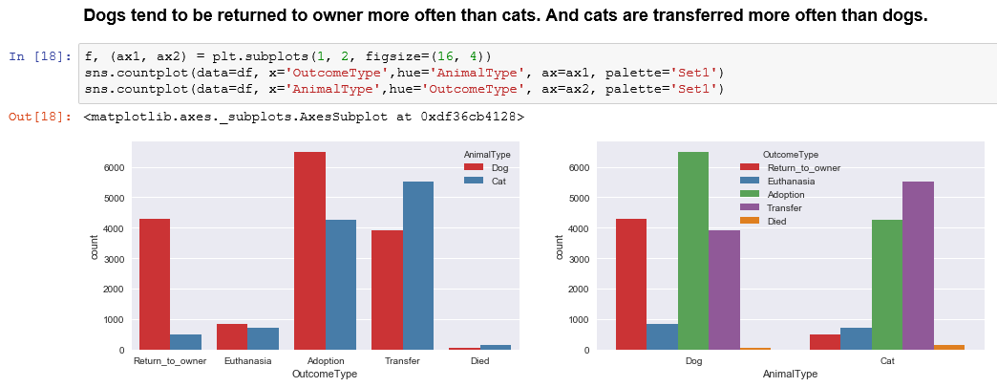
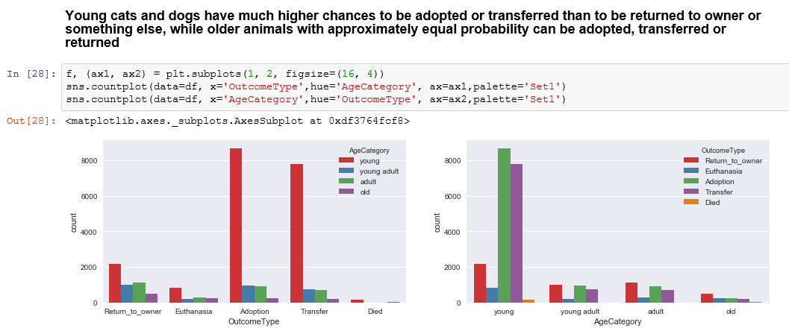
Animal type
vs
Outcome type
Created a age category and compared it with outcome type

Slide 8
Pre-processing steps
The most common pre processing steps that anyone would follow is :
Try to fill the NaN and missing values with either most common value in that column or give them a unique value.
Normalizing the data if they are scattered with different units. The AgeuponOutcome was given in different units, so we normalized it to a common unit like weeks.
The first step can be managed and assigned a particular value with the help of OneHotEncoding , which is an inbuilt feature of sklearn or manually assigning values. So we converted all the categorical data to numeric type. This in turn took care of the NaN and missing types by assigning numeric values to them.
Had to split the time that was given in a particular format into its’ basic units such as Hour, Minute, Month and Year.
Thereafter, we started predicting the data sets.

Slide 9
The Analysis - Conclusion
The classes given to us were categorical.
Hence, we tried classifying them from KNN to RandomForest and even implemented other classifying algorithms.
The accuracies were recorded as follows from worse to best:
CLASSIFIER USED | ACCURACY
Stochastic Gradient Descent | 0.415824915825
Extra Tree | 0.564347175458
K- Nearest Neighbours | 0.594837261504
Decision Trees | 0.594837261504
Gaussian Naïve Bayes | 0.618780396558
Logistic Regression | 0.627946127946
Extra Trees (ensemble) | 0.678638234194
Random Forest | 0.685185185185

