Slide 1
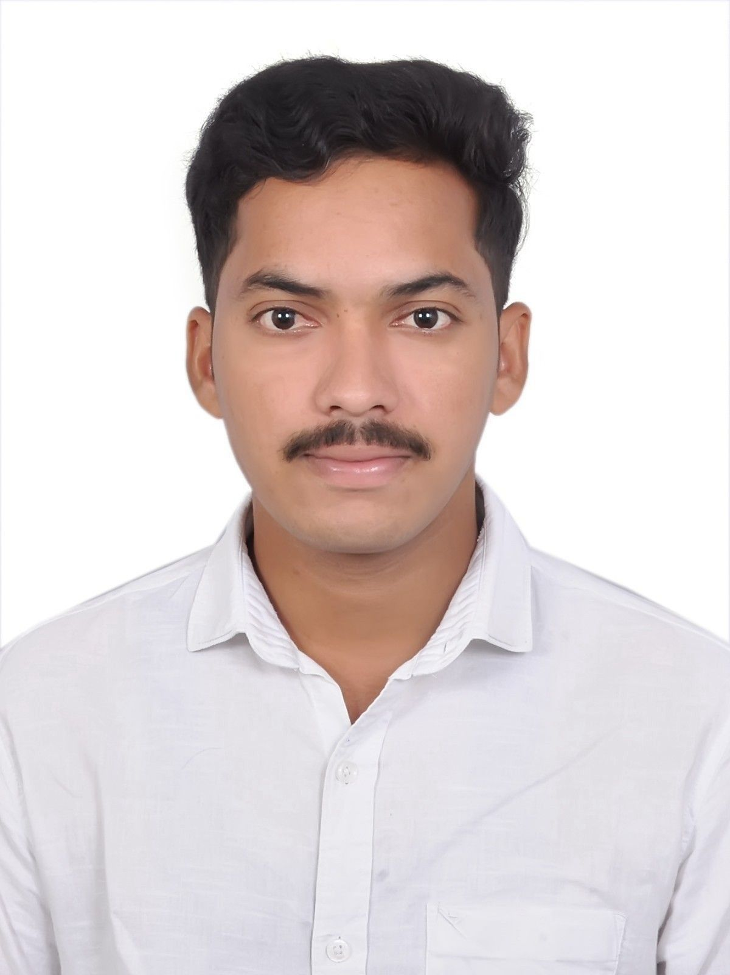

  Photo
Associate ID: 2430996 | +91 7674808920
Profile:
Passionate about learning, building, and improving through hands-on project experience and continuous exploration of new technologies.
Mainly worked on Web Development and Foundation in Java ,Oops.
Knowledge on Machine Learning Algorithms.
Currently contributing to Moment Accessibility initiatives, ensuring digital inclusivity through compliance testing.
Educational Qualification:
B.tech in Computer Science and Engineering 2021-2025
Kalasalingam Academy of Research and Education , Krishnan Kovil, TamilNadu.
CGPA: 8.07
  Area of Competency
  Developed a Employee Management System using HTML, CSS , Java Script , java and SQL .
  Developed a secure machine learning-based system an Online Voting System using OpenCV and KNN algorithm for real-time Face Recognition.
  Conducting accessibility testing using tools like NVDA, Talk Back, and Accessibility Scanner to validate compliance.
Technical & Domain Skills:
Testing Skills Accessibility Testing, SDLC
Skills Java, MySQL, HTML, CSS, Java Script.
Algorithms Machine learning.
Tools GitHub , Postman client.
Accessibility-Domain Aria features, WCAG Guidelines, WAI Patterns.
Test Management Tools NVDA, Talk Back, Accessibility Scanner(Android).
Operating System Windows

