Slide 1
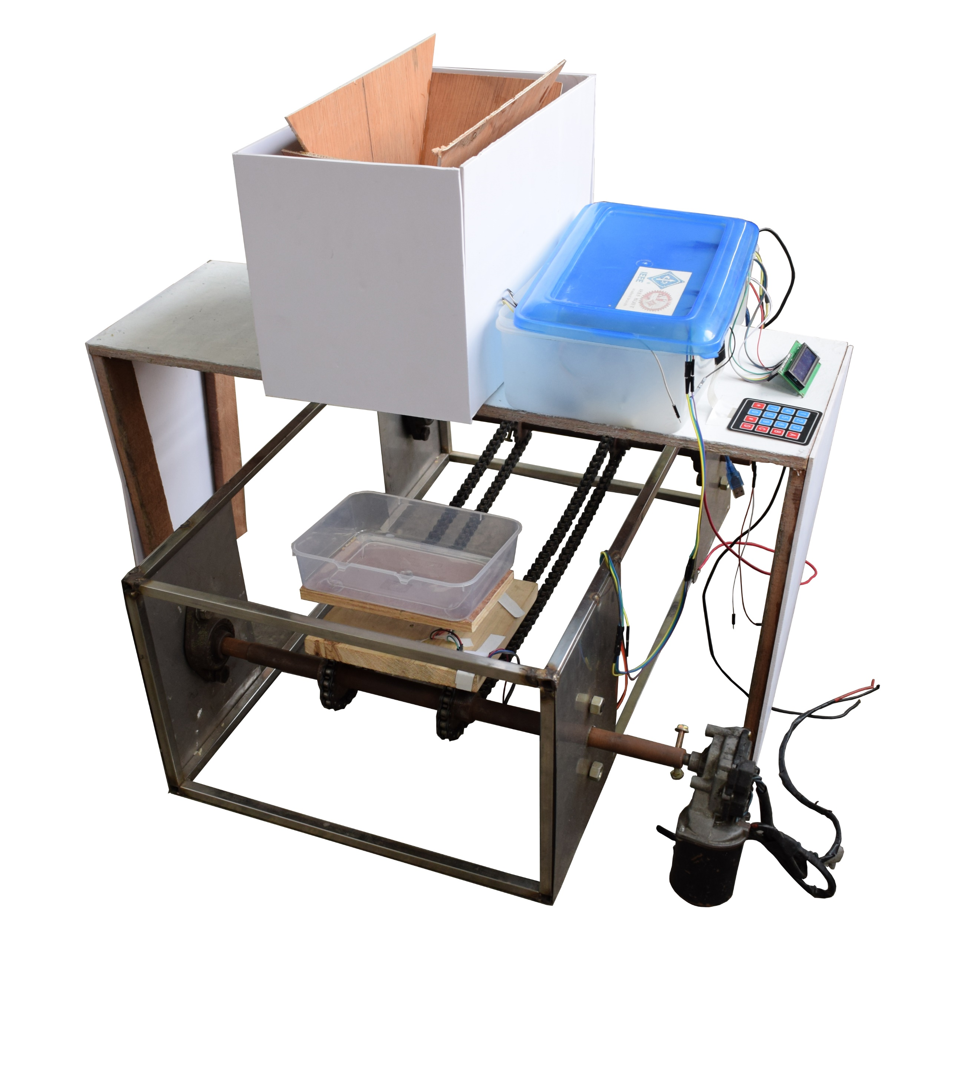
Automatic Weight Measuring Device
Introduction
Method of Operation
Market Value
Measurement is perhaps one of the most fundamental concepts in science. Weight measurement is one of the device in all industries and local shops. So, developing this weight measuring system is one of the most challenging things. For that concern we develop a system where machine can measure weight in an automatic way and also in a short possible time.
Desired amount is given as input via keypad
As the DC Motor starts, the container moves forward
As soon as the sonar detects the container, the DC Motor stops and the servo motor rotates 90 degree to open the gate
Then the contained good will continue to fall from the storage
When the desired amount is obtained the servo motor will return to its initial position to close the gate
Then the DC Motor starts again and the container moves forward to the collector
Controlling Automatic Weight Measuring Device is easier than the existing digital weight measuring machine.
Favorable for the chemical and fertilizer sellers.
Conveyer belt mechanism increases the mobility of the measuring system.
Limitation of Current Device
Objectives
Our current device can only measure up to 5 KG.
Storage space is not sufficient
Not easily portable
Measuring weight in automated way
Time efficient
Providing a fantastic and easy selling system for seller
Provide an easy way to operate large industry
Conclusions
As Automatic Weight Measuring Device reduces human labor and saves time, this will be beneficial for the grocery shop and industries .
Apparatus
Electrical Components
Load Cell
Sonar Sensor
Arduino Mega
Keypad
LCD
DC Motor
Servo Motor
12V Battery
Relay Switch
npn Transistor (BC549)
Mechanical Components
Chain
Sprocket
Shaft (MS)
Frame (SS)
Acknowledgement
We would like express our sincere gratitude towards our respected teachers, Dr. M.A. Rashid Sarkar, Partha Kumar Das and Musanna Galib for their help.
Group Members
Arnob Nandy Mazumder 1410092
Sazzil Hossain 1410099
Shawon Kuamr Saha 1410106
Tanveer Imtiaz 1410113
Dipta Saha 1410120

