Slide 1
Presentation of ME 400: Project & Thesis
STUDY OF BLADE PERFORMANCE PARAMETERS OF HORIZONTAL AXIS WIND TURBINE FOR DIFFERENT AIRFOIL SECTION TO BE USED IN BANGLADESH
Under the supervision of:
Dr. Md. Mahbubul Alam
Professor , Department of Mechanical Engineering
BUET
Presented By-
Md. Samim ul Islam (1410141)
Badhan Sarker Shuvo (1410105)
Arnob Nandy Mazumder (1410092)

Slide 2
Overview
Introduction to wind power
Problem statement
Airfoil analysis
Solution flowchart
Results
Conclusion

Slide 3
Wind Power
Wind is a key source of renewable energy in the world.
Wind turbine is to extract the energy from the wind.
The kinetic energy of the wind is converted to rotational energy by the turbine blades.
The rotating shaft is usually connected to a generator for electricity production.

Slide 4
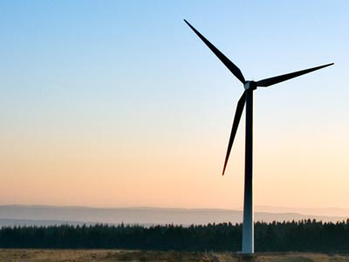
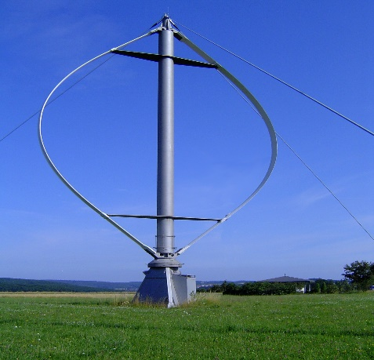
Wind turbine types
There are 2 types of wind turbine depending on their axis of rotation.
- Horizontal Axis Wind Turbine (HAWT)
- Vertical Axis Wind Turbine (VAWT)
Commercially HAWT is used in wind power plants because of its efficiency in both low speed and high speed wind.
Fig: Horizontal axis wind turbine
Fig: Vertical axis wind turbine

Slide 5
Wind Turbine Power Equation
Power available in wind, Pw = 0.5×ρ×A×v³
Turbine power, PT = Pw × Cp
Where,
ρ = air density (kg/m³)
A = Area swept by the turbine (m²)
v = Wind speed normal to A (m/s)
Cp = Turbine power coefficient

Slide 6
Problem Statement
We calculated the power coefficient (Cp) for the turbine described in the Table below. The turbine has a tip radius of 5 m and a tip speed ratio of 8 and three blades.
r [m] | γ [º] | c [m]
0.2 | 61.0 | 0.70
1 | 74.3 | 0.71
2 | 84.9 | 0.44
3 | 89.1 | 0.30
4 | 91.3 | 0.23
5 | 92.6 | 0.19
Power coefficient was calculated for airfoils NACA 0012, NACA 0015, NACA 23018, NACA 23024, NACA 2415, NACA 25112, NACA 64210.

Slide 7
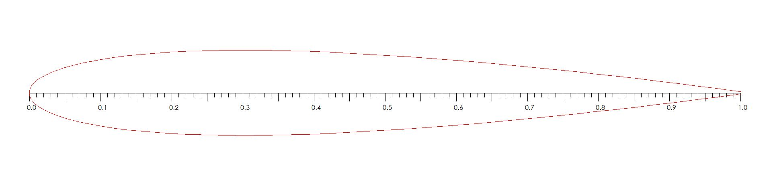
NACA 0012 Airfoil
Fig: Chord distribution
Lift coefficient curve for NACA 0012 airfoil
Drag coefficient curve for NACA 0012 airfoil

Slide 8
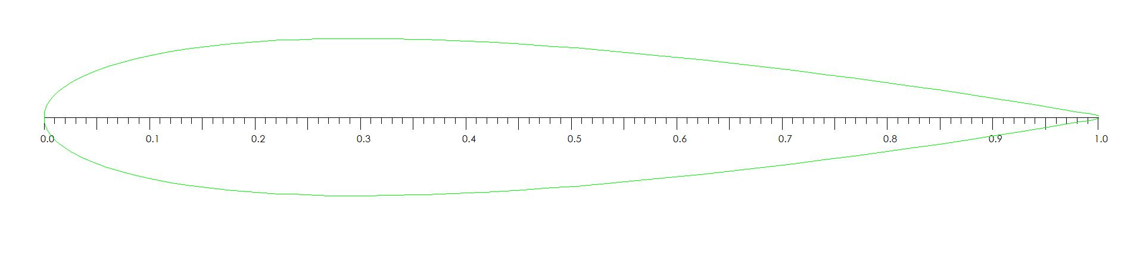
NACA 0015 Airfoil
Fig: Chord distribution

Slide 9
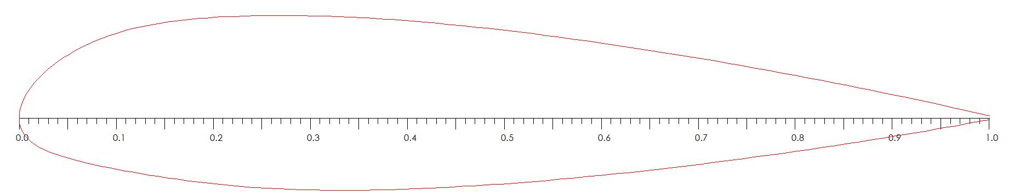
NACA 23018 Airfoil
Fig: Chord distribution

Slide 10
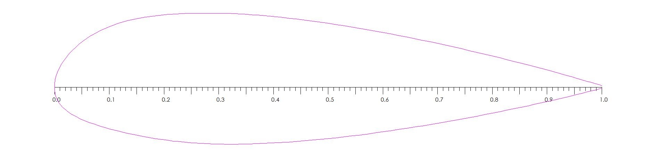
NACA 23024 Airfoil
Fig: Chord distribution

Slide 11
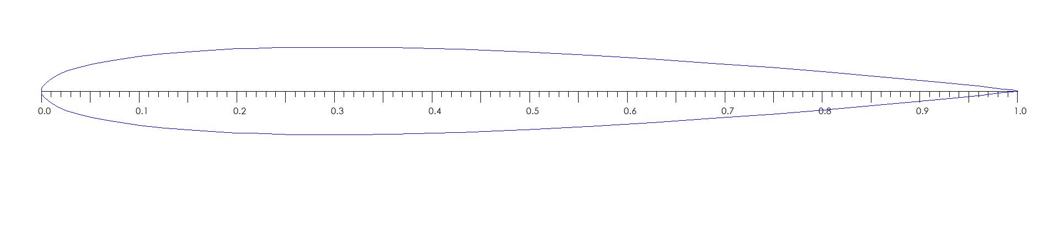
NACA 25112 Airfoil
Fig: Chord distribution
Lift coefficient curve for NACA 25112
airfoil
Drag coefficient curve for NACA 25112 airfoil

Slide 12
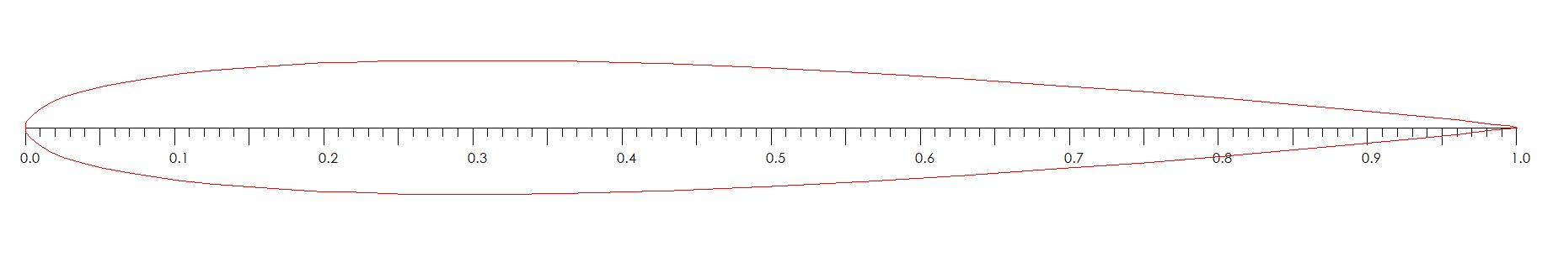
NACA 64210 Airfoil
Fig: Chord distribution

Slide 13
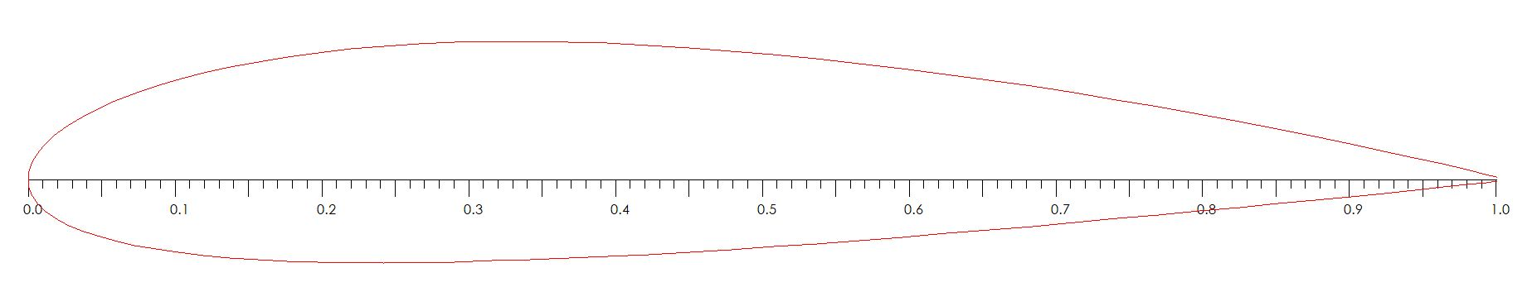
NACA 2415 Airfoil
Fig: Chord distribution

Slide 14
Start
Flow chart
Insert all the inputs
Select Position 1
Calculate solidity of rotor
Select next position
Calculate initial flow angle
End
Calculate incident angle
Calculate flow angle
Display power coefficient
Calculate CL and CD
Calculate a and a’
Calculate power coefficient
No
Are these first values of a and a’?
Are those value for final position?
Yes
Store as previous a and a’
Yes
No
No
Is (new a-previous a)/new a <0.0001?
Is (new a'-previous a)/new a' <0.0001?
No
Yes
Store as final a and a’
Yes

Slide 15
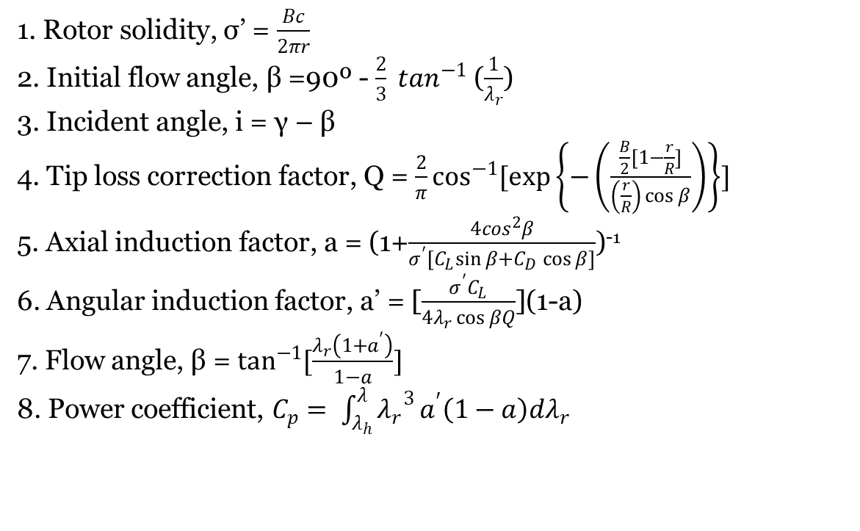
Equations
1. Rotor solidity, σ’ = $\frac{Bc}{2πr}$
2. Initial flow angle, β =90º - $\frac{2}{3} \tan^{−1}$ ($\frac{1}{λ_{r}}$)
3. Incident angle, i = γ – β
4. Tip loss correction factor, Q = $\frac{2}{π}\cos^{−1}{[\exp\left\{−\left(\frac{\frac{B}{2}[1−\frac{r}{R}]}{\left(\frac{r}{R}\right)\cos{β}}\right)\right\}]}$
5. Axial induction factor, a = (1+$\frac{4\cos^{2}β}{σ^{′}{[C}_{L}\sin{β+}C_{D}\cos{β]}}$)⁻¹
6. Angular induction factor, a’ = [$\frac{σ^{′}C_{L}}{4λ_{r}\cos{βQ}}$](1-a)
7. Flow angle, β = $\tan^{−1}{[\frac{λ_{r}\left(1+a^{′}\right)}{1−a}]}$
8. Power coefficient, $C_{p}= \int_{λ_{h}}^{λ}{{λ_{r}}^{3}}a^{′}\left(1−a\right)dλ_{r}$

Slide 16
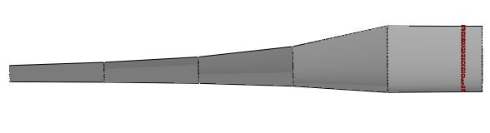
Result
Variation of axial induction factor
Fig: Axial induction factor

Slide 17
Fig: Axial induction factor

Slide 18
Fig: Axial induction factor

Slide 19
Fig: Axial induction factor

Slide 20
Fig: Axial induction factor

Slide 21
Fig: Axial induction factor

Slide 23
Variation of angular induction factor
Fig: Angular induction factor

Slide 24
Fig: Angular induction factor

Slide 25
Fig: Angular induction factor

Slide 26
Fig: Angular induction factor

Slide 27
Fig: Angular induction factor

Slide 28
Fig: Angular induction factor

Slide 31
Power that can be extracted by the wind turbine in Bangladesh

Slide 32
Conclusion
After studying several airfoil, we find that NACA 0015 provides the best performance for our turbine.
We have worked with fixed tip speed ratio, for further study variable tip speed ratio may be used.
In Bangladesh, Chittagong will provide highest power output but only for a certain period.
The power output of the turbine will be low and inconsistent in most of the time throughout the year, so the turbine may be used for water pumping system rather than electricity generation

Slide 33
References
[1] Lysen,E. H. (1983) Introduction to Wind Energy.
[2] G. Ingram, “Wind Turbine Blade Analysis using the Blade Element Momentum Method.,” October, vol. 1.1, no. c, pp. 1–21, 2011.
[3] Normal Wind Speed | Bangladesh Meteorological Department, http://bmd.gov.bd/p/Normal-Wind-Speed/ [Last access on 19 April 23, 2019]
[4] Marten,D. and Wendler,J. (2013) QBlade Guidelines v0.6

Slide 34
THANK YOU

