Slide 1
DATA SCIENCE AND AI LAB · T2 – 2026
FinQuery
An AI-Powered, Stock-Specific Public Update Analyzer
for Indian Capital Markets
MILESTONE 3 · RAG PIPELINE & RETRIEVAL
Team 06
Akbar Ali — 23f1002997
Gurram Sai Sri Ram Hruthik — 22f3001648
NandanReddy Parnapalli — 22f3002857
Shubham Gattani — 21f3002082
Shubhashish Biswas — 21f1001460

Slide 2
MILESTONE 3 WALKTHROUGH
What We'll Cover
01
02
03
Dataset Organization
Preprocessing Pipeline
RAG System Architecture
Raw vs. processed layout, no train/val/test split
Convert → filter → extract → section → embed
Offline ingestion path meets online query path
04
05
06
Matching Data to Model Input
Why This Architecture
Small-Scale Verification
Embedding, vector schema, generation prompt
Design decisions, alternatives, known limitations
10-document pipeline run, query to grounded answer
FinQuery — Milestone 3
2

Slide 3
SECTION 1 · DATASET ORGANIZATION
Raw → Processed, Traceable per Source
SOURCE
RAW INPUT
PROCESSED (RETRIEVAL-READY) OUTPUT
NSE filings (≤ 10 pages)
data/nse_files_final/categorisation_by_pages/equal_or_less_than_10_pages
data/nse_files_final/whole_document_cleaning/equal_or_less_than_10_pages
NSE filings (> 10 pages)
data/nse_files_final/categorisation_by_pages/more_than_10_pages
data/nse_files_final/knowledge_extraction/.../cleaned_section_files
Infosys IR documents
data/infosys_earning_calls_press_conf_fact_sheets_results
.../infosys_ir_earning_calls_clean_markdowns
Yahoo Finance articles
data/yfinance/pdfs
data/yfinance/clean-mds
Trendlyne broker reports
data/trendlyne/pdfs
data/trendlyne/clean-mds
Demo verification subset
data/demo-bot-data
data/demo-bot-output
Every processed file keeps a name traceable to its source PDF, so any chunk retrieved at query time can always be mapped back to the raw document it came from.
FinQuery — Milestone 3
3

Slide 4
SECTION 1 · DATASET ORGANIZATION
No Train / Validation / Test Split — By Design
This is a Retrieval-Augmented Generation system, not a supervised model trained on labelled examples — so a conventional split does not apply. This is intentional, not overlooked:
AI
▤
⊘
Frozen Models
Knowledge Base, Not Labels
No Learning to Bound
text-embedding-3-small and gpt-4o-mini are both pre-trained OpenAI models used purely at inference time — no weights in this system are fit to the corpus.
The corpus plays one role: a knowledge base embedded once and searched at query time, not a set of labelled examples to learn from.
Splitting a knowledge base into train/val/test partitions would not exercise any learning process — it would add bookkeeping without adding rigor.
FinQuery — Milestone 3
4

Slide 5
SECTION 2 · PREPROCESSING PIPELINE
One Conceptual Pipeline, Four Sources
Every source follows the same five stages — only the filtering step and the knowledge-extraction prompt are source-specific.
Convert
→
Filter / Select
→
Extract
→
Section (if long)
→
Embed
PDF → Markdown via Docling (deterministic, no API calls)
Keep only informative filings; other sources are pre-curated
Source-specific LLM prompt → clean Markdown + YAML front matter
Documents > 10 pages split along heading structure first
One embedding vector per cleaned chunk, indexed in ChromaDB
PDF-to-Markdown Conversion (§2.1). All PDFs across all four sources are first converted with Docling, an open-source converter chosen because it is deterministic, needs no external API calls, and produces structurally faithful Markdown (headings, tables, paragraph boundaries) — a far better starting point for LLM cleaning than raw OCR text.
NSE filings : datapreparation/data-preprocessing/NSE_PDFs_Extraction_and_Conversion_to_MD.ipynb
Infosys IR : datapreparation/data-preprocessing/Earning_calls_and_quarterly_updates_parsing.ipynb
Post-conversion: rename_markdown_from_source_url.py → file-dedup.py
FinQuery — Milestone 3
5

Slide 6
SECTION 2 · PREPROCESSING PIPELINE
Filtering NSE Filings, Then Splitting by Length
1 · Metadata Rule
→
2 · Keyword Search
→
3 · Manual + LLM Review
NSE desc category checked against a fixed keep/reject list
GOOD/BAD keyword list on title + attchmntText for ambiguous categories
Unresolved filings judged by an LLM content-review pass
65
72
137
Rule-based keep
LLM-accepted from review
Final NSE source set
Cheap rules resolve the unambiguous majority; the LLM only judges the genuinely hard cases — auditable and accurate without paying LLM cost on every filing.
Splitting by page count (§2.3)
PAGE COUNT
DOCUMENTS
HANDLING
≤ 10 pages
109 documents
Cleaned as complete documents
> 10 pages
28 documents
Sectioned before cleaning (heading-aware groups)
FinQuery — Milestone 3
6

Slide 7
SECTION 2 · PREPROCESSING PIPELINE
Knowledge Extraction: Source-Specific Prompts
Noisy Markdown → clean Markdown + YAML front matter. All prompts forbid summarizing, inferring, or rewriting — only non-substantive noise is removed.
SOURCE
REMOVED AS NOISE
ALWAYS PRESERVED
NSE filings
Exchange wrappers, signatures, safe-harbor text, headers/footers
Tables, figures, risks, governance/CSR/litigation detail, quotations
Infosys IR documents
Same v6 prompt (all IR docs ≤ 10 pages)
Same as above
Yahoo Finance articles
Site nav, ads, cookie/subscription prompts, author bios
Headline, byline, date, every quote, figure, analyst opinion
Trendlyne reports
Branding banners, analyst contact/disclaimer boilerplate
Recommendation, target price, valuation, projections, every ratio
Every prompt outputs the same contract: title, description, topics, sample_queries — letting embeddings capture intent alongside content. As of this milestone, all 109 ≤ 10-page NSE, 16 IR, 6 Yahoo Finance, and 5 Trendlyne documents are cleaned.
FinQuery — Milestone 3
7

Slide 8
SECTION 2 · PREPROCESSING PIPELINE
Sectioning Documents Longer Than 10 Pages
An 80-page annual report cannot go through the whole-document prompt in one call — it would exceed a safe context budget and blur section boundaries. The 28 NSE documents > 10 pages are split first, via the datapreparation/sectioner module.
1 · Parse & Split
→
2 · Concatenate
Split along heading structure → JSON manifest + section files + validation report
Group consecutive sections into prompt-sized files (group_001.md, group_002.md …)
document_name: "Infosys_02072025225219_SEfiling_AGMtranscript_2025.md"
group_id: "..._group_006"
source_section_count: 2
page_start: 52 page_end: 60 estimated_tokens: 3975
source_section_ids: [..._011, ..._012]
This produced 749 grouped section files across the 28 long documents. Each group is cleaned with the dedicated section prompt (KE-section-prompt-v1.md), which preserves the sectioner's metadata block and appends a second, section-specific summary block — so provenance and semantic summary both travel with the chunk.
FinQuery — Milestone 3
8

Slide 9
SECTION 2 · PREPROCESSING PIPELINE
One Chunk per Cleaned Markdown File
A hierarchical, structure-aware strategy — not blind fixed-size chunking. The sectioning step already performs the natural split for long documents, so no further arbitrary token-window slicing is layered on top.
8k
◈
⌗
Generous Context
Semantic Coherence
Metadata Travels With It
text-embedding-3-small supports up to 8191 tokens — comfortably larger than any cleaned document or section group, so nothing needs splitting for size.
Each chunk is already one coherent disclosure unit; the generation model always sees a complete, self-contained piece of context.
Provenance and generated summary (title, description, topics, sample queries) live in each chunk's own front matter — no separate reattachment step.
FinQuery — Milestone 3
9

Slide 10
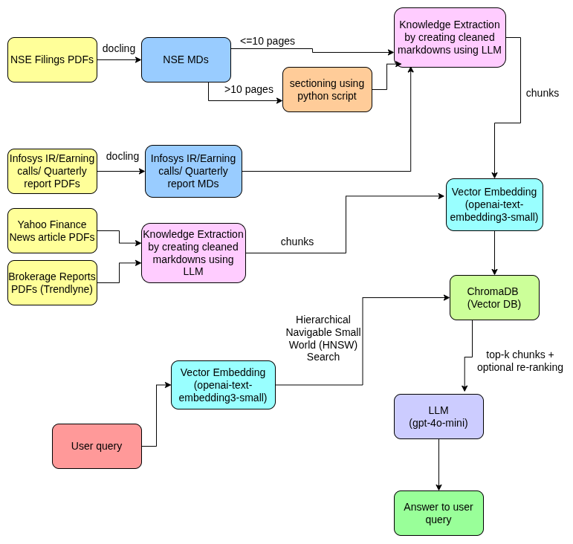
SECTION 3 · RAG SYSTEM ARCHITECTURE
End-to-End Data Flow
Figure 1. Offline ingestion (top/left, run once per document) meets the online query path (bottom) at the vector database.
FinQuery — Milestone 3
10

Slide 11
SECTION 3 · RAG SYSTEM ARCHITECTURE
Offline Ingestion Path — Run Once per Document
#
COMPONENT
ROLE
1
NSE / IR / Yahoo Finance / Trendlyne PDFs
Raw source documents
2
Docling conversion
PDF → Markdown
3
Sectioning (> 10-page NSE docs only)
Splits long Markdown into page-bounded groups
4
Knowledge extraction (source-specific prompts)
Noisy Markdown → clean chunk + YAML front matter
5
Vector embedding (text-embedding-3-small)
Each clean chunk → one 1536-dim vector
6
ChromaDB
Persistent store for chunk text, vector, and metadata
FinQuery — Milestone 3
11

Slide 12
SECTION 3 · RAG SYSTEM ARCHITECTURE
Online Query Path — Run Once per Question
#
COMPONENT
ROLE
7
Vector embedding of the user query (same model)
Query text → vector in the same 1536-dim space
8
HNSW semantic search
Finds nearest chunk vectors to the query vector in ChromaDB
9
Top-3 chunks
Nearest three chunks passed forward as retrieved context
10
LLM (gpt-4o-mini)
Generates the final answer, grounded only in retrieved chunks
11
Answer to user query
Returned to the user
The document embedding (stage 5) and query embedding (stage 7) share the same model and 1536-dimension space — that identity is what makes HNSW nearest-neighbor search meaningful.
FinQuery — Milestone 3
12

Slide 13
SECTION 4 · MATCHING DATA TO MODEL INPUT
Embedding Model Input & Vector Store Schema
4.1 Embedding Model Input
4.2 Vector Store Schema (finance_documents)
with open(file, "r", encoding="utf-8") as f:
text = f.read()
embedding = get_embedding(text)
# client.embeddings.create(model="text-embedding-3-small", input=text)
ids
Chunk's relative file path
documents
The entire cleaned Markdown file — YAML front matter and body together — is embedded as one input string. No chunk approaches the 8191-token ceiling, so nothing is truncated.
Full chunk text (front matter + body)
embeddings
1536-dim vector from text-embedding-3-small
metadatas
{filename, filepath, company}
FinQuery — Milestone 3
13

Slide 14
SECTION 4 · MATCHING DATA TO MODEL INPUT
Query-Time Retrieval & Generation Input
4.3 Query-Time Input. A user question is embedded with the identical model and passed to collection.query() with n_results=3. Chroma's HNSW index returns the three closest chunks with their metadata and distances.
4.4 Generation Model Input
CONTEXT
==============================
FILE : <chunk-1 filename>
==============================
<chunk-1 text>
... (chunk 2, chunk 3) ...
QUESTION
<user question>
The three retrieved chunks are concatenated into one context block, each wrapped with a FILE: header for provenance, and sent as a single user message to gpt-4o-mini via the Chat Completions API — with an explicit instruction to answer only from the supplied context or state that the information was not found.
FinQuery — Milestone 3
14

Slide 15
SECTION 5 · WHY THIS ARCHITECTURE
Five Decisions, Five Alternatives Considered
DECISION
ALTERNATIVE CONSIDERED
WHY THIS CHOICE
RAG, not fine-tuning
Prompted-only LLM / fine-tuned model
Keeps facts current per filing cycle without retraining as disclosures arrive
Whole-chunk retrieval
Fixed-size / sliding-window chunking
Embedding context is generous; fixed windows risk severing a number from its qualifier
text-embedding-3-small
text-embedding-3-large
Right balance for a low-hundreds-of-documents corpus — cheaper, faster, ceiling never hit
ChromaDB + HNSW
Hosted / server-based vector DB
Lightweight, embeddable, no separate server — fits the Streamlit demo scope
gpt-4o-mini generation
Larger model (gpt-4o)
Inexpensive per-query, ample context for 3 chunks, follows grounding instructions reliably
FinQuery — Milestone 3
15

Slide 16
SECTION 5 · KNOWN LIMITATIONS
Stated Plainly, Not Glossed Over
Retrieval is fixed at the top-3 nearest chunks with no re-ranking or query decomposition — a question needing evidence from 4+ filings will not see all of it.
No metadata filtering at query time (date, document type) — retrieval relies entirely on embedding similarity even when a query implies a specific period or source.
Section-level extraction for the 28 long NSE documents has not run at full scale — those 749 section groups are not yet part of the searchable corpus.
The corpus currently indexed for retrieval is the 109 whole-document NSE filings plus IR, Yahoo Finance, and Trendlyne material (and, for §6, the 10-document demo subset).
Team 06 · FinQuery · Data Science and AI Lab, T2 2026

Slide 17
SECTION 6 · SMALL-SCALE END-TO-END VERIFICATION
Ten Filings, Carried Through the Full Pipeline
Ten NSE announcements spanning several disclosure types (CSR press releases, an acquisition, a joint-venture outcome, ESOP/postal-ballot filings, an AI-day filing) confirm every stage interoperates — not just that each script runs in isolation.
STAGE
EXECUTED BY
VERIFIED OUTCOME
Conversion + cleaning
run-whole-doc-prompt-on-demo-bot.py
10/10 cleaned Markdown files, valid front matter
Chunk definition
§2.6 policy
Each of 10 cleaned files = exactly one chunk
Embedding generation
index_documents.py
All 10 chunks embedded, written to persistent Chroma store
Storage
ChromaDB `finance_documents`
One vector + document + metadata record per chunk
Retrieval
search.py / retriever.py
Query correctly returns 3 nearest of 10 chunks via HNSW
Generation
retriever.py → gpt-4o-mini
Answer grounded in the 3 retrieved chunks
FinQuery — Milestone 3
17

Slide 18
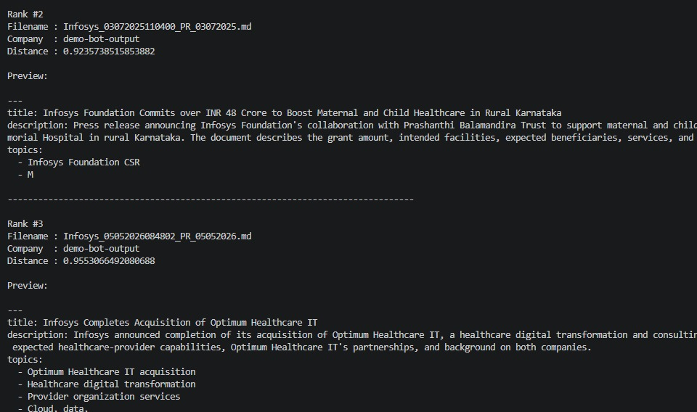
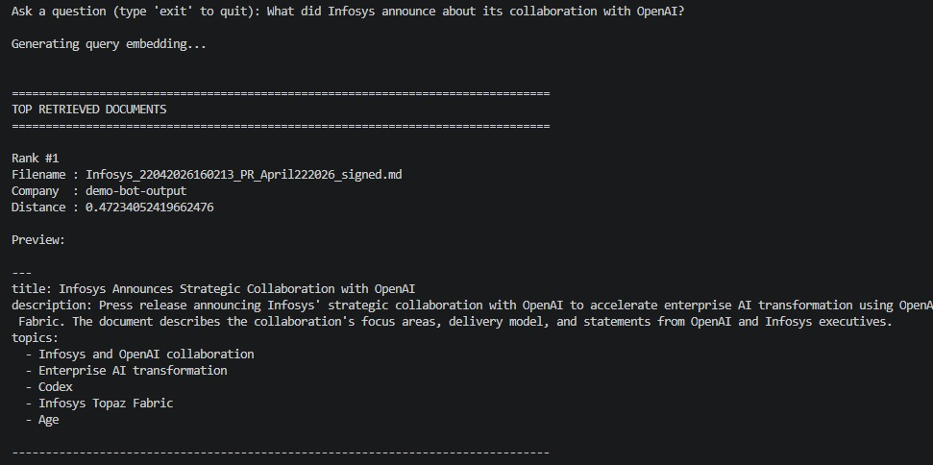
SECTION 6 · SMALL-SCALE END-TO-END VERIFICATION
Example Query — Embedding & Top-3 Retrieval
QUERY "What did Infosys announce about its collaboration with OpenAI?"
Rank #1: Infosys_22042026160213_PR_April222026_signed.md (distance 0.472)
Rank #2 / #3: distances 0.924 and 0.955 — complete the top-3 context set
FinQuery — Milestone 3
18

Slide 19
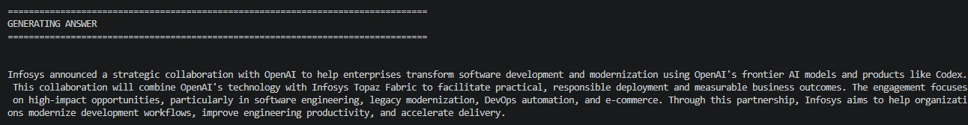
SECTION 6 · SMALL-SCALE END-TO-END VERIFICATION
Generated Answer, Grounded in Retrieved Context
“Infosys announced a strategic collaboration with OpenAI to help enterprises transform software development and modernization using OpenAI's frontier AI models and products like Codex. This collaboration will combine OpenAI's technology with Infosys Topaz Fabric to facilitate practical, responsible deployment and measurable business outcomes — focused on software engineering, legacy modernization, DevOps automation, and e-commerce.”
This run demonstrates the full chain end to end: a natural-language question is embedded, matched via HNSW search, and answered using only the text of the retrieved chunks — with the correct top-ranked chunk surfaced first by similarity distance, exactly as the architecture in §3 and §4 specifies.
FinQuery — Milestone 3
19

