Slide 1
FinQuery
From raw financial filings
to accurate, cited answers
in seconds.
An AI-Powered, stock-specific, Public Update Analyzer(PUA) for Indian Capital Markets
A production-ready RAG system for Infosys financial Q&A — combining semantic vector search, BM25 keyword matching, and reciprocal rank fusion with a SQL fact layer to eliminate hallucinations on numerical queries.
DS & AI Lab · Group 6 · T2 2026
Akbar Ali — 23f1002997
Gurram Sai Sri Ram Hruthik — 22f3001648
NandanReddy Parnapalli — 22f3002857
Shubham Gattani — 21f3002082
Shubhashish Biswas — 21f1001460

Slide 2
The Problem We Set Out to Solve
2
Financial Q&A is uniquely hard — three compounding challenges
Unstructured & Vast
Numbers Must Be Exact
Speed & Usability Matter
Infosys publishes hundreds of PDFs, earnings call transcripts, press releases, and NSE filings every year. No single structured database captures it all — a RAG system must search across all source types simultaneously to find the right chunk.
A wrong revenue figure is not just unhelpful — it is dangerous. LLMs hallucinate confidently on numeric facts. Analysts need verifiable, source-cited numbers every single time. One wrong percentage point can flip a buy/sell recommendation.
Analysts ask dozens of questions per session. A system that takes 4 minutes per question (as naive cross-encoder rerankers do) is not production-ready, regardless of accuracy. Sub-second response time is a hard requirement for real workflows.
207
50
FY25–FY26
documents chunked
hand-crafted test questions to validate
all Infosys quarters covered

Slide 3
Our Data Universe
3
Five source types · all Infosys FY25 – FY26
NSE
Filings
Infosys IR
Docs
Trendlyne
Yahoo
Finance
Q&A
Benchmark
180
16
5
6
50
NSE filings
documents
news articles
& analyses
market articles
& commentary
hand-crafted
test questions
Regulatory filings,
results announcements,
quarterly docs
Earnings call transcripts,
press releases,
investor docs
Financial news summaries,
brokerage reports
Stock news, analyst views,
market reports
Gold-standard evaluation set
for recall measurement
All sources ingest → ChromaDB vector index + BM25 keyword index

Slide 4
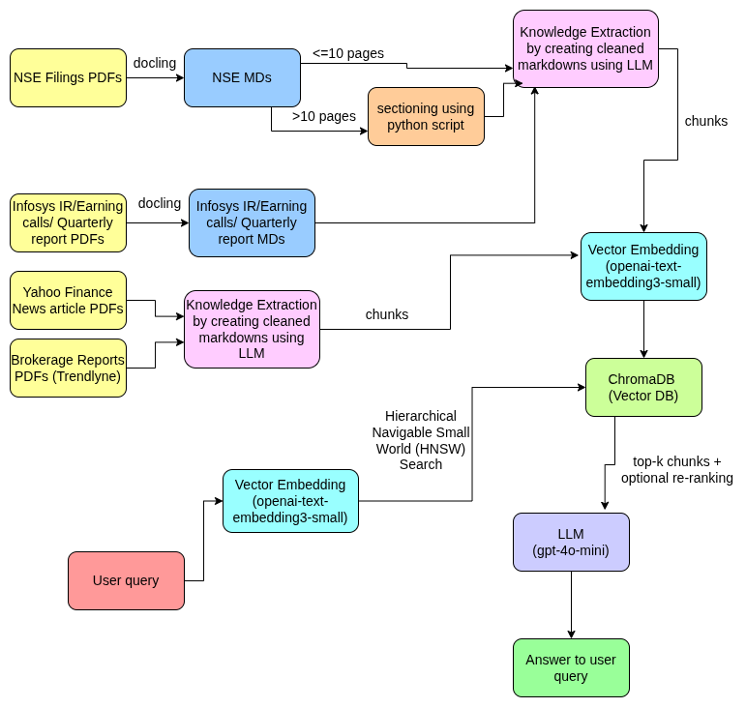
From PDFs to a Searchable Knowledge Base
4
How raw documents become indexed, retrievable chunks
Key steps
Parse
PDFs → docling → Markdown
Section
Long docs (>10 pp) split
by Python script + LLM
Embed
Metadata YAML header only
(not body text)
Index
ChromaDB (vector)
+ BM25 (keyword)
Key innovation
Embedding only the YAML metadata header — not body text — lifted Recall@3 from 40% → 74% (+34 pp) while being 13× faster.

Slide 5
How We Measured Success
5
Retrieval recall as the ground-truth metric
What is Recall@k?
Benchmark
For each test question, we know which source document contains the correct answer. Recall@k = 1 if that document appears in the top-k retrieved results, else 0.
We measure Recall@3, @5, and @7, averaged across 50 questions.
50
hand-crafted questions
4
Why retrieval recall?
source categories
If the right chunk is never retrieved, no LLM — however powerful — can produce a correct answer. Retrieval is the fundamental bottleneck: fix retrieval first, then worry about answer generation.
Our final recall scores (Hybrid RRF system):
Recall@3 = 76% · Recall@5 = 82% · Recall@7 = 88%
8
strategies tested
3
recall depths: @3 @5 @7

Slide 6
The Research Journey — Three Phases
6
Systematic experimentation from baseline to production
Phase 1
Phase 2
Phase 3
Full-Text Embedding
Metadata-Only Embedding
Hybrid BM25 + Vector (RRF)
Three strategies tested on 50 questions:
① Vector-only baseline — embed full document body; query as-is.
② HyDE — generate a hypothetical answer, then embed it as the query.
③ BGE cross-encoder reranker — re-score top-k results using a neural model.
Breakthrough insight: strip the body text and embed only the YAML front-matter (quarter label, source type, document category).
Also tested Metadata + BGE cross-encoder to see if reranking still adds value on top of the cleaner embeddings.
Combine keyword (BM25) and semantic (vector) search via Reciprocal Rank Fusion:
score = Σ 1 / (60 + rank_i)
Tested BM25-only, Hybrid RRF, and Hybrid + CE reranker to find the optimal trade-off between recall and latency.
Best R@3: 58% (BGE reranker)
Best latency: 6.3 s · BGE: ~4 min
Conclusion: body text adds noise;
HyDE hurts entity-heavy queries.
R@3: 74% (+34 pp vs baseline)
Latency: 0.48 s — 13× faster
CE reranker on meta: R@3=74%
No gain + 1.74 s overhead.
R@7: 88% · R@3: 76%
Hybrid RRF chosen as production
system: 0.56 s latency, no CE
overhead, domain-agnostic.

Slide 7
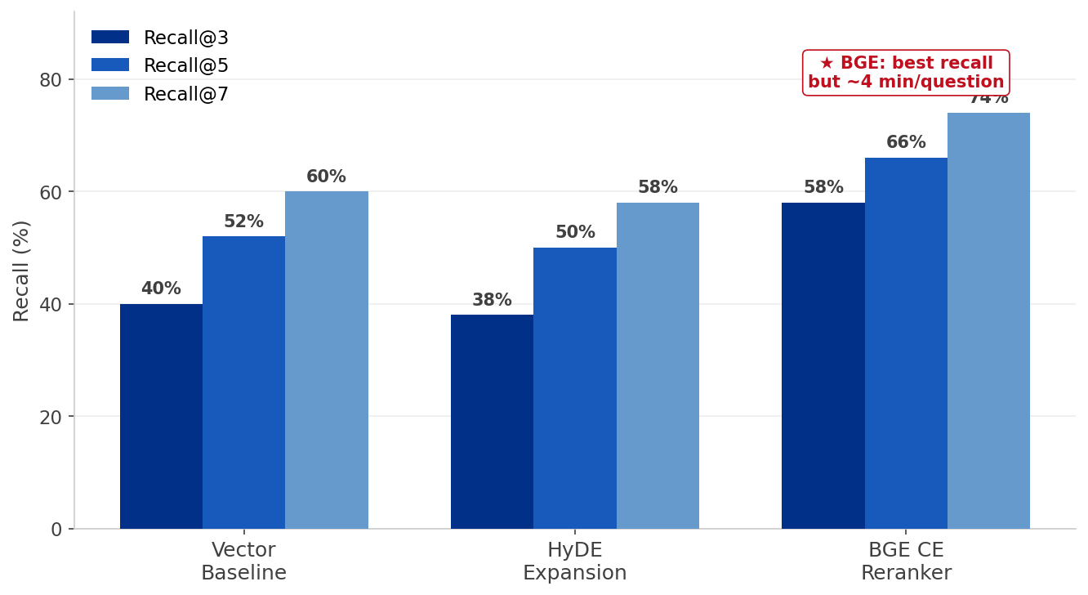
Phase 1: Full-Text Embedding Results
7
Three strategies on 50 questions
Key Findings
Baseline R@3 = 40%
HyDE: R@3 = 38% — no gain.
Entity-heavy queries already
contain the right vocabulary.
BGE reranker: R@3 = 58%
but ~4 minutes per question.
Root cause
Full-text body embedding (thousands of tokens per chunk) produces noisy, unfocused vectors. Regulatory filings mix quarter-specific data with boilerplate, tables, and narrative — none of which helps retrieve the right quarter. The vector drifts away from the query signal.
Phase 1 verdict: BGE reranker achieves the highest recall (R@3 = 58%) but at ~4 min/question — wholly impractical. Phase 2 addresses the root cause directly.

Slide 8
Phase-2: The Breakthrough: Embed Metadata, Not Body Text
8
A single architectural change → +34 percentage points in Recall@3
BEFORE — Full-text body embedding
+34 pp
Embed entire document body (thousands of tokens). Noisy vectors — body text dilutes the quarter/source signal. The semantic space becomes too broad to match specific quarter and doc-type queries.
Recall@3 = 40% · Latency = 6.3 s/question
Recall@3 improvement
▼ swap embedding target ▼
Why it works:
NSE documents carry rich YAML headers with exact quarter labels, source categories, and document types. The raw question ('Q3 FY26 margin') maps almost directly to those header terms.
Body text adds company history, regulatory boilerplate, and narrative — noise that pushes the vector away from the query.
AFTER — Metadata-only embedding
Embed only YAML front matter (quarter, source, doc type). Compact, precise vectors — vocabulary matches query terms exactly. Fewer tokens means faster embedding and sharper retrieval.
Recall@3 = 74% · Latency = 0.478 s · 13× faster
Recall@3
Latency
What changed
40% → 74%
6.3 s → 0.48 s (13× faster)
Embedding target only — same model

Slide 9
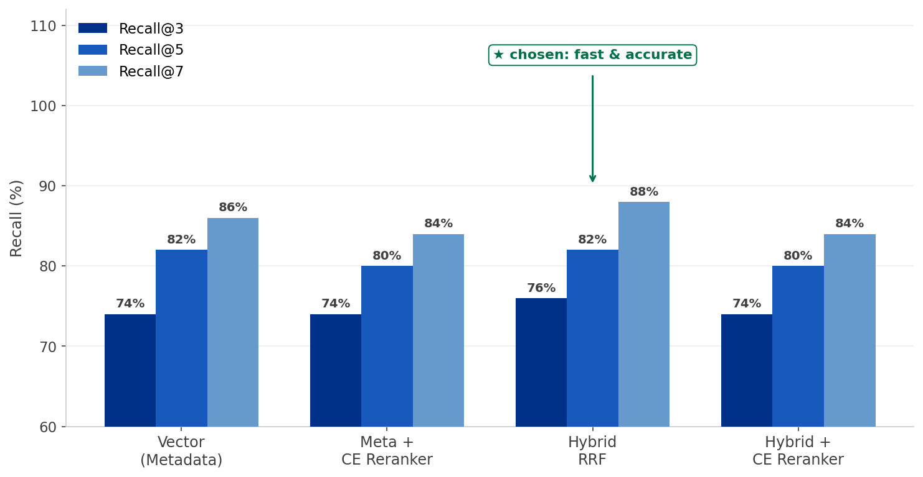
Phase 3: Hybrid BM25 + Vector Search (RRF)
9
Why we chose Hybrid RRF — and why we skipped the cross-encoder reranker
CE vs. RRF
CE reranker:
R@3 = 74% · +1.74 s latency
Hybrid RRF (chosen):
R@3 = 76% · 0 s overhead
RRF wins on both recall AND speed.
Why not CE reranker?
The BGE cross-encoder was trained on MS-MARCO web queries — it has no understanding of financial domain terms, quarter labels, or Infosys-specific vocabulary. Domain mismatch means it cannot reliably distinguish which NSE filing chunk is most relevant.
RRF formula: score = Σ 1 / (60 + rank_i)
Simple, fast, domain-agnostic.
Production choice: Hybrid RRF — R@3 = 76%, R@7 = 88%, latency = 0.56 s. Higher recall than any reranker, zero domain-adaptation needed.

Slide 10
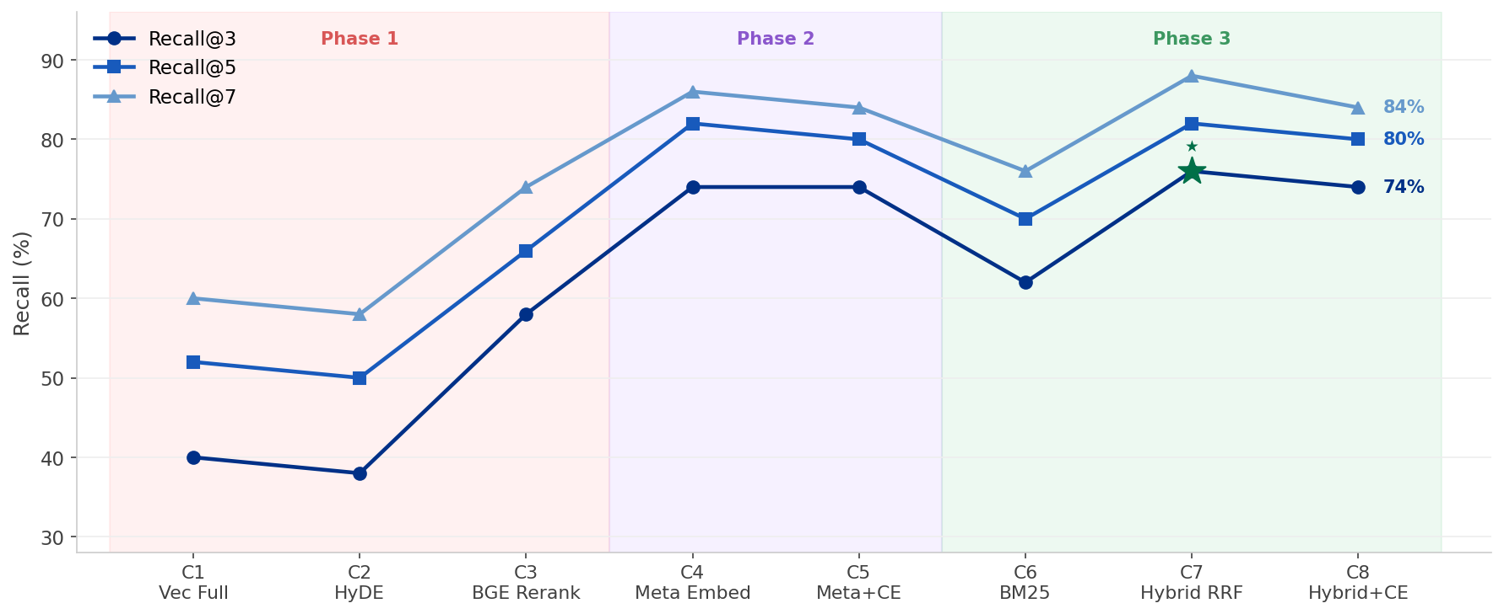
All 8 Strategies — Recall Progression
10
Every experiment in sequence; ★ = production choice

Slide 11
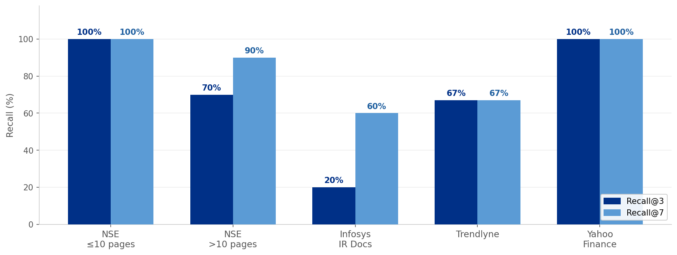
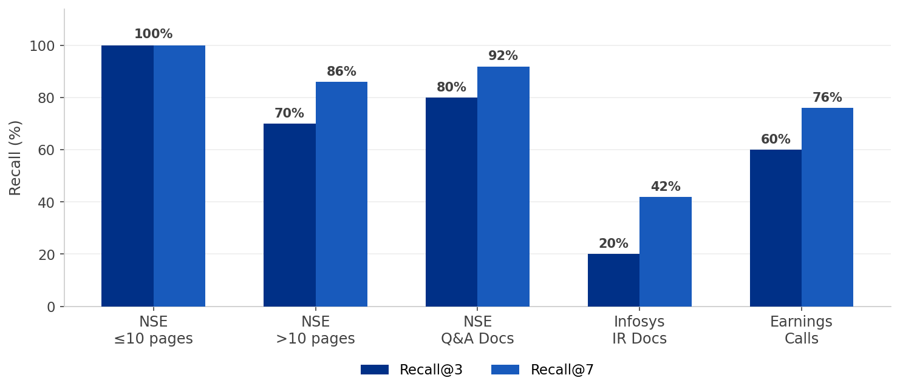
Where Does the System Perform Best?
11
Category-wise Recall@3 and Recall@7 breakdown
NSE ≤10 pages
NSE >10 pages
Infosys IR Docs
100% R@3 — short docs
index and retrieve cleanly
70% R@3 — chunking splits
long reports imperfectly
Only 20% R@3 — these queries
are best handled by the Fact DB

Slide 12
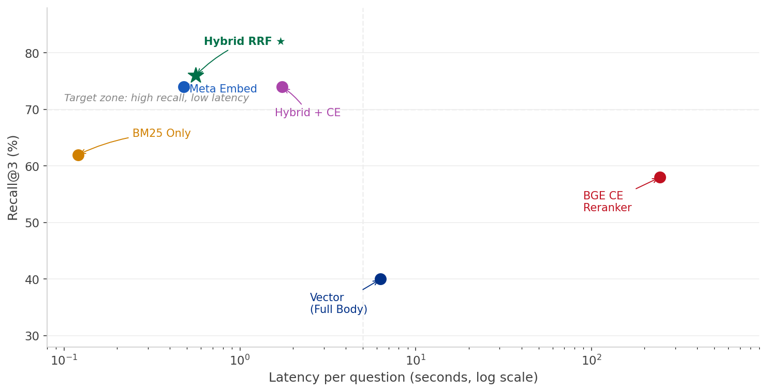
Speed vs. Accuracy — Every Strategy at a Glance
12
The ideal system is top-left: high recall, low latency
Verdict
★ Hybrid RRF:
R@3 = 76%
0.56 s latency
BGE Reranker:
R@3 = 58%
245 s latency
Why Hybrid wins
Hybrid is both faster AND more accurate than the BGE reranker. BM25 adds keyword precision that pure vector search misses on entity-heavy financial queries. RRF merges the two signals without any additional latency.
Hybrid RRF is the production system: highest recall at the second-lowest latency. The BGE reranker sits in the worst quadrant — slower AND less accurate.

Slide 13
The Hallucination Problem in Finance
13
Why retrieval quality alone is not enough for numeric queries
Question:
Our Solution: Fact Database / Numeric Fidelity Layer
"What was Infosys's operating margin in Q3 FY26?"
Route numeric queries to the Fact DB:
Vector RAG answer (no fact layer):
"…the operating margin was approximately 17.8%." ✗ WRONG (actual: 21.1%)
① LLM generates SQL from the question
② SQLite executes on 2,551 stored rows
③ Exact value returned — no generation
Why does this happen?
0
The retrieved chunk may not contain the exact figure — the value may span a table row that was split during chunking, or the same metric appears rounded differently across documents. The LLM interpolates from nearby figures. Even a 1–2 pp margin error can flip an analyst's recommendation.
numeric hallucinations
on Fact DB path queries

Slide 14
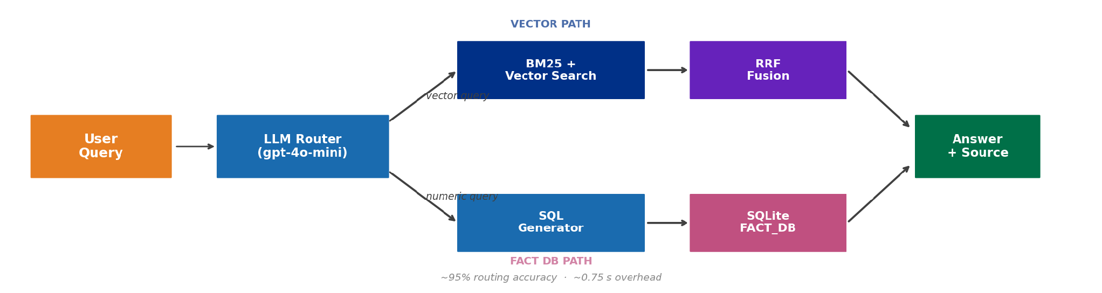
How FinQuery Works End-to-End
14
LLM-based router directs each query to the right retrieval path
Query Router
FACT_DB path
VECTOR path
gpt-4o-mini · temperature=0
~95% routing accuracy · ~0.75 s
2,551 rows · 7 metrics
Q1 FY25–Q4 FY26 · Infosys IR
Zero hallucination on numbers
Hybrid RRF retrieval
top-3 chunks → gpt-4o-mini
Qualitative & explanatory Q

Slide 15
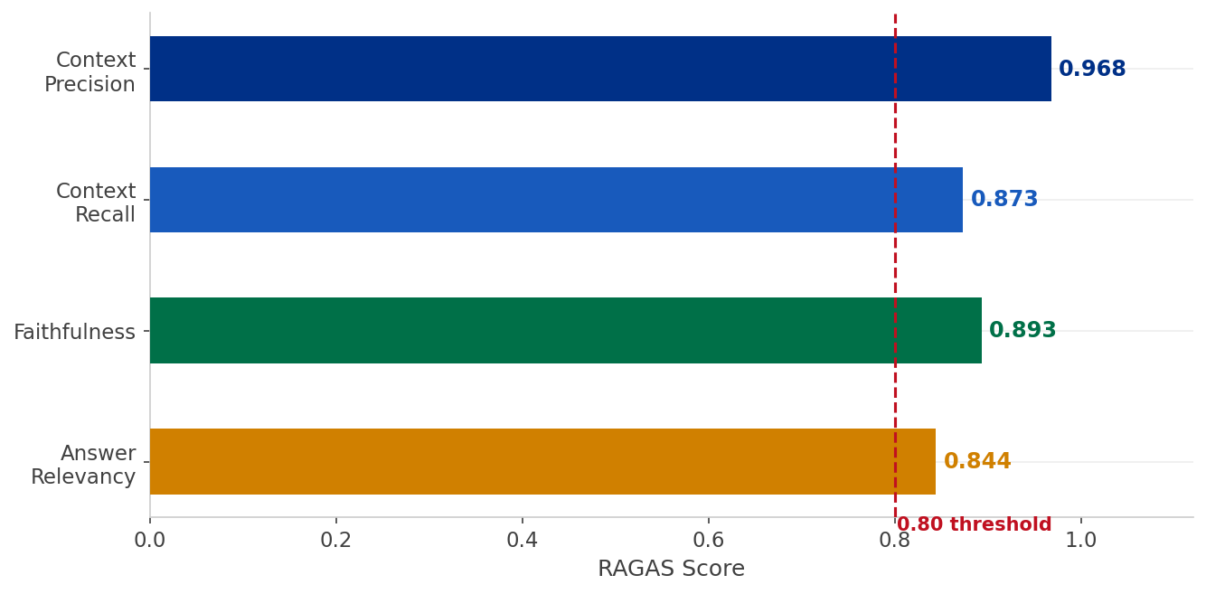
Final Answer Quality — RAGAS Evaluation
15
Pipeline A (vector RAG path) · 50 questions · gpt-5.6-luna
Context Precision
0.968
Retrieved chunks
are highly relevant
Context Recall
0.873
Needed information
found in context
Faithfulness
0.893
Answer grounded
in retrieved text
Answer Relevancy
All 4 metrics exceed 0.84 — strong, verifiable answer quality.
0.844
Answer directly
addresses question

Slide 16
Results at a Glance
16
Final production system — Hybrid RRF + Fact DB
76%
88%
0.56 s
0.90
Recall@3
Recall@7
Retrieval Latency
Avg RAGAS Score
Top-3 retrieval
accuracy
Near-perfect coverage
by rank 7
Per question
13× faster vs Phase 1
Across all 4
RAGAS metrics
~95%
0
8
5
query routing accuracy
numeric hallucinations
(Fact DB path)
retrieval strategies
compared
source types
indexed

Slide 17
What This Project Taught Us
17
Three transferable lessons for production RAG systems
Representation beats model size
Embedding only the right signal (YAML metadata) outperformed expensive cross-encoder rerankers. A +34 pp recall gain came from a 10-line architectural change, not a larger or newer model. The lesson: what you embed matters more than how you score it.
Hallucination needs structural, not just prompt-level, solutions
Routing numeric questions to an SQL database eliminates an entire class of errors that no amount of prompt engineering can reliably fix. The LLM writes SQL; the database returns the exact value. For financial systems, this boundary is non-negotiable.
Benchmark distribution matters as much as benchmark size
Entity-heavy questions (proper nouns, quarter labels) behave very differently from general semantic queries. HyDE hurt recall here because the raw question was already the best query vector — the generated passage only added drift. Know your query distribution before choosing a retrieval strategy.

Slide 18
Thank You
FinQuery — AI-Powered Financial Intelligence System
From 40% → 88% retrieval recall · Zero hallucinations on numbers · 0.56 s latency
DS & AI Lab · Group 6 · T2 2026

