Slide 1
MILESTONE 5 — RAG EVALUATION & OPTIMIZATION
FinQuery
An AI-Powered, Stock-Specific Public Update Analyzer
for Indian Capital Markets
Team 06 — IIT Madras
Akbar Ali — 23f1002997
Gurram Sai Sri Ram Hruthik — 22f3001648
NandanReddy Parnapalli — 22f3002857
Shubham Gattani — 21f3002082
Shubhashish Biswas — 21f1001460

Slide 2
PROJECT SCOPE
FinQuery - Milestone 5
What Changed in Milestone 5
• Section-aware chunking for long NSE and Infosys IR documents into 1,500–2,500 token chunks.
• New section cleaning prompt with stronger table summarization and semantic YAML metadata.
• Full corpus re-embedding after YAML quoting fixes: 1,877 Markdown documents re-indexed.
• Metadata-only retrieval pipeline embedding only generated YAML metadata (section_title, section_description, topics, sample_queries).
• Lightweight cross-encoder reranking stage added on top of metadata retrieval.
1,500–2,500
3,000
1,877
1,875
preferred chunk token range
hard max tokens per chunk
documents re-embedded
metadata docs embedded
2

Slide 3
CONTEXT
FinQuery - Milestone 5
Previous-Milestone Pipeline
1
Clean source financial documents into Markdown
Milestone 4 Baseline Results
Pipeline | Pool | R@3 | R@5 | R@7 | Latency
Chroma-only | Top 10 | 40% | 50% | 54% | 6.251 s
HyDE | Top 10 | 40% | 42% | 46% | 9.320 s
BGE reranking | Top 25 | 58% | 64% | 64% | 245 s
2
Embed each document using OpenAI text-embedding-3-small
3
Store embeddings, text and filenames in ChromaDB
4
Embed the user question and retrieve nearest documents
5
Optionally apply HyDE or cross-encoder reranking
Milestone 5 extends this baseline with section-aware chunking and metadata-only retrieval, achieving 88% Recall@7 at 3.173 s — 78× faster than BGE reranking on CPU.
6
Send top-3 contexts to gpt-4o-mini for grounded answer
3

Slide 4
BENCHMARK
FinQuery - Milestone 5
Single 50-Question Evaluation Dataset
Source Category | Questions
NSE documents ≤ 10 pages | 24
NSE documents > 10 pages | 10
Infosys IR (earnings calls / press conf) | 10
Trendlyne analyst reports | 3
Yahoo Finance articles | 3
Total | 50
Ground-Truth Design
Full relative file paths (e.g., data/nse_files_final/…/group_001.md) eliminate ambiguity between repeated chunk filenames.
Strict Evaluation
Recall@k is exact: a question is correct only if the expected source document appears in the top-k retrieved results.
Distribution
Dataset mirrors the corpus composition: 24 short NSE press releases, 10 long NSE sections, 10 IR quarterly chunks, and 6 external reports.
4

Slide 5
SETUP
FinQuery - Milestone 5
Configuration Used for Milestone 5
Component | Configuration
Embedding model | OpenAI text-embedding-3-small
Answer-generation model | OpenAI gpt-4o-mini
RAGAS evaluator LLM | gpt-5.6-luna
RAGAS evaluator embeddings | text-embedding-3-small
Full-text BGE reranker | BAAI/bge-reranker-v2-m3
Metadata cross-encoder | cross-encoder/ms-marco-MiniLM-L-6-v2
Vector database | ChromaDB persistent collections
GPU runtime | Google Colab T4 GPU
Local runtime | Python virtual environment
1,877
1,875
full-text Markdown embeddings
metadata-only embeddings (2 skipped)
5

Slide 6
RESULTS
FinQuery - Milestone 5
Chroma-Only vs BGE Reranking (Full-Text Corpus)
Pipeline | Pool | R@3 | R@5 | R@7 | R@9 | Avg Latency
Chroma-only | Top 10 | 34% | 38% | 40% | 40% | 6.251 s
BGE reranking (CPU) | Top 35 | 40% | 46% | 50% | 56% | 486 s
+6 to +16 pp
486 s CPU
3.7 s GPU
BGE reranking improved over Chroma-only by 6, 8, 10, and 16 percentage points at Recall@3, @5, @7, @9.
BGE reranking averaged 486 seconds per question on CPU — too slow for interactive use.
On a Colab T4 GPU the same pipeline averaged only 3.695 seconds end-to-end, making it practical.
6

Slide 7
METHOD
FinQuery - Milestone 5
Metadata-Only Retrieval Pipeline
What Gets Embedded (per chunk)
Pipeline A — No Reranking
section_title
section_description
1. Embed query with text-embedding-3-small
2. Retrieve top-10 from metadata_embeddings collection
3. Read top-3 document bodies from disk
4. gpt-4o-mini generates grounded answer
The section heading
One-sentence summary
topics
sample_queries
Comma-separated topic list
5-20 example questions (based on information density)
Latency: 0.478 s Recall@7: 82%
Pipeline B — With Cross-Encoder Reranking
1. Embed query with text-embedding-3-small
2. Retrieve top-20 from metadata_embeddings collection
3. Cross-encoder (ms-marco-MiniLM-L-6-v2) re-scores all 20
4. Read top-3 reranked document bodies from disk
5. gpt-4o-mini generates grounded answer
Latency: 3.173 s Recall@7: 88%
7

Slide 8
RESULTS
FinQuery - Milestone 5
Metadata-Only Retrieval Performance
Pipeline | Pool | R@3 | R@5 | R@7 | Avg Latency
Metadata-only embedding | Top 10 | 74% | 78% | 82% | 0.478 s
Metadata-only + cross-encoder rerank | Top 20 | 74% | 82% | 88% | 3.173 s
+34 pp
+24 pp
13× faster
77× faster
Better Recall@3 vs Chroma-only baseline (74% vs 40%)
Better Recall@7 vs BGE reranking (88% vs 64%)
Metadata-only vs full-text Chroma pipeline (0.478 s vs 6.251 s)
Metadata+rerank vs CPU BGE reranking (3.173 s vs 245 s)
8

Slide 9
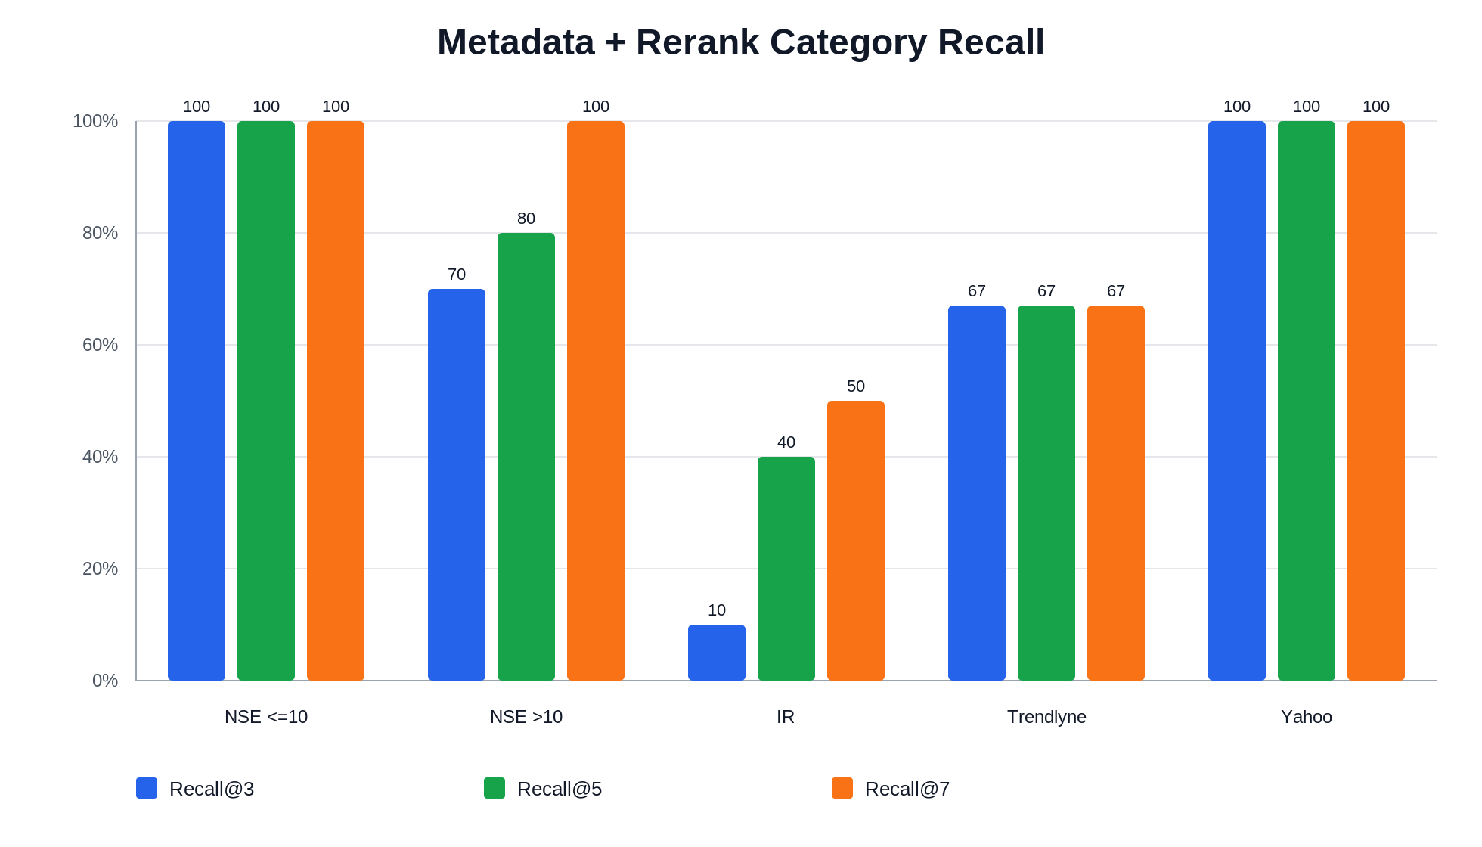
ANALYSIS
FinQuery - Milestone 5
Where Metadata + Reranking Works Best
100%
NSE ≤10 pages and Yahoo Finance — perfect at all recall levels
67%
Trendlyne — limited by competing quarterly reports
10%
Infosys IR Recall@3 — quarterly docs share identical YAML vocabulary
9

Slide 10
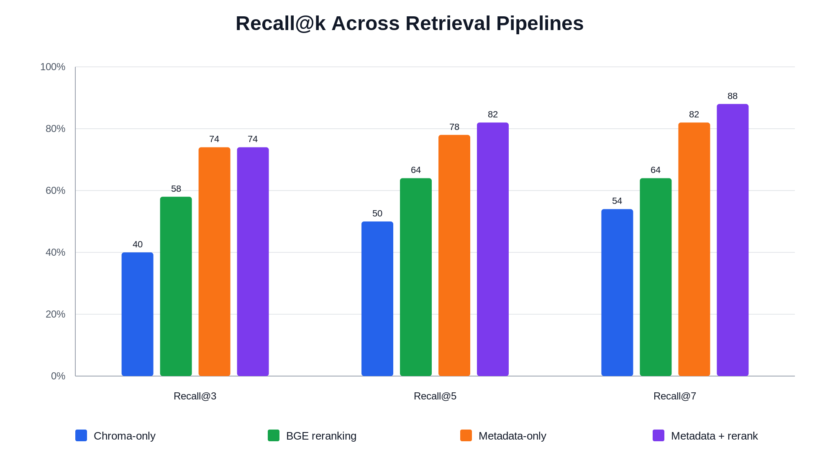
RESULTS
FinQuery - Milestone 5
Recall@k Across All Retrieval Pipelines
Best at every cutoff
Metadata + rerank dominates: 74% → 82% → 88%
Chroma-only
40% → 50% → 54%
BGE reranking
58% → 64% → 64%
10

Slide 11
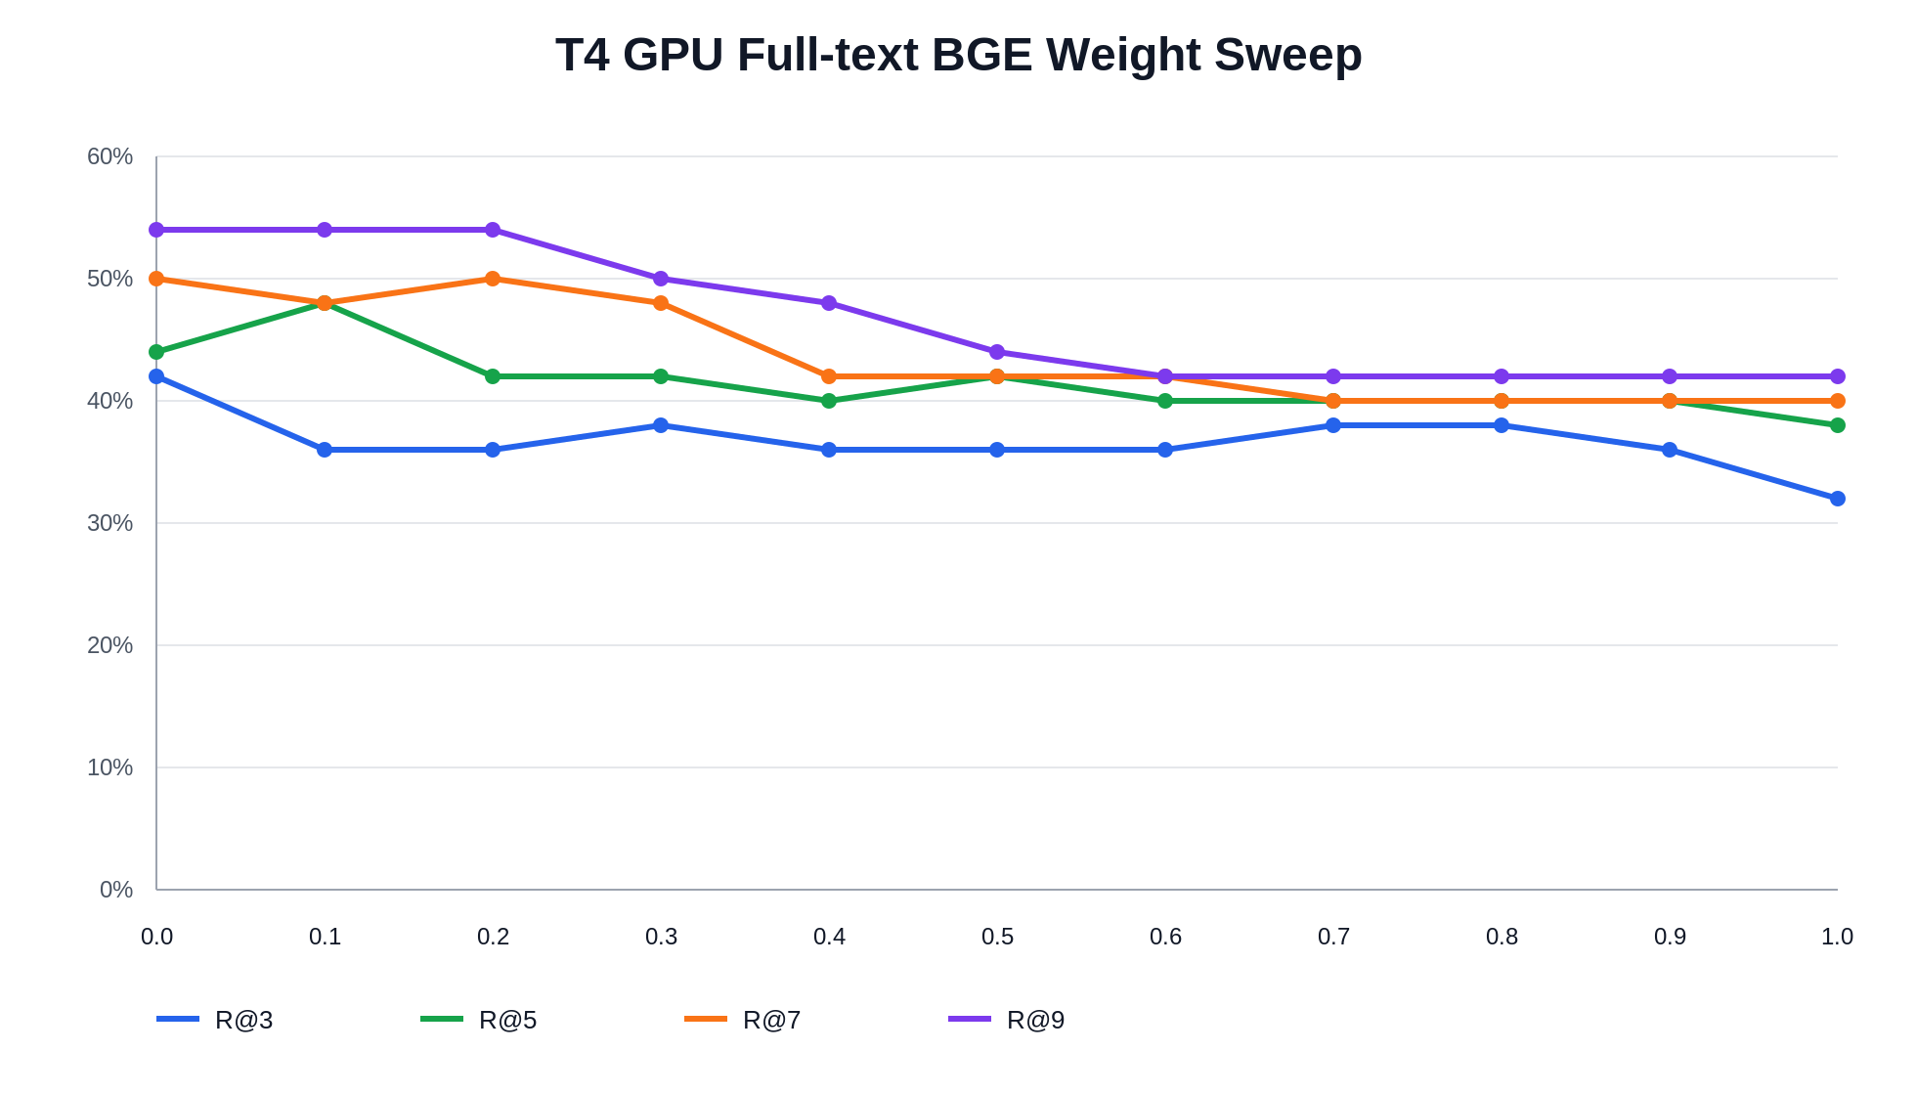
EXPERIMENT
FinQuery - Milestone 5
T4 GPU Full-Text BGE Score-Weight Sweep
Best Configuration
Body=0.0 / Metadata=1.0 gives best Recall@3 (42%) and Recall@9 (54%)
Why Metadata Wins
Document bodies contain boilerplate and heterogeneous text. Metadata is shorter and more aligned with question intent.
3.278 s
mean reranking time on T4 GPU
11

Slide 12
ANSWER QUALITY
FinQuery - Milestone 5
RAGAS Evaluation — Pipeline A
Property | Value
Dataset | 50 investor-oriented questions
Pipeline | Metadata-only top-10 → top-3 context → gpt-4o-mini
Answer-generation model | gpt-4o-mini
RAGAS evaluator LLM | gpt-5.6-luna
RAGAS embeddings | text-embedding-3-small
Reference answers | Human-reviewed grounded answers
faithfulness
Are all answer claims supported by the retrieved context? Scores unsupported additions as failures.
context_precision
Are the retrieved documents relevant to the question? High score = low noise in context.
context_recall
Does the retrieved context contain all information needed for the reference answer?
answer_relevancy
Does the generated answer actually address the question? (Can under-score long faithful answers.)
12

Slide 13
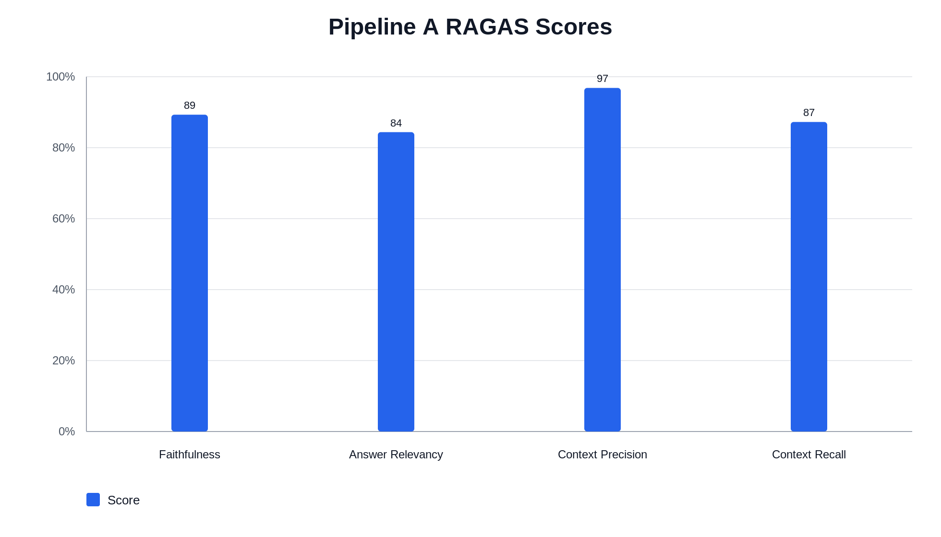
ANSWER QUALITY
FinQuery - Milestone 5
Pipeline A RAGAS Scores
0.8929
faithfulness
0.8439
answer relevancy
0.9683
context precision
0.8725
context recall
13

Slide 14
QUALITATIVE RESULTS
FinQuery - Milestone 5
Representative Success Cases
ID 9 — Q3 FY26 Earnings Call (IR)
Mean: 0.96
ID 22 — Infosys–Intel Partnership (NSE ≤10)
Mean: 0.99
Q: What was the TCV of large deals Infosys closed in Q3 FY26 and net-new share? A: $4.8 billion, with 57% net new business. ✓ Perfect match — single factual query, distinctive metadata.
Q: What is the strategic rationale behind Infosys and Intel deepening their partnership? A: Facilitate enterprises' transition from AI pilots to large-scale production deployments. ✓ Unique partner name in metadata → ranked 1st.
ID 17 — September 2025 Buyback (NSE ≤10)
Mean: 0.98
ID 24 — Bank CTBC Finacle (NSE ≤10)
Mean: 0.99
Q: Buyback size, price per share, and shares proposed for repurchase? A: ₹18,000 crore at ₹1,800/share; 10,00,00,000 shares. ✓ Only document in corpus with this specific buyback — unambiguous retrieval.
Q: What benefits is Bank CTBC Indonesia gaining from Infosys Finacle on cloud? A: 6 benefits correctly listed: scalability, faster innovation, 300%+ efficiency gain, etc. ✓ Unique bank name ensures first-rank retrieval.
14

Slide 15
QUALITATIVE RESULTS
FinQuery - Milestone 5
Where the Pipeline Still Fails
ID 46 — Wrong Document / Wrong Year
Mean: 0.36
Answer: $14.9B (FY26 value). Reference: $11.6B (FY24-25). FY26 document ranked #1; correct AGM transcript was at rank 3. Both share identical YAML vocabulary — only body numbers differ.
ID 15 — Multi-Chunk Fragmentation
Mean: 0.65
Listed 3 third-party recognitions; reference had 8. Evidence split across two chunks of the same press release (group_001 and group_002). Only group_002 was retrieved in top-3.
ID 34 — Vocabulary Collision
CR: 0.00
Reference: '77% reported financial loss, 53% reputational damage.' Pipeline retrieved Form 20-F risk sections (generic AI risk language) instead of the specific Responsible AI press release with exact statistics.
15

Slide 16
ERROR ANALYSIS
FinQuery - Milestone 5
Patterns in Model Mistakes
IR Quarterly Ambiguity
RAGAS Answer-Relevancy Artefact
Q1–Q4 earnings calls, press conferences, and fact sheets share YAML terms (revenue guidance, operating margin, large-deal TCV). Metadata embedding retrieves the wrong quarter, causing the LLM to state the wrong number.
Long, multi-clause answers generate synthetic questions that do not reconstruct the original. Cosine similarity falls near zero even when the answer is correct and faithful.
Multi-Chunk Fragmentation
Temporal Disambiguation Failure
List-style questions whose evidence spans multiple chunks of one document are answered incompletely. Retrieving group_002 does not guarantee group_001 is also included in the top-3 context.
Adjacent fiscal years share identical YAML vocabulary; only the body text contains the differentiating number. The metadata pipeline cannot distinguish FY24-25 from FY25-26.
LLM Over-Elaboration
When the context states a brief one-sentence reason, gpt-4o-mini adds plausible but ungrounded justifications. RAGAS faithfulness penalizes each unentailed claim.
16

Slide 17
CONCLUSION
FinQuery - Milestone 5
Key Observations & Recommended Direction
Key Observations
Limitations
• Metadata-only embedding: 74% Recall@3 at 0.478 s — 13× faster than baseline
• Cross-encoder reranking: improves Recall@7 to 88% with 3.173 s total latency
• Pipeline A RAGAS: faithfulness 0.89, context precision 0.97, context recall 0.87
• T4 GPU reduces BGE reranking to 3.278 s — matching metadata cross-encoder speed
• Metadata-heavy BGE scoring (body=0.0) gives best full-text recall
• Infosys IR is the hardest category: Recall@3 only 10%
• IR quarterly disambiguation requires body-text or explicit YAML fields (quarter, fiscal year)
• List-style questions need adjacent-chunk co-retrieval
• Pipeline B RAGAS evaluation not yet completed
Best Speed-Quality Tradeoff
Metadata-only retrieval + lightweight cross-encoder reranking gives the strongest Recall@7 (88%), keeps latency practical (3.173 s), and performs especially well on documents with distinctive semantic metadata.
Next: Add fiscal_year and quarter fields to IR YAML metadata to resolve quarterly ambiguity.
17

