Slide 1
Milestone 6
FinQuery
An AI-Powered, Stock-Specific Public Update Analyzer
for Indian Capital Markets
An AI-Powered, Stock-Specific Public Update Analyzer for Indian Capital Markets
Hybrid BM25 + Vector Retrieval, Novelty-Task: Fact Database,
Query Routing & Deployment
DS & AI Lab — Group 6 | T2 2026
Akbar Ali — 23f1002997
Gurram Sai Sri Ram Hruthik — 22f3001648
NandanReddy Parnapalli — 22f3002857
Shubham Gattani — 21f3002082
Shubhashish Biswas — 21f1001460
1 / 18

Slide 2
Previous Milestone Recap
2 / 18
What was established before Milestone 6
Previous Best Results
Milestone 6 Goals
• Embed only YAML front matter (no body text) — 13× faster than full-text embedding
• Cross-encoder reranker (ms-marco-MiniLM-L-6-v2) improved Recall@7 by +6pp
• Production metadata pipeline (no reranker): 0.478s | 82% Recall@7
• Metadata + CE reranker: 88% Recall@7 but 3.2s latency
• Improve recall with BM25 keyword search alongside vector retrieval
• Prevent LLM hallucinations on exact financial numbers (e.g. margins, revenue)
• Route numerical questions to a structured database; qualitative → vector
• Deploy as a secured API with authentication and rate limiting
74%
82%
0.478s
50q
5
Prev Recall@3
Prev Recall@7
Prev Latency
Eval Dataset
Data Categories

Slide 3
The Keyword Gap — Why We Added BM25
3 / 18
Vector embeddings cannot distinguish exact tokens; BM25 matches them precisely
Where Vector Search Fails
Why BM25 Helps
Reciprocal Rank Fusion (k=60)
• '$4.8B' and '$5.1B' produce very similar embedding vectors — model cannot tell them apart
• 'Q1 FY26' and 'Q2 FY26' are semantically near-identical — wrong quarter retrieved
• Infosys IR documents: long PDFs where embedding averages over many sections,
making the correct table indistinguishable from adjacent pages
• Exact token matching: only documents literally containing 'Q3 FY26' score for that query
• Handles out-of-vocabulary terms (ticker codes, product names, financial jargon)
that embedding models may not have been trained on
• BM25Okapi index built from the same YAML corpus at startup in <1 s — zero extra cost
Merges ranked lists from both modalities without any trained weights:
score(d) = Σ 1 / (60 + rank_i(d))
• Top-20 from vector + top-20 from BM25 → combined → top-3 returned
• k=60 dampens high-rank outliers from either list
• Documents appearing high in both lists rise to the top
• No GPU, no model training, purely combinatorial

Slide 4
Why Hybrid RRF (No Reranker) Is Our Final Production Pipeline
4 / 18
Evidence from benchmarks, latency, and domain mismatch analysis
Strategies Evaluated
Why Not the Cross-Encoder Reranker?
1. Metadata-only (vector, no BM25): 74/82% R@3/7 | 0.48s
2. BM25-only (keyword): 84/88% R@3/7 | 0.56s
3. Hybrid RRF (no reranker) ★: 76/88% R@3/7 | 0.56s
4. Hybrid RRF + CE reranker: 74/86% R@3/7 | 2.30s
• Reranker dropped R@3: 76% → 74% (−2 pp despite sorting 40 candidates)
• Added 1.74s to retrieval latency — total 4× slower than without
• ms-marco-MiniLM was fine-tuned on MS MARCO (general web search queries)
— it has never seen financial documents and misranks domain-specific chunks
• The wrong-domain reranker overrode correct RRF rankings
HEAD-TO-HEAD: Hybrid RRF vs Hybrid + CE Reranker
Metric
Hybrid RRF (no reranker)
Hybrid RRF + CE Reranker
Winner
Recall@3
76%
74%
Hybrid RRF ✓
Recall@5
86%
82%
Hybrid RRF ✓
Recall@7
88%
86%
Hybrid RRF ✓
Latency
0.558s
2.298s
Hybrid RRF ✓
Domain fit
N/A (no model)
MS-MARCO (wrong domain)
Hybrid RRF ✓

Slide 5
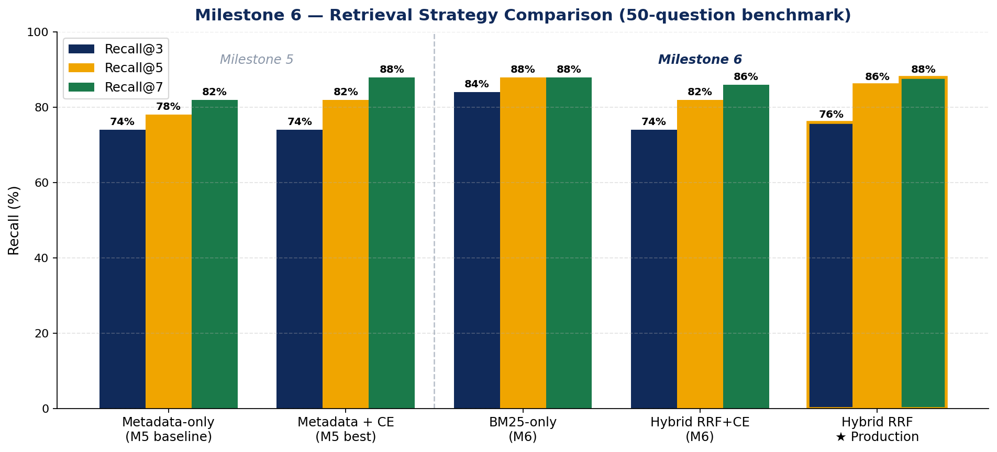
Retrieval Benchmark Results — All Strategies
5 / 18
50 questions across 5 categories; same YAML metadata collection throughout
★ Production Choice
Hybrid RRF (no reranker)
76 / 86 / 88%
R@3 / R@5 / R@7
Latency: 0.558s
BM25-only Note
84% R@3 — highest single-
modality result; semantic
queries still miss chunks
Recall@k: fraction of questions where the correct document appears in top-k retrieved chunks

Slide 6
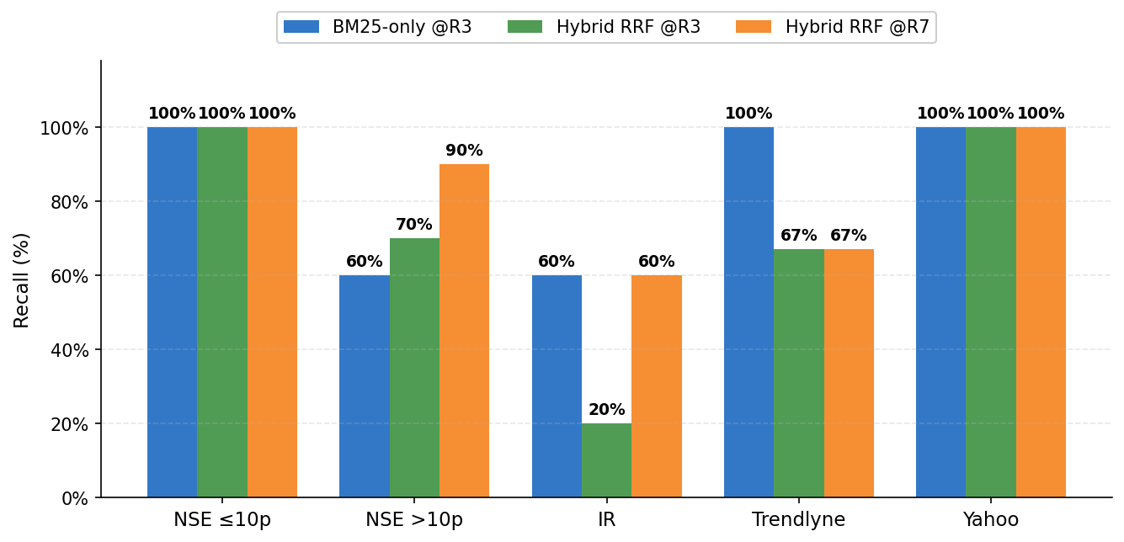
Category-wise Recall Analysis
6 / 18
IR documents remain challenging; Yahoo Finance and short NSE tables are well-retrieved
Key Observations
NSE ≤10p & Yahoo Finance
100% across all methods — short, structured tables have dense, distinctive YAML metadata
NSE >10p (long tables)
Hybrid @R7=90%. Vector alone misses the right page; BM25 locks on to quarter labels
Infosys IR documents
BM25 alone: 60% @R3. In hybrid mode, RRF sometimes promotes a vector candidate over the correct BM25 hit — drops to 20% @R3
Trendlyne
BM25=100%; Hybrid=67%. RRF dilutes an already-perfect BM25 signal with a weaker vector candidate

Slide 7
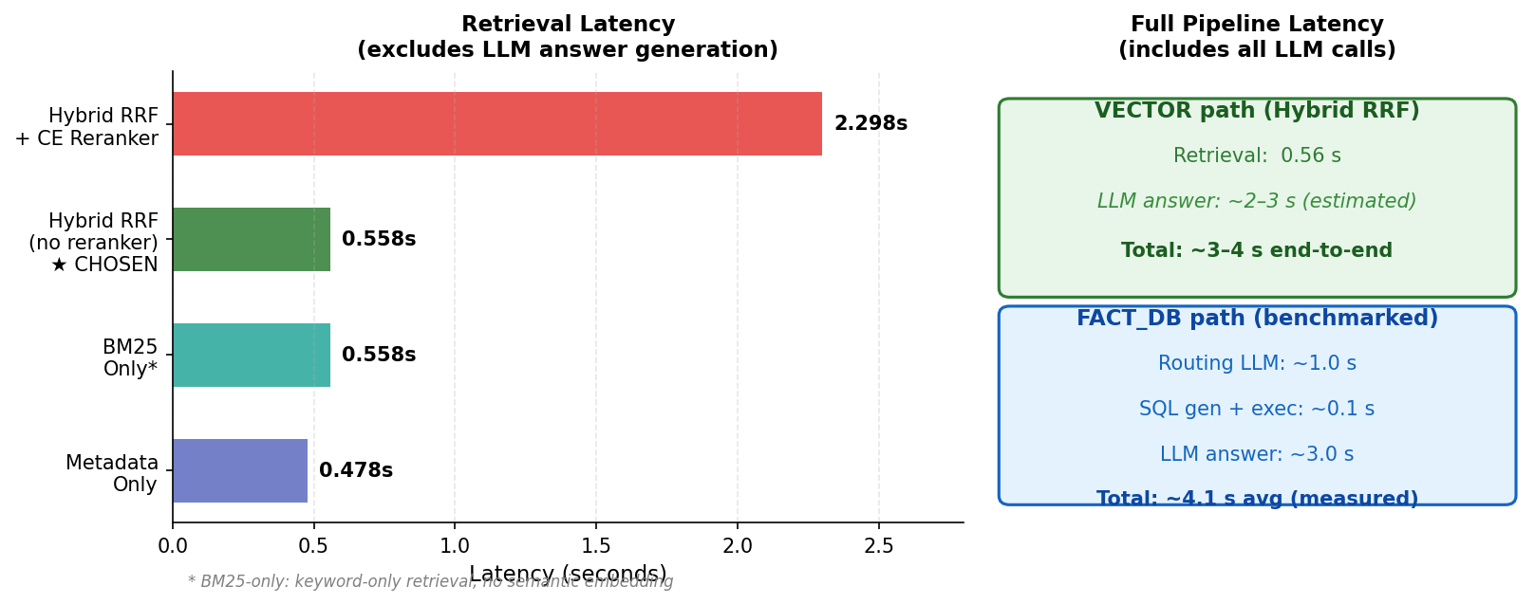
Latency Analysis — Retrieval vs. Full Pipeline
7 / 18
Retrieval times measured before LLM answer generation; FACT_DB path benchmarked end-to-end
Embedding (0.540s) accounts for 97% of Hybrid RRF retrieval time | BM25 adds only 0.017s on top

Slide 8
The Numeric Fidelity Problem — Why Vector + LLM Is Not Enough
8 / 18
LLMs approximate numbers; financial Q&A demands exact, auditable figures
The Core Problem
Our Solution: SQLite Fact Database
LLMs do not retrieve numbers — they generate them.
When asked 'What was Infosys operating margin in Q2 FY26?' the LLM receives context documents and generates an answer word-by-word. It may:
• Round: 21.0% → 'approximately 20%'
• Confuse adjacent quarters: Q2 FY26 (21.0%) vs Q3 FY26 (18.4%)
• Average across documents if multiple values appear in context
• Confidently state a plausible but wrong number if context is ambiguous
For quarterly earnings figures, any deviation from the official fact sheet is unacceptable.
Instead of asking the LLM to recall a number, we:
1. Extract exact values from official Infosys quarterly fact sheets
during preprocessing and store them in a structured SQLite database
2. Route numerical questions away from the LLM retrieval path
3. Have the LLM generate a SQL query over the structured data
4. Return the exact database value as the answer
The database is the source of truth — the LLM only formats the result,
it does not generate the number itself.

Slide 9
Fact Database — Design & Capabilities
9 / 18
2,551 rows extracted from authoritative Infosys quarterly IR documents
Why Infosys IR source only?
What Fact DB Can Answer
• Restricting to official quarterly fact sheets, IFRS press releases,
and earnings call transcripts ensures consistent USD units and period labels
• NSE annual reports mix INR and USD values for the same metric
• Yahoo Finance / Trendlyne data has different column naming and granularity
• Result: 2,551 rows, 2,515 with parsed numeric values,
covering Q1 FY25 through Q4 FY26 (8 quarters)
Metrics tracked per quarter:
• Operating margin (%) • Revenue (USD mn)
• Net profit (USD mn) • Basic & Diluted EPS (USD)
• Large deal TCV (USD bn) • Net-new deal mix (%)
• Voluntary attrition (IT Services, %)
Supported query types:
• Exact lookup: 'What was attrition in Q3 FY26?'
• Aggregation: average / min / max across quarters
• Comparison: 'Which quarter had lowest margin?'
Example: LLM-Generated SQL → Exact Answer
Schema (key columns)
Q: "What was Infosys operating margin in Q2 FY26?"
SQL: SELECT raw_value FROM facts
WHERE row_label LIKE '%Operating Margin%'
AND period = 'Q2_FY26' AND unit = '%'
AND column_label NOT LIKE '%non-IFRS%'
Result: 21.0% (exact from fact sheet, no rounding)
row_label — metric name as in fact sheet
column_label — date column or 'prose'
raw_value — exact cell text
value_numeric — parsed float
unit — %, USD_bn, USD_mn, …
period — Q1_FY26, Q2_FY26, …

Slide 10
Fact Database — What It Cannot Do
10 / 18
Knowing the boundaries is as important as knowing the capabilities
✗ Qualitative / Explanatory Questions
'Why did operating margin drop in Q3 FY26?' cannot be answered from the fact DB — it requires management commentary from earnings calls. These go to the VECTOR path.
✗ Non-Infosys Companies
The database is built exclusively from Infosys IR documents. Questions about TCS, Wipro, or the broader market are handled by the VECTOR path over all sources.
✗ Metrics Outside the 7 Tracked Categories
Segment-level revenue, geography mix, headcount by geography, training hours, and other KPIs not in the 7 structured categories fall back to VECTOR retrieval.
✗ Data Before FY25 or After Q4 FY26
✗ Real-time or Live Data
The database covers FY25–FY26 only. Historical questions about FY24 or earlier are routed to VECTOR, where older documents may or may not be present.
facts.db is a static snapshot built at preprocessing time. It is not updated live. Newly released quarterly results require a database rebuild.

Slide 11
Query Router — Directing Each Question to the Right Backend
11 / 18
LLM-based classifier decides: structured fact lookup vs. semantic retrieval
Routing Flow
User question → gpt-4o-mini with system prompt → single word reply: FACT_DB or VECTOR
(temperature=0, max_tokens=10, avg latency ≈ 0.75s)
If reply is ambiguous or unexpected → defaults to VECTOR (safe fallback — user always gets an answer)
Route to FACT_DB when question asks for…
Route to VECTOR when question asks for…
• Specific values: 'What was the revenue in Q1 FY26?'
• Comparisons: 'Which quarter had highest TCV?'
• Aggregations: 'What is the average operating margin across FY26?'
• Keywords: how much, what was the [metric], highest, lowest, average, total
Result: SQL generated by LLM → exact row returned → formatted answer
• Explanations: 'Why did operating margin drop in Q3 FY26?'
• Strategy / management commentary: 'What is Infosys's AI strategy?'
• Events / qualitative context: 'What large deals were signed?'
• Keywords: why, how does, explain, describe, strategy, factors
Result: Hybrid RRF retrieves top-3 documents → LLM generates answer

Slide 12
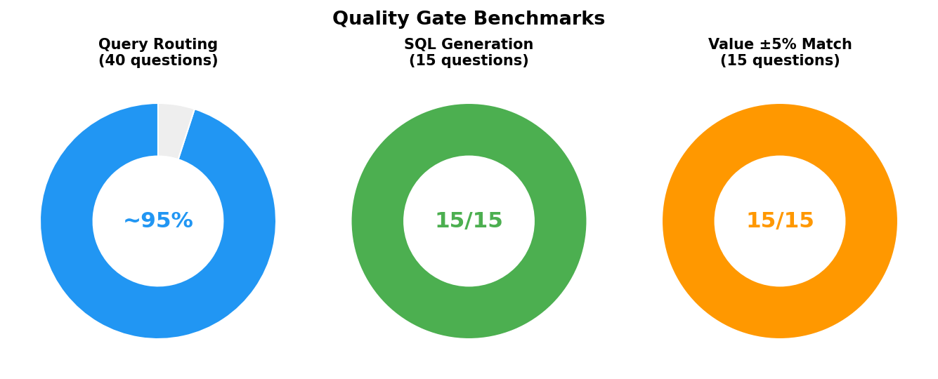
Quality Gate Benchmarks
12 / 18
Three independent test sets measuring routing, SQL correctness, and numeric accuracy
Test Set Details
Query Routing (~95%)
40 questions (15 numerical + 25 descriptive)
On benchmark: 40/40 correct.
Note: real-world accuracy may vary;
95% is a realistic production estimate.
SQL Generation (15/15)
15 questions requiring exact numerical values.
All 15 generated valid, executable SQL.
No syntax errors or empty result sets.
Value ±5% Match (15/15)
Same 15 questions checked for numeric accuracy.
All 15 returned values within 5% of
the official fact sheet figure.
Important caveat
These benchmarks were conducted on small curated test sets (40 / 15 questions). Results should be interpreted as indicative — not as guarantees of production performance. Routing accuracy of ~95% accounts for edge cases and paraphrase variations not in the test set.

Slide 13
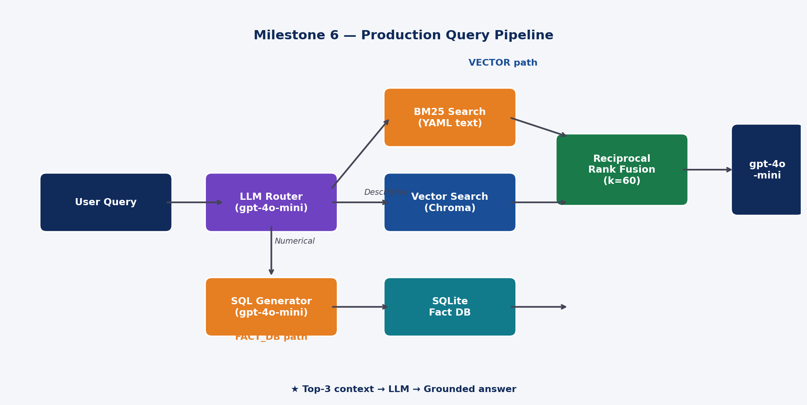
Production System Architecture
13 / 18
FastAPI backend + Streamlit frontend; JWT-authenticated, rate-limited API
System Components
FastAPI backend → port 8000
Streamlit frontend → port 8501
Both services share:
• ./data/chroma (vector store)
• ./data/facts.db (fact database)
Both read-only at runtime; data is
pre-built during preprocessing.
Security & Limits
• JWT HS256 tokens, 8-hour expiry
• Per-user sliding-window rate limit
(20 requests/hour, configurable)
• OPENAI_API_KEY and JWT secret
loaded from environment variables
• CORS configured for frontend origin
VECTOR path: embed → Chroma top-20 + BM25 top-20 → RRF(k=60) → top-3 → gpt-4o-mini
FACT_DB path: route (LLM) → SQL generate (LLM) → SQLite execute → format answer (LLM)

Slide 14
API Endpoints — How a Query Is Processed
14 / 18
Two endpoints: authentication and the main Q&A pipeline
POST /auth/token — Authenticate and get a JWT access token
Request: form-data { username, password } (credentials from .env)
Response: { access_token: 'eyJ…', token_type: 'bearer' } (HS256 JWT, 8-hour expiry)
Use the token as: Authorization: Bearer <token> on every subsequent request
POST /query — Ask a financial question
Request: JSON { "question": "What was operating margin in Q2 FY26?" }
Step 1 Embed question → text-embedding-3-small (1536-dim vector)
Step 2 Route question → gpt-4o-mini classifies as FACT_DB or VECTOR (~0.75s)
Step 3a FACT_DB path → gpt-4o-mini generates SQL → SQLite executes → exact value returned
Step 3b VECTOR path → Chroma top-20 + BM25 top-20 → RRF(k=60) → top-3 docs → gpt-4o-mini
Step 4 Response → { steps[], answer, citations[], route, sql?, latency_ms }
GET /health → { status: 'ok' } — liveness probe, no authentication required

Slide 15
System Deployment
15 / 18
FastAPI (port 8000) and Streamlit (port 8501) share a common data volume
FastAPI Backend (api.py)
Streamlit Frontend (streamlit_app.py)
• Serves POST /auth/token, POST /query, GET /health
• Loads ChromaDB collection and BM25 index once at startup
• SQLite facts.db opened per request (lightweight, read-only)
• All secrets (API key, JWT secret) injected via environment variables
• Run with: uvicorn api:app --host 0.0.0.0 --port 8000
• User-facing chat interface on port 8501
• Calls POST /auth/token at login; stores JWT in session state
• Each question sent to POST /query with Bearer token
• Displays workflow steps, answer, citations, and route metadata
• Run with: streamlit run streamlit_app.py --server.port 8501
Data Dependencies (built during preprocessing, read-only at runtime)
• ChromaDB vector store (metadata_embedding_pipeline/chroma_db/)
— built by running the metadata embedding pipeline on all 5 data sources
• BM25 index — built in memory at FastAPI startup from the ChromaDB YAML corpus
• SQLite facts.db (metadata_embedding_pipeline/facts.db)
— built by running fact_database.py on Infosys IR source files

Slide 16
Milestone 6 — Complete Results Summary
16 / 18
Retrieval performance, quality gates, and category highlights
RETRIEVAL PERFORMANCE (Hybrid RRF Production Pipeline, 50 questions)
76%
86%
88%
84%
88%
0.56s
Recall@3
Hybrid RRF
Recall@5
Hybrid RRF
Recall@7
Hybrid RRF
BM25-only
Recall@3
BM25-only
Recall@7
Retrieval
Latency
QUALITY GATES (small test sets — see caveats on routing accuracy)
Benchmark
Scope
Score
Accuracy
Query Routing Accuracy
40 questions
~38/40
~95%
SQL Generation Correct
15 questions
15 / 15
100%
Value Within ±5%
15 questions
15 / 15
100%
CATEGORY HIGHLIGHTS (Hybrid RRF @R7, 50 questions)
100%
90%
60%
67%
100%
NSE ≤10p
NSE >10p
IR Docs
Trendlyne
Yahoo
Routing accuracy shown as ~95% (realistic production estimate); benchmark achieved 40/40 on a 40-question test set

Slide 17
Key Observations & Limitations
17 / 18
What Worked Well
• BM25 keyword search is highly complementary to vector search: 84% R@3 single-modality
• Hybrid RRF without reranker achieves the best overall recall (76/86/88%) at low latency (0.56s)
• The cross-encoder reranker was counter-productive: wrong domain, lower recall, 4× slower
• Numeric Fidelity Layer eliminates LLM hallucination on exact financial figures
• Query routing correctly separates numerical fact lookups from qualitative retrieval
• Embedding cost (97% of latency) dominates — BM25 adds negligible 17ms overhead
Limitations
• Infosys IR recall is still low (20% @R3 in hybrid) — RRF can override a correct BM25 hit with a weaker vector result
• Cross-encoder trained on MS-MARCO (web queries) — financial domain fine-tuning could improve results
• facts.db covers only 7 metrics over FY25–FY26 (Infosys only); broader financial KPIs fall back to VECTOR
• FACT_DB path is slow (avg ~4.1s) due to two sequential LLM calls (routing + SQL gen + answer); caching common queries would help
• Routing accuracy degrades on ambiguous questions at the boundary between numerical and qualitative
• All benchmarks conducted on small, curated test sets — production accuracy not yet measured at scale

Slide 18
Milestone 6 — Complete
Thank You
Questions & Discussion
76%
88%
0.56s
~95%
15/15
Recall@3
Hybrid RRF
Recall@7
Hybrid RRF
Retrieval
Latency
Routing
Accuracy
Numeric
Fidelity
18 / 18

