Slide 1
MILESTONE 4 — TRAINING & EXPERIMENTATION
FinQuery
An AI-Powered, Stock-Specific Public Update Analyzer
for Indian Capital Markets
Akbar Ali — 23f1002997
Gurram Sai Sri Ram Hruthik — 22f3001648
NandanReddy Parnapalli — 22f3002857
Shubham Gattani — 21f3002082
Shubhashish Biswas — 21f1001460
Team 06 · IIT Madras

Slide 2
DATASETS USED
Retrieval Corpus — Sources & Volumes
Source | Data Used | Purpose
NSE Corporate Announcements | Infosys filings, last 12 months | Primary source for official disclosures
Infosys Investor Relations | Earnings calls, press conf., fact sheets, IFRS/INR releases | Detailed financial & operational context
Trendlyne | Brokerage / research reports | Analyst and market interpretation
yfinance | News and market-related articles | Supporting recent market context
Benchmark Query Set | 50 Infosys-related test questions | Retrieval / evaluation experiments
Corpus volumes after filtering: 240 NSE PDFs → 137 retained (65 rule-based + 72 GPT/Codex review) · 109 short (≤10pp) / 28 long (>10pp) → 749 header-aware sections · 16 Infosys IR docs · 6 yfinance articles · 5 Trendlyne reports · 50 benchmark questions
FinQuery — Milestone 4
2

Slide 3
NECESSARY PREPROCESSING
Pipeline & Chunking Strategy
1
2
3
4
PDF → Markdown
(Docling)
NSE filtering
(metadata+keyword+review)
Dedup &
renaming
Page-count split
(≤10pp/>10pp)
5
6
7
8
Header-aware
sectioning
Source-specific
cleaning
Chunking
(1 file/section)
Embed + index
(ChromaDB)
Chunking:
Short docs (≤10pp): whole cleaned file = 1 chunk. Long NSE docs (>10pp): each header-aware section = 1 chunk.
Source-specific cleaning focus:
NSE — strip exchange wrappers, signatures, boilerplate · IR — preserve earnings-call/report structure · Trendlyne — preserve recommendations, target prices, valuation logic · yfinance — preserve facts, dates, quotes, figures
FinQuery — Milestone 4
3

Slide 4
MODEL ARCHITECTURE
End-to-End RAG Flow & Key Components
INDEXING — OFFLINE
Raw Public
Documents
PDF / Article
Preprocessing
Clean Markdown
+ YAML Metadata
Embedding Model
(text-embedding-3-small)
ChromaDB
Vector Index
QUERY — ONLINE
User
Query
Query Embed /
HyDE Expansion
Top-k Semantic
Retrieval
BGE
Reranking
gpt-4o-mini
Generation
Grounded
Response
Key Components
YAML metadata layer: title, description, topics, sample queries per chunk. Embedding: text-embedding-3-small → 1536-d vectors, stored in ChromaDB collection finance_documents. BGE reranker: final_score = 0.8×body_score + 0.2×metadata_score over top-25 candidates. gpt-4o-mini: generates the answer strictly from retrieved context; states when not found.
FinQuery — Milestone 4
4

Slide 5
TRAINING & EXPERIMENTAL CONFIGURATION
Frozen Models, Retrieval & Reranking Setup
No conventional training was performed — weights, loss function, optimizer, learning rate, batch size, and epochs are not applicable. All models used are frozen pretrained models.
Frozen Pretrained Models
Retrieval, Reranking, HyDE & Hardware
Model | Usage
text-embedding-3-small | Embeds chunks & queries (1536-d)
gpt-4o-mini | Generates grounded answers from context
BGE reranker | Optional cross-encoder reranking
Setting | Value
Vector DB / collection | ChromaDB / finance_documents
Baseline / rerank candidates | Top 3 / Top 25
Final LLM context | Top 3 chunks
Reranking weights | 0.8 body + 0.2 metadata
HyDE | 1 hypothetical passage (gpt-4o-mini), embedded instead of raw query
Hardware | CPU sufficient; GPU helps only for BGE reranking
Evaluation metrics: Recall@3 / @5 / @7, latency, success rate, and qualitative grounding — measured over the 50-question benchmark.
FinQuery — Milestone 4
5

Slide 6
HYPERPARAMETER EXPERIMENTS
Three Pipelines, Head to Head
Method | Successful | Recall@3 | Recall@5 | Recall@7 | Avg Latency
Chroma only | 50/50 | 40% | 50% | 54% | 6.251 sec
Chroma + HyDE | 50/50 | 40% | 42% | 46% | 9.320 sec
Chroma + BGE Reranking | 50/50 | 58% | 64% | 64% | 245.342 sec
Settings Tested
Retrieval strategy: Chroma-only, Chroma + HyDE, Chroma + BGE reranking Candidate pool: Top 3 (baseline/HyDE) vs. Top 25 (reranking) — final LLM context always Top 3 chunks Query representation: raw user query vs. HyDE-generated hypothetical passage BGE score weighting: 0.8 × body_score + 0.2 × metadata_score, evaluated at Recall@3/5/7 Answer model: gpt-4o-mini throughout
FinQuery — Milestone 4
6

Slide 7
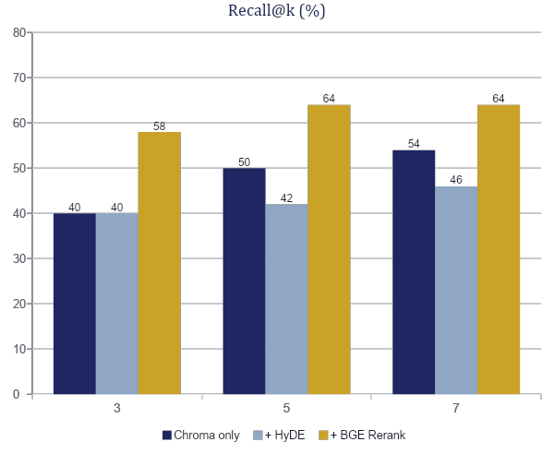
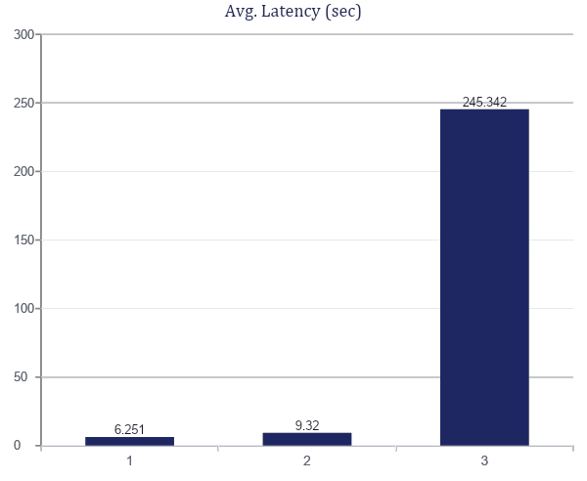
HYPERPARAMETER EXPERIMENTS
Recall vs. Latency Trade-off
Chroma Only
HyDE
Chroma + Re-ranking
BGE reranking lifts Recall@3 from 40% to 58% but is ~40× slower than the Chroma-only baseline.
FinQuery — Milestone 4
7

Slide 8
HYPERPARAMETER EXPERIMENTS
Alternative Choice Experimented - HyDE
Additional Experiment — RRF (raw query + HyDE)
Method | Recall@3 | Recall@5 | Recall@7
Raw query baseline | 40% | 50% | 54%
HyDE only | 40% | 42% | 46%
Raw query + HyDE (RRF) | 48% | 54% | 58%
Final Hyperparameter Choices
Setting | Choice | Reason
Query representation | Raw query (baseline) | Fast; beat HyDE-only
Candidate count for reranking | Top 25 | Wider pool for reranker
Reranking score | 0.8 body + 0.2 metadata | Body primary; metadata aids title/date matches
Final LLM context | Top 3 chunks | Focused, manageable latency
Best accuracy / best practical | Chroma+BGE rerank / Chroma-only | Highest recall / lowest latency
FinQuery — Milestone 4
8

Slide 9
RERANKING
Re-ranking Results
Best Setting (Chroma + BGE): Latency by Stage
BGE Reranker Model
Stage | Avg. Time
Query embedding | 1.236 sec
Chroma retrieval | 0.089 sec
BGE reranking | 243.994 sec
Median / range | 229.987 sec / 185.5–454.8 sec
Total sequential runtime | 204.45 min
BAAI/bge-reranker-v2-m3
Cross-encoder architecture
~568 million parameters
~2.27 GB model weights on disk
~2.5–3.5 GB estimated runtime memory
Runs on CPU; GPU acceleration recommended
Reranking 25 candidates — with separate body and metadata scoring — is the dominant cost. CPU works, but GPU acceleration is recommended for interactive latency.
FinQuery — Milestone 4
9

Slide 10
GENERALIZATION & STABILITY
Techniques Used and Their Effect
With no trained weights, “stability” means consistent retrieval, grounded answers, and error-free completion across unseen questions.
Technique | Effect
Multi-source corpus (NSE, IR, yfinance, Trendlyne) | Improved coverage across regulatory, company, news, brokerage views
Source-specific preprocessing prompts | Reduced noise before embedding; more reliable retrieval
YAML metadata enrichment | Helped embeddings capture content and document intent
Structure-aware chunking | Preserved financial context; avoided cutting numbers from explanations
Grounded answer prompt | Reduced hallucination risk; improved faithfulness
Persistent ChromaDB index + benchmark logging | Reproducible retrieval; traceable failures
BGE reranking | Improved Recall@3 from 40% to 58%
FinQuery — Milestone 4
10

Slide 11
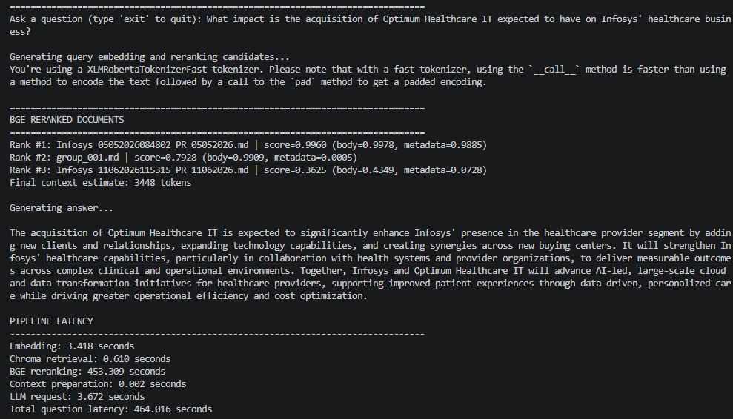
SAMPLE OUTPUT
Example — Grounded Answer(1)
FinQuery — Milestone 4
11

Slide 12
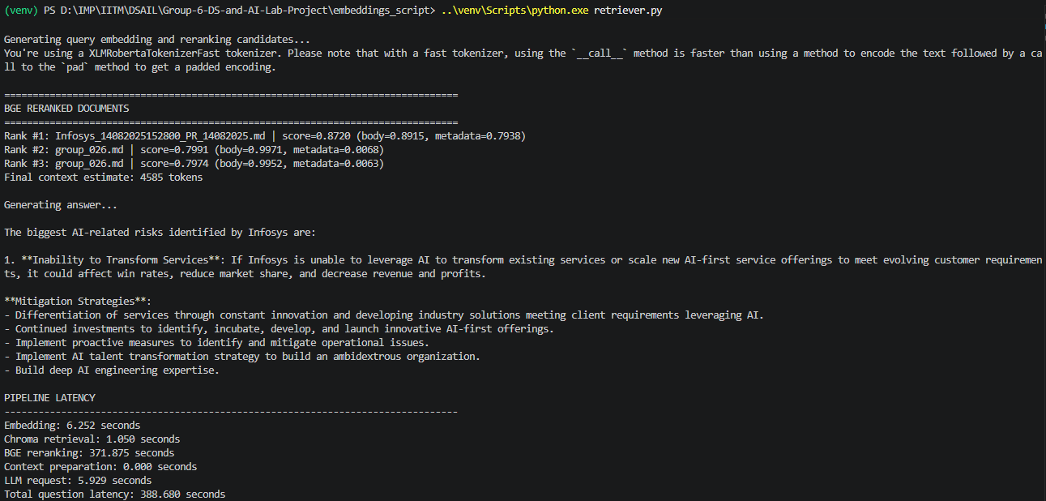
SAMPLE OUTPUT
Example — Grounded Answer(2)
FinQuery — Milestone 4
12

Slide 13
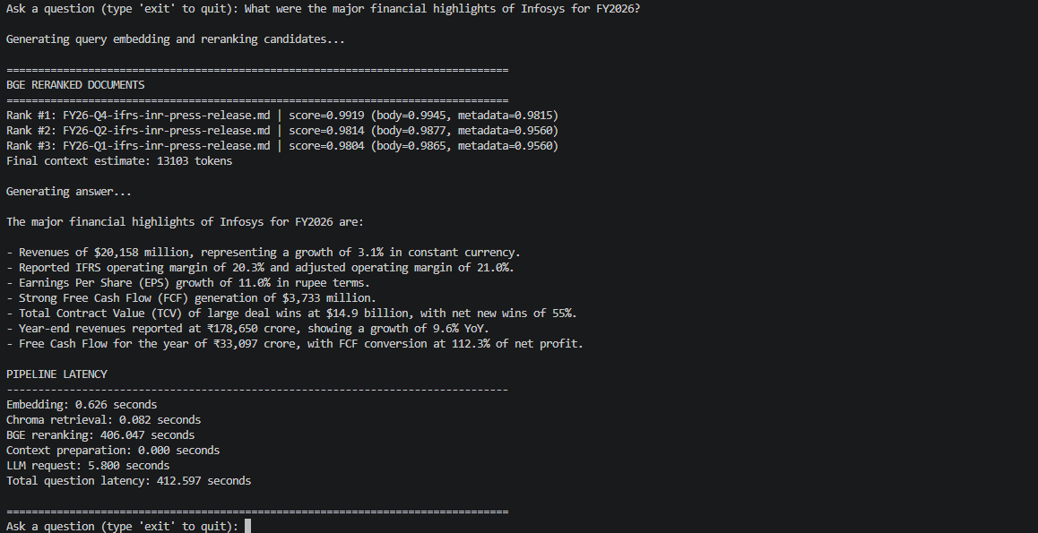
SAMPLE OUTPUT
Example — Grounded Answer(3)
FinQuery — Milestone 4
13

Slide 14
KEY FINDINGS
What Worked Well vs. What Didn’t
Worked Well
Didn’t Perform as Expected
Finding | Evidence
RAG architecture | Answered from fresh disclosures, no fine-tuning
Clean Markdown + YAML metadata | Reduced noise; clearer chunk identity
Chroma + BGE reranking | Recall@3 40%→58%; Recall@5 50%→64% Improved Recall
Grounded generation | Useful, source-grounded answers when retrieval was correct
Issue | Observation
HyDE | Recall@3 flat at 40%; Recall@5/@7 dropped vs. baseline
Large chunks | Some ≈ 8k tokens; higher noise-to-signal ratio
Top-3 context limit | Recall@5/@7 > Recall@3 — right doc often excluded
Long NSE documents | Lower Recall@3 than short filings
BGE reranking latency | ~245 sec/question — too slow for interactive use
FinQuery — Milestone 4
14

Slide 15
EVALUATION FRAMEWORK
RAGAS: Scoring the Generated Answer
RAGAS
Retrieval-Augmented Generation Assessment
An LLM-based evaluator (gpt-4o-mini) scores the generated answer itself on four dimensions — not just whether retrieval found the right document.
Faithfulness
Is the saved answer supported by its retrieved context?
Answer Relevancy
Does the saved answer address the question?
Context Precision
Is the retrieved context useful for the reference answer?
Context Recall
Does the retrieved context contain the facts in the reference answer?
Scores are useful for comparing pipeline versions — they are not a replacement for human review. Evaluated on the no-reranking baseline (RAGAS/no_reranking_ragas_summary.md); results on the following slides.
FinQuery — Milestone 4
15

Slide 16
EVALUATION FRAMEWORK
RAGAS Results: No-Reranking Baseline
Evaluated on the no-reranking baseline: 50 Infosys questions, each scoring the saved answer against its saved top-3 retrieved contexts and a manually prepared reference answer. Evaluator: gpt-4o-mini. Embedding: text-embedding-3-small. All 50 rows completed successfully — 0 failures.
Metric | Avg. Score | What It Measures
Faithfulness | 0.8101 | Whether the answer is supported by the retrieved context
Answer relevancy | 0.6655 | Whether the answer addresses the question
Context precision | 0.9117 | Whether the retrieved context is useful and focused for the reference answer
Context recall | 0.7769 | Whether the retrieved context contains the facts needed for the reference answer
RAGAS scores range from 0 to 1, where a higher score indicates better performance. Retrieved context was generally precise and answers were mostly grounded in the available evidence. Answer relevancy was the weakest average metric — some answers didn’t address the question as directly as expected — and the lower context recall suggests the top-3 context limit can exclude information needed for some questions.
FinQuery — Milestone 4
16

Slide 17
KEY FINDINGS
Bottlenecks & Improvement Plan
Main Bottlenecks
Improvement Plan
Bottleneck | Why It Matters
Chunk size too large | Dilutes relevant span; less precise embedding/reranking
Table-heavy documents | Key rows get buried without structure-aware handling
Reranking latency | ~245 sec/question, impractical for real-time use
Semantic-only retrieval | Can miss exact company/deal names
Top-3 context limit | Correct docs at ranks 4–5 never seen by the LLM
Improvement | Expected Benefit
Reduce chunk size | Lower noise-to-signal ratio
Table-aware chunking | Preserve financial tables as queryable units
Top 3 → Top 5 context | Recovers near-miss documents at ranks 4–5
Hybrid dense + BM25 | Catches exact keyword/entity matches
Lighter reranker + richer metadata | Lower latency; better title/date matching
FinQuery — Milestone 4
17

Slide 18
SUMMARY
BGE Reranking Was the Headline Result
40% → 58%
6.3 → 245 sec
50/50
Recall@3, Chroma-only → + BGE reranking
Average latency, same comparison
Benchmark questions, zero failures
FinQuery uses frozen pretrained models throughout. Generalization and stability came from clean preprocessing, metadata enrichment, structure-aware chunking, grounded prompting, and reranking. Next steps: smaller table-aware chunks, hybrid BM25 + dense retrieval, richer metadata, and a lighter reranker for top-5 context at interactive latency.
Team 06 · IIT Madras · FinQuery Milestone 4

