Slide 1
Drone Navigation Using Brain-computer Interface (BCI)
Group members
Supervisor
M Raheal Safdar
Madiha
Naneeta
Dr Ahsanullah Abro

Slide 2

Background

Slide 3
Brain-computer interfaces
Brain-Computer Interface (BCI) technology allows direct communication between the human brain and a computer, using brain signals like electroencephalography (EEG).
It has the potential to revolutionize technology interaction, though challenges remain in improving accuracy, reducing complexity, and addressing ethical implications.
Despite these challenges, the potential benefits of BCI technology are significant, with applications in medicine, gaming, and human-computer interaction (HCI).

Slide 4
Types of BCIs
Non-Invasive
Non-invasive BCIs use techniques such as electroencephalography (EEG) to measure brain activity from the surface of the scalp.
invasive
Invasive BCIs, on the other hand, involve the implantation of electrodes directly into the brain.

Slide 5



Applications of BCIs
Medical
BCI systems can be used to help individuals with disabilities, such as spinal cord injuries or neurodegenerative diseases, regain their independence.
Gaming
BCI systems can be used to control games directly using brain, or they can be used to enhance the gaming experience
HCI
BCI systems can be used to control computers, devices, or machines directly through brain, eliminating the need for traditional input devices.
Military operation
BCI systems can be used to control unmanned aerial vehicles (UAVs), unmanned ground vehicles (UGVs), or other military equipment directly through brain, reducing the time and effort
Human augmentation
BCI systems can be used to provide real-time feedback to the user, allowing them to monitor their brain activity and adjust it to achieve better performance.

Slide 6
How BCI works

Slide 7
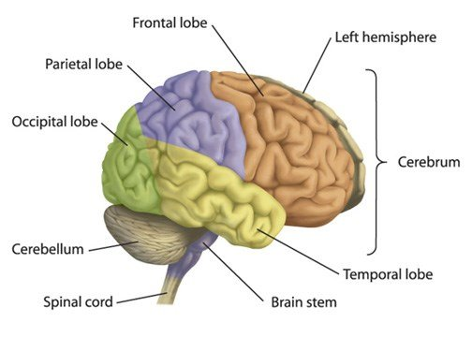
Brain structure
The frontal (orange), parietal (purple), occipital (green), temporal (yellow), and insula are the five main lobes that make up the cortex.
For BCI systems, the brain cortex is crucial since it is connected to many different neurological responses and processes.
The Primary Motor Cortex (M1) is a part of the cortex that BCI implementations frequently examine because of its close connection to motor functions.

Slide 8
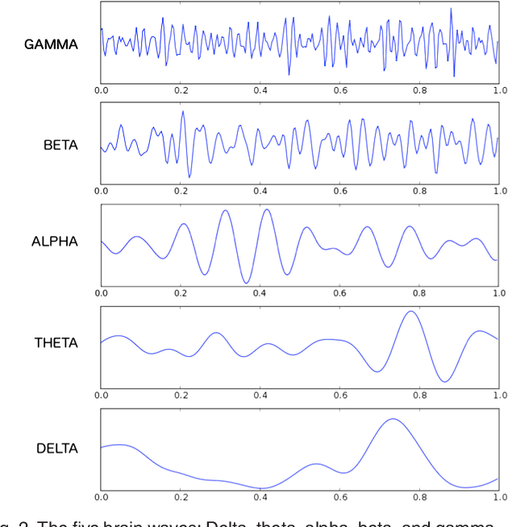
Electroencephalography (EEG) signals
EEG (Electroencephalogram) signals are recordings of the electrical activity of the brain, detected through electrodes placed on the scalp. The EEG signals are divided into following categories:
Delta (0 - 4 Hz)
Theta (4 - 8 Hz)
Alpha (8 - 13 Hz)
Beta (13 - 30 Hz)
Gamma (30 - 100 Hz)

Slide 9
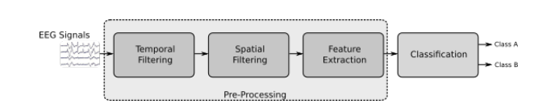
EEG Signal Pre-processing
The preprocessing stage can be divided into smaller units that handle the transformation of signals in various ways to eliminate different types of noise or artifacts.
Temporal filtering, which processes EEG signals in the time domain, and spatial filtering, which improves the representation of neural activity and removes interfering signals that may affect EEG data quality, are two significant filtering methods widely utilized in BCI systems.

Slide 10
EEG Signal Pre-processing
Temporal Filtering
Temporal filtering in EEG data involves processing the time-varying components of the signal, such as the frequency or amplitude. Some common temporal filters used in EEG data analysis include band-pass, high-pass, low-pass, and notch filters.
Spatial Filtering
Spatial filtering in EEG data involves processing the spatial components of the signal, such as the location and configuration of the electrodes. This can be done using techniques like Independent Component Analysis (ICA) or Principal Component Analysis (PCA).
Feature extraction
After applying temporal and spatial filtering techniques, it is important to choose the right set of features taking into account the characteristics of the signal to be classified and, more importantly, the mechanisms used for classification.

Slide 11
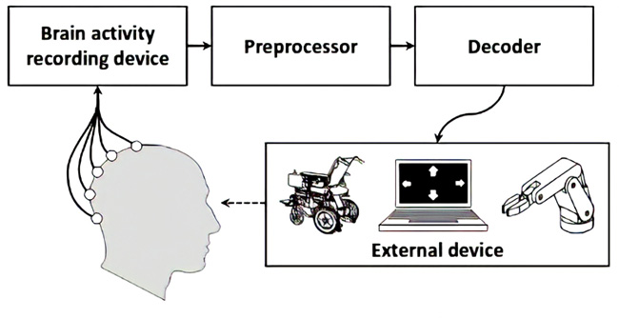
Signal Classification
The extracted features are then given to different deep learning and machine learning models.
The model with best performance metrics is chosen for the final testing.
The data in real time is given to model for the classification and label is then transferred to the targeted device.

Slide 12
Previous work
Study 1
Study 2
EEG headset was used to collect brain signals while controlling a drone using facial expressions and mental commands. The accuracy of the test was based on the correctness of the commands, which depended on the person's attentiveness.
This study proposed four motor imagery tasks to control a Parrot 2 AR drone using an Emotiv EPOC+EEG headset that provides 14-lead EEG data. The tasks involve imagining movements with the left and right hand, fingers, and elbows. They used a Python-based algorithm to run the experiment
Study 3
Study 4
This study developed a BCI system based on the SSVEP paradigm to control a drone, replacing it with a feedback loop using LEDs controlled by an Arduino board. They used an Emotiv Neuroheadset with 16 channels to acquire brain signals and tested the system on ten healthy subjects.
In this study the authors trained four different mental tasks to control the Parrot Rolling Spider drone, with the Emotiv Insight headset (7 channels) used to collect brain signals. The tasks included an ascending task, descending task, right task, and a left turn task. The programming environment EEGLAB was used to access the EEG data.

Slide 13

Problem Identification

Slide 14
Problem Statement
In recent years, a lot of research has been done in this subject, with researchers attempting to develop user-friendly and easy to use assistive technology for drone navigation. BCI will be the new horizon as an assistive technology being used for drone navigation. However, there is a lack of navigational cues to detect user’s brain signals and to translate them into expected actions and activities accurately to control the navigational cues of drone.

Slide 15
Project Goals
Open up the communication between the python program and the Drone Simulator.
01
02
03
Establish one-way communication from brain signals to python program running on our laptop.
Control drone navigation in 6 directions in the environment of Drone Simulator.

Slide 16

Proposed Approach

Slide 17
Dataset Discussion
Motor Imagery in EEG Signals
This work uses EEG technology to interpret brain signals for drone navigation.
In this paradigm user performs specific movements which are translated into drone control commands.
The alpha-band frequencies in the mu-wave are used to detect motor activity in the brain.

Slide 18
Dataset Discussion
EEG Signal Acquisition
The data acquisition process involves the subject sitting in a relaxed position while performing motor actions without electronic devices nearby to minimize noise.
The recording takes approximately 8 seconds, with the actual recording starting after 6 seconds, and lasts for 1 second to capture the most stable samples possible.
The OpenBCI Ultra cortex Mark IV headset, a low-cost and open-source EEG headset, was explored in this work.

Slide 19
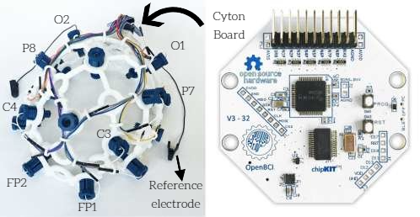
Dataset Discussion
OpenBCI Headset
The Ultra cortex is an open-source, 3D-printable headset designed to work with the OpenBCI system.
The Ultra cortex Mark IV Headset (Cyton board is mounted on the head cap) has eight channels namely Fp1, Fp2, C3, C4, P7, P8, O1 and O2 and 2 reference electrodes that are placed according to 10-20 international system

Slide 20
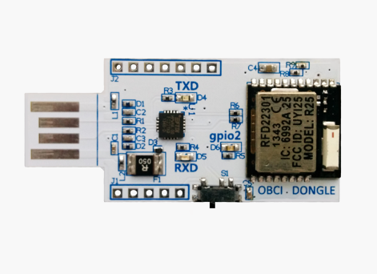
Dataset Discussion
USB Dongle
The OpenBCI USB Dongle is a small device as shown in figure that is used in conjunction with OpenBCI EEG (electroencephalography) systems to wirelessly connect EEG electrodes to a computer or other device.

Slide 21
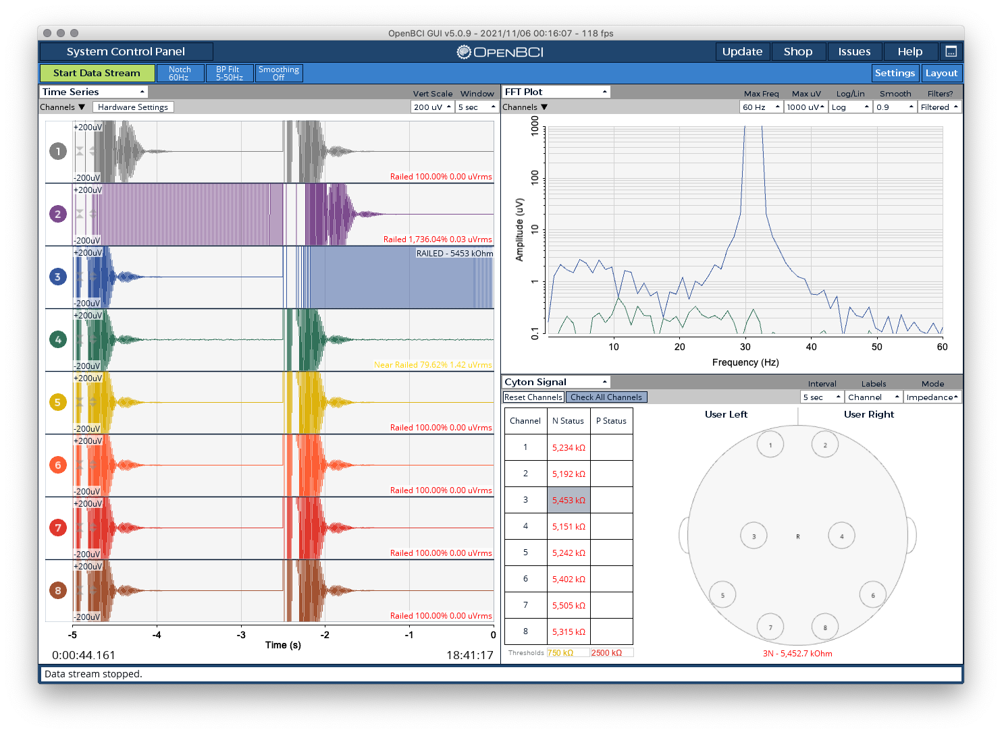
Dataset Discussion
OpenBCI GUI
The OpenBCI GUI software allows users to visualize, analyze, and interact with EEG data in real-time, making it easier to perform experiments, evaluate data, and develop new applications.

Slide 22
Dataset Discussion
Data Collection
The dataset used in this project was collected using previously mentioned procedure.
Total of 300 files were collected for total six actions, 50 for each action.
Subject was trained to perform actions namely clench, chew, feet, head, jerk and eye blink.
These six actions are mapped for drone navigation in 6 directions which are:
Up => head, Down => Chew, Left => Eye blink, Right => Feet, forward => Clench, Backward => Jerk

Slide 23
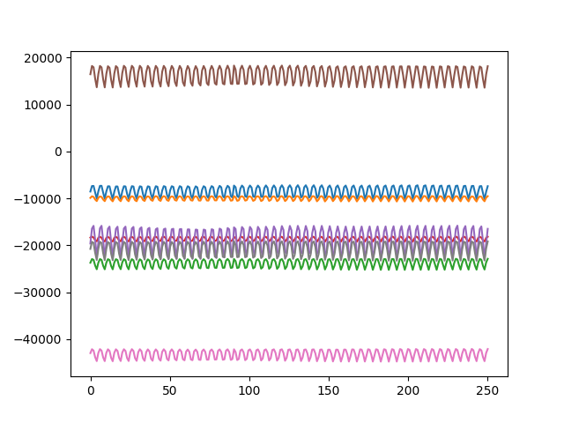
Dataset Discussion
Data Format
The data acquisition protocol outlined above captures each sample as an EEG signal stored in a matrix.
Each row of the matrix represents a different electrode, and since the Cyton Board has a sample rate of 250Hz and a one-second acquisition time, each channel in a sample will have 250 timestamps.
As a result, each sample is represented as an 8x250 matrix.

Slide 24
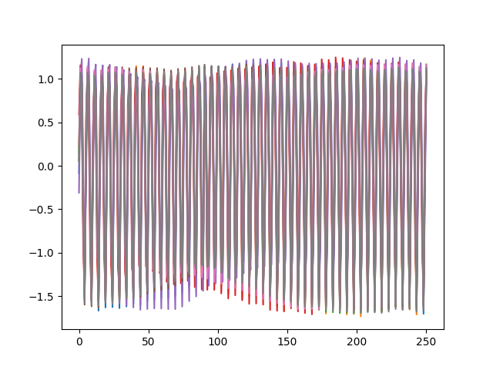
Data Preprocessing
The very first step in manipulating the data is to implement a notch filter to eliminate the 50Hz frequency.
Then we conducted band-pass filtering. Through grid searches, we determined that 2Hz and 65Hz were the optimal thresholds.
This filtering process was accomplished using a Butterworth band-pass filter from the BrainFlow library

Slide 25
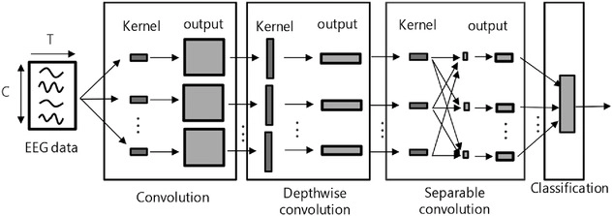
Model Architecture
In our experiment, EEGNet was utilized as the end-to-end convolutional neural network. Th compact CNN architecture is designed for EEG-based brain-computer interfaces and can be applied to various BCI paradigms, even with limited training data.

Slide 26
Model Architecture Cont.
The network is composed of 4 blocks: a Conv2D block, followed by a DepthwiseConv2D block, a SeparableConv2D block, and a final block for classification.

Slide 27
Model Training
Due to the lack of data, in order to have robust results, a 5-fold cross validation was performed.
In each step 70% of the data was used as training set (210 samples), 20% as validation set (60 samples) and 10% as test set (30 samples).
The splitting process takes into account the label of the samples, ensuring that each set was perfectly balanced among the six classes.
As final result of the 5-fold process, we take as a result the average of accuracy among the five test set results.
The model has been trained for a maximum of 10k epochs, Adam optimizer with a learning rate equal to 5e-5 was used and batch size is set to 32.
The training accuracy in one of the fold reached up to 94%.

Slide 28
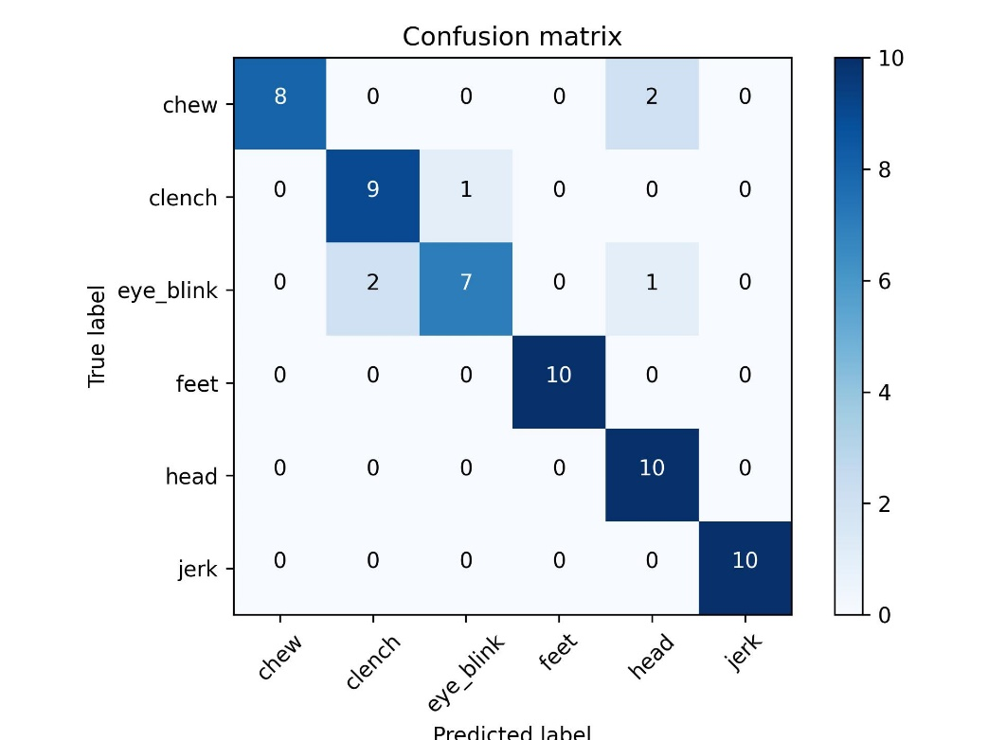
Model Testing
The performance of our BCI system is evaluated by analyzing the model performance.
The model is tested on the EEG dataset and its performance is measured in terms of accuracy.
The model gave accuracy of 89%.

Slide 29
Results

Slide 30
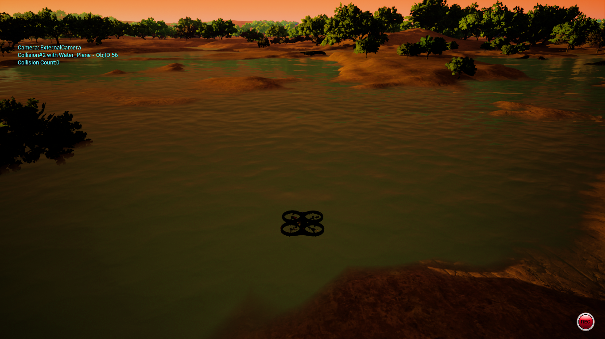
Drone Navigation
The trained model was tested in real time after acquiring the EEG signals from Open BCI headset and results were shown in AirSim virtual drone simulator.
The subject was instructed to relax and clear their mind before the test and perform same actions that they performed while dataset acquisition.
Finally, after carrying out few experiments live testing showed that the BCI-based drone navigation model was able to accurately control the movement of the drone in response to the subject’s movements.

Slide 31
Limitations and Future Work

Slide 32
Limitations
EEGNet model accuracy is still not up to the mark.
Our work is based on subject-specific trained model.
The drone will navigate in six directions only, no other operations are supported.
.
Our project is not a compact hardware device as a sellable product.

Slide 33




Future Work
Other drone actions like flip roll, or operations can be added to control by the brain signals in the project as a future work.
The model’s accuracy can be improved as a future work by trying out different approaches.
This project can be a sellable product by making the compact and user-friendly headset.
Subject-specific trained model can be replaced by non-subject-specific model.
.

Slide 34
Thank You

