Slide 1
Drone Navigation Using
Brain-Computer-Interface (BCI)

Slide 2
GROUP MEMBERS
Naneeta
Madiha
M Raheal Safdar
SUPERVISOR: DR. AHSANULLAH ABRO
Co-SUPERVISOR: AHMED ALI SHAH / RIAZ AFRIDI

Slide 3
Introduction
Brain Computer Interfaces (BCI)
Electroencephalography (EEG)
EEG Headset (OpenBCI)
Drone Simulation

Slide 4
Problem Statement
There is a lack of navigational cues to detect user’s brain signals and to translate them into expected actions and activities accurately to control the navigational cues of drone.

Slide 5
Aim and Objectives
To make people able to control electric devices specifically Drone through Brain signals.
To control Drone movement through mental commands in six specific directions (left, right, forward, backward, up, down).

Slide 6
Tools and Technology
Tools
Google Collaboratory
OpenBCI GUI
Visual studio code
Programming Languages
Python

Slide 7
Dataset Discussion
Visual imagery EEG dataset available at Kaggle is used in this project.
Six classes, namely (left, right, up, down, forward, backward).
Total 180 files, with 30 files for each class.
30 subjects aged between 18-24 were selected to collect the dataset.

Slide 8
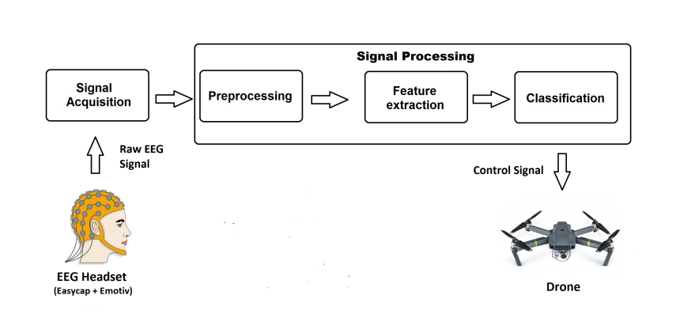
Proposed Architecture

Slide 9
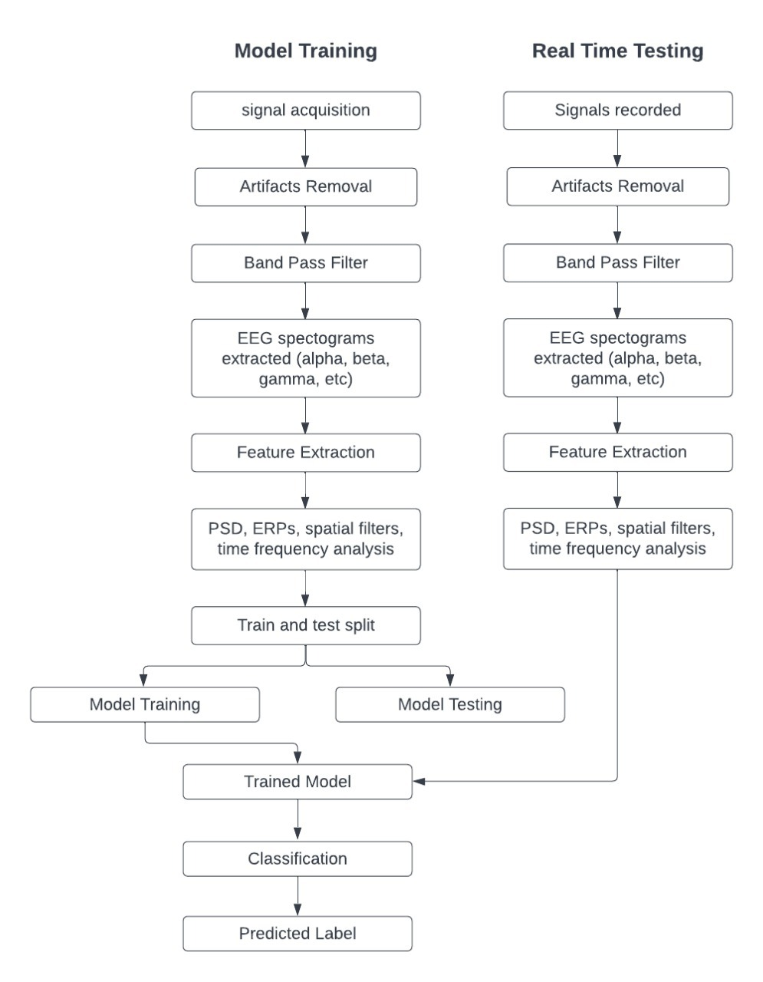
Machine learning pipeline

Slide 10
Implementation
Python libraries
Headset connection
Pylsl
Preprocessing
Scikit learn
Model
Keras
Arduino connection
pySerial

Slide 11
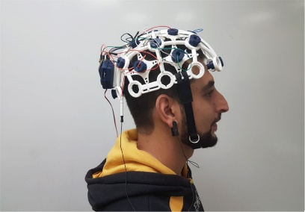
Real Time Model Testing
Step 1
OpenBCI headset should be on.

Slide 12
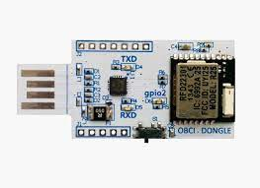
Real Time Model Testing
Step 2
USB dongle should be inserted in the PC.

Slide 13
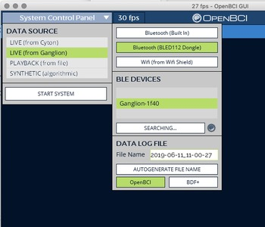
Real Time Model Testing
Step 3
The OpenBCI software should be installed on the laptop or PC.

Slide 14
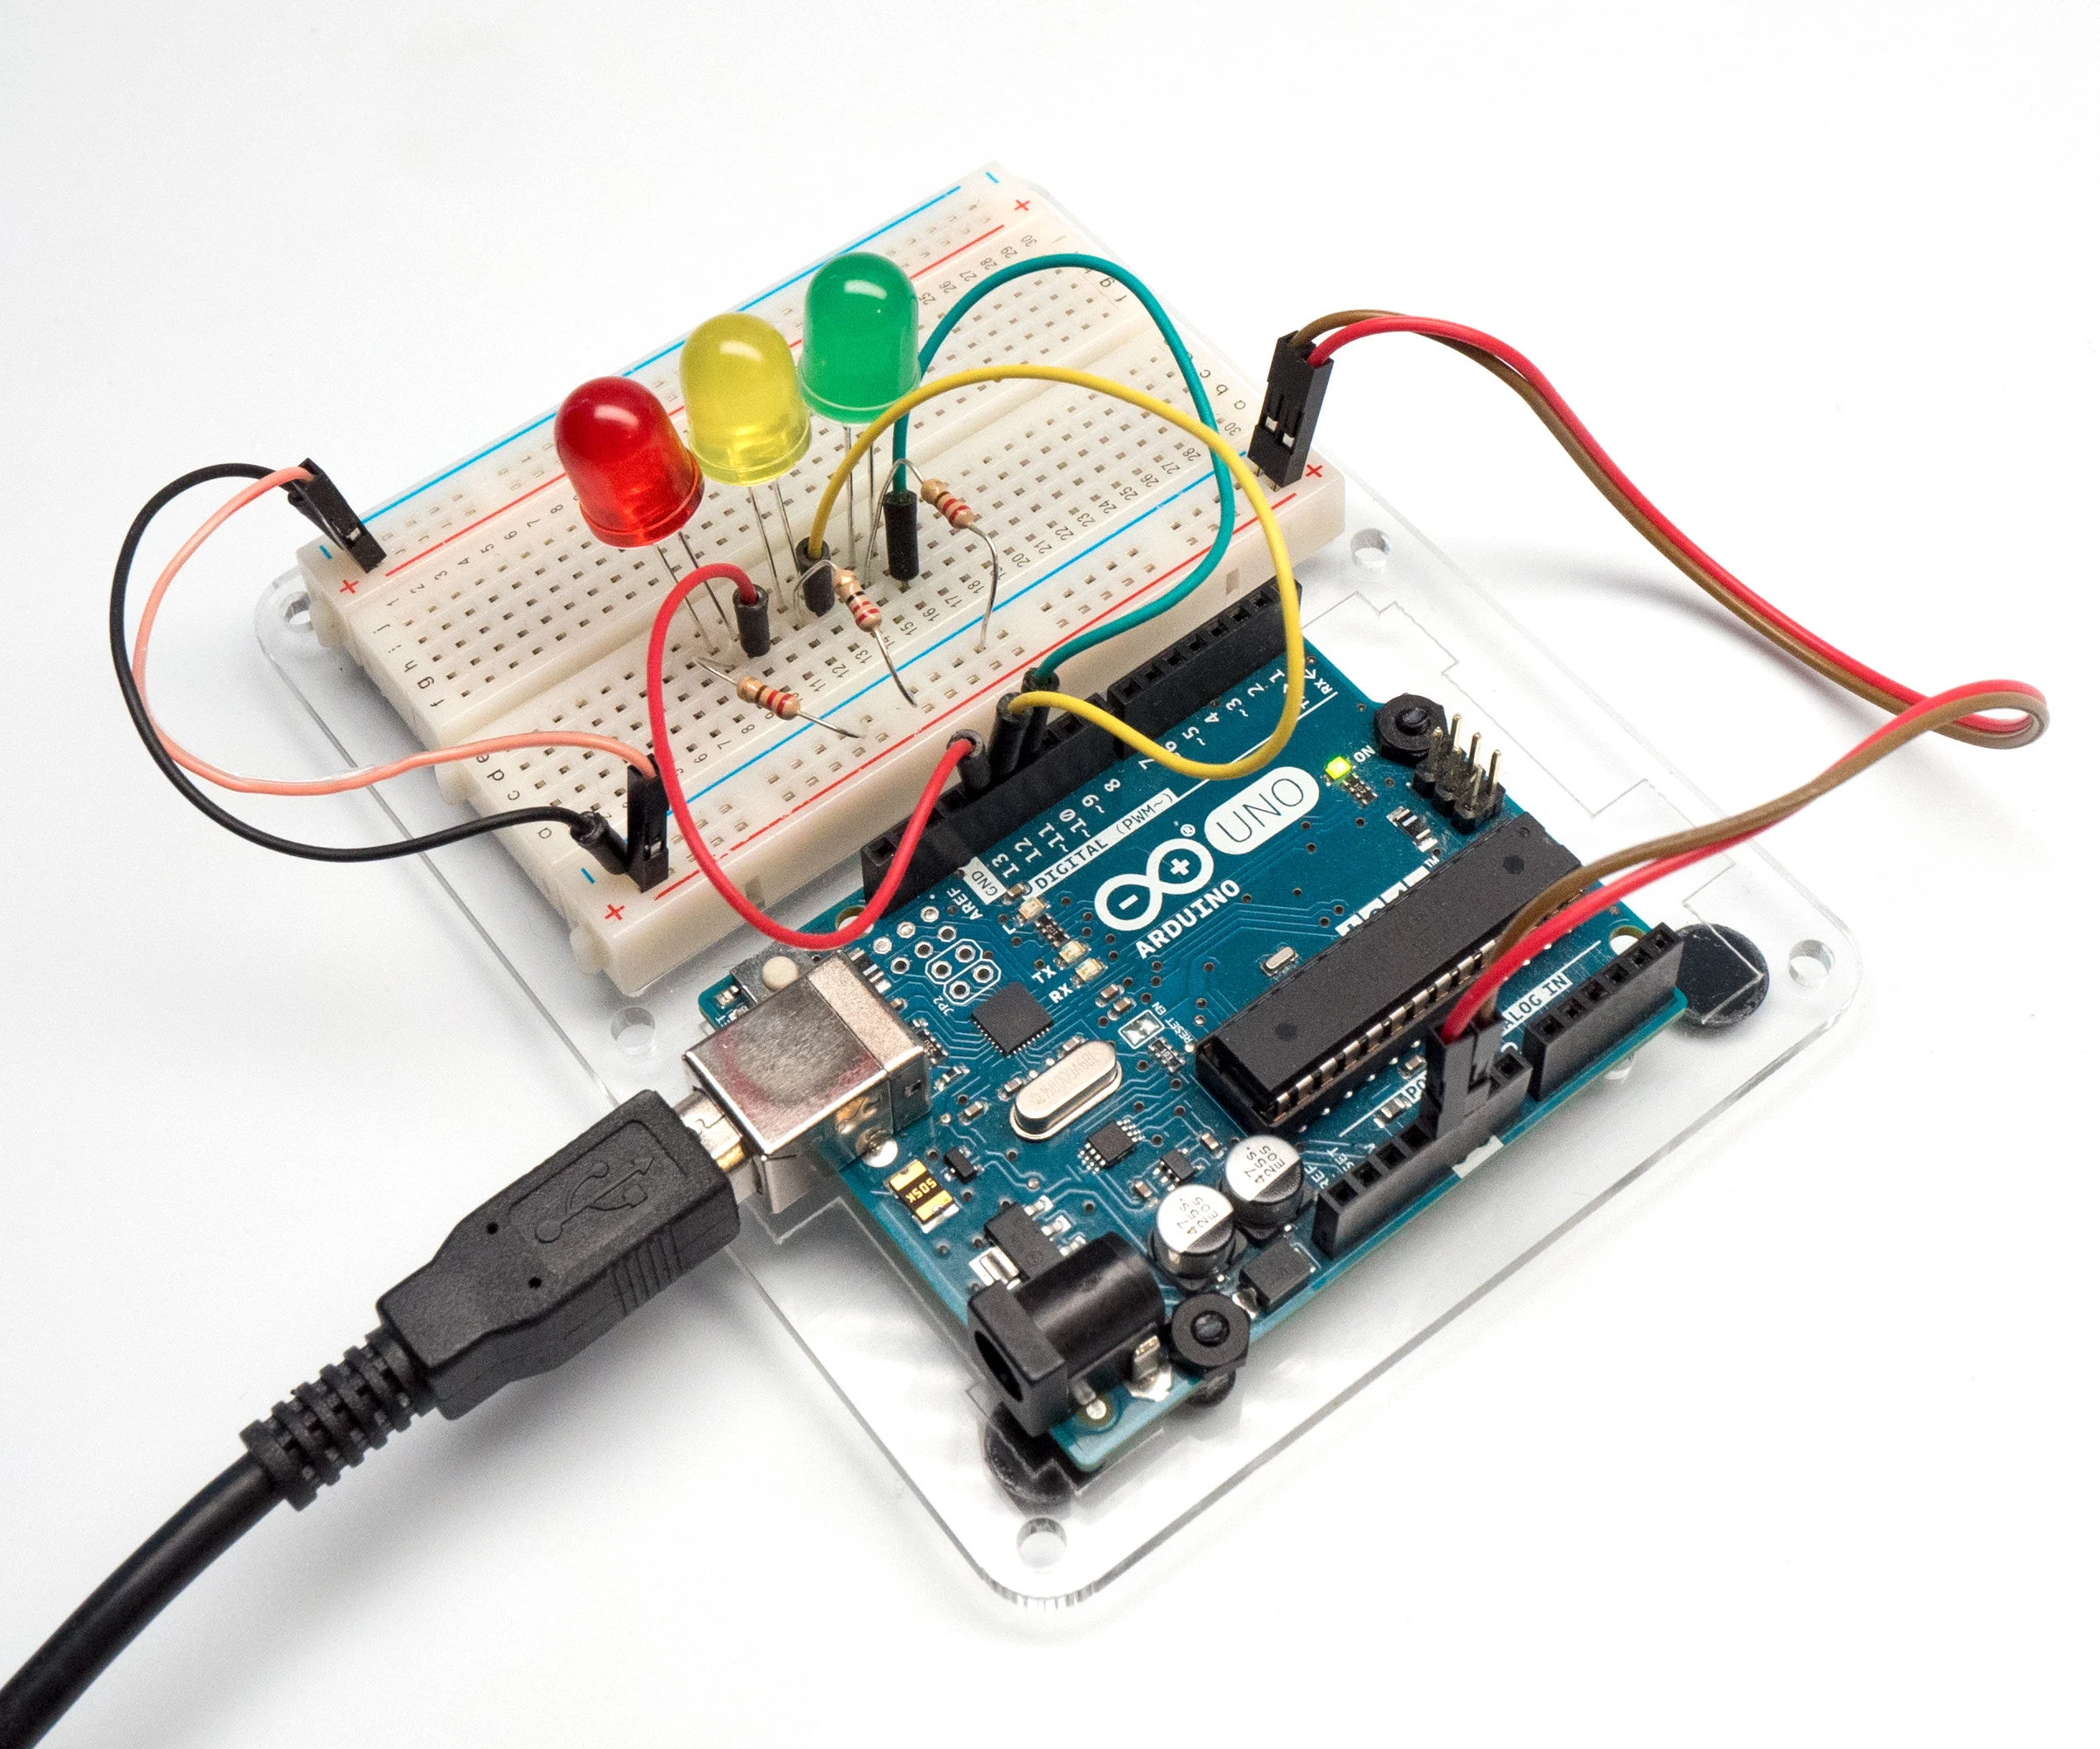
Real Time Model Testing
Step 4
Connect Arduino with LEDs.

Slide 15
Demo

Slide 16
THANK YOU
ANY SUGGESTION?

